Slide 1
Agents of Abuse
Stimulants

Slide 2
Table of Contents
I. History of Methamphetamine
Desoxyn
Ampetamine vs methamphetamine
II. Mechanism of Action
III. Neurotransmitters Affected
Methamphetamine
Cocaine
MDMA
IV. Routes of Administration/Pharmacokinetics
V. Synthesis of Meth/Cocaine
V1. Long term effects
VII. Stimulant psychosis

Slide 3
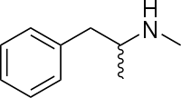
History of Methamphetamine
Methamphetamine was first synthesized from ephedrine in Japan in 1893 by chemist Nagai Nagayoshi
WWI usage: the German military dispensed it under the trademark Pervitin.
From 1942 until his death Adolf Hitler may have been given intravenous injection of meth
It supposed that he developed Parkinson like symptoms from use of meth
After WWII, Japanese governmnt banned meth in 1951
After WWII, Japanese government banned meth in 1951; Height of the Japanese amphetamine epidemic. There are estimated to be over 2 million amphetamine users in a population of 88.5 million.

Slide 4
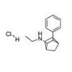
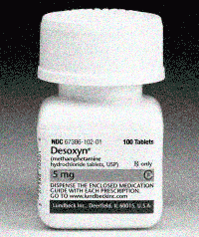
Desoxyn
Amid concerns about over-prescribing by doctors and diversion to the illegal market, Abbot laboratories withdrew injectable Desoxyn (the trade name for legally manufactured methamphetamine)
Burroughs Wellcome withdrew injectable Methedrine (another trade name for legally manufactured methamphetamine), leaving “intravenous methamphetamine users without a product that could be readily injected.
This created demand for an inexpensive water-soluble powder product

Slide 5
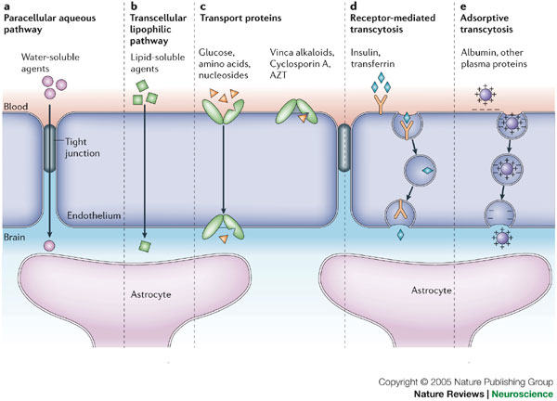
Amphetamine vs. Methamphetamine
The added methyl group to amphetamine renders the chemical
More lipid soluble
Enhacing transport across the BBB
More stable against enzymatic degradation by MAO
(Monoamine oxidase)

Slide 6
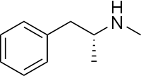
Levomethamphetamine
Family of the phenylamines
Chiral with two isomers
Levorotary form is called levomethamphetamine (levamfetamine) and is sold as an OTC drug used in inhalers for nasal decongestion
Interestingly, levomethamphetamine does not possess any significant central nervous system activity or addictive properties
Levomethamphetamine

Slide 7
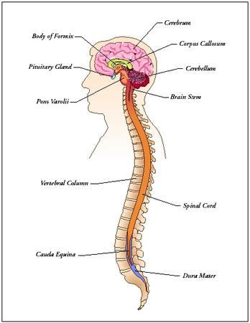
Methamphetamine
Potent CNS stimulant that affects neurochemical mechanisms responsible for regulating heart rate, body temperature, attention, mood and emotional responses associated with alertness
Acute physical effects of the drug closely resemble the physiological and psychological effects of an epinephrine-provoked fight-or-flight response
Bradycardia
Hypertension
Vasoconstriction
Bronchodilation

Slide 8
Dopamine plays a role in METH-induced neurotoxicity experiments
Experiments in which the production of dopamine has been reduced or dopamine release has been inhibited showed a decrease in the toxic effects of METH administration.
It has been proposed that defective sequestering of DA into vesicles back to the presynaptic cleft lead to a generation of ROS in the cytoplasm
Ingesting methamphetamine
Dopamine concentrations
Increase at post synaptic cleft
Decrease at pre-synaptic cleft
Generation of ROS
Demise of DA neurons
CELL DEATH

Slide 9
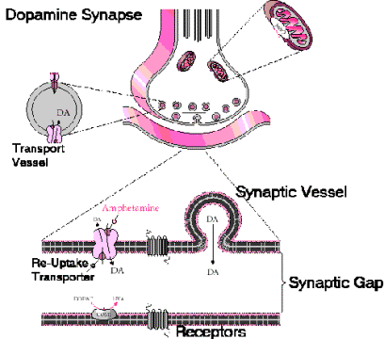
Mechanism of Action
Methamphetamine causes the norepinephrine, dopamine, and serotonin (5HT) transporters to reverse their direction of flow, leading to a release of these vesicles from the cytoplasm → synapse
While other stimulants like cocaine bind to DAT inhibiting reuptake of these NT, METH along with amphetamine pose as agonists that is taken up into the DAT preventing re-uptake of DA

Slide 10
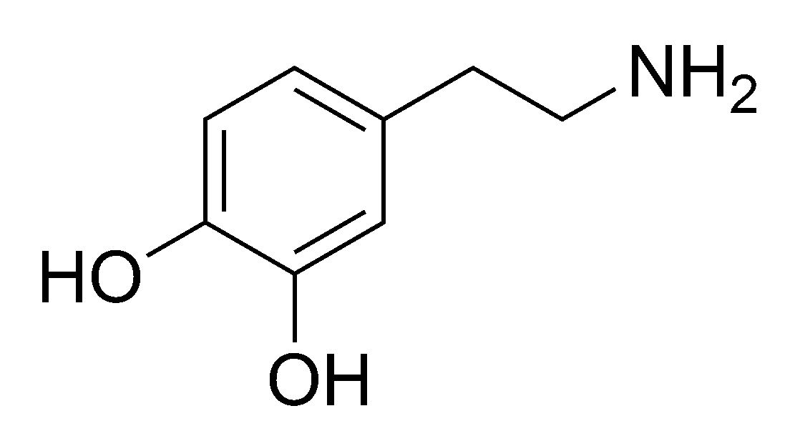
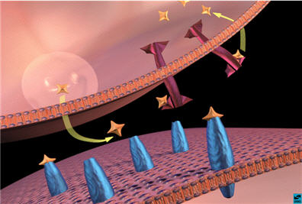
METH interacting with DA receptors in the neuron

Slide 11
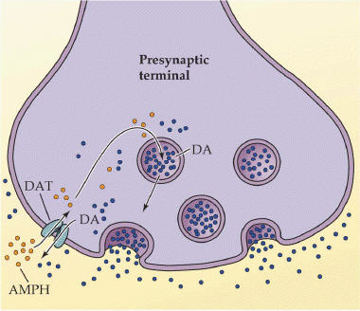
Once METH binds one of two things happens…
So far, it appears that both of these mechanisms occur. Methamphetamine appears to act both at the DAT (as well as NE and 5-HT transporters)
Option 1: The DAT is reversed, dumping DA out into the synpase
Option 2: Vesicles containing DA dump their DA into the cytosol, building up in the presynaptic neuron, and making a lot more DA available to be dumped into the sypanse by the reversed DAT

Slide 12
Video review on Meth mechanism

Slide 13
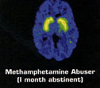
METH causes DA degeneration
Dopamine and serotonin concentrations, dopamine and 5HT uptake sites are reduced after the administration of methamphetamine.

Slide 14
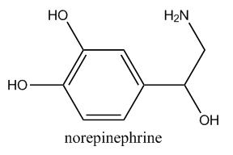
Meth and the NE system
As seen with the dopamine system, the drug meth can influence norepinephrine transmitters by blocking the re-uptake mechanism. But there are some differences…
Meth does not stimulate excess chemical release at the norepinephrine synapses.
Meth is not neurotoxic to the norepinephrine system synapses and receptors
It stimulates an increase in the growth of the norepinephrine nerve.
This growth does not mean that the brain becomes more efficient at administering norepinephrine chemicals
Notes:
Norepinephrine (NE)also called noradrenaline is a neurotransmitter that plays a part in controlling alertness, rest cycles, attention, and memory

Slide 15
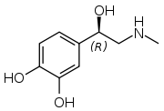
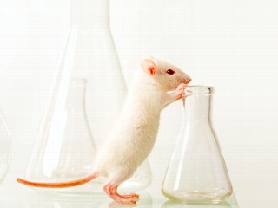
Meth and Epinephrine system
Meth influences epinephrine transmitters by blocking the re-uptake mechanism (as seen with the DA and NE systems)
This excess of epinephrine surging to different areas of the brain is partially responsible for the increased energy and rush that the meth user feels.
Meth users lose their appetite as a direct result of having excess epinephrine chemicals in circulation. The user loses weight as their body feeds off the empty energy of this continual adrenaline rush while they are not even thinking about taking the time to eat.
Notes:
Meth is a drug that lab rats will take instead of eating food, and they will die of starvation when food is right under their nose.
Because all the epi stores have been depleted the crash after the meth wears off is so intense. With epinephrine store depletion, the crash is the resulting complication, and the user’s body has to rest until adrenaline stores are replenished.

Slide 16
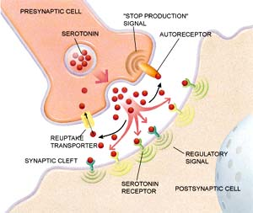
Serotonin (5-HT) and Meth
Reduces the level of serotonin in the brain which produces radical mood changes by blocking the synthesis of serotonin (like DA)
Irreversibly kills 5-HT receptors
Serotonin deficiences in people and animals have been shown to exhibit…
Violent behavior
Anxiety
Depression
Impulsiveness
Notes:
Serotonin (5-HT) is the last of the neurotransmitters that we will be studying. Serotonin plays an important role in many behaviors including sleep, appetite, memory, sexual behavior, and mood. The chemical structure of serotonin closely resembles that of many hallucinogens. A hallucinogen like LSD can bind onto serotonin receptors, mimicking the actual neurotransmitter, resulting in unnatural stimulation in different areas of the brain.
Because it irreversibly kills serotonin receptors a person might exhibit violent and dangerous behavior. For the rest of their lives they are going to be lacking the ability to produce adequate amounts of serotonin. Feelings of depression and guilt could be theirs till they die. The meth user is going to be more inclined towards drug and alcohol abuse

Slide 17
Summary of Meth effects on certain NTs
Neurotransmitter Affected by Meth | Stimulated Release of Chemicals | Blocked Re-uptake of Chemicals | Disturbances in the Release/Synthesis | Cell death and axon decay
Dopamine | X | X |  | X
Norepi |  | X
Epinephrine | ? | X |  | ?
Serotonin |  |  | X | X
How do these NT control short term tolerance?
Notes:
Short term tolerance
As with other amphetamines the tolerance mechanism is unknown but short term tolerance is thought to be linked to be caused by depleted levels of Nt within the synaptic vesicles available for release into the synaptic cleft following subsequence reuse. Short term stolerance typically last until neurotransmitter levels are fully replenished – because of the toxic effects on the dopaminergic neurons this can be greater than 2-3 days

Slide 18
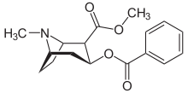
How other stimulants affect NTs
Cocaine
MDMA
Causes brain cells to adapt functionally to strong imbalances of transmitter levels in order to compensate for extremes
Down/up regulation
Studies suggest cocaine abusers do not show normal age-related loss of striatal DAT sites, suggesting cocaine has neuroprotective properties for DA neurons
Lack of normal amounts of DA in the brain cause dysphoria
Binds to 5-HT transporter responsible for moving serotonin from the synapse to terminate the signal
Thus, increasing the sertonin signal
MDMA is also an agonist for sertonin and causes massive release of sertonin from the neurons
Has similar effects on the norepi system but little on DA

Slide 19
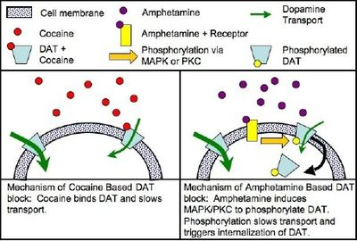
Cocaine mechanism

Slide 20
How does METH initiate addiction?
Reinforcement behavior is a term that refers to a stimulus that strengthens or weakens the behavior that produced it.
DA is responsible for reinforcement behaviors.
This actually increases drug seeking behavior
Meth short-circuits DA levels, directly influencing reinforcement behaviors
Resulting in addiction
For meth addicts the euphoria is the stimulus that induces drug seeking behavior
Notes:
AS you might imagine this kind of

Slide 21
Routes of Administration
Injection
The hydrochloride salt of methamphetamine is soluble in water.
Intravenous users risk developing pulmonary embolism
Insufflation
A user crushes the methamphetamine into a fine powdernd then sharply inhales into the nose where meth is absorbed through the mucous membrane and straight into tbe bloodstream
Smoking
Commonly smoked in glass pipes made from glassblown Pyrex pipes
Long term lung damage
Most dangerous
Suppository
Increase sexual pleasures and the effects of the drug last longer
Higher bioavailability in the bloodstream

Slide 22
Pharmacokinetics
Oral administration
Peak [meth] = 3.12 to 6.3 hours after administration
Highly lipophilic – crosses BBB
Half life varies between 9-12 hrs
30-54% of the drug is excreted unchanged
Notes:
The amphetamine metabolite peaks at 10 to 24 hours
Following intravenous dose – 45% is excreted unchanged

Slide 23
Methamphetamine
Physical effects can include:
Anorexia
Hyperactivity
Hyperthermia
MDMA
Dilated pupils
Bradycardia
Tachycardia
Convulsions
METH mouth
Meth bugs

Slide 24
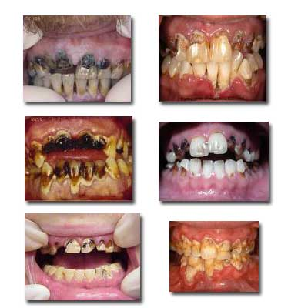
Meth Mouth
Advanced tooth decay attributed to METH use.
According to the ADA, meth mouth “is probably caused by combination of drug induced psychological and physiological changes resulting in xerostomia, extended periods of poor hygience, increase consumption of sugard soft drinks, and teeth clenching and grinding (bruxism).”
The acidic components of meth can also damage teeth

Slide 25
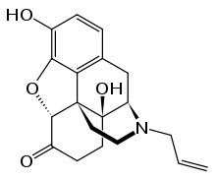
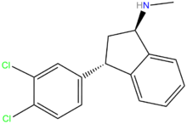
Drugs to combat Meth addiction
To combat addiction doctors are starting to use other forms of stimulants, like dextroamphetamine
There are no publicly available drugs comparable to naloxone, which blocks opiate receptors and is therfore used in treating opiate dependence for use with meth addition
Some experiments with some monoamine reuptake inhibitors such as indatraline have been suscessful in blocking the action of methamphetamine
There have been some studies linking fluoxetine, bupropion and imipramine may reduce craving and improve adherence to treatment.
Further research has suggested that modafinil can help addicts quit meth use
Notes:
Although because of the highly addictive nature of methamphetamine, these drugs have very low success rates in treating meth use.

Slide 26
Synthesis of Meth
For the drug manufacturer meth production has several advantages over production of such plant-based drugs as cocaine or heroin…
Production in labs = product is close to sale
Reduces number of people involved
This substantially reduces the cost
Made inside so there is no growing season
Meth can cook in a matter of hours

Slide 27
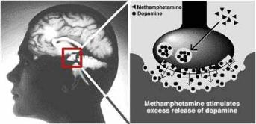
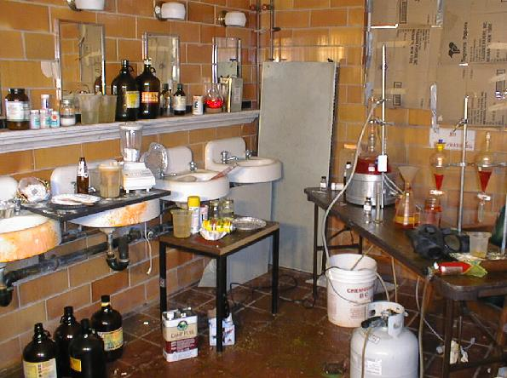
Meth Labs
An illegal site where the drug is manufactured.
Can be found in garages, kitchens, vehicles, hotel and motel rooms, storage lockers, campgrounds, etc.
One in five of these sites is discovered because of chemical explosions
Toxic contamination remains behind from the manufacturing process on surfaces in the meth lab itself
Cleaning up a meth lab site requires costs of anywhere between $3000 and $10,000

Slide 28
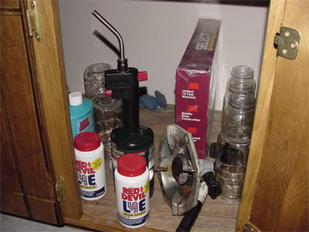
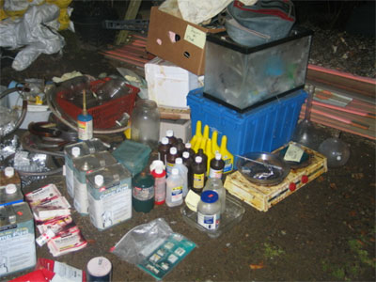
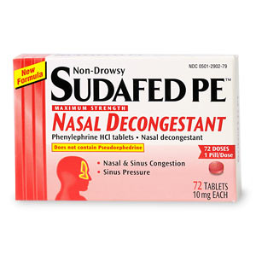
Precursor Chemicals
Top 3: Psuedoephedrine, Iodine crystals, Red phosphorus
Other Chemicals include:
Muriatic Acid
Acetone
Methanol
Tubing and PVC connectors
Red Devil Lye
Ammonium
Fertilizer

Slide 29
Making Cocaine
Notes:
http://www.youtube.com/watch?v=U_bZZt1zs60

Slide 30
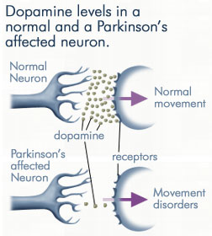
Long term effects of Meth
Depression
Suicide
Serious heart disease
Anxiety
Violent behavior
Stimulant psychosis
Increased risk of Parkinson’s Disease
Amphetamine psychosis resembling schizophrenia
Notes:
Parkinson’s disease is also a result of the deminse of DA NT in the substatia nigra (region of the midbrain)

Slide 31
Stimulant psychosis
Psychosis associated with stimulant users who typically use large doses of the drug.
Typically the psychosis ceases 7-10 days after discontinuing the drug
However, long term heavy use of meth can cause permanent psychotic episodes where users experience
Hallucinations
Delusions
Paranoia

Slide 32
Meth psychosis

Slide 33
References
"Methamphetamine: toxic. Additive. Devastating. Get the facts! Also known as 'meth' or 'ice,' this highly addictive and brain-altering drug is a threatening scourge on individuals, families, and communities." New York Times Upfront 10 Oct. 2005: SI+. Academic OneFile. Web. 12 Apr. 2011.
Barr, AM.; Panenka, WJ.; MacEwan, GW.; Thornton, AE.; Lang, DJ.; Honer, WG.; Lecomte, T. (Sep 2006). "The need for speed: an update on methamphetamine addiction.". J Psychiatry Neurosci 31 (5): 301–13. PMC 1557685. PMID 16951733.
Fong P. Methamphetamine abuse growing. The Vancouver sun (1986). 2002-02-14
Schep LJ, Slaughter RJ, Beasley DM (August 2010). "The clinical toxicology of metamfetamine". Clinical Toxicology (Philadelphia, Pa.) 48 (7): 675–94.

Slide 34
References
B.K. Logan. Methamphetamine - Effects on Human Performance and Behavior. Forensic Science Review, Vol. 14, no. 1/2 (2002), p. 142
Grinspoon; Hedblom (1975-01-01). Speed Culture: Amphetamine Use and Abuse in America. Harvard University Press. p. 18.
Davidson C, Gow AJ, Lee TH, Ellinwood EH (August 2001). "Methamphetamine neurotoxicity: necrotic and apoptotic mechanisms and relevance to human abuse and treatment". Brain Research. Brain Research Reviews 36 (1): 1–22

Slide 35
Readings
http://find.galegroup.com.proxy.libraries.smu.edu/gtx/retrieve.do?contentSet=IAC-Documents&resultListType=RESULT_LIST&qrySerId=Locale%28en%2CUS%2C%29%3AFQE%3D%28ti%2CNone%2C15%29METHAMPHETAMINE%3AAnd%3AFQE%3D%28da%2CNone%2C4%292005%3AAnd%3AFQE%3D%28iu%2CNone%2C1%293%3AAnd%3AFQE%3D%28pu%2CNone%2C22%29New+York+Times+Upfront%3AAnd%3AFQE%3D%28vo%2CNone%2C3%29138%24&sgHitCountType=None&inPS=true&sort=DateDescend&searchType=AdvancedSearchForm&tabID=T003&prodId=AONE&searchId=R3&currentPosition=1&userGroupName=txshracd2548&docId=A137871959&docType=IAC

Slide 36
Readings
http://www.drugabuse.gov/PDF/RRMetham.pdf
http://web.ebscohost.com.proxy.libraries.smu.edu/ehost/detail?sid=430dd5f0-424a-481b-a59e-d05be1bf7338%40sessionmgr113&vid=2&hid=104&bdata=JnNpdGU9ZWhvc3QtbGl2ZSZzY29wZT1zaXRl#db=pbh&AN=382716

Slide 37
Homework
How is methamphetamine harmful?
What specific brain changes occur for methamphetamine users?
Which neurotransmitters does methampetamine affect?
How do amphetamines affect obesity?
What is the abuse potential of amphetamines?

