Slide 1
Demise of the Mind: Alzheimer’s Disease
Colton Nielson

Slide 2
Today’s Roadmap of Alzheimer’s
General Introduction
History/Facts
Risk Factors
The 3 Stages
Mechanisms of Alzheimer’s
Drugs
The cutting edge: Cure?

Slide 3
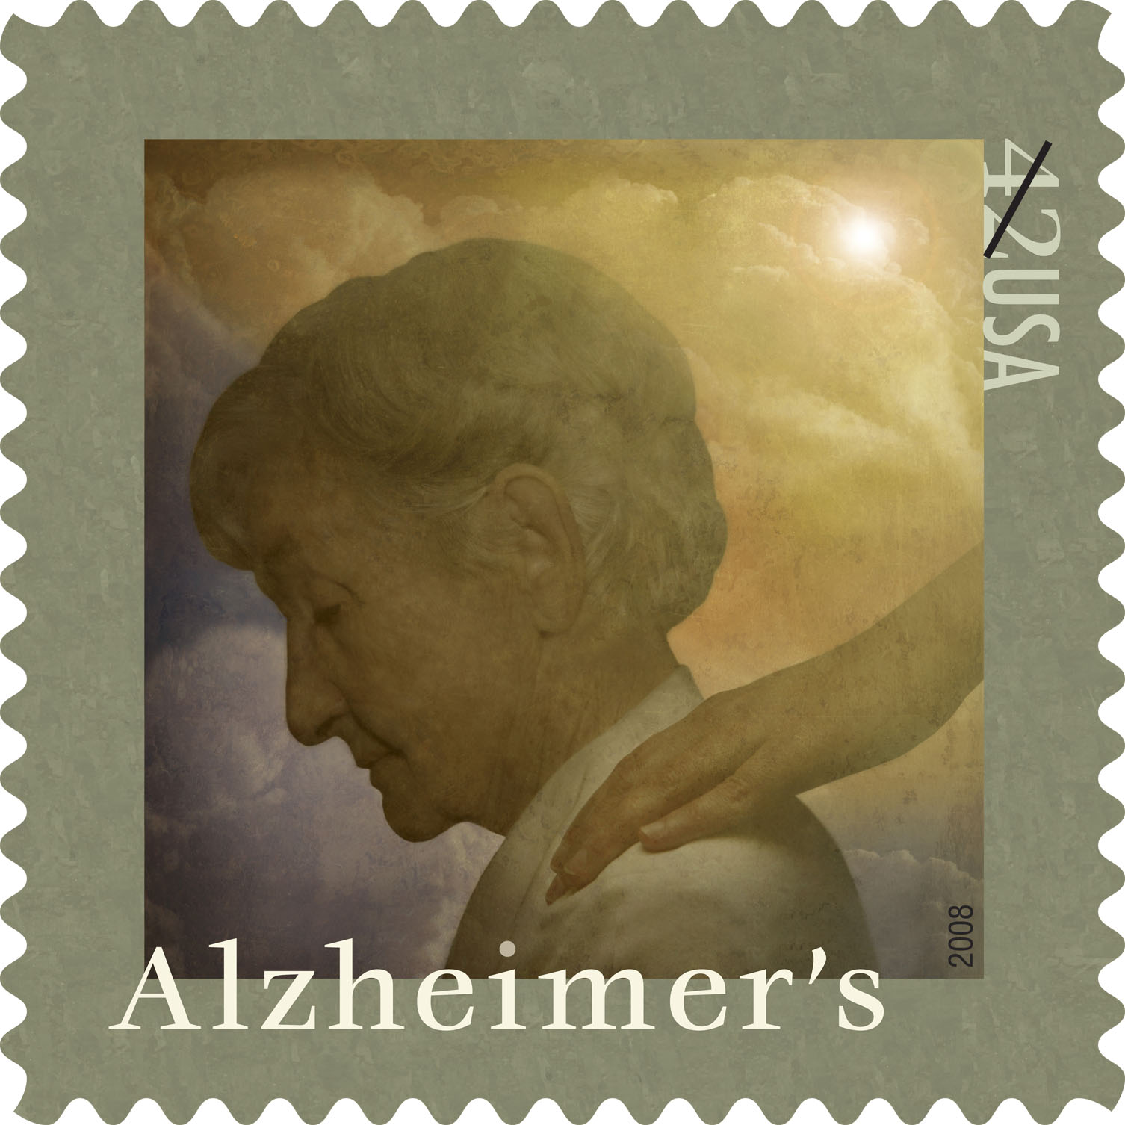
What is Alzheimer’s Disease?
First discovered by Dr. Alois Alzheimer in 1906
Alzheimer’s disease (AD) is an irreversible, progressive brain disease that slowly destroys memory and cognitive skills, and eventually results in death of the patient
Complex neurodegenerative disorder
Increasing age is the greatest risk factor
Probability of occurrence doubles every 5 years after the age of 60

Slide 4
A breakdown of Alzheimer’s Disease
Currently 7th leading cause of death in U.S.
Estimated U.S. economy dollar losses of $1.75+ trillion
Cost of annual patient care in U.S. is $100+ billion
Annual costs of Alzheimer’s Stricken patient in U.S. is $40,000 +
Effects 37 million people worldwide
Notes:
All other major causes of deaths in past years have declined except for Alzheimer’s which have increased over 46% during this time

Slide 5
Predisposed Risk Factors
Age
Low mental ability in early life
Reduced mental and physical activity in late life
Head injuries
Vascular diseases: hypertension and atherosclerosis, smoking, obesity, and diabetes
Decreased reserve capacity of the brain
Reduced brain size
Low educational and occupational status
Down’s Syndrome or other forms of mental retardation

Slide 6
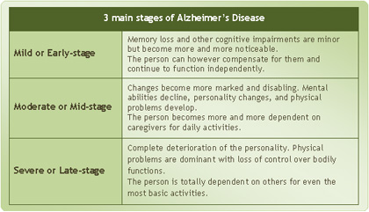
The Three Stages of Alzheimer’s Disease
Scientists have debated the number of differentiable stages-today, three is widely accepted number

Slide 7
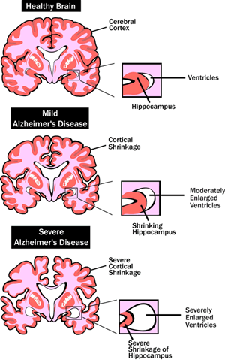
Stage 1 of Alzheimer’s Disease
Typically lasts 2-4 years leading up to and including diagnosis
Symptoms: recent memory loss that can effect job performance
Examples include:
Getting lost on the way to work
Taking longer with routine chores
Trouble handling money or paying bills

Slide 8
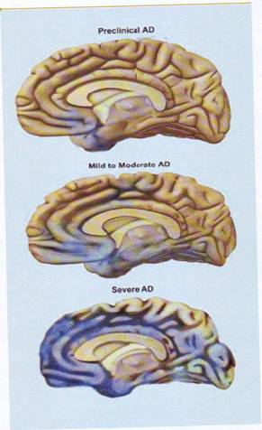
Stage 2 of Alzheimer’s Disease
Duration of 2-10 years
Symptoms include: increasing memory loss and confusion with a shorter attention span
Examples of Stage two Alzheimer’s:
Problems recognizing close friends and family
Problems finding the right words
Rapid swing s in body weight
Necessity of full-time supervision

Slide 9
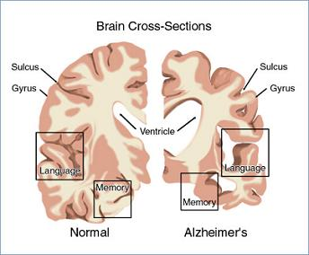
Stage 3 of Alzheimer’s Disease
Terminal Stage
Duration of 1-3 years
Symptoms include: inability to identify family members or themselves in a mirror
Examples:
rapid weight loss
Loss of interest in self care
Loss of communication
Loss of control of bowels and bladder
Notes:
http://www.msnbc.msn.com/id/42653936/ns/health-alzheimers_disease/from/toolbar

Slide 10
Diagnostic Methods
Only way to diagnose is autopsy of the brain
There are several diagnostic methods Physicians perform
take a detailed patient history
Take a past family medical history
Physical and neurological examinations
Neuropsychological testing-measure memory, language, simple math skills
CT scans or MRI tests which can detect strokes or tumors or changes in brain structure that suggests early signs of AD

Slide 11
Genetics Behind Alzheimer’s Disease
Two forms: familial and sporadic
Familial-autosomal dominant disorder with early onset
1st mutation causing familial found in amyloid precursor protein (APP) gene on chromosome 21
Most mutations are in the homologous presenilin 1 (PSEN1) and presenilin 2 (PSEN2) genes
Familial is uncommon: occurrence rate well below 0.1%

Slide 12
Genetics Behind Alzheimer’s Disease
Sporadic disease linked with apolipoprotein E (APOE)
Heterozygotes for the APOE allele experience 3x
the risk of developing the disease compared to individual without
Homozygotes increase risk of disease over 15x
Mechanism: APOE allele modifies age of onset-each allele lowers age of onset of disease by 10 years

Slide 13
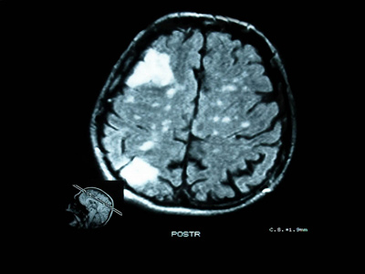
What happens within the Brain
Get diffuse cerebral atrophy with widened sulci and enlarged ventricles
Destruction of nerve synapses has been linked with correlation of cognitive decline
Lesions occur and neurons are further destroyed
Notes:
mri

Slide 14
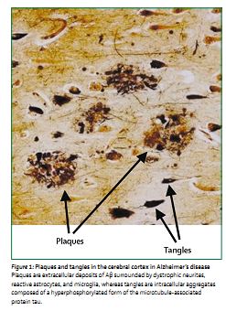
Physiology of the Brain
Plaques are known as microscopic clumps of a protein called beta-amyloid peptide and tangles are twisted microscopic strands of the protein tau.
Believed beta-amyloid may directly interact with tau to accelerate formation of neurofibrillary tangles.
Beta-amyloid activates inflammatory response from brain

Slide 15
A Hypothesis Behind Alzheimer’s Disease
Amyloid-Beta PP is type-1 transmembrane protein
Cleaved by two proteases (beta and gamma secretases) to from Amyloid beta
Amyloid beta occurs normally in plasma and CSF
Mismetabolism of Amyloid-beta PP is believed to initiate event that leads to aggregation of Amyloid-beta
Strong evidence in favor of hypothesis: Extra Chromosome 21 in Down’s Syndrome, which contains the Amyloid beta PP gene, leads to increased synthesis of Amyloid beta PP and early onset of Alzheimer’s disease
Notes:
This Cascade hypothesis has been believed for years. At the end we will discuss a potential cure in which this hypothesis is modified

Slide 16
Problems with Acetylcholine
Post-mortem studies show reduced uptake and reduced release
Without this critical neurotransmitter, memory loss associated with the onset of Alzheimer’s Disease is observed
many symptoms of dementia explained
There was false hope that restoring cholinergic balance by AchE inhibitors would reverse progression
Still main target used today

Slide 17
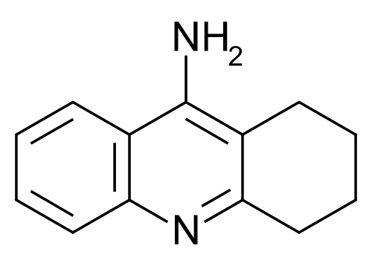
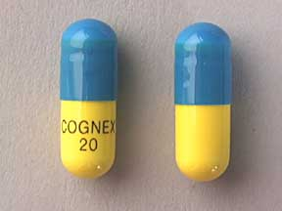
Tacrine (Cognex)-The first Cholinesterase Inhibitor
1993-FDA approved as first Alzheimer drug
Studies-delay institutionalization up to 1 year-reduce costs up to $3.6 billion annually
Estimated lifetime savings of $10,000
Notes:
Reduce physician visits, saving on nursing-homes

Slide 18
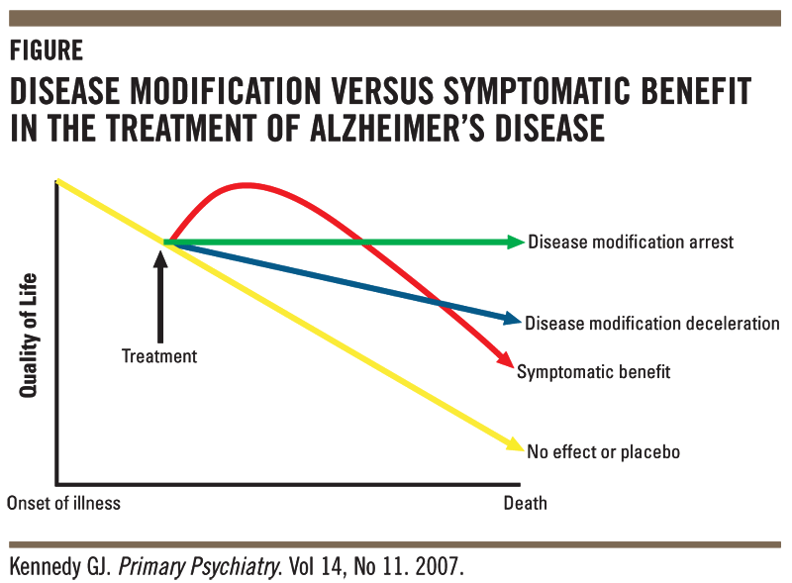
Tacrine-The Other Side of the Story
Unfortunately, associated with sever hepatotoxicity
Affected its permeability-often eliminated too soon or too late
Induced variable drug amounts in body
Attributed to poor selectivity for AchE as also binds butyrylcholinesterase
Lead to 2nd generation drugs

Slide 19
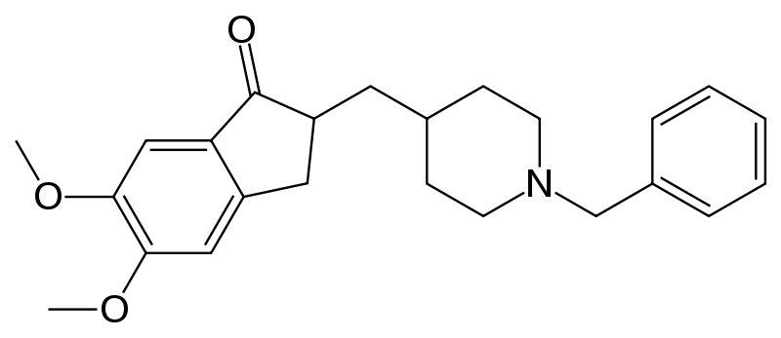
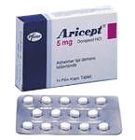
Donepezil (Aricept)
Can cross the BBB with nearly 100% efficiency-approved for all stages of treatment
Highly selective reversible inhibitor of AchE
Unaffected by food
Long plasma half-life of 70 hours-administered once daily
Most widely used across the world
Reduced Side effects

Slide 20
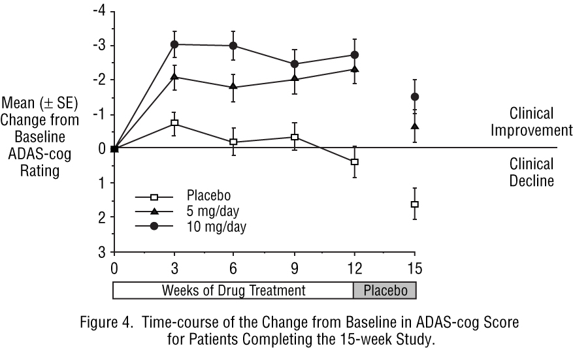
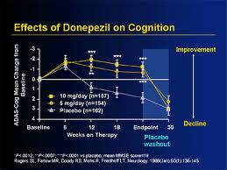
Donepezil (Aricept)
Cognition advantages up to 1 year

Slide 21
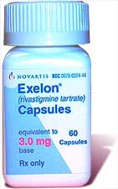
Rivastigmine (Exelon)
Although short half life of 2 hours, cholinesterase inhibition in brain last up to 10 hours
Therefore, identified as pseudo-irreversible inhibitor of AchE and BuchE
Short half life leads to 2x daily dosing

Slide 22
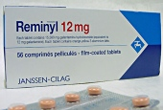
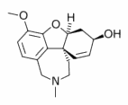
Galantamine (Reminyl)
Isolated from Galanthus woronowii
Competitive and reversible AchE inhibitor
Much less potent than Tacrine against BuchE
Drug acts directly on nicotinic receptors increasing release of acetycholine
Short half life of 8 hours-2x daily

Slide 23
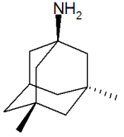
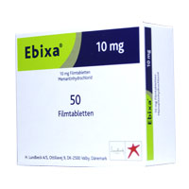
Memantine (Ebixa or Namenda)
2003-released onto market.
NMDA (N-methyl-D-asparate) receptor antagonist
regulates activity of glutamate-chemical messenger involved in learning and memory
Up until now-drugs weren’t neuro-protective and only enhanced cognitive state
Protects brain cells against excess glutamate-released by damaged cells of patients

Slide 24
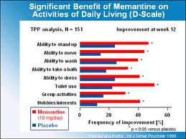
Memantine (Ebixa or Namenda)
Diseased brain-attachment of glutamate to NMDA receptors permits calcium to flow freely into cell
Over time-leads to chronic overexposure to calcium which speeds cell damage
Memantine slows progress of disease up to 1 year

Slide 25
Drug Administration
Oral route long preferred
Alzheimer’s drugs associated with “first-pass” metabolism-leads to reduction in bioavailability of medications
Recent studies show greater patient cooperation with transdermal route, buccal, and nasal routes
All Alternative ways to deliver a drug to CNS without associated oral administration side affects

Slide 26
Alternative Treatments to Alzheimer’s Disease
Alzheimer’s lower in countries with low fat and calorie diets
Essential fatty acids-improvement in mood and mental function than placebo
Vitamin E depletion in patient-2000 IU daily can delay onset
Vitamin C in synergy enhanced effects
Thiamine (B1)-marked improvements in mental function and assessment scores
Vitamin B12 and Melatonin also show potential

Slide 27
Future Drug Targets
Amyloid Protein: beta-secretase and gamma-secretase
Tau protein-main ingredient of tangles-other hallmark abnormality
Anti-inflammatory drugs
Insulin release

Slide 28
Future Drug Targets
Within 3-4 years, next generation of drug therapy expected to reach the market.
Scientists have discovered how the beta-amyloid protein fragment is clipped from its parent compound amyloid precursor protein (APP) by two enzymes: beta-secretase and gamma-secretase
HUGE area of research-develop medications aimed at every possible point in amyloid protein
Especially these two enzymes
Notes:
The beta-amyloid fragments clump into plaques

Slide 29
Future Drug Targets
Tau Protein: main ingredient of tangles-other hallmark brain abnormality
Researchers are attempting to develop drugs that bind tau molecules
Want to keep them from collapsing and twisting into tangles-destructs critical cell transport mechanisms
Anti-inflammatory drugs will attempt to offset inflammation response caused by the disease

Slide 30
A Bright Future: Insulin
Reduced glucose utilization and energy metabolism occurs early in the course of Alzheimer’s Disease-correlates with impaired cognition
Regulated by insulin and insulin growth factor 1 (IGF-1)
Reduced levels of insulin and IGF-1 polypeptide genes found in advanced Alzheimer’s disease patients
In frontal lobe-progressively reduced levels of mRNA corresponding to insulin, IGF-1, and IGF-2 polypeptides and their receptors, and tau were found as the disease advanced

Slide 31
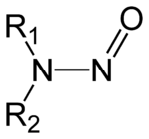
A Bright Future: Nitrosamines
Nitrosamines formed by chemical reaction between Nitrites or other proteins
Nitrates and Nitrates-found in cured meats, cheese products, as well as beer and bottled water
Generated under strong acid conditions-stomach or from broiling or frying foods
Can prevent by removing sodium nitrite content in food

Slide 32
A Bright Future: Nitrosamines
Strong parallels between age-adjusted increases in death rate from Alzheimer’s in human exposure to nitrates, nitrites, and nitrosamines
Nitrosamines found in preserved foods as well as fertilizer
Society has moved to diet rich in amines and nitrates-leads to increased nitrosamine production
Increased exposure-caused both to processed foods and crops leeching nitrates from the soil and contaminating water supplies used for crop irrigation

Slide 33
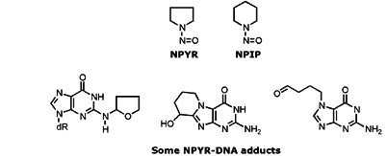
Nitrosamines: Mechanism of Action
Become reactive at cellular level-changes gene expression and leads to DNA damage
The changes induced by nitrosamines are similar to those of aging, as well as Alzheimer’s Disease
Produce biochemical changes inside cells and scientists are beginning to believe Alzheimer’s could be caused by nitrosamines found in processed foods, and water

Slide 34
A Bright Future: Inflammation
Cascading basic science, genetic, and clinical evidence supports key role of the inflammatory cytokine, TNF, in the pathogenesis of Alzheimer’s Disease
Inflammation of the brain long known as a strong contributor to Alzheimer’s Disease
http://nrimed.reachlocal.net/videos/dementia-patient-recognizes-wife-after-inr-treatment/

Slide 35
Readings
Wilkinson, David . "Pharmacotherapy of Alzheimer's disease." Psychiatry 4.1 (2005): 43-47. Print.
Alzheimer's Association. "The Journal of Alzheimer's Association." 2010 Alzheimer's Facts and Figures 1st ser. 6.2 (2010): 158+. Print.

Slide 36
Homework Questions
List the 4 FDA approved Alzheimer’s Disease drugs and draw their structure
These FDA approved drugs have not always been available for drug treatment. Prior to the use of these drugs, Alzheimer’s patients were commonly treated with WHAT forms of drugs to minimize their abnormal behavior?
What is Alzheimer’s disease (define)
How are Nitrosamines formed? How can nitrates and nitrites enter the body?

