Slide 1
Anti-Obesity Drugs
Aaron Cheatham

Slide 2
Fat is just what we thought
The cause of excess subcutaneous and visceral fat deposition in an individual is the cumulative effect of an imbalance between the energy of ingested food and that expended in the course of daily activities
Essentially, the deposition of fat is an adaptive physiologic process of energy storage that became maladaptive when technological advances altered the balance between the availability of food and the body’s expenditure of energy.

Slide 3
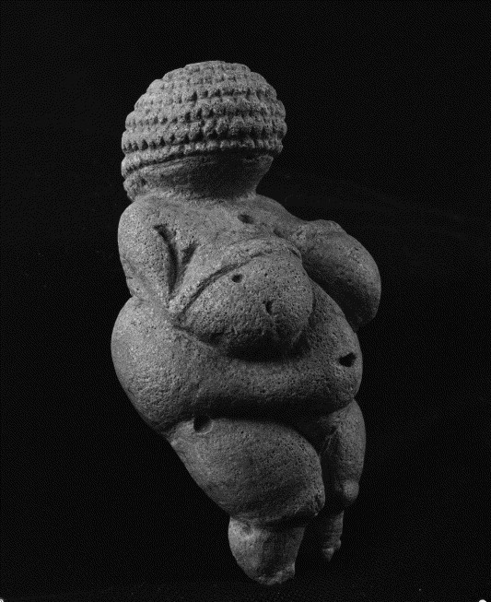
Historical Roots
Fat as a natural mechanism for storing food reserves
The ability to store surplus fat from the least possible amount of food intake may have made the difference between life and death
Evolutionary advantage
Fat was culturally pleasing well into the first decades of the 20th century
Paintings, literature, politically
The Venus of Willendorf
25,000 BC

Slide 4
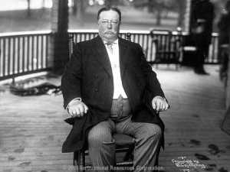
President William Taft(1857-1930)
At 5’11, 243 at graduation
320 pounds when he became secretary of war
340 pounds when he was in the White House
body mass index of more than 45

Slide 5
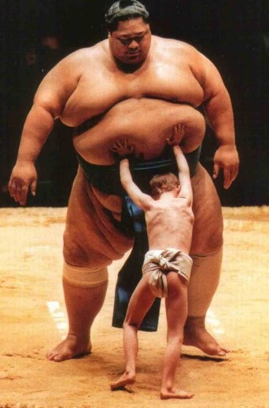
Taking Notice
The health consequences of obesity began to be noted in the medical literature in the eighteenth century
Throughout most of the nineteenth century and well into the early twentieth century, medical opinion held that carrying an extra 20 to 50 pounds of excess “flesh” was healthy
It provided a reserve of vitality that would keep a person from being run down by a long lasting illness
Being thin was unhealthy and advice was geared towards how to gain weight

Slide 6
First Alarm
The first alarm against excess weight was sounded by the insurance industry
By the 1930s, the medical profession made a total about face on the desirability of excess “flesh” and accepted excess fat as a health problem
Psychiatrists capitalize by convincing people that obesity is a psychological malfunction, soon realized false
It was not until 1960s that the study of obesity was in full swing and it was at this time that fat became an “organ” with its own hormones, receptors, genetics, and cellular biology rather than the passive store of energy

Slide 7
Advances
Agricultural Revolutions – good but bad
Thermodynamics
Nutritional balance
Energy Conversion
Gastric physiology
Alphonse Quetelet’s body mass index (BMI),
is now used for the classification of overweight
status.

Slide 8
Classification
Obesity is a medical condition in which excess body fat has accumulated to the extent that it may have an adverse effect on health.
It is defined by body mass index (BMI) and further evaluated in terms of fat distribution via the waist–hip ratio and total cardiovascular risk factors.
BMI is closely related to both percentage body fat and total body fat.

Slide 9
Classification
Metric: BMI = kilograms / meters²
US customary and imperial:
BMI = lb * 703 / in²
BMI | Classification
< 18.5 | underweight
18.5–24.9 | normal weight
25.0–29.9 | overweight
30.0–34.9 | class I obesity
35.0–39.9 | class II obesity
≥ 40.0 | class III obesity

Slide 10
Great Example!!!!
Height: 5’8
Weight: 159
BMI: 23
Great Body weight!

Slide 11
Effects on health
cardiovascular diseases,
diabetes mellitus type 2
obstructive sleep apnea
certain types of cancer
osteoarthritis

Slide 12
Health Effects - Mortality
Obesity is one of the leading preventable causes of death worldwide
mortality risk is lowest at:
BMI of 20–25 kg/m² in non-smokers
24–27 kg/m² in current smokers
BMI above 32 has been associated with a doubled mortality rate among women over a 16-year period
On average, obesity reduces life expectancy by six to seven years

Slide 13
Health Effects – Morbidity
Health consequences fall into two broad categories:
Those attributable to the effects of increased fat mass:
Osteoarthritis(Compression)
Obstructive sleep apnea(Soft Tissue)
Social stigmatization
Those due to the increased number of fat cells:
Diabetes(resistin hormone)
Cancer(inflammation, cell communication)
cardiovascular disease(Hypertension)
non-alcoholic fatty liver disease(fat build-up

Slide 14
Survival paradox
A High BMI can be beneficial
Heart disease
Cardiac bypass surgery
People lose weight to an unhealthy point
maybe because of more intense treatment

Slide 15
Causes
Diet
bad food
Sedentary Lifestyle
Not enough exercise
Genetics
FTO gene(fat mass), perhaps inheritance of leptin resistance
Medical and psychiatric illness
Hypothyroidism, Cushing's syndrome, Eating disorders
Social determinants
Poor equals fat

Slide 16
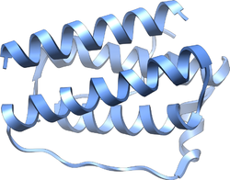
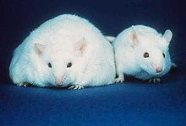
Pathophysiology
Leptin
This field of study was relatively unexplored until leptin was discovered in 1994
plays a key role in regulating energy intake and energy expenditure, including appetite and metabolism.
It is one of the most important adipose derived hormones
Leptin circulates at levels proportional to body fat.
It enters the central nervous system (CNS) in proportion to its plasma concentration.
Its receptors are found in brain neurons involved in regulating energy intake and expenditure.
It controls food intake and energy expenditure by acting on receptors in the mediobasal hypothalamus[

Slide 17
Pathophysiology
Brain
Adipose Tissue
Leptin
Neuropeptide Y
anadamide
a-MSH
Stomach
CCK
PYY3-36
ghrelin

Slide 18
Pathophysiology
Leptin acts on receptors in the hypothalamus of the brain where it inhibits appetite by:
counteracting the effects of neuropeptide Y
counteracting the effects of anandamide and CCK
promoting the synthesis of α-MSH and PYY 3-36
The absence of leptin (or its receptor) leads to uncontrolled food intake and resulting obesity.

Slide 19
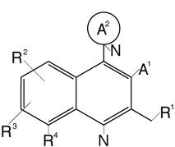
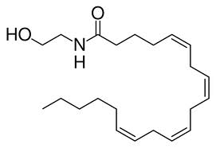
Pathophysiology
Long-Term inhibition
Neuropeptide Y: a potent feeding stimulant secreted by cells in the gut and in the hypothalamus
Anandamide: Stimulant secreted by the hypothalamus
Melanocyte-stimulating hormone(a-MSH): appetite suppressant produced in pituitary gland
Short term
Cholecystokinin(CCK): Family of hormones responsible for digestion of fats
Peptide YY(PYY3-36): Protein responsible for suppression of hunger
Ghrelinis: a hormone produced mainly by P/D1 cells lining the fundus of the human stomach stimulates hunger.
Ghrelin levels increase before meals and decrease after meals. It is considered the counterpart of the hormone leptin.

Slide 20
Pathophysiology
Brain
Adipose Tissue
Leptin
Neuropeptide Y
anadamide
a-MSH
Stomach
CCK
PYY3-36
ghrelin

Slide 21
Pathophysiology
Leptin and ghrelin are considered to be complementary in their influence on appetite, with ghrelin produced by the stomach modulating short-term appetitive control (i.e. to eat when the stomach is empty and to stop when the stomach is stretched).
Leptin is produced by adipose tissue to signal fat storage reserves in the body, and mediates long-term appetitive controls (i.e. to eat more when fat storages are low and less when fat storages are high).
Studies show that the lower leptin levels promote uncontrolled fat storage.
So why not just give a pill containing leptin?

Slide 22
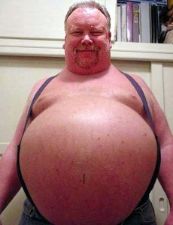
Leptin Deficient?
Studies show that Obese individuals actually have very high levels of Leptin but their body seems to be Leptin resistant.
Perhaps reason for inheritance
So what now?

Slide 23
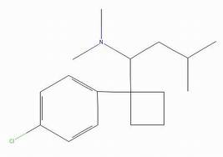
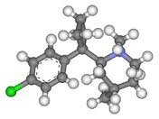
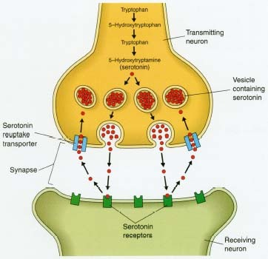
Sibutramine(meridia)
Originally developed as an antidepressant but was not
effective.
was found to reduce body weight and appetite and
increase satiety.
Pharmacodynamics
Sibutramine is a neurotransmitter reuptake inhibitor
that reduces the reuptake of serotonin (by 53%),
norepinephrine (by 54%), and dopamine (by 16%),
thereby increasing the levels of these substances in
synaptic clefts and helping enhance satiety.
(±)-dimethyl-1-[1-(4- chlorophenyl) cyclobutyl]-N,N,3-trimethylbutan- 1-amine

Slide 24
Sibutramine
Pharmacokinetics
Sibutramine is well absorbed from the GI tract (77%), but undergoes considerable first-pass metabolism, reducing its bioavailability. The drug itself reaches its peak plasma level after 1 hour and has also a half-life of 1 hour. Sibutramine is metabolized by cytochrome P450 in liver into two pharmacologically-active primary and secondary amines(M1 and M2) with half-lives of 14 and 16 hours
Peak plasma concentrations of active metabolites 1 and 2 are reached after three to four hours
The following metabolic pathway mainly results in two inactive conjugated and hydroxylated metabolites

Slide 25
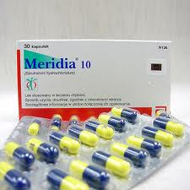
Sibutramine
Side effects
dry mouth, paradoxically increased appetite, nausea, strange taste in the mouth, upset stomach, constipation, trouble sleeping, dizziness, drowsiness, menstrual cramps/pain, headache, flushing, or joint/muscle pain.
The main side effect was an increase in blood pressure resulting in heart attacks and strokes
Resulted in withdrawn from American market

Slide 26
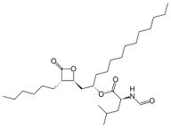
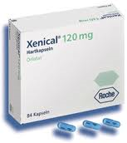
Orlistat(Xenical)
The only FDA approved anti-obesity drug
Orlistat is the saturated derivative of lipstatin,
a potent natural inhibitor of pancreatic lipases.
Reduces blood pressure
Reduces likely hood of type 2 diabetes by 40%

Slide 27
Orlistat
Orlistat works by inhibiting gastric and pancreatic lipases, the enzymes that break down triglycerides in the intestine
When lipase activity is blocked, triglycerides from the diet are not hydrolyzed into absorbable free fatty acids, and are excreted undigested instead
At the standard prescription dose of 120 mg three times daily before meals, orlistat prevents approximately 30% of dietary fat from being absorbed

Slide 28
Orlistat
Side effects
Diarrhea,
Abdominal pain
Some cases of liver failure

Slide 29
Treatment
The main treatment for obesity consists of dieting and physical exercise.
The most effective treatment for obesity is bariatric surgery. Surgery for severe obesity is associated with long-term weight loss and decreased overall mortality.

Slide 30
Future
Rather than stopping caloric intake there is starting the be a focus on speeding up metabolic process and bodies willingness to burn energy.
With that, leptin and how it regulates other peptides involved in energy homeostasis
Recognition of the importance of the hypothalamus in the regulation of energy homeostasis has led to the targeting of neuropeptides and their receptors in this region for weight loss therapies.
Also some fat gene isolations

Slide 31
Readings
http://jcem.endojournals.org/cgi/content/full/89/6/2616
Pharmacological Approaches to Weight Reduction: Therapeutic Targets Judith Korner and Louis J. Aronne Department of Medicine, Columbia University College of Physicians and Surgeons (J.K.), New York, New York 10032; and Weill Medical College of Cornell University, Comprehensive Weight Control Program (L.J.A.), New York, New York 10021
http://www.clinicaladvances.com/article_pdfs/gh-article-200711-redinger.pdf
The Pathophysiology of Obesity and Its Clinical Manifestations
Richard N. Redinger, MD Department MedicineUniversity of Louisville 530 South Jackson Street, 3rd floor Louisville, KY 40292

Slide 32
Questions
Which industry gave first alarm about Obesity?
What is also known as the The Quetelet Index and what is it used for?
What life long complication is most associated with obesity?
Name five health effects of excess weight.
What hormone is most responsible for appetite?
Why is it not as simple as giving obese people more Leptin to regulate their weight.
Name two obesity drugs?

