Slide 1
Anticancer Therapy: Kinase Inhibitors
Charles Harrell

Slide 2
Outline of Material Presented
Definition of Cancer
Understanding Kinases
Kinase Inhibitor Functionality
Economic Considerations
Assigned Reading
Homework Questions

Slide 3
What is Cancer?
The American Cancer Society Defines Cancer as “a group of diseases characterized by uncontrolled growth and spread of abnormal cells.”
According to the US National Cancer Institute: 11,714,000 people in the United States had cancer in 2007
About 1,529,560 new cases of cancer were diagnosed in the US in 2010

Slide 4
Kinases
Kinases are a group of proteins responsible for phosphorylating substrates using ATP or another energy source.
About 518 different kinases have been identified in the human body.
Many kinases initiate a signal cascade whenever they phosphorylate certain proteins, magnifying their effects.

Slide 5
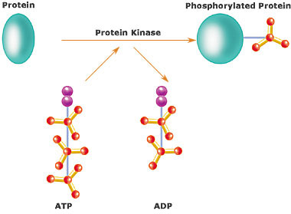
Protein Kinases
Human genes code for about 500 protein kinases
Make up approximately 2% of human genes
30% of all proteins are regulated through the activity of protein kinases
Source: Wikipedia

Slide 6
Tyrosine Kinases
Protein kinases that phosphorylate tyrosine residues
Divided into two classes:
Receptor Tyrosine Kinases – protrude into extracellular space
Nonreceptor Tyrosine Kinases – confined within the cytoplasm
Goodman and Gilman: “In a growing number of human malignancies, mutations that constitutively activate protein tyrosine kinases are implicated in malignant transformation; thus protein tyrosine kinases are targets for cancer therapy.”

Slide 7
Oncogenic Transformation
http://www.youtube.com/watch?v=3nODx3cT1RU
Can occur in a number of different ways
Important distinction is that the kinase remains constitutively active whether the receptor ligand is present or not.
Notes:
http://www.youtube.com/watch?v=3nODx3cT1RU

Slide 8
Kinases as Drug Targets
Because of their crucial position in regulating oncogenic transformation, the kinases have been recently targeted as a potential place where the development of cancer can be halted.
Furthermore, because of the specificity of mutated kinases to their substrates, drugs can selectively target cancerous cells only.
Around 30% of all efforts in the pharmaceutical industry are focused on protein kinases as a target.

Slide 9
Currently Available Kinase Inhibitors
Imatinib (Gleevec) used in the treatment of chronic myelogenous leukemia
Erlotinib (Tarceva) used in the treatment of many types of cancer
Gefitinib (Iressa) used to treat many forms of cancer
Bevacizumab (Avastin) blocks angiogenesis necessary for cancer growth and proliferation
Notes:
Most kinase inhibitors end in –tinib or -umab

Slide 10
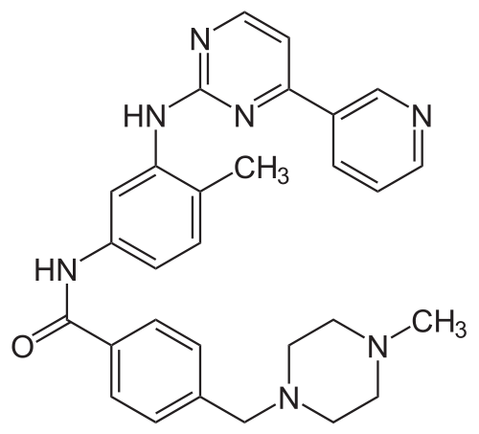
Imatinib (Gleevec)
Developed in the 1990’s using rational drug design after the discovery of the Philadelphia Chromosome
Works by binding and inactivating the bcr-abl kinases
Hailed as a “magic bullet” cure for cancer

Slide 11
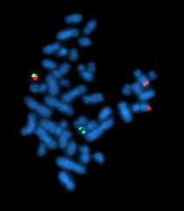
Philadelphia Chromosome
Translocation between Abl1 gene on chromosome 9 and BCR gene on chromosome 22
Can be visualized using FISH
Present in around 95% of all cases of CML

Slide 12
Imatinib Mechanism
Binds to the dysfunctional Bcr-abl kinase and fixes it in a state where the kinase can no longer bind its substrate.
http://www.youtube.com/watch?v=7ZMVQ1Vbb7Y
Notes:
http://www.youtube.com/watch?v=7ZMVQ1Vbb7Y

Slide 13
Problems
Resistance or Intolerance to Imatinib is common after the drug has been administered for several years.
This is solved by administering 2nd generation bcr-abl kinase inhibitors which have been developed since Imatinib and have a higher affinity for the bcr-abl kinase. [Ex. Nilotinib (Tasigna) and Dasatinib (Sprycel)]
Women who become pregnant must stop treatment as Imatinib can lead to the development of fetal abnormalities in the womb.

Slide 14
Erlotinib and Gefitinib
Tyrosine kinase inhibitors that act on the epidermal growth factor receptor (EGFR)
Bind to the ATP site of tyrosine kinases and prevent the dimerization of the protein, keeping it inactive.
Efective against many types of cancer because they inhibit the rapid, uncontrolled growth needed for cancer progression

Slide 15
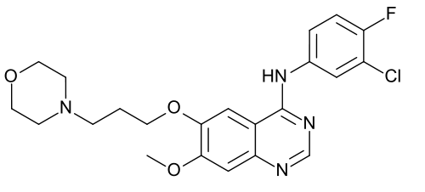
Structures
Erlotinib
Gefitinib

Slide 16
Problems
Resistance to treatment after about 8 months to a year
Side Effects:
Rash
Diarrhea
Loss of Apetite
Fatigue
Interestingly, the severity of rashes has been indicated as a sign that the treatment is working effectively.

Slide 17
Economic Considerations
Costs of Gleevec for a single year range between $32,000 for lower doses and $98,000 for higher doses.
According to 2006 Census Bureau Data, the median salary in the United States is $32,140 a year.
Patent dispute between Novartis and India over the development of generic Imatinib

Slide 18
Assigned Readings
Goodman and Gilman’s The Pharmacological Basis of Therapeutics 12th edition pp. 1731-1738
Guoqing Wei, Shamudheen Rafiyath, and Delong Liu “First-line treatment for chronic myeloid leukemia: dasatinib, nilotinib, or imatinib” in Journal of Hematology and Oncololgy 2010; 3: 47

Slide 19
Homework
Explain the mechanism for mutations that give rise to resistance to tyrosine kinase inhibitors.
What is the major enzyme responsible for the metabolism of imatinib?
What are two other names that EGFR is known by?
What correlation can be observed between response to treatment and adherence to treatment in the case of chronic conditions such as CML?
Name one future BCR-ABL inhibitor that is in phase 3 clinical trials.

Slide 20
Questions?

