Slide 1
Antidepressants and Anxiolytic Agents
Khalil Chamseddin

Slide 2
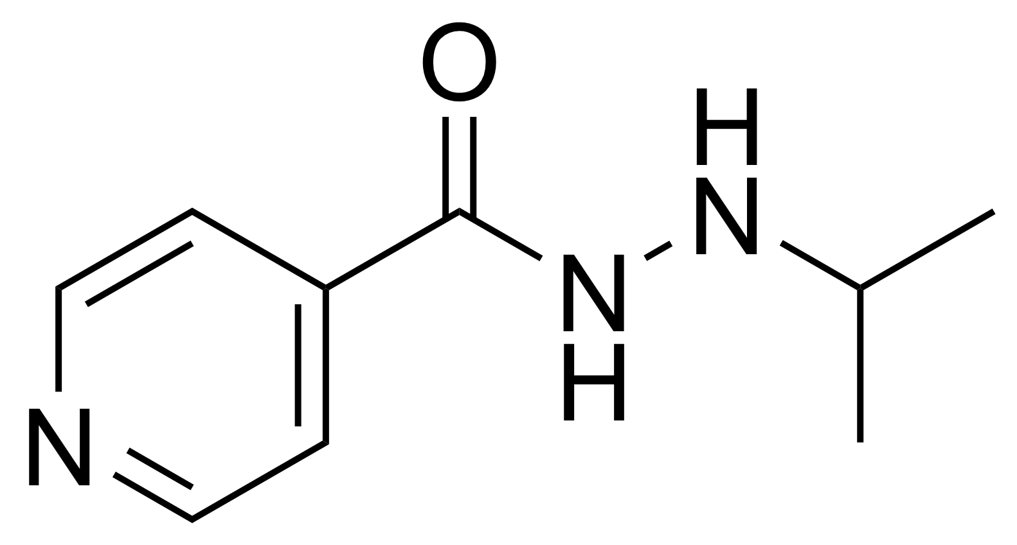
History
Prior to antidepressant agent discovery in the 1950s, electroconvulsive shock was administered as well as opiates to induce euphoria in patients with anxiety. The 1950s was known as the Golden decade for the psychopharmacology industry. Nathan Kline went further to show that it had a stimulatory effect on depressed patients.
When treating tuberculosis patients with iproniazid, it was seen that the patients had an positive increase in moods, which seemed to be a side effect of iproniazid. It was primarily a mono amine oxidase inhibitor and led the way for drugs of similar actions.
Imipramine later followed as a tricyclic drug in 1958.
These discoveries led the way to discover causes of depression
Iproniazid

Slide 3
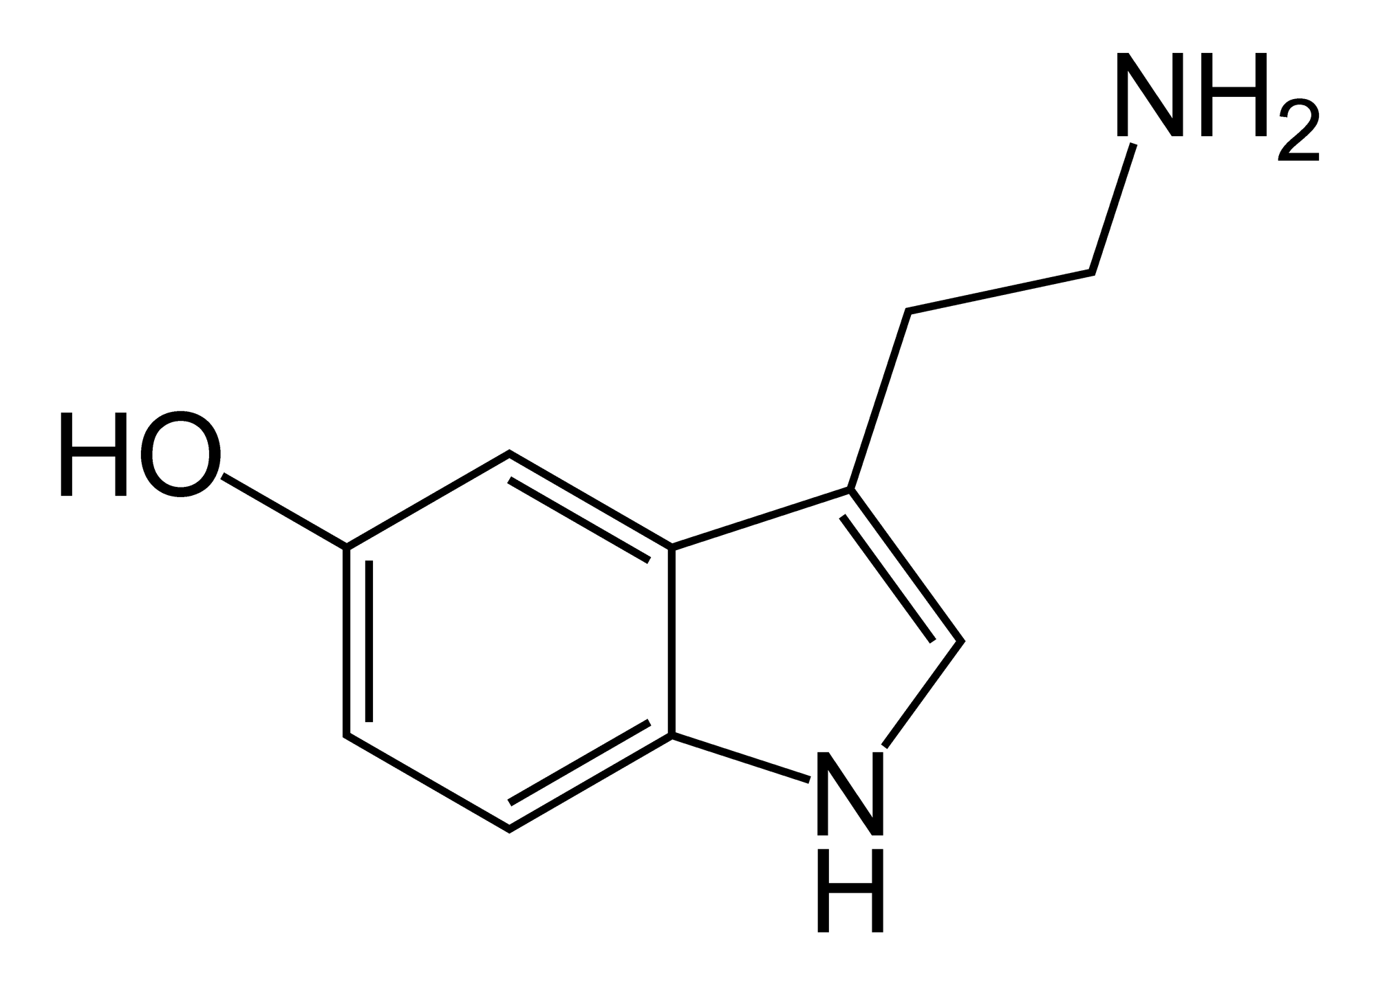
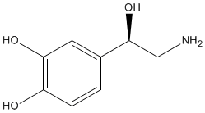
Theories of Depression
Catecholaminergic hypothesis (1965) was formulated on the inhibitory affects of iproniazid on MAOs, reuptake blocking of noradrenalin and by imipramine and the emptying of noradrenalin by reserpine.
It suggested that depression was due to love levels of noradrenaline in the synaptic cleft.
Serotonergic Theory (1968) was based on depression being caused by a decrease in serotonin in the synaptic cleft. This theory was based on tricyclic antidepressants improving the transmission of serotonin.
TCAs blocked the reuptake of serotonin.
Serotonin Noradrenaline

Slide 4
Major Depression
A change in mood that last for a entire day for at least two weeks. Characterization of changes in mood can be feelings of worthlessness and excessive guilt as well as a loss of interest in most activities. Can be debilitating and effective productiveness.
Symptoms (four or more most be seen for diagnosis)
Significant changes in weight. Either a loss or gain due to change in appetite
Difficulty sleeping
Fatigue and loss of energy
Loss of concentration and inability to make decisions
Thoughts of suicide
Changes in movement associated with mental tension, excessive movement or slow movement

Slide 5
Dysthymic Disorder (Chronic Depression)
A more mild form of major depression yet it a long term change in mood that last for at least two years. The symptoms are at a less of a degree yet are more persistent.
Symptoms (two or more must be seen for diagnosis)
Fatigue and decrease in energy
Low self esteem
Feelings of hopelessness and worthlessness
Change in diet and eating habits
Lack of concentration

Slide 6
Manic Depression (Bipolar Disorder)
It is characterized by cycling between states of mania and depression. Features of mania are irritable moods and elevated energy levels. Symptoms and cycles would last for up to a week.
Symptoms (three or more must been seen for diagnosis)
Increase in self-importance and self esteem
Elevated pace of thinking
More talkative
Decreased need for sleep
Excessive behaviors
Psychotic features like hallucinations and delusions may be possible.

Slide 7
Other Classifications of Depression
Seasonal Affective Disorder – episodes of depression related to seasonal changes throughout the year.
Atypical Depression- similar symptoms to Major Depression and Dysthymic Disorder yet features mood reactivity which responses to positive events affect mood. Mood reactivity also has increased sleeping and eating.
Adjustment Disorder- depression caused by a response to an event in ones life. Loss of job, or ending of relationships may trigger adjustment disorder.
Post Partum Depression- triggered by giving birth, usually associated with changes in hormones. The episodes may begin within four weeks of birth and vary in duration.
Psychotic Depression- episodes of depression characterized by hallucinations and delusions.

Slide 8
Epidemiology
Depression is the fourth leading disease burden according to WHO.
13 to 14 million people annually have a depression disorder.
It primarily affects twice as many women then men. This could be related to hormonal changes such has menopause, postpartum depression and menstrual cycle.
Typically single individuals or divorced individuals were more likely to become depressed.
It primarily affects people between the age 20 to 40.
Ethnicity does not play a role.

Slide 9
Causes of depression
Along with the biological hypothesis of chemical imbalances there are other causes of depression.
Depression can be linked to emotional and past sexual abuse. Personal conflicts or big events in ones life.
Medications- there are some medications like resperine which helps treat hypertension, and Accutane which helps treat acne that may cause depression or increase the likelihood of it.
Genetics may also play a role in depression. It is thought that a past family history of depression given a higher chance for an individual to become diagnosed with depression.

Slide 10
Diagnosis of Depression
The Diagnostic and Statistical Manual of Mental Disorders IV is the text referred to by physicians and mental health professions to accurately diagnose a mental disorder.
They look at the patients mood symptoms (affective), their social symptoms (behavior), their concentration and decision making (cognitive) and their physical symptoms (somatic)
Affective-depressed mood
Behavioral- withdrawal or agitation
Cognitive-level of concentration
Somatic-eating behaviors an sleeping behavior
Also, the blood is tested for any medications to rule that out as a possible cause for depression.

Slide 11
Medicinal Treatments
Tricyclic Antidepressants
Monoamine oxidase inhibitors (MOAIs)
Selective Serotonin Reuptake Inhibitors (SSRIs)
Serotonin Norepinephrine Reuptake Inhibitors (SNRIs)
Anxiolytic Agents

Slide 12
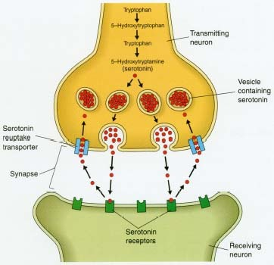
Brief Overview of Nervous System

Slide 13
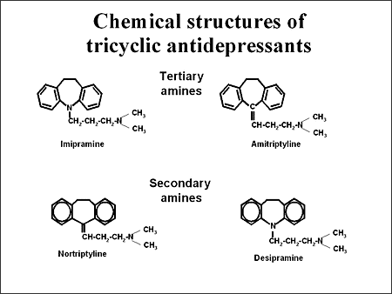
Tricylic Antidepressants
Tricyclic Antidepressants have a wide variety of action. They inhibit the reuptake of serotonin and norepeiephrine and block alpha adrenergic, serotonergic, histiminic,and muscarinic receptors.
Tricyclic Antidepressants are classified as tertiary amines and secondary amines.
Secondary Amines
Desipramine (norpramin)
Nortiptyline (aventyl HCl)
Tertiary Amines
Imipramine (tofranil)
Clomipramine (anafranil)
Doxepin (adapin)
Trimipramine (surmontil)
Amitriptyline (elavil)

Slide 14
TCAs Mechanism of Action
One of the targets for TCAs is the human serotonin transporter. (hSERT) These transporters are a part of neurotransmitter sodium symporter family which use gradients of sodium and chloride ions to accumulate serotonin against its own gradient.
The three ring structure holds important to the induced fit binding to the hSERT receptor and binds into several positions of the various receptors and transporters.
TCAs have a narrow therapeutic index thus overdose may be easy.

Slide 15
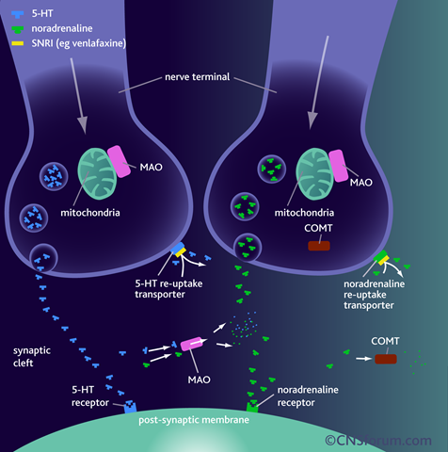
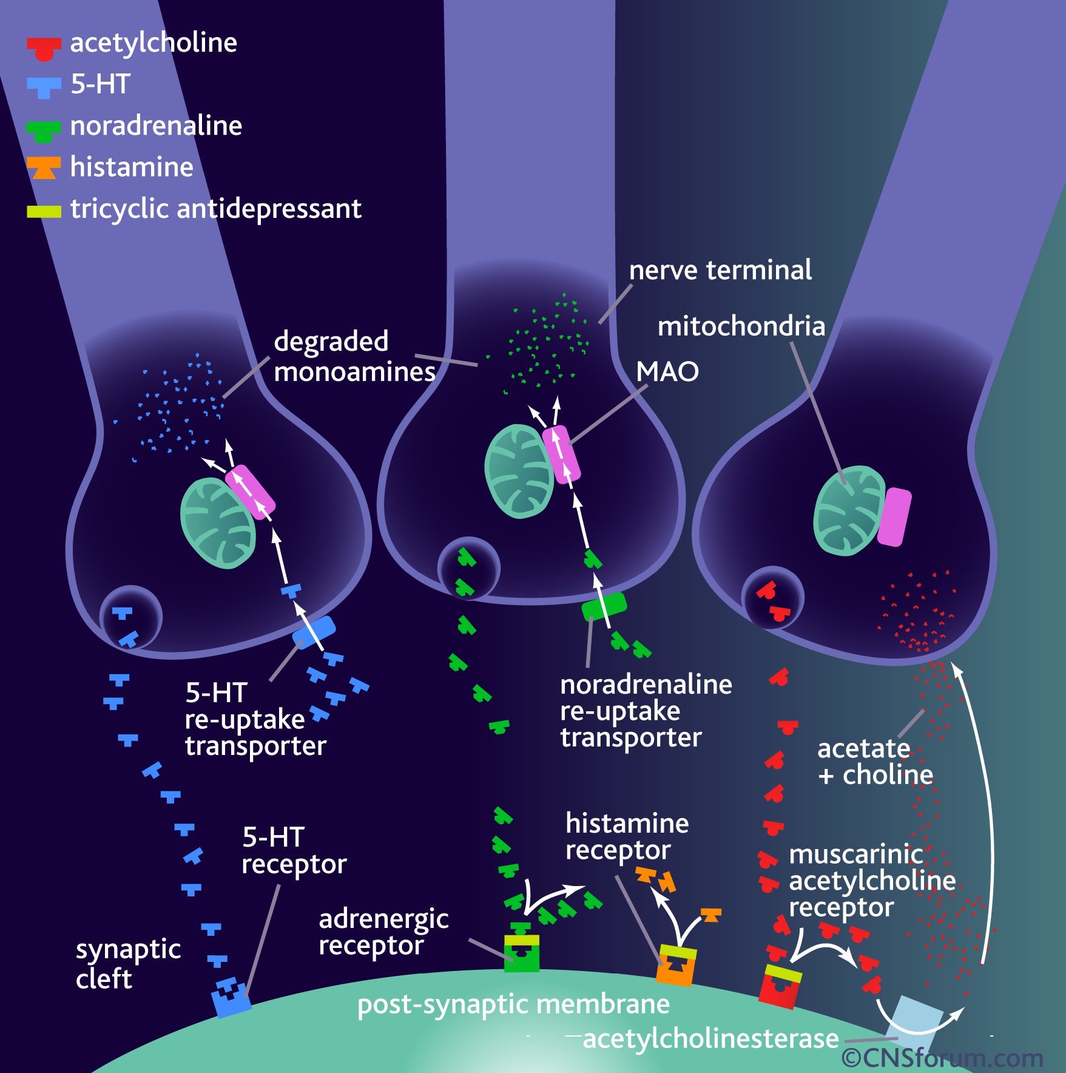
Mechanism of Action

Slide 16
Secondary Versus Tertiary TCAs
Secondary
Enhance noradrenaline levels preferentially over serotonin.
High doses may cause irritability and high activity.
Used when the patient is withdrawn and fatigued.
Tertiary
Preferentially raise serotonin levels.
High doses act as sedatives and give anticholinergic side effects.
Used when the patient is agitated frequently and experiences insomnia.

Slide 17
Side Effects of TCAs
Anti-cholinergic effects –dry mouth, urinary retention, constipation and complications of vision.
Other side effects may be drowsiness, dizziness, sexual side effects such as impotence, and heart burn.
Overdose situations may cause cardiotoxicity and convulsions.

Slide 18
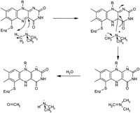
Monoamine Oxidase Inhibitors
Monoamine oxidases A and B are flavoproteins in the outer membrane on mitochondria which causes oxidative deamination of monoamine neurotransmitters. MAO-As break down serotonin, epinephrine and noradrenalin and MAO-Bs degrades phenethylamine.
They degrade any left over neurotransmitter. Inhibition of these enzymes will allow greater quantity of neurotransmitters to remain.
MAOis
Reversible
Moclobemide (Manerix)
Irreverislbe
Isocarboxazid (Marplan)
Phenelzine (Nardil)
Selegiline (Eldepryl) transdermal
Tranylcypromine (Parnate)

Slide 19
MAOIs
Flavin is associated to a Ser-Gly-Gly-Cys-Tyr peptide on a thioether bond of cysteine. MAO inhibitors form adducts with the flavin protein to inhibit binding of monoamines and there later degradation.
They either bind reversibly or irreversibly. Reversible MAOis are preferred primarily because they are shorter acting than irreversible which may decrease dietary restriction.
MAOs are located in other tissues, specifically the gut where it breaks down toxic dietary monoamines like tyramine. By nonselective inhibiting MAO, increased consumption of tyramine could be detrimental and put dietary restrictions on the patients.
Aged cheese, overripe fruits, red wines, concentrated yeast products and some fish products may contain abnormal levels of tyramine which should be consumed less if taking MAOIs. A primary problem with high tyramine levels is hypertension.

Slide 20
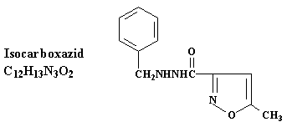
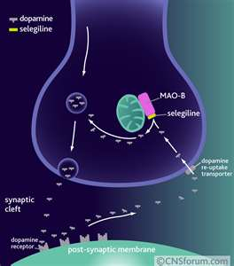
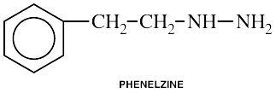
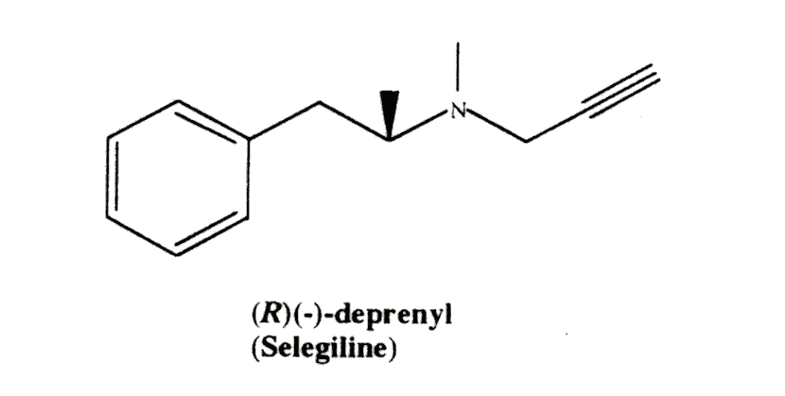
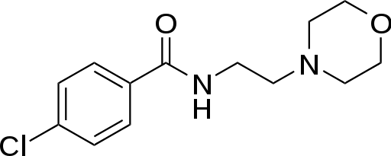
MAOIs Mechanism
Moclobemide

Slide 21
MAOIs Side Effects
Hypertension, shakes, convulsions, tachycardia and hyperthermia may occur. Other side effects are similar to that of TCAs like drowsiness, sexual side effects, restlessness, and nausea.
Selectivity of MAO-A over MAO-B removes dietary restrictions against tyramine in foods.
They are usually a second choice of treatment due to the restrictions and side effects.

Slide 22
Selective Serotonin Reuptake Inhibitors
When serotonin is released from the pre-synaptic nerve terminal, it binds to 5-HT receptors on the post-synaptic terminal to cause a depolarization, and binds to the pre-synaptic 5-HT_{1A} to inhibit the continual release of serotonin.
The binding of SSRIs to the reuptake transporters increases the concentration of serotonin. Due to the increased concentration of serotonin in the synaptic cleft, pre-synaptic inhibitory cells continue firing, after a couple of weeks, the pre-synaptic neuron is desensitized and the therapeutic affects of SSRIs can be seen.
Antagonist of the 5-HT_{A1} receptor by pindolol allows the desired affect of SSRIs to be seen quicker.

Slide 23
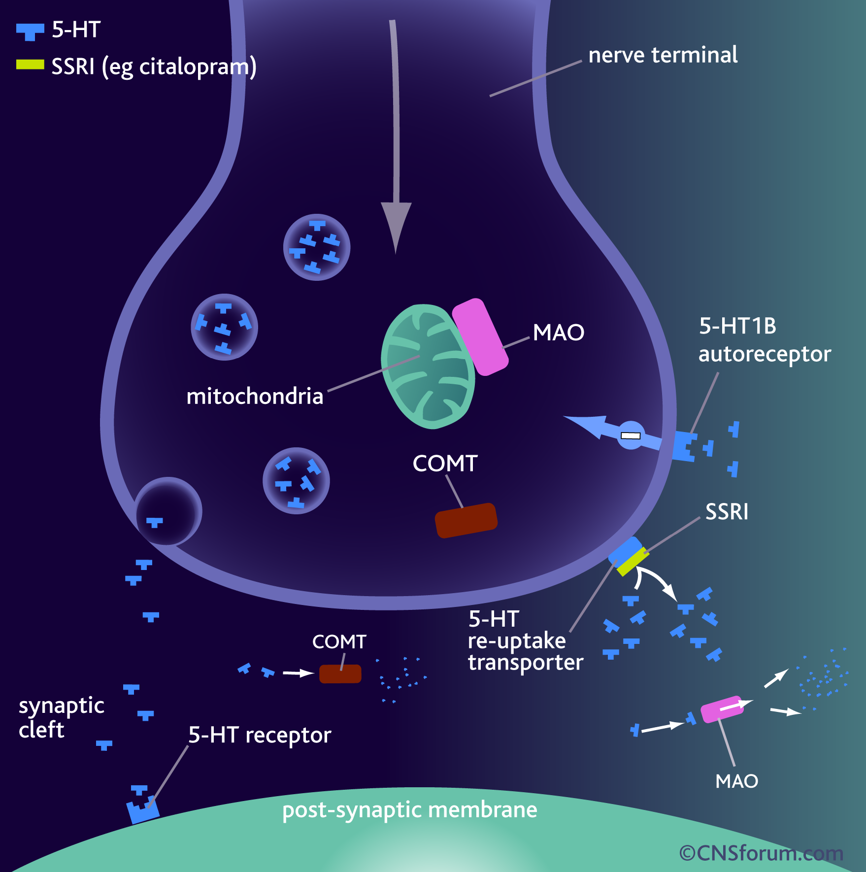
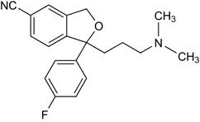
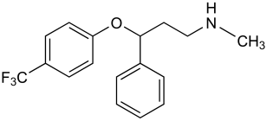
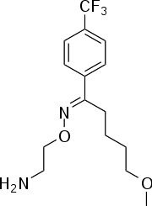
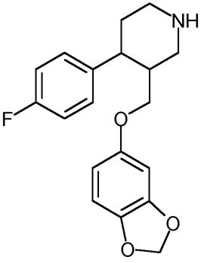
SSRIs Mechanism
Citalopram (Celexa)
Fluoxetine (Prozac)
Fluvoxamine (Luvox)
hSERT is a solute carrier reuptake transporter and is targeted by the selective serotonin reuptake inhibitors. They overlap the substrate binding site by binding to the Ser-438 reside of hSERT. It directly inhibits the serotonin binding site.
Paroxetine (Paxil)

Slide 24
Side Effects of SSRIs
Share common side effects to other drugs yet less hazardous due to the selectivity.
Nausea, headache, insomnia, sexual side effects and agitation. Nausea can be attributed to over stimulation of the 5-HT₃ receptor.
These side effects are less harmful and can be administered to children and elders.

Slide 25
Serotonin Norepinephrine Reuptake Inhibitors
It is seen that SNRIs have the efficacy of TCAs with the minimal side effects of SSRIs. Though serotonin neurotransmission plays an important role in depression, noradrenalin transmission has been attributed to lack of motivation and a loss of interest. Patients given SNRIs are seen to achieve remission in a shorter amount of time.
SNRIs are able to block the reuptake transporters of serotonin and noradrenalin without the blocking of alpha adrenergic receptors and histamine receptors.
SNRIs have similar analgesic effects of TCAs because of the dual targeting of the drugs, yet have limited side effects because of their selectivity.

Slide 26
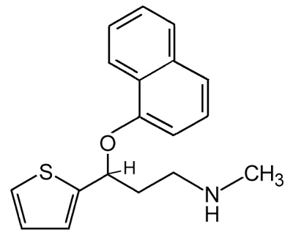
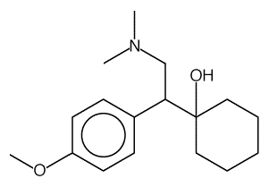
SNRIs
Venlafaxine (effexor)
Duloxetine (cymbalta)
duloxetine
venlafaxine
3-aryloxypropylamine is a structural motif that has a high affinity to binding to monoamine transporters.

Slide 27
Anxiolytic Agents
Antidepressants like MAOIs and TCAs can be used to treat anxiety, yet other specific drugs such as anxiolytic agents like benzodiazepines and barbiturates can be used to treat anxiety.
Benzodiazepines have affects on GABA-A receptors by binding to the receptor and causing a conformational change to increase the affinity of GABA binding to the receptor. GABA is an inhibitory neurotransmitter which slows down the brain and produces sedative effects.

Slide 28
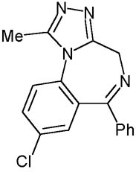
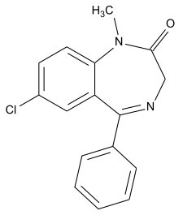
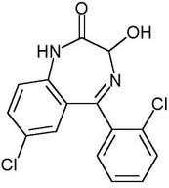
Types of Anxiolytic Agents
Benzodiazepine
Alprazolam (xanax)
Diazepam (valium)
Lorazepam (Ativan)
Alprazolam (xanax)
Diazepam (valium)
Iorazepam (ativan)

Slide 29
Side Effects of Anxiolytic Agents
Drowsiness, los of memory, confusion, trouble concentrating, sleeping troubles and loss of coordination.

Slide 30
Readings
“Antidepressants” Jon Nash and David Nutt
“Pharmacogenomics of Antidepressant Drugs” Sonja Horstmann and Elizabeth B. Binder
Optional Readings
“SNRIs Versus SSRIs: Mechanisms of Action in Treating Depression and Painful Physical Symptoms” Norman Sussman M.D.

Slide 31
Questions
Briefly explain the “monoamine theory of depression”.
What is responsible for the toxic side effects of TCAs?
Why is a “wash out” period needed between different drug uses? How long is the “wash out” period?
Given an example of a Noradernergic and Specific Sertonergic Antidepressant. How does it work?
Name four ways in which the drug is modified to become inactive.
What are two complications brought on in study of pharmacogenetics of antidepressants?

Slide 32
Works Cited
http://web.ebscohost.com/ehost/pdfviewer/pdfviewer?sid=cd651af3-cc34-47c2-9663-786b25eaf05c%40sessionmgr110&vid=2&hid=113
http://www.sciencedirect.com/science?_ob=ArticleURL&_udi=B82YB-4PYYPNK-7&_user=686190&_coverDate=11%2F30%2F2007&_rdoc=1&_fmt=high&_orig=gateway&_origin=gateway&_sort=d&_docanchor=&view=c&_acct=C000038118&_version=1&_urlVersion=0&_userid=686190&md5=077328988bc26558f6074308beb0c347&searchtype=a
http://www.sciencedirect.com/science?_ob=ArticleURL&_udi=B6T1J-41KNXTH-15&_user=686190&_coverDate=09%2F29%2F2000&_alid=1712912401&_rdoc=5&_fmt=high&_orig=search&_origin=search&_zone=rslt_list_item&_cdi=4892&_sort=r&_st=13&_docanchor=&view=c&_ct=87210&_acct=C000038118&_version=1&_urlVersion=0&_userid=686190&md5=6056b342e5459f3edc6feb83c751d180&searchtype=a
http://www.biopsychiatry.com/antidepressants.pdf
http://www.sciencedirect.com/science?_ob=ArticleURL&_udi=B6T8T-4MCWDB7-3&_user=686190&_coverDate=06%2F30%2F2007&_rdoc=1&_fmt=high&_orig=gateway&_origin=gateway&_sort=d&_docanchor=&view=c&_searchStrId=1713010082&_rerunOrigin=google&_acct=C000038118&_version=1&_urlVersion=0&_userid=686190&md5=92911f118ffb8f53b9a59b6d4150bb8c&searchtype=a
http://www.sciencedirect.com/science?_ob=ArticleURL&_udi=B6T26-3WWTYVF-2&_user=686190&_coverDate=07%2F31%2F1999&_rdoc=1&_fmt=high&_orig=gateway&_origin=gateway&_sort=d&_docanchor=&view=c&_searchStrId=1714696245&_rerunOrigin=scholar.google&_acct=C000038118&_version=1&_urlVersion=0&_userid=686190&md5=dbb1fb118e4fd276684d470dfe298568&searchtype=a
http://emedicine.medscape.com/article/815695-overview#a0104
http://www.ncbi.nlm.nih.gov/pmc/articles/PMC2665081/
http://www.ncbi.nlm.nih.gov/pmc/articles/PMC181155/
http://www.psychiatrist.com/pcc/pccpdf/v05s07/v05s0704.pdf
http://www.sciencedirect.com/science?_ob=ArticleURL&_udi=B6TF9-4F0117J-1&_user=686190&_coverDate=02%2F01%2F2005&_rdoc=1&_fmt=high&_orig=gateway&_origin=gateway&_sort=d&_docanchor=&view=c&_searchStrId=1714921037&_rerunOrigin=scholar.google&_acct=C000038118&_version=1&_urlVersion=0&_userid=686190&md5=11ba11ea3a35d4dd306537a24b2bec9d&searchtype=a

