Slide 1
Grace Davis
Antidepressants
April 19, 2011
Medicinal Chemistry
CHEM 5398

Slide 2
Depression and Symptoms
Foremost cause of disability as measured by years lived with a disability
Affects 121 Million people worldwide
2000: 4th largest global burden of disease
Measured by sum of years of potential life lost due to premature mortality
Between 15-44 2nd cause of premature mortality
2001-2002 Study estimated 6.6% of US adults suffered from MDD in that year (Centers for Disease Control and Prevention)
Lifetime Prevalence=6.7%
Women affected TWICE as much as men

Slide 3
Depression

Slide 4
Depression

Slide 5
Prevalence

Slide 6
Depression Symptoms
Depressed or sad mood
Pessimistic worry
Diminished Interested in Normal Activities
Mental Slowing & Poor Concentration
Insomnia or Increased Sleep
Significant weight loss/ gain
Agitation
Feelings of guilt and worthlessness
Difficulty making decisions
Decreased energy/ fatigue
Decreased libido
Suicidal Ideation/Suicidality
Crying Spells
“Empty mood”
Persistent Anxiousness
Feelings of hopelessness
Low self-esteem
Physical changes
Headaches
Digestive problems
Chronic pain

Slide 7
Types of Depression
To be classified as depressed must fit criteria of Diagnostic and Statistical Manual of Mental Disorders (DSM-IV-TR)
Major Depressive Episode
Symptoms must occur nearly every day for at least 2 weeks
Episodes can last for several months
Dysthymia
Chronic State of depressive mood persists for at least 2 years
Children and adolescents must be for 1 year
At least 2 symptoms must follow for at least 2 consecutive months
Can also have double depression
Manic Depression (Bipolar)
Antidepressants not commonly used alone for treatment
This is due to the “switch” between a depressed episode and a manic episode
Antidepressants can induce the “switch” to occur
SSRIs and bupropion are less likely to induce
Mood Stabilizers such as Lamictal (lamotrigine)

Slide 8
Other Types of Depression
Post Partum Depression (PPD)
10-17% of women experience depression during pregnancy
Situational Depression
Seasonal Depression Disorder (SADD)
Has been proven to be treated with Light Therapy

Slide 9
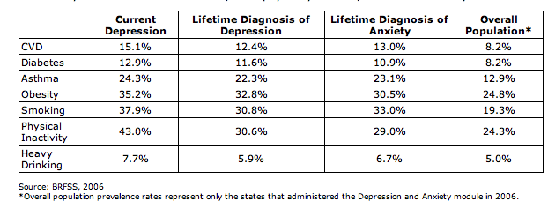
Comorbidity
Comorbidity is presence of more than 1 disorder at a time
Depression has a very high comorbidity rate
Challenge because antidepressants must be able to be taken with other medication

Slide 10
History of Psychopharmacology
Psychopharmacology: study of drug-induced changes in mood, sensation, thinking, and behavior
Originates in late 19th century
First techniques was using Lithium in insane asylums
Becomes legitimate field of study in early 20th century
Early common ways to treat depression
Psychoactive substances
Chemical shock treatments
Electroconvulsive therapy

Slide 11
History of Psychopharmacology
http://www.psychiatrist.com/pcc/pccpdf/v05s07/v05s0702.pdf

Slide 12
History of Antidepressants
1952: Iproniazid is created to treat tuberculosis
Physicians see that TB patients have side effects such as:
Mood-elevation
More cheerful, more active, more optimistic
Ernst Zeller finds that iproniazid and its chemical relatives slow enzymatic breakdown of Monoamine Norepinephrin (NE), serotonin (5-HT), and dopamine (DA)
Does this through inhibition of mitochondrial enzyme monoamine oxidase inhibitors (MAOIs)
Monoamine/ Catecholaminergic Hypothesis
Leads to First Generation Antidepressants
Although proven not used clinically until 1960s

Slide 13
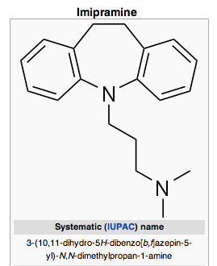
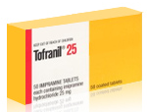
History of Antidepressants
1950s/1960s another class of antidepressants being researched
Tricyclic Antidepressants (TCAs)
Found to block reuptake of NE and 5-HT from synapse
Increases binding affinity with receptors
Named for their 3-ringed cyclic structure
First clinically useful TCA is Imipramine (Tofranil)

Slide 14
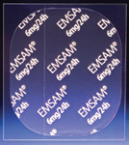
First Generation Antidepressants: Monoamine Oxidase Inhibitors
MAOIs: Iproniazid, Phenelzine, Isocarboxazid, Tranylcypromin, Transdermal Patch-Selegiline
Reversible inhibitors of MAO-A & MAO-B
MAO-B is only found in serotonergic neurons
Slow enzymatic breakdown of 5-HT, NE, & DA
Actylation is process of MAOIs metabolism
Excreted within 24 hours
Can take up to 2 weeks for MAOIs to activate
Currently rarely prescribed because of their toxicity and increased safety precautions for patient
Hypertension most common side effect

Slide 15
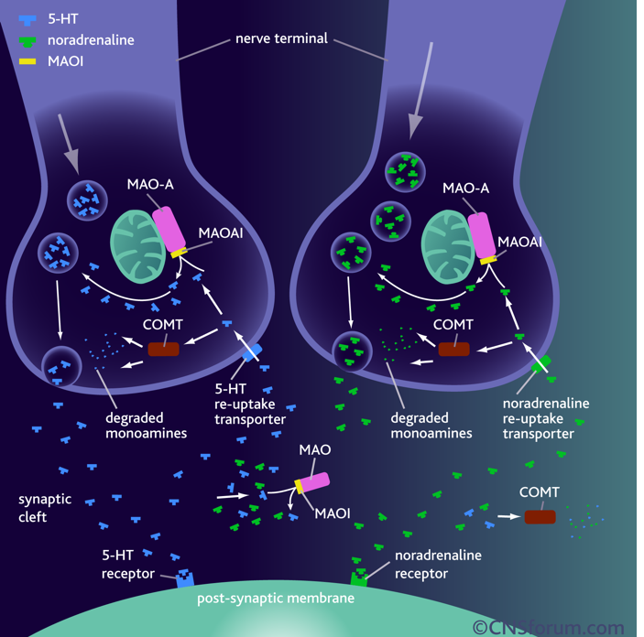

Slide 16
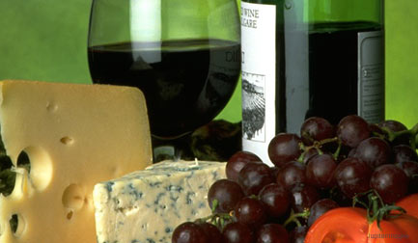
First Generation Antidepressants: Monoamine Oxidase Inhibitors
Side Effects
Hypertension
Due to interactions with food and other medications
Must avoid food containing tyramine
Cheese, red wine, fava beans, sauerkraut
Dangerous Blood-pressure levels

Slide 17
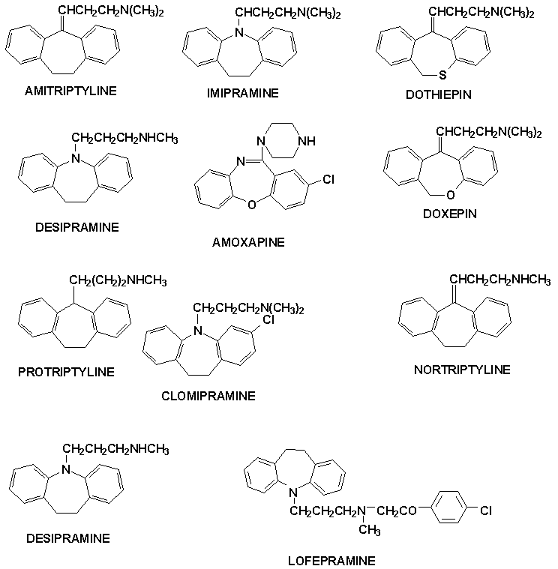
First Generation Antidepressants: Tricyclic Antidepressants
Discovered through structural working of antihistamines, sedatives, analgesics, and Antiparkinson drugs
Named for their 3-ringed cyclic structure
Usually have a tertiary side chain
Inhibit both NE and 5-HT
Modification of these drugs led to second generation antidepressants-SSRIs/ SNRIs

Slide 18
First Generation Antidepressants: Tricyclic Antidepressants
Side effects
Drowsiness
Dry mouth
Blurred vision
Constipation
Urinary retention
Dizziness
Sexual Dysfunction
Increased heart rate
Disorientation or confusion
Low blood pressure
Weight gain
Fatigue
Headache
Sensitivity to sunlight
Nausea
Seizures (particularly with maprotiline)

Slide 19
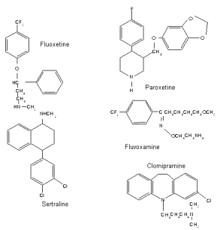
Second Generation Antidepressants
Most commonly used antidepressants/ First line treatment
Discovered between 1984-1997
Based on Serotonergic Theory
Block reuptake of 5-HT or NE
Results in enhanced and prolonged serotonergic neurotransmission
Inhibit both SERT and NET
Controlled by negative feedback
Broad range drug
Can treat a wide spectrum psychiatric, behavioral, & medical conditions
Such as anxiety and OCD
Selective Serotonin Reuptake Inhibitors (SSRIs)
Target Serotonin (5-HT)
Selective Norepinephrine Reuptake Inhibitors (SNRI)
Target Norepinephrin (NE)
Surpass First Generation drugs because they are safer and less toxic
Have a greater efficacy

Slide 20
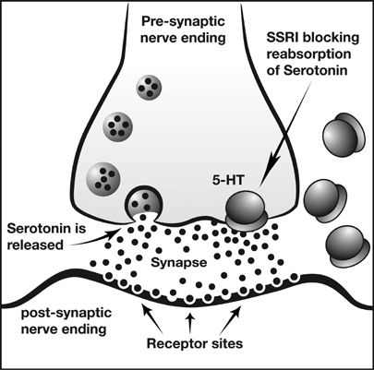

Slide 21
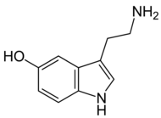
Second Generation Antidepressants: Serotonin
Serotonin discovered by Dalhstrom and Fuxe
“Polymorphisms in the serotonin reuptake transporter (SERT) gene have been associated with depression and other mood disorders…SERTs are downregulated in the presence of SSRIs (Best).
Serotonin is synthesized in serotonorgic terminals from tryptophan
Competes with tyrosine and the branched chain amino acids for transport across Blood-brain barrier
Serotonin is metabolised by monoamine oxidase and aldeyde dehydrogenase to 5-hydroxyindoleacetic acid.

Slide 22
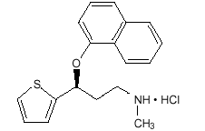
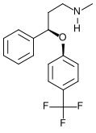
Second Generation Antidepressants
SNRIs
Duloxetine (Cymbalta)
Milnacipran (Savella)
Venlafaxine Effexor
(Desvenlafaxine (Pristiq)
SSRIs
Fluoxetine (Prozac) manufactured by Eli Lilly
Fluvoxamine maleate (Luvox) manufactured by Solvay
Paroxetine (Paxil) manufactured by Smith Kline Beecham
Sertraline (Zoloft) manufactured by Pfizer
Citalopram (Celexa) manufactured by Forest Laboratories

Slide 23
Second Generation Antidepressants
Side effects:
Insomnia
Increased anxiety
Decreased libido
Worsen depressive symptoms
Nausea
* Due to overstimulation of 5-HT

Slide 24
Atypical Antidepressants
Antidepressants that don’t fit into the other classes
Mechanisms of action do not fit First or Second generation
Still treat depression by affecting neurotransmitters
(5-HT, DA, NE)
Used for patients that have not had success with other classes of antidepressants

Slide 25
Atypical Antidepressants
FDA- approved Atypicals
Bupropion (Wellbutrin, Wellbutrin SR, Wellbutrin XL)
Mirtazapine (Remeron, Remeron SolTab)
NefazodoneTrazodone (Oleptro)
Side Effects:
Seizures

Slide 26
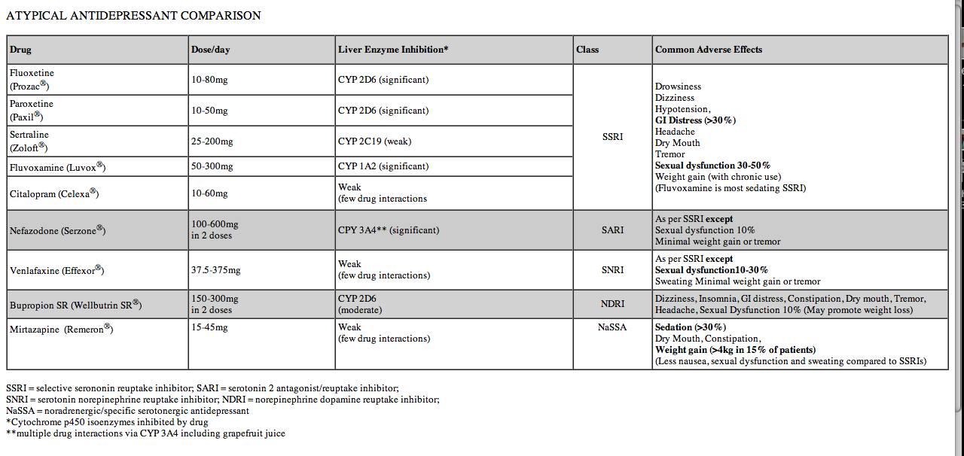
Atypical Antidepressants
http://www.vhpharmsci.com/vhformulary/tools/atypical_antidepressants.htm

Slide 27
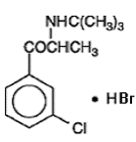
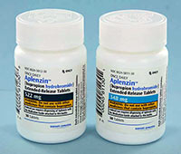
Atypical Antidepressants: Bupropion (Aplenzin)
Racemic mixture
HBr instead of HCl (Welbutrin)
Mechanism of action is unknown
Presumed that this action is mediated by noradrenergic and/or dopaminergic mechanisms
66% effective in reducing depression while Prozac is 62% effective
Time to peak plasma concentrations is approx. 5 hours
Only FDA approved single pill for 522 mg
No generic substitute *
Relatively weak inhibitor of the neuronal uptake of norepinephrine and dopamine
does not inhibit monoamine oxidase or the re-uptake of serotonin

Slide 28
Atypical Antidepressants: Bupropion (Aplenzin)
Side Effects:
Seizures
Increased restlessness, agitation, anxiety, and insomnia, especially shortly after initiation of treatment
Weight loss:
In studies conducted with the immediate-release formulation of bupropion hydrochloride, 35% of patients receiving TCAs gained weight, compared to 9% of patients treated with the immediate-release formulation of bupropion hydrochloride.

Slide 29
Most Popular Antidepressants
http://psychcentral.com/lib/2010/top-25-psychiatric-prescriptions-for-2009/

Slide 30
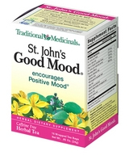
Other Forms of Treatment
Electroshock Therapy
Early 20th century, not successful
Light Therapy
Used for SADD or people not exposed to light often
Miners or residents of certain areas
St. John’s Good Mood Tea/ St. John’s Wort Tea
On February 10, 2000, the FDA issued a Public Health Advisory letter stating that the herb appears to interfere with certain medications used to treat heart disease, depression, seizures, certain cancers, and organ transplant rejection. The herb also may interfere with the effectiveness of oral contraceptives.
Exercise
Cognitive Behavioral Therapy
Prescription Medical Food/ Augmentation Agent
L-Methylfolate
Used in combination with antidepressant resulted in 2.5 times as many patients achieving major improvement in depressive symptoms as compared with a single antidepressant
Deplin: 7.5 mg = 66*800 mcg folic acid pills
http://www.deplin.com/
http://www.neiglobal.com/Default.aspx?tabid=485

Slide 31
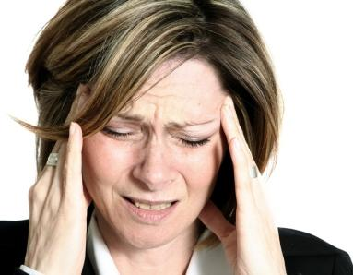
Antidepressants Application
MAOIs, TCAs, SSRIs can be used to treat:
Chronic pain/ Fibromaylgia
Migraines
OCD
Social Anxiety/Anxiety Disorders
Huntington’s Disease

Slide 32
Depression Untreated
World Health Organization reports 25% of affected individuals do not have access to effective treatment
Problem because approximately 10-15% of people with severe depression will attempt suicide

Slide 33
Depression: Unsolved Problems
Efficacy is a major problem
20% of all depressed patients do not respond to multiple different antidepressants at adequate doses
Currently, primary care physicians prescribed antidepressants more often than psychiatrists
Patients describe vague somatic symptoms to them rather than emotional symptoms
Problem because a study showed that Primary Care Physicians misdiagnosed depression in 66% of patients with the illness
http://www.youtube.com/watch?v=pSfxUwpGdes
Mechanism is still poorly understood
Leads physicians and psychiatrists to guess which antidepressant is right for a specific patient
Comorbidity

Slide 34
Depression: Unsolved Problems
Therapeutic Lag
Experience this after initially taking first dose
Can be from 3-4 weeks up to 8 weeks
Deters and frustrates patient
A reason why a patient will quit treatment
Also patient can still experience negative effects of depression that interfere with their everyday life

Slide 35
Depression: Future Directions
The National Institute of Mental Health is currently funding 3 studies
Focus: To understand how adolescents should be best treated
Extended phase of year-long Treatment of Adolescents with Depression Study (TADS) to determine long-term outcomes associated with the treatments under study
Treatment of Resistant Depression in Adolescents (TORDIA)
Used to determine how to treat adolescents with depression who are resistant to the first SSRI antidepressant they have tried
Participants will receive one of three other antidepressant medications, either alone or in combination with CBTTreatment of Adolescent Suicide Attempters (TASA)
Participants are randomly assigned to receive carefully monitored antidepressant medication with routine support and management, CBT, or combination of antidepressant plus CBT
http://www.psych.org/Share/Parents-Med-Guide/HTML-Physician-Depression.aspx#14

Slide 36
Depression: Clinical Treatment
Depressed patients can have a response to the antidepressant
Less symptoms
Feel like the antidepressant is working against depression
Clinicians should strive to treat their patients to remission,
virtually no symptoms of depression
return to normal functioning for the patient
Optimal outcome for patient

Slide 37
Reading
Goodman and Gilman’s The Pharmacological Basis of Therapeutics, 12th edition, Chapter 15, pp. 398-415.
http://www.time.com/time/health/article/0,8599,1952143,00.html
http://www.psychiatrist.com/pcc/pccpdf/v05s07/v05s0702.pdf (copy url instead of clicking link)

Slide 38
Questions
How do SSRIs work?
Why are Second generation antidepressants more effective than the First generation antidepressants?
What is “therapeutic lag”?
For other kinds of medical conditions can antidepressants be use?
What is L-methylfolate? How does it help depressed patients?
Describe the difference between “response” and “remission”.

