Slide 1
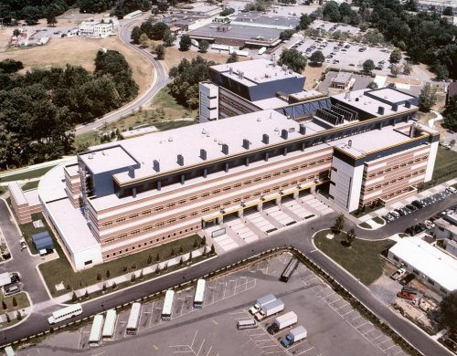

Slide 2
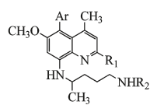

Slide 7
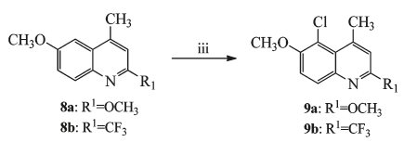

Slide 9
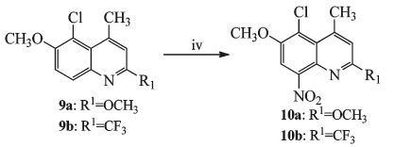

Slide 11
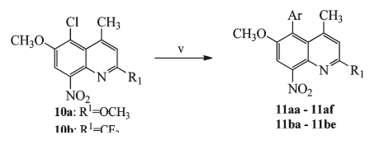

Slide 13
Suzuki Coupling

Slide 14
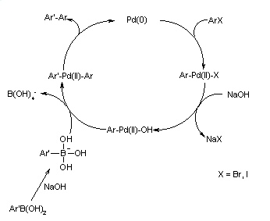
Mechanism of Suzuki Coupling

Slide 15
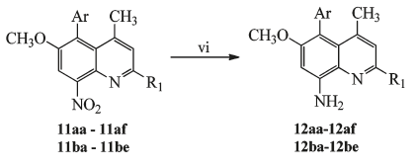

Slide 16
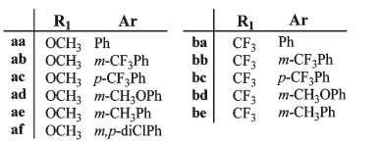

Slide 17
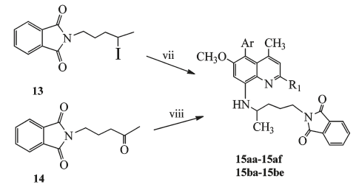
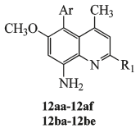

Slide 19
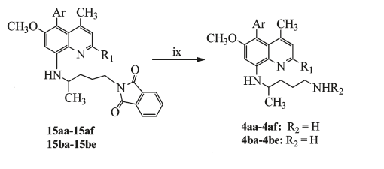

Slide 21
Gabriel Synthesis
Notice that the phthalimide moiety serves as a ‘protected’ form of ammonia.
The phthalimide carbonyls increase the acidity of the nitrogen (thus allowing formation of its conjugate base)
Most importantly, the phthalimide carbonyls protect the nitrogen form ‘over alkylation’ thus preventing the formation of secondary and tertiary amines (and quaternary ammonium salts).

Slide 22
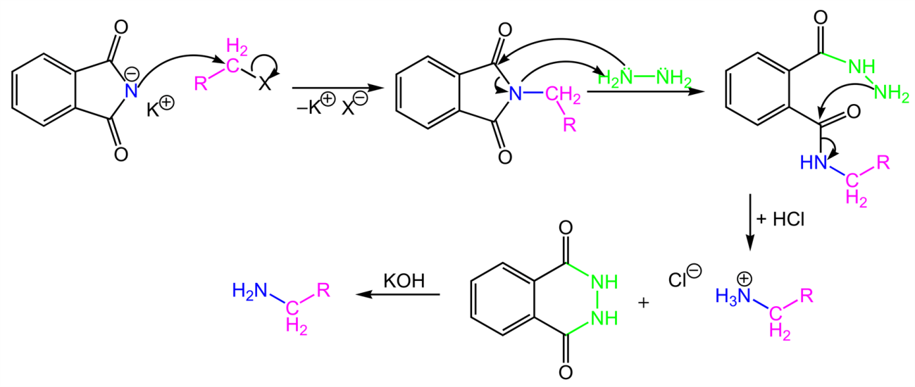
Gabriel Synthesis Mechanism

Slide 23
