Slide 1
Antipsychotic treatment of Schizophrenia
Seminar on the Manifestation of the Disease, Prevalence in Society, and Treatment by Antipsychotics
By Olivia Beran

Slide 2
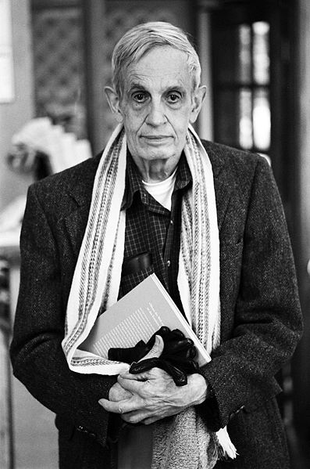
A Beautiful Mind
Notes:
The 2001 Academy Award winning film A Beautiful Mind was based upon the life of John Nash, a U.S. mathematician who jointly won the Nobel Prize for Economics in 1994

Slide 3
Overview of Presentation Material
Definition
Early Years
General Causes
Schizophrenia in the World Context
Burden
Symptoms
Treatment
Typical Antipsychotics
Atypical Antipsychotics
Selecting an Antipsychotic
Assigned Reading
Reading Questions

Slide 4
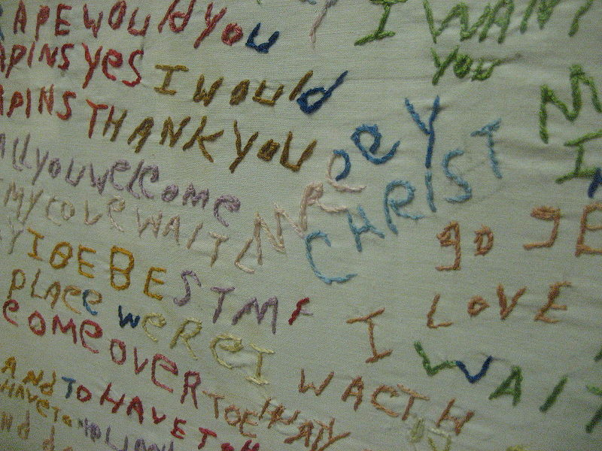
Definition
Embroidered cloth by schizophrenia patient
“Schizophrenia is a mental disorder characterized by a disintegration of thought processes and of emotional responsiveness. It most commonly manifests as auditory hallucinations, paranoid or bizarre delusions, or disorganized speech and thinking, and it is accompanied by significant social or occupational dysfunction.”
Resource: "Schizophrenia." Wikipedia. Wikipedia, n.d. Web. 6 Apr 2011. <http://en.wikipedia.org/wiki/Schizophrenia>.

Slide 5
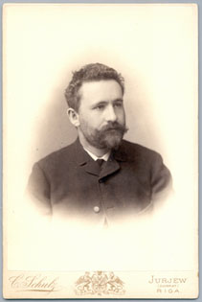
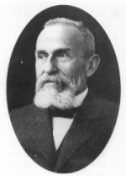
The Early Years of Schizophrenia
First described by Emil Kraeplin in 1896
Separated from manic-depressive illness
“Dementia praecox” syndrome
“Schizophrenia” introduced by Eugen Bleuler in 1911

Slide 6
General Causes of Schizophrenia
Behaves epidemiologically like other complex diseases
Although, genetic factors neither necessary nor sufficient
Therefore, gene + environmental interactions → schizophrenia
Notes:
“Behaves epidemiologically” means that the disease has a tendency to cluster within families
“Other complex diseases” include diabetes and cardiovascular disease

Slide 7
General Causes Continued
Environmental risk factors:
Season of birth
Adverse rearing environments
Urban life stresses during upbringing
Cannabis use
Stress in daily life
Minority position
Notes:
“Cannabis use” is just fancy talk for “marijuana use”

Slide 8
Schizophrenia in the world context
Schizophrenia in an industrialized country vs. developing country
Consider the World Health Organization “Determinants of Outcome of Severe Mental Disorders” Study
Percentage of patients in full remission at the 2 year mark
63% in developing countries
37% in developed countries
Explanation?
Notes:
Explanation could potentially be due to stronger family support and fewer demands on patient, but no exact causation is clear

Slide 9
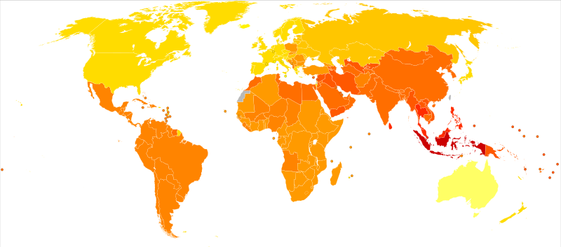
Rates of schizophrenia by country per 100,000 inhabitants
Resource: "Schizophrenia." Wikipedia. Wikipedia, n.d. Web. 6 Apr 2011. <http://en.wikipedia.org/wiki/Schizophrenia>.

Slide 10
Burden of Schizophrenia
Direct effects
Care costs
Indirect effects
Loss of productivity
Disability and premature death
Burden on caregivers
Legal problems and violence

Slide 11
Burden Continued
Disability and premature death
2001 World Health Report
8th leading cause of disability-adjusted life years worldwide
Reduces a person’s life span by 10 years
30% of schizophrenia patients attempt suicide at least once in their lifetime
About 10% of patients die by suicide
Cost
Psychotic disorders = most expensive mental illnesses in terms of costs of care/patient
1.5% (UK), 2% (the Netherlands, France), and 2.5% (USA) of national health expenditures
Notes:
8th leading cause in age group 15-44
30% figure from 1999 Radomsky et al. study
10% figure from 1990 Caldwell and Gottesman study

Slide 12
Symptoms of Schizophrenia
Positive symptoms:
Delusions
Hallucinations
Thought/reality disorders
Negative symptoms:
Poverty of speech
Lack of motivation
Apathy
Inability to express emotions
Cognitive deficits
Alterations of attention, working memory, and executive functions
Positive symptoms < negative symptoms
Notes:
Prior to the discussion of treatment for schizophrenia, it is important to address two distinct classes of symptoms related to the disease
Positive symptoms occur more often in lesser or acute phases as compared to negative symptoms

Slide 13
Treatment of Schizophrenia
Medications
Typical vs. atypical antipsychotics
Psychosocial interventions
Rehabilitation
Notes:
Medications to relieve symptoms and prevent relapse
Typical antipsychotics were the norm over 30 years ago, whereas today atypical antipsychotic drugs have become the norm to treat a variety of psychoses because of their superiority with regard to extra pyramidal symptoms (EPS)
Psychosocial interventions help patients and families cope with illness and aim to prevent relapses
Rehabilitation aims to reintegrate patients into community and help them regain occupational functioning

Slide 14
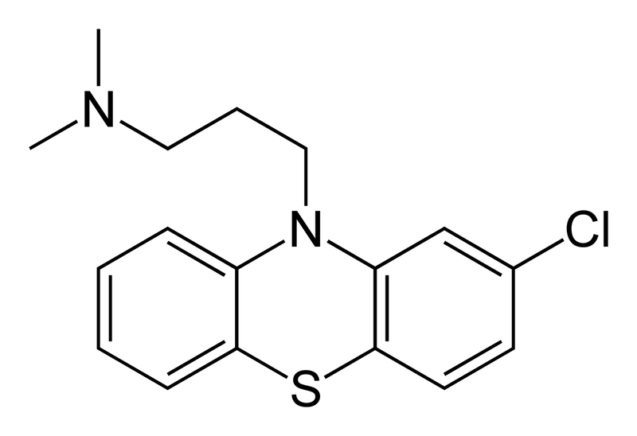
Typical Antipsychotics
Early 1950s: discovery of
chlorpromazine
Pros of chlorpromazine:
Effective in treatment of positive symptoms
Aids in prevention of psychotic relapses
Cons of chlorpromazine:
Persistent symptoms
Modest improvement of negative and cognitive symptoms
Acute (e.g. extra pyramidal side-effects [EPS]) and chronic side effects (e.g. tardive dyskinesia [TD])
Notes:
Development of typical, conventional antipsychotics began with the discovery of chlorpromazine
Persistent symptoms in 25-60% of patients
Became accepted that antipsychotics should also induce EPS

Slide 15
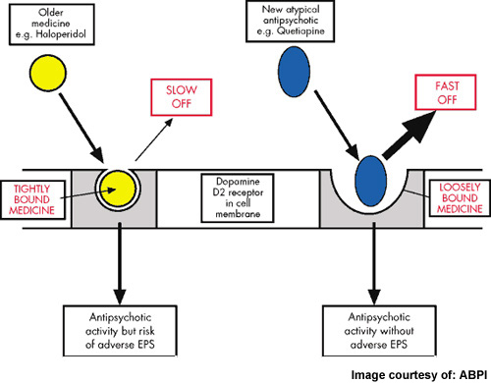
How do typical antipsychotics work?
1976: Two studies confirm that neuroleptics altered dopamine (DA) turnover

Slide 16
How Do Typical Antipsychotics Work? Continued
This DA hypothesis guided neurobiological research of Schizophrenia for 30 years

Slide 17
Atypical antipsychotics
Produce significantly fewer EPS and carry a lower risk of TD
Differ from typicals in mechanism of action, although atypicals do not all share the same mechanism
Prototype of atypical agents = clozapine

Slide 18
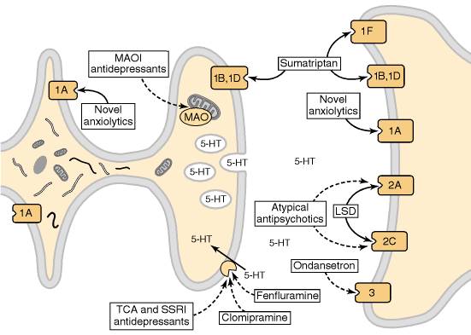
How do atypical antipsychotics work?
Serotonin (5-HT-)-receptor-based mechanisms postulated to play critical role in action of atypical antipsychotics

Slide 19
How do atypical antipsychotics work? Continued

Slide 20
Typical vs. Atypical Antipsychotics
Major difference between these two classes is due to the potent 5-HT2A receptor antagonism + weak D2 receptor antagonism of clozapine and other atypicals from first generation typicals
In addition, while all second-generation antipsychotics work via dopamine and serotonin receptors, each is characterized by a unique pharmacological characteristics, most notably side effects

Slide 21
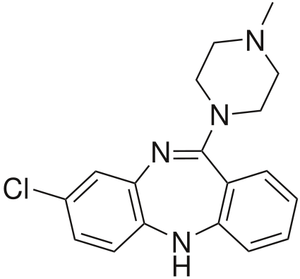
Clozapine
Manufactured in 1959 and first marketed in early 1960s
Withdrawn from market in mid-1970s after Finnish incident + agranulocytosis
Even so, clozapine reintroduced so as to treat people…
Resistant to typical neuroleptics
Compliant with blood monitoring
Improves delusions and hallucinations
Reduces the risk of suicide
Increases cortical dopamine (DA) and acetylcholine release
Various effects on glutamatergic system
Main clinical advantage = nil incidence of EPS
Notes:
Finnish incident refers to 1975 incident when 16 people in Finland developed severe blood reactions causing them to become dangerously susceptible to infection; it was then also discovered that clozapine could produce agranulocytosis in 1 to 2% of all cases (agranulocytosis is a severe lowering of white blood cell count)

Slide 22
Extension of Atypical
Originally, atypical = clozapine
Extended to include characteristics common to recently developed antipsychotic drugs
Absence of hyperprolactinemia
Greater efficacy in treating (+) and (-) symptoms
Absence of TD or dystonia after chronic administration
Notes:
Only clozapine seems to fulfil all of this criteria
If we broaden our definition of “atypical” to mean drugs that produce no or fewer EPS than typical antipsychotics, we are able to include several second-generation antipsychotics such as risperidone, olanzapine, ziprasidone, quetiapine, sertindol, and aripiprazol

Slide 23
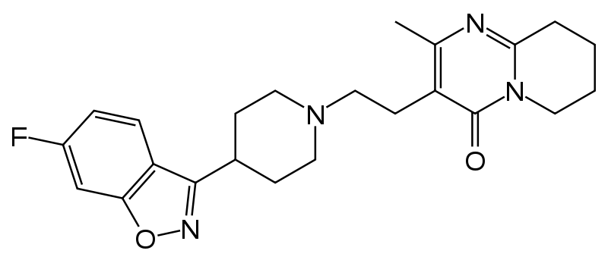
Risperidone
Benzisoxazolic derivative with strong blocking affect on the D2 and 5-HT2 receptors
Stronger effect than haloperidol (= 1st generation APD) but only when administered in doses > 8 mg/day

Slide 24
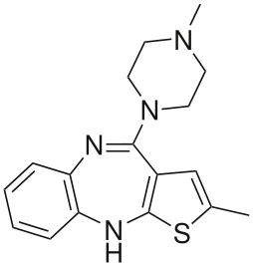
Olanzapine
Tienobenzodiazepine
Affinity for the following binding sites:
Dopamine (D1 – D4)
Serotonergics (5-HT2,3,6)
Muscarinics (sub-types 1 – 5)
Adrenergics (alpha2)
Histaminergics
Greater effect than haloperidol when administered at daily dose of 7.5 – 20 mg
Notes:
When administered at this daily dose level, Olanzapine showed greater effect over Haloperidol in the following ways:
More premature interruptions in treatment for lack of efficacy among patients treated with Haloperidol vs. Olanzapine
Premature interruptions due to adverse effects more so with Haloperidol vs. Olanzapine
Anticholinergics needed more of the time in Haloperidol use vs. Olanzapine use (49% vs. 15%)

Slide 25
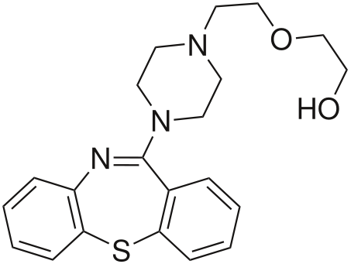
Quetiapine
New antipsychotic
Structurally related to clozapine but no need for blood monitoring
Predominant affinity for 5-HT2 in comparison with D2
Low incidence of EPS (less than 10%)

Slide 26
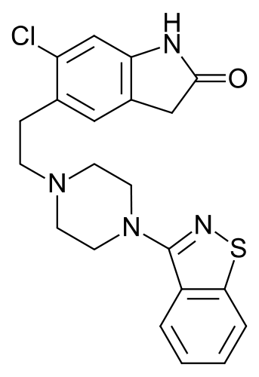
Ziprasidone
Benzotiazolilpiperazine
More affinity for 5-HT2 than D2 receptor
Provokes less EPS than conventional/typical antipsychotics

Slide 27
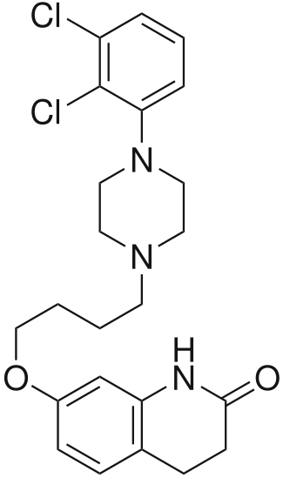
Aripiprazole
One of the newest antipsychotics
Acts as an antagonist as well as an agonist
Lower incidence of EPS as well

Slide 28
Which drug is right for me?
Consider a young, highly agitated young man of normal weight who is highly agitated and has a history of treatment resistance
Clozapine
Low risk for drug-induced obesity
Side effect of sedation
Failure to respond to other antipsychotics
Consider a slightly overweight middle-aged woman who is stable but needs chronic treatment
Risperidone
Less risk of weight gain
Ziprasidone
If patient experiences serious depression
Notes:
A physician must carefully examine each schizophrenia case and decide which second-generation antipsychotic accurately meets their needs; these two case examples will display how a patient’s lifestyle and schizophrenia history can aid a physician in choosing an antipsychotic

Slide 29
Resources
De Oliveira, I.R., and M.F. Juruena. "Treatment of psychosis: 30 years of progress." Journal of Clinical Pharmacy and Therapeutics 31.6 (2006): 523-34. Web. 5 Feb 2011.
Roessler, Wulf, Hans Joachim Salize, Jim van Os, and Anita Riecher-Roessler. "Size of burden of schizophrenia and psychotic disorders." European Neuropsychopharmacology 15. (2005): 399-409. Web. 5 Feb 2011.
"Schizophrenia." Wikipedia. Wikipedia, n.d. Web. 6 Apr 2011. <http://en.wikipedia.org/wiki/Schizophrenia>.
Tamminga, Carol. "Similarities and Differences Among Antipsychotics." Journal of Clinical Psychiatry 64. (2003): 7-10. Web. 6 Apr 2011.
Notes:
In-text citation = (De Oliveira, and Juruena 523-34)
In-text citation = (Roessler, Salize, van Os, and Riecher-Roessler 399-409)
In-text citation = (Tamminga 7-10)

Slide 30
Assigned Reading
De Oliveira, I.R., and M.F. Juruena. "Treatment of psychosis: 30 years of progress." Journal of Clinical Pharmacy and Therapeutics 31.6 (2006): 523-34. Web. 5 Feb 2011.
Only read p. 523 – 527

Slide 31
Reading Questions
In 1980, a distinction was made between two types of schizophrenia. Define type I schizophrenia and type II schizophrenia, as well as the types of symptoms usually experienced within each type of the disease.
What was the first typical antipsychotic developed?
Define atypical antipsychotic drugs.
What was the first atypical antipsychotic developed?

