Slide 1
Antipsychotics for the Treatment of Schizophrenia
Philip Cofoid

Slide 3
Schizophrenia
Prevalence of 0.3% to 0.5% worldwide
Before antipsychotic drugs, the outcome of schizophrenia usually resulted in:
Catatonic states
Institutionalization
Complete debilitation
Antipsychotics have not only made schizophrenia manageable, they immensely improve the quality of life of the patients

Slide 4
Symptoms
Positive
Delusions, hallucinations, lack of insight, & other distortions of reality
Negative
Lack of motivation, speech impairment, lack of initiative, apathy, reduced social drive, & inability to experience pleasure
Cognitive
Intellectual Deficits

Slide 5
Symptoms
Disorganizational
Disorganized thought and behavior
Mood
Abnormal emotional arousal or depression
Motor
Retardation of psychomotor activity & excessive, unconscious motor activity.

Slide 6
Other Problems
Increased mortality rate
High risk of suicide
Reduced level of employment
Social Stigmatism
Overall reduced quality of life

Slide 7
Onset
Patient experiences two or more of the following during a period of one month:
Delusions
Hallucinations
Disorganized Speech and Behavior
Negative Symptoms
Average age of onset
Males – 26 years of age
Females – 31 Years of age
Mostly occurs after puberty and before 50

Slide 8
Long Term Effects
There are varying outcomes of schizophrenia
Perpetuate in a severe defect state
Varying degrees of partial recovery
Complete remission

Slide 9
Causes of Schizophrenia
Studies have indicated genetic predisposition for schizophrenia
The incidence of schizophrenia is increased by certain environmental factors
Urban environment
Low socio-economic status
Migrants and minorities
Obstetric complications
Childhood trauma

Slide 10
Due to a combination of genetic predispositions and environmental factors
Epigenetic
DNA methylation
Histone Modifications
Multiple diseases and causes exhibiting similar symptoms

Slide 11
History
In 1950, French surgeon Henri Laborit wanted to reduce surgical shock
Believed that shock was due to the overuse of anesthesia
Used anti-histamines with sedative effects
Later in 1950, Chlorpromazine was discovered by Paul Charpentier
In 1952, Laborit began to notice a change in mental state of his patients when using Chlorpromazine

Slide 12
Psychiatrists Deniker and Delay began testing the drug on schizophrenic patients
Patients became more managable
In 1954, it was approved by the FDA under the trade name thorazine.
Companies began creating modeled after chlorpromazine
These became known as typical antipsychotics

Slide 13
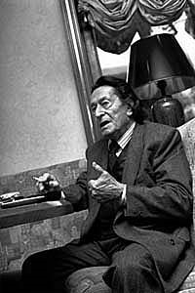
Douter ca ne peut être que bon, le doute ce n’est pas la négation, c’est l’attente de quelque chose d’autre… le doute c’est de ne jamais croire qu’on est arrivé à appréhender l’ensemble.
Doubting can only be a good thing, doubt is not a negation, but the waiting of something else. ... Doubting, it’s believing that we never had understood the whole thing.
– Herni Laborit

Slide 14
In 1974, clozapine was released in Europe, but was quickly withdrawn from the market
It had a side effect of agranulocytosis
Further studies on the drug, led to its re-release in 1991
Lower incidence of extrapyramidal symptoms
Believed to treat negative symptoms
Clozapine was the model for atypical antipsychotics

Slide 15
Antipsychotics
The goal of antipsychotic therapy is to maximize functional recovery of the patient, while minimizing the adverse affects of the drug.
Improve the overall quality of life
Three classes of antipsychotics
1st Generation (Typical)
2nd Generation (Atypical)
3rd Generation (Rational)

Slide 16
Dopamine Hypothesis
Once widely accepted as a model of schizophrenia, has since been deemed at least partially inadequate
Suggests schizophrenia is caused by dopaminergic system dysfunction
Increased dopamine activity within subcortical brain regions
All current antipsychotics block the dopamine D2 receptors
Only addresses the positive symptoms of schizophrenia

Slide 17
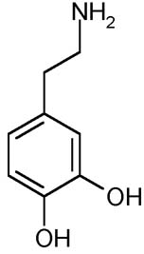
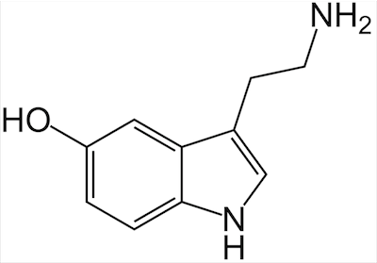
Major Receptor Targets of Current Drugs
Dopamine D2
Antagonism reduces positive symptoms
Serotonin 5-HT2A
Helps to reduce certain side effects
Fine-tunes dopamine output
Other receptors involved:
Dopamine D1, D3, D4, & D5
Serotonin 5-HT1A & 5-HT2C
Muscarinic M1
Adrenergic α1 & α2
Histamine H1

Slide 18
Current Antipsychotics
Only effective in treating the positive symptoms of schizophrenia
Neglect various negative symptoms and cognitive dysfunction
All current antipsychotics inhibit dopamine D2 receptors
Side effects:
Dystonias, akaththisia, parkinsonism, hypotension, seizures, sexual dysfunction, metabolic side effects, agranulocytosis, neuroleptic malignant syndrome, and various others.

Slide 19
First Generation
Classified based on their chemical structure
Antagonists with high affinity for D2 receptors
Higher incidence of side effects known as extra-pyramidal symptoms (EPS)
Movement disorders
Acute dystonic reactions, puedoparkinsonism, & akathisia
Generally cheaper
Off patent drugs

Slide 20
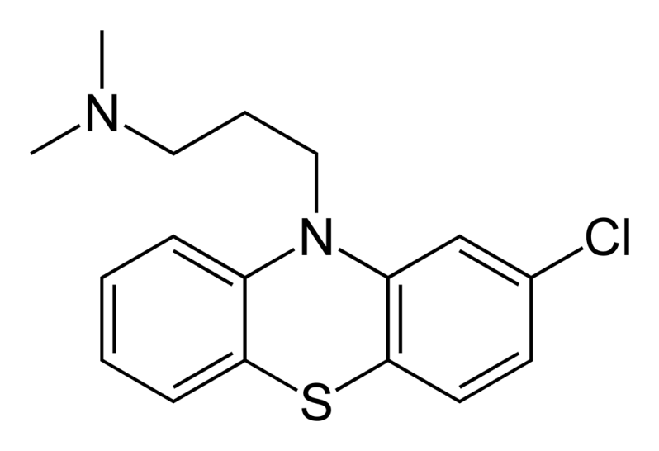
Chlorpromazine (Thorazine)
Phenothiozine Class
Low potency FGA
200-800 mg/day
Very high affinity for D2
High affinity also for 5HT2A, D1, D3, D4, alpha-1, & H1
Moderate affinity for other receptors
“Dirty Drug”

Slide 21
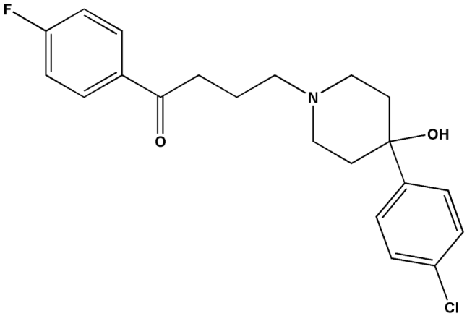
Haloperidol (Haldol)
Butyrophenone Class
High Potency FGA
5-20 mg/day
Most prescribed FGA
Very High Affinity for D2
“Clean Drug”

Slide 22
Second Generation
Classified based on their receptor affinity:
Serotonin/dopamine antagonists
Multi-acting receptor-targeted antipsychotics (MARTA)
D2/D3 Antagonists
Partial dopamine agonist
Overall, a lower affinity for D2 and a higher affinity for the 5-HT2A
Lower incidence of EPS
Higher risk of metabolic side effects and weight gain

Slide 23
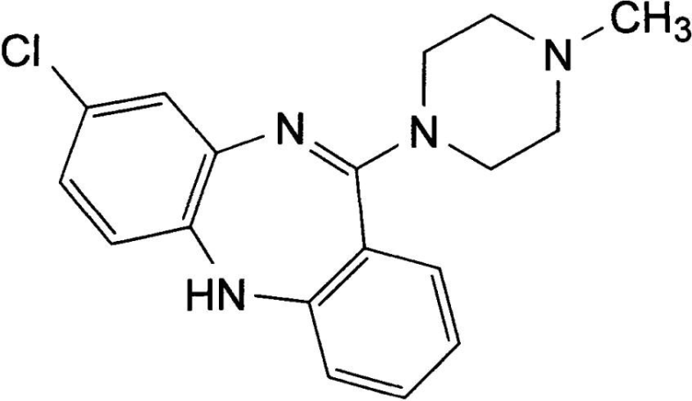
Clozapine
MARTA
Greatest efficacy of current antipsychotics
Risk of lethal agranulocytosis
Used to treat refractory schizophrenia
FDA mandated blood monitoring
Very high 5-HT2A:D2 affinity ratio ≈ 10

Slide 24
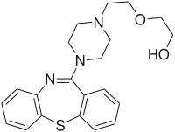
Quetiapine (Seroquel)
MARTA
Currently the most prescribed antipsychotic in the US
Generally consistent efficacy
Low EPS without agranulocytosis
Highest sedating effect of SGAs
Patent expires this year

Slide 25
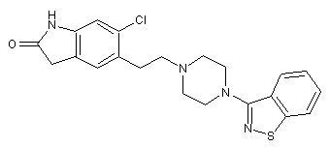
Ziprasidone (Geodon)
Serotonin/Dopamine Antagonist
Highest 5-HT2A selectivity
Can cause heart arrhythmia

Slide 26
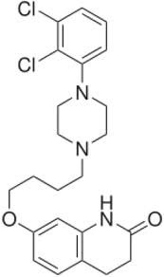
Aripiprazole (Abilify)
Partial Dopamine Agonist
Has high affinity for D2
Activates the receptor, but to a lesser extant than dopamine
Still causes an inhibitory effect

Slide 27
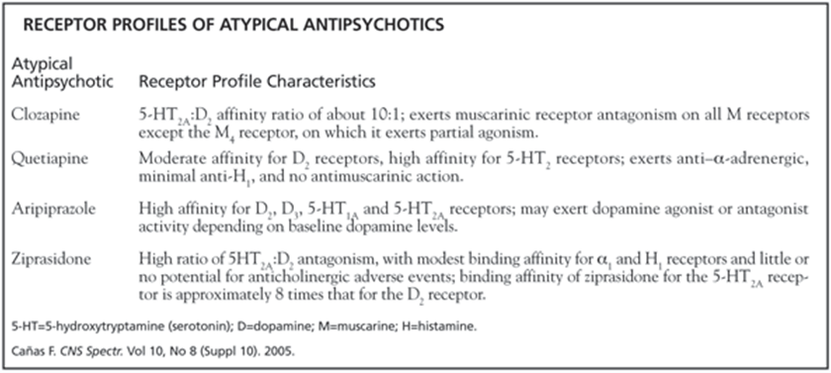

Slide 29
Recent Findings
Recent studies and meta-analysis have shown:
Current antipsychotics only treat positive symptoms
Some may even worsen negative and cognitive symptoms
The advantages and disadvantages of FGAs and SGAs do not apply to all drugs in each class
It is inconclusive whether SGAs have greater efficacy than FGAs for treating positive symptoms
Minimal improvement in efficacy in the past fifty years

Slide 30
Incomplete Hypothesis
DA Hypothesis has been slowly adapted to changing models since its creation
Biggest Problem:
failure to account for negative and cognitive symptoms
Researchers have begun to stray away this hypothesis
Need a more encompassing model

Slide 31
Glumatergic Model
Proposed based on observed clinical actions of PCP and ketamine
Function by blocking N-methyl-D-aspartate-type glutamate receptors (NMDARs)
Suggest a dysfunction of NMDARs in the glutamatergic system for schizophrenia
Greater potential of accounting for the multiple symptoms of schizophrenia

Slide 33
Third Generation
Rationally designed drugs
Based on the glutamatergic and similar models
Developed to stimulate glutamate or NMDAR function

Slide 35
RG1678
Developed by Roche
Currently beginning stage 3 clinical trials
The first antipsychotic drug to show improvement in negative symptoms
Glycine reuptake inhibitor
Inhibits re-absorption of glycine, which normalizes levels of glutamate

Slide 36
QUESTIONS?

Slide 37
READING ASSIGNMENT
Kim DH, Maneen MJ, Stahl SM. Building a better antipsychotic: receptor targets for the treatment of multiple symptom dimensions of schizophrenia. Neurotherapeutics. 2009;6:78-85

Slide 38
PROBLEMS
What are the greatest unmet needs regarding current treatment of schizophrenia?
Inhibition of which receptor causes a reduction in positve symptoms?
What is “hit and run” receptor binding?
Theoretically, how does inhibition of the glycine transports GLYT1lead to solving NMDA hypoactivity?
What side effects are associated with the blockade of the H1 histaminic receptor?

