Slide 1
The Design, Synthesis, and Evaluation of Mechanism-Based β-Lactamase Inhibitors
CWRU 2009

Slide 2
Major Classes of β-Lactam Antibiotics
Potent, broad-spectrum antibiotics
Usually well tolerated
Structural similarities include a negatively charged carboxylate, (usually fused bicylic) β-lactam, and C6 appendage

Slide 3
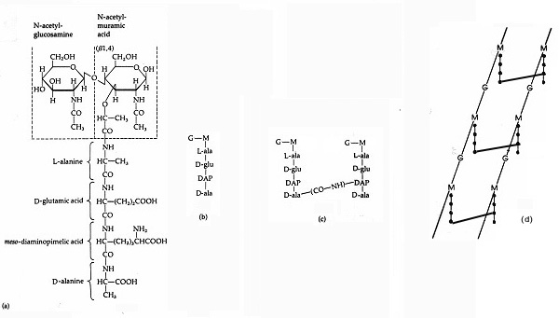
The β-lactam antibiotics interfere with one or more members of a crucial set of bacterial enzymes, known as the penicillin-binding-proteins (PBPs), that are responsible for cross-linking glycan strands through a protruding peptide side chain.

Slide 4
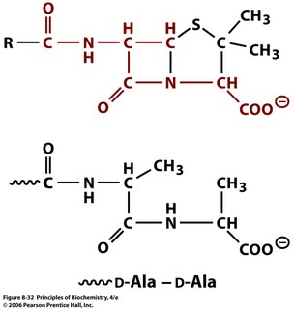
The β-lactam antibiotics are believed to resemble the D-Ala-D-Ala terminus of the pentapeptide side chain (Strominger Hypothesis)
Bacterial transpeptidases cleave between the two D-Ala residues, to form an intermediate acyl-enzyme, which is then reacted with a free amino moiety (e.g. the w amino group of diaminopimelic acid) to form the cross link.

Slide 5
Link

Slide 6
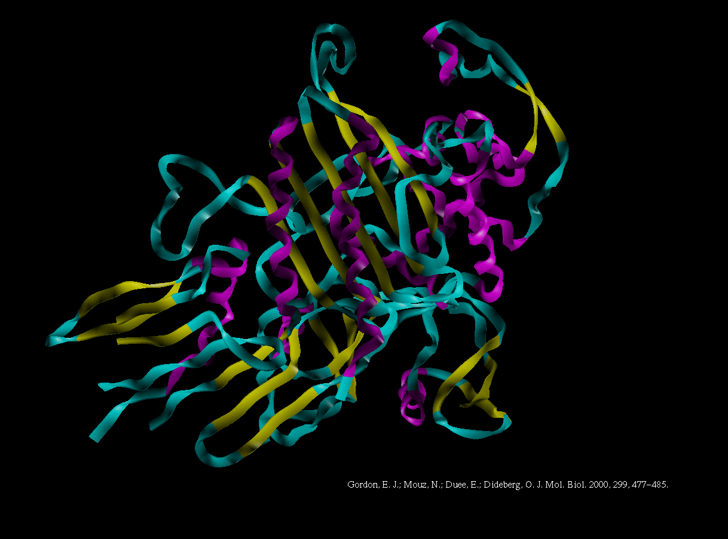

Slide 7
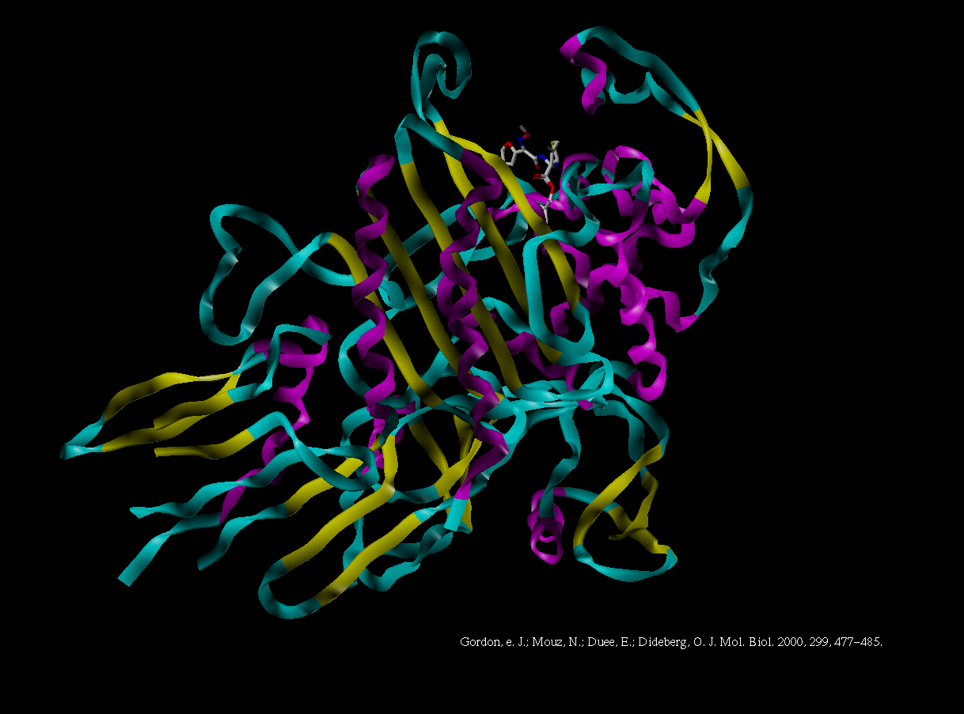

Slide 8
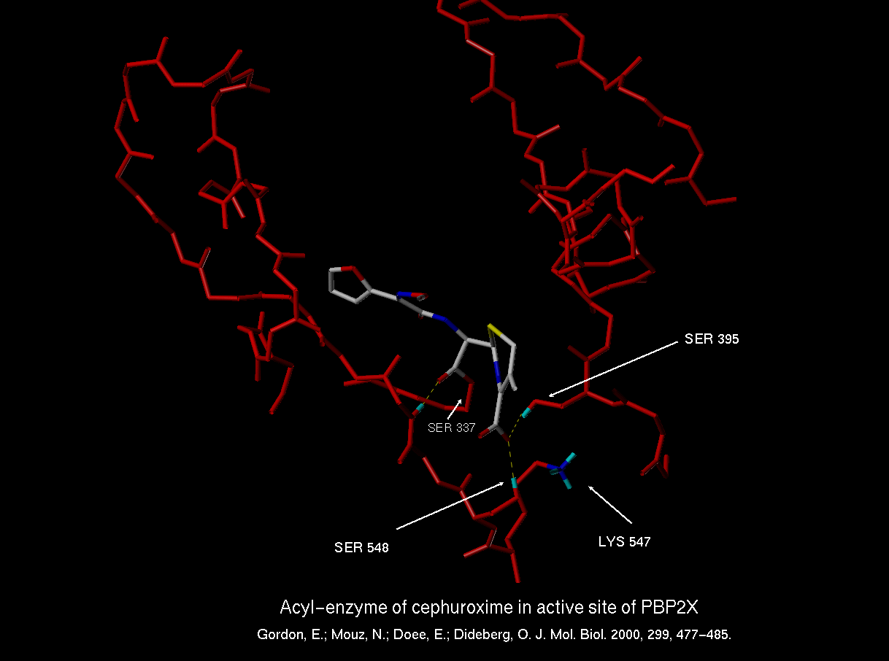

Slide 9
Why are β-lactam antibiotics such good drugs?
β-Lactam antbiotics still comprise approximately half the commercial antibiotic market.
Formation of a covalent bond to the target(s) may be an effective strategy for avoiding resistance due to point mutations which lower affinity
Targeting the bacterial cell wall avoids the necessity to accumulate in cytoplasm, thus avoiding efflux pumps.
β-lactams do not penetrate most mammalian cell types, resulting in low toxicity (disadvantage when treating atypicals)
Most commonly observed resistance is due to production of β-lactamase(s)

Slide 10
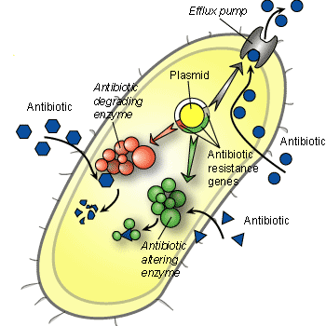
Resistance to β-Lactam Antibiotics
Production of one or more enzymes (β-lactamases) that hydrolytically destroy β-lactam antibiotics
Produce PBPs that do not recognize penicillin
In the case of Gram-negative strains delete outer membrane porins, which are responsible for the allowing the β-lactams to reach the periplasm and hence the cell wall
In the case of Gram-negative strains, upregulate efflux pumps, which are responsible for pumping out foreign substances (including β-lactams).
Action of Serine β-Lactamases

Slide 11
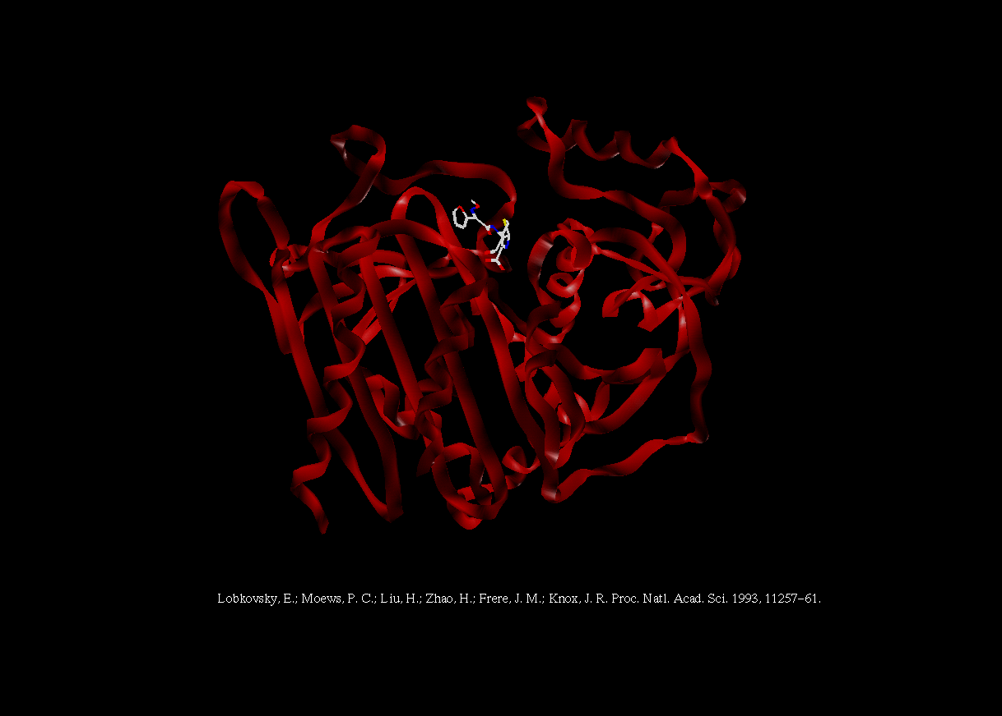

Slide 12
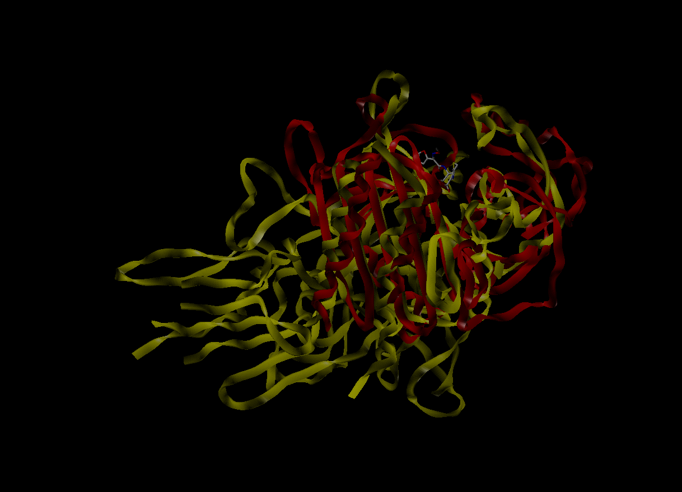

Slide 13
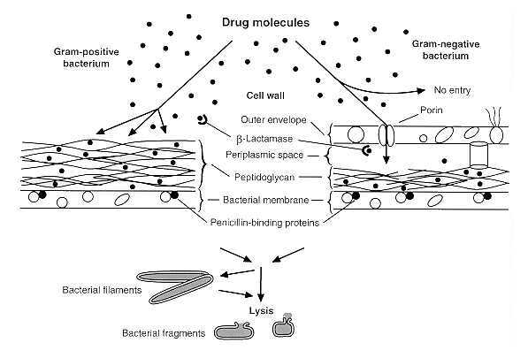
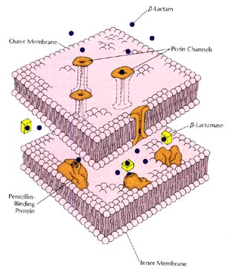
The β-Lactamases
More than 600 different β-lactamases, grouped into four classes A-D
Classes A, C, and D are serine enzymes
Class B are zinc metalloenzymes
Historically, the class A (serine) enzymes were the most prominent
Can be produced in large quantity (hyperexpressed)
Produced in the periplasm of Gram-negative organisms, or extracellularly in Gram-positive strains.

Slide 14
Bulky
group
Enzyme
One early strategy for countering β-lactamase mediated resistance was to design β-lactam antibiotics which would also be poor β-lactamase substrates.
This was achieved by incorporating sterically large substituents at C6 (penicillin) or C7 (cephalosporin).

Slide 15
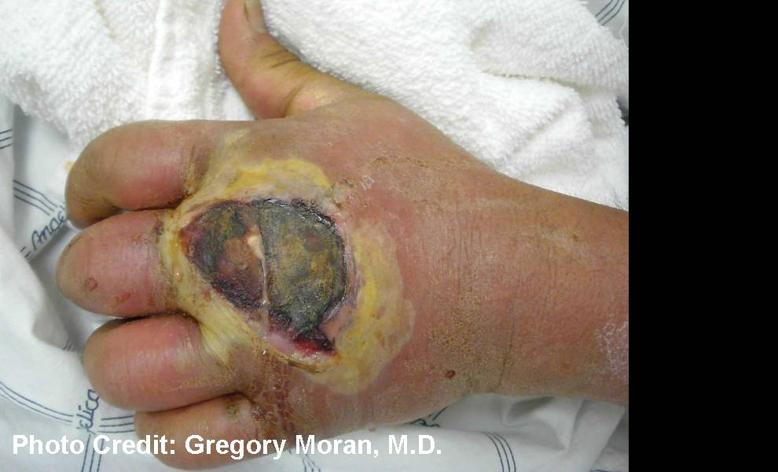
Methicillin-resistant Staphylococcus aureus
MRSA
Unfortunately, this gave rise to new forms of resistance, such as the appearance of a penicillin binding protein with reduced affinity for all β-lactam antibiotics (PBP2a in MRSA) and also the appearance of β-lactamases with enlarged active sites (extended spectrum β-lactamases or ESBLs) that could accommodate the larger antibiotics.

Slide 16
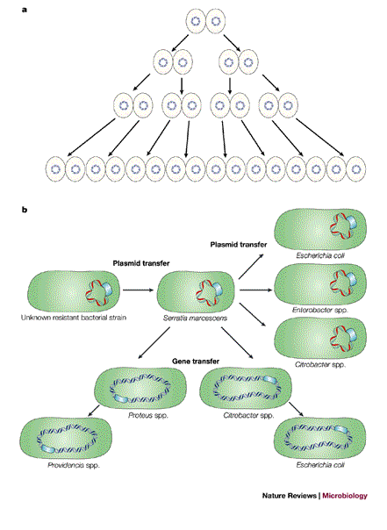
Recent Trends in β-Lactamase-mediated Resistance
Broad spectrum β-lactamases, known as extended spectrum β-lactamases (ESBLs) capable of hydrolyzing third generation cephalosporins, are disseminated widely (e.g. class A, CTX-M)
Class C β-lactamases (AmpC) are more widely disseminated, now including many plasmid-mediated AmpCs (e.g. FOX and CMY)
Classes A and D enzymes have evolved the ability to hydrolyze the carbapenem class of antibiotics. These serine carbapenemases are increasingly widespread (e.g. KPC).
Class B metallo-β-lactamases are disseminating widely. These enzymes were originally seen in Asia and in Europe, but cases of resistance due to class B β-lactamases are now appearing in the US (e.g. IMP and VIM).

Slide 17
Current Commercial β-Lactamase Inhibitors
A second approach was to develop inhibitors of β-lactamase
Unfortunately, current commercial inhibitors target only class A enzymes

Slide 18
Since the inhibitors have no independent antibacterial activity (i.e. ability to bind PBPs), they must be coadministered with β-lactam antibiotics

Slide 19
How do these commercial inhibitors work?
Placing sulfur at the sulfone oxidation state predisposes the thiazolidine ring to fragment, producing the iminium ion shown above.
The iminium ion can then tautomerize to the β-aminoacrylate, or be captured by a second active site serine, producing in both cases, a stabilized acyl-enzyme.

Slide 20

How can we build a better mousetrap?
Irreversible inhibitors offer numerous opportunities for improving the inhibitory efficiency.

Slide 21
The Inhibitor Design Process
enzymatic mechanism
active site dimensions and binding characteristics
synthetic feasibility
generate a library of prospective inhibitors
Assay against
all relevant enzymes

Slide 22
Initially we focused on designing inhibitors which held the potential to quickly form very stable acyl-enzymes.
Focus Here

Slide 24
IC50 Values against the class C β-lactamase derived from Enterobacter cloacae, strain P99

Slide 25
Further mechanistic investigations uncovered an isotope effect on the rate of inactivation. A mechanism consistent with this observation is shown below.
Stabilized
Acyl-Enzyme

Slide 26
New chemical methodology facilitated the preparation of new inhibitors.

Slide 27
The availability of 6-oxopenicillanate simplifies the synthesis of 6-alkylidene penams, as shown.

Slide 28


Slide 32
Table 1. Inhibitory activity on Three Representative Serine β-Lactamases IC₅₀ (μM)
R¹ | R² | P99 | TEM-1 | PC1
None (Tazo) | CH₂C₂H₂N₃ | 51.9 | 0.297 | 2.57
CO₂Na | CH₃ | 4.50 | 1.8 | 108
CO₂Na | CH₂O₂CCH₃ | 0.708 | 0.180 | 76.53
CO₂Na | CH₂O₂CCH₂Cl | NT | 0.196 | 7.2
CO₂Na | CH₂O₂CH | 0.592 | 1.84 | 173
CO₂Na | CH₂O₂CCH₂Ph | 0.54 | 0.0154 | 579.0
CO₂Na | CH₂O₂CCH₂3’,4’-C₆H₃(OH) ₂ | 0.37 | 0.105 | 116
CO₂Me | CH₂O₂CCH₃ | 9.51 | 2.72 | NT
CO₂NH₂ | CH₂O₂CH₃ | 8.48 | 0.31 | 2.21
CO₂Na | CH₂Cl | 527.0 | 120.5 | 2100
CO₂Me | CH₂Cl | 13.91 | 44.51 | 432
CO₂Na | CH=CHCN | 6.76 | 21.67 | 504
CO₂Na | CH₂O₂CCH₂-S-tet | 0.64 | 0.233 | NT
CO₂Me | CH₂O₂CCH₂-S-tet | 13.2 | 2.37 | 939.7
α’-pyr | CH₂O₂CCH₃ | 0.062 | 0.004 | 0.66
α’-pyr | CH₂O₂CCH₂Ph | 0.001 | 0.04 | 0.39
α’-pyr | CH₂O₂CCH₂-3’,4’-C₆H₃ (OH) ₂ | 0.026 | 0.06 | 0.7
Buynak, J. D. et. al. BMCL 1999, 9, 1997-2002.

Slide 33
 | Piperacillin | PIP:TAZ | PIP:JDB/LN-1-255
P. aeruginosa Ps505A1 (AmpC derepressed) | >64 | 16 | 2
A. sobria ((Asb A, OXA-12, AsbM) | 64 | 64 | 1
S. marcescens GC 4132 (Amp C, in vivo) | 64 | 32 | 4
E. coli C600N (no b-lactamase) | 2 | 2 | 1
E. coli C600N +(TEM-1) | >64 | 4 | 2
E. coli C600N + (IRT – 2) | >64 | 8 | 2
E. coli C600N + (SHV – 4) | >64 | 2 | 2
E. coli C600N + (PSE – 1) | 32 | 1 | 2
E. coli C600N + (OXA-10) {PSE-2} | >64 | 2 | 2
E. coli C600N + (MIR-1) | 64 | 8 | 8
E. coli C600N + (Imi-1) | >64 | 16 | 8
E. coli 300 + (TEM-1) | >64 | 4 | 1
E. coli 300 + (ampRampC) | 16 | 4 | 2
K. Pneumoniae KC 2 (TEM-10) | >64 | 2 | 4
E. coli GC6265 (TEM-1, in vivo) | >64 | 4 | 4

Slide 34
Inhibition of Representative β-lactamases (IC₅₀, μM)
Inhibitor | TEM-1 E. Coli | AmpC P. aeruginosa | AmpC A. baumannii | OXA-40 A. baumannii | In serum AmpC P. aeruginosa
JDB/SA-3-18 | 0.0004 | 0.008 | 0.017 | 0.0060 | 0.012
JDB/SA-4-11 | 0.00010 | 0.185 | 0.191 | 0.191 | 0.028
JDB/SA-4-17 | 0.00003 | 0.012 | 0.020 | 0.007 | 0.014
JDB/SA-4-141 | 0.0002 | 0.065 | 0.071 | 0.583 | 0.029
JDB/SA-4-157 | 0.0006 | 0.201 | 0.515 | 0.888 | 0.080
JDB/SA-4-196 | 0.0001 | 0.006 | 0.015 | 0.046 | 0.003
JDB/SA-4-198 | 0.0001 | 0.039 | 0.052 | 0.079 | 0.015
JDB/LN-1-255 | 0.00003 | 0.006 | 0.004 | 0.011 | 0.082

Slide 35
Synergy of Inhibitors with Imipenem Against Resistant P. aeruginosa
 | Imipenem (mg/L) | JDB/SA-3-18 (mg/L) | JDB/SA-4-11 (mg/L) | JDB/SA-4-17 (mg/L) | JDB/SA-4-141 (mg/L) | JDB/SA-4-157 (mg/L) | JDB/SA-4-196 (mg/L) | JDB/SA-4-198 (mg/L) | JDB/LN-1-255 (mg/L)
MIC | 20 | 0 | 0 | 0 | 0 | 0 | 0 | 0 | 0
0.5 MIC | 10 | 12.5 | 25 | 25 | 12.5 | 3.125 | 6.25 | 12.5 | 6.25
0.25 MIC | 5 | 100 | 50 | 50 | 25 | 12.5 | 12.5 | 25 | 25
0.125 MIC | 2.5 | 100 | 100 | 100 | 25 | 25 | 12.5 | 50 | 50
0.0625 MIC | 1.25 | >100 | >100 | >100 | 50 | 50 | 25 | 100 | 100
0.0313 MIC | 0.625 | >100 | >100 | >100 | >100 | >100 | >100 | >100 | >100

Slide 36
Inhibition of β-Lactamase (IC50 μM)
R | Escherichia coli W3310 (Class A) | Enterobacter cloacae P99 (Class C)
t-butylmethylidene (allene) | >2000 | 11.8
α-pyridyl | 44 | 1.30
CO2But | 0.28 | 429
tazobactam | 1.37 | 51.9
clavulanic acid | 3.3 | >2000

Slide 37
Initial attempts to improve the cephalosporin series of β-lactamase inhibitors relied on analogy with the cephalosporin antibiotics themselves.

Slide 38
But these efforts resulted in an abysmal failure!

Slide 39
Since the charge neutral pyridine moiety is a better leaving group than the negatively charged acetate, it is more likely to follow pathway 1 above.
Yet all the inhibitory mechanisms we have proposed follow pathway 2.

Slide 40
Type | R1 | R2 | TEM-1 | PC1 | P99 | GC1
Tazo |  |  | 0.32 | 2.8 | 49.8 | 3.4
I | 2’-py | E-CH=CH-CN | 0.014 | 0.72 | 0.01 | 0.012
I | 2’-py | E-CH=CHCO₂Me | 0.02 | 0.30 | 0.20 | 0.30
I | 2’-py | E-CH=CHCONH₂ | 0.09 | 0.10 | 0.026 | 0.01
I | 2’-py | Z-CH=CClCO₂Me | 0.07 | 1.4 | 0.90 | 0.18
I | 2’-py | E-CH=CH-CH=CH₂ | 68 | 75 | 24 | NT
I | 2’-py | E-CH=CHCO₂But | NT | 240 | 1.48 | NT
I | 2’-py | E-CH=CHCO₂Na | 2.5 | 31 | 0.31 | NT
I | 2’-py | E-CH=CHNO₂ | 0.07 | 0.20 | 0.02 | 0.10
I | 2’-py | E-CH=CH-2’-py | 0.20 | 4.3 | 0.18 | NT
I | 2’-py | E-CH=CH-2”py-N-ox | 0.006 | 8.6 | 0.60 | 0.10
I | 2’-py | CN | 2.34 | 280 | 0.029 | NT
I | 2’-thzl | E-CH=CHCONH₂ | 0.90 | 154 | 0.29 | NT
II | 2’py | E-CH=CHCO₂Me | 2.9 | 6.0 | 0.03 | 0.06
II | 2’-py | E-CH=CH-CO₂But | NT | NT | 440 | 150
II | 2’-py | E-CH=CHCO₂Na | 2.5 | NT | 6.60 | NT

Slide 41
R | TEM-1 Inhibition IC₅₀, μM | P99 Inhibition IC₅₀, μM
Tazobactam | 0.25 | 101.6
CH=CH-CONH₂ | 0.2615 | 0.022
CH=CH-CONHCH₂CF₃ | 0.078 | 1.18
CH=CH-CONHCH₂CH₂OH | 0.0701 | 0.212
CH=CH-CONHCH(CH₂) ₂ | 0.240 | 0.824
CH=CH-CONH-CH₂CH₂ (CN₃H₄) | 0.0083 | 0.0055
CH=CH-CONHOH | 7.69 | 0.128
CH=CH-CONHC₆F₅ | 4.28 | 0.127
CH=CH-CON(CH₂CH₂) ₂NMe | 0.053 | 6.34
CH=CH-CONHCH ₂Ph | 1.4 | 0.11
CH=CH-CONHNH ₂ | 0.39 | 1.1
CH=CH-CO-NHC ₆H₄OH | 0.11 | 0.035
CH=CH-CONHCH ₂CO ₂Na | 4.2 | 0.31
CH=CH-CONH(CH ₂) ₃NH ₂ | 1.59 | 4.2

Slide 42
How do my inhibitors work?
Intramolecular capture of intermediate imine is more efficient than intermolecular capture (and/or tautomerization)
Inhibitors tend to be more general to all (serine) β-lactamases, since inhibitory mechanism does not depend on enzyme active site groups

Slide 43
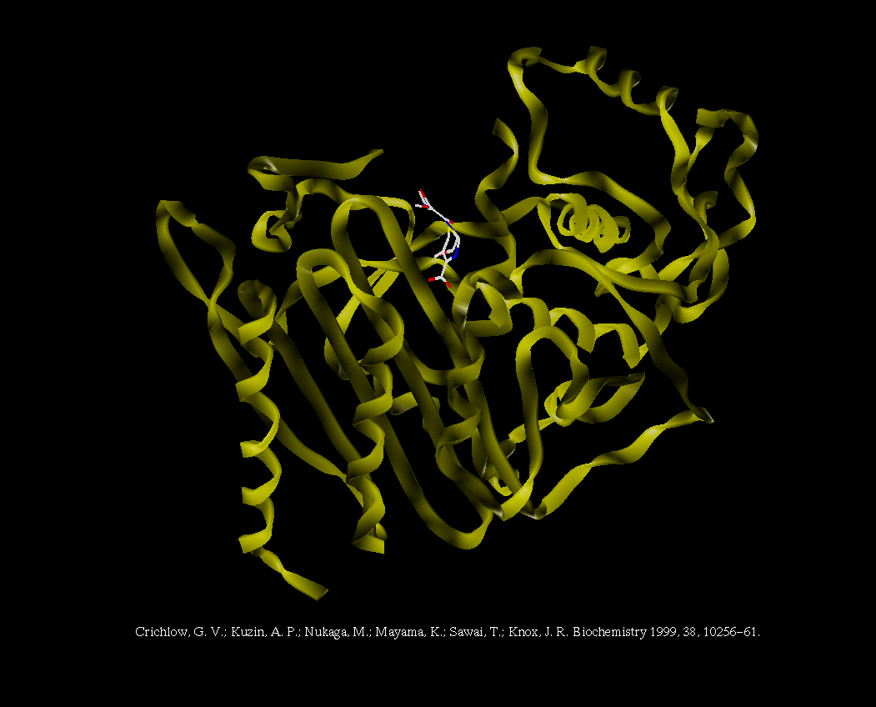

Slide 44
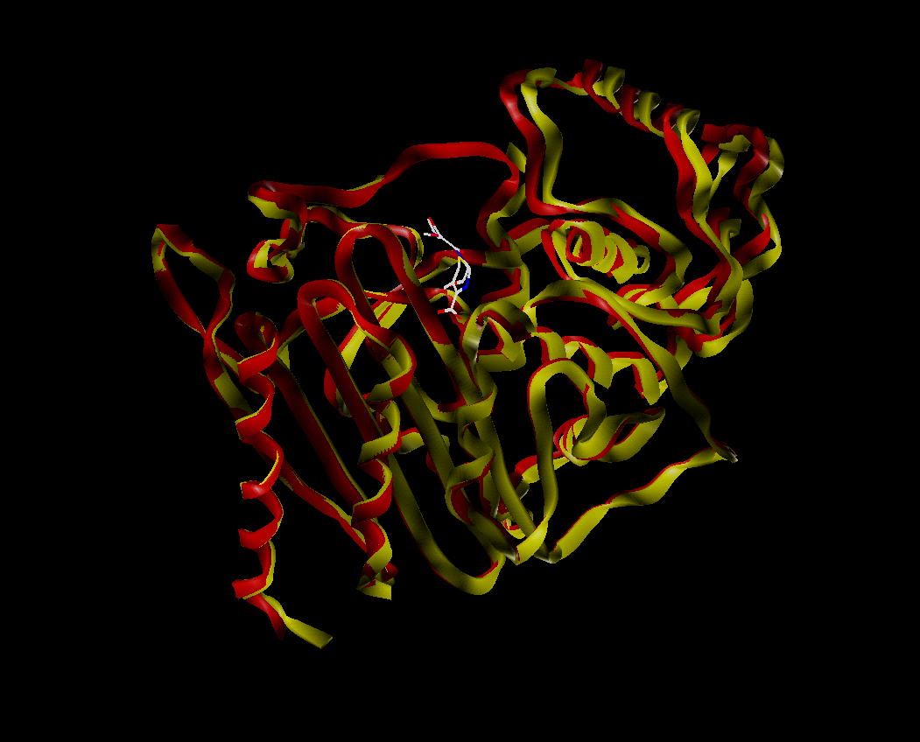

Slide 45
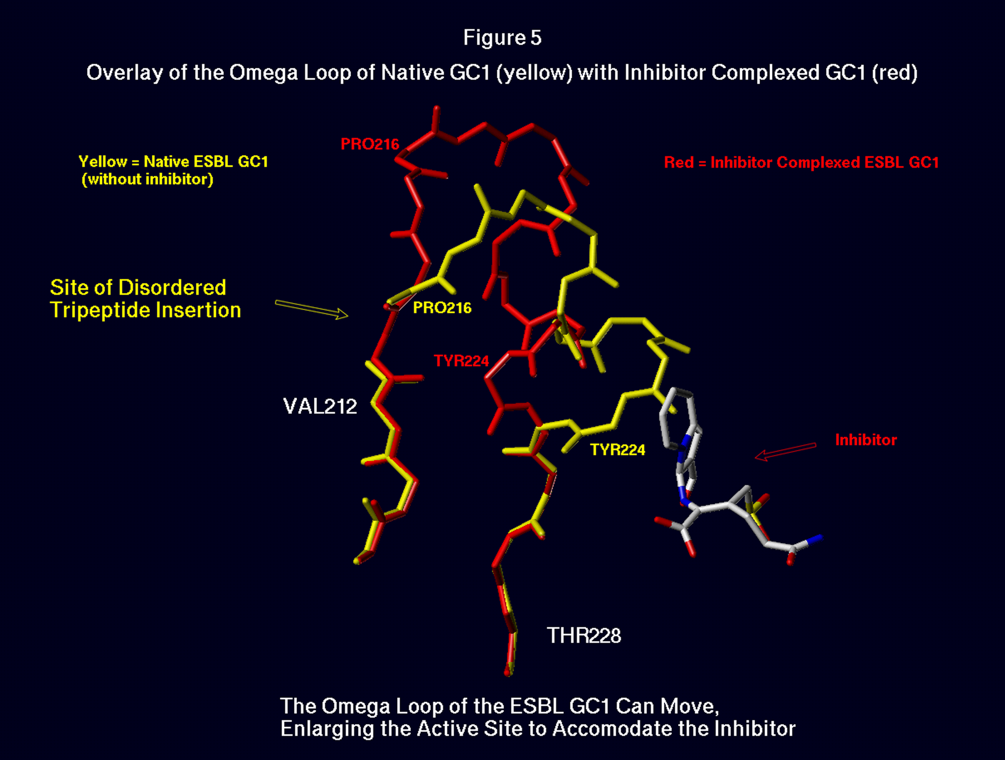

Slide 46
Next goal: Prepare penicillin-derived inhibitors of metallo-β-lactamases
Problem: Metallo-β-lactamases are still a small portion of total number of β-lactamase producing strains
Solution: Prepare a single molecule that can function as dual inhibitor of both metallo- and serine-β-lactamases.
Problem: Metallo and serine β-lactamases have profoundly different mechanisms of action.

Slide 47
Proposed series of events involved in the hydrolysis of a cephalosporin substrate by the L1 metallo-β-lactamase.

Slide 48
Inhibiting metallo-β-lactamases
Like most metalloenzymes, metallo-β-lactamases are inactivated by good zinc chelators.
Potential problem is that zinc chelating agents would likely be nonspecific, thus resulting in toxicity.
Solution: Generate a zinc chelating moiety that relies on the action of the enzyme itself to achieve optimal inhibitory activity (i.e. generate a mechanism-based metalloenzyme inhibitor).

Slide 49
Proposed Mechanism-based Inhibitors of the Zinc Metallooenzymes

Slide 55
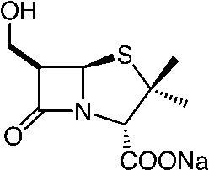
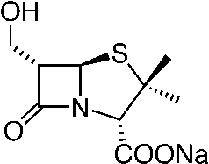
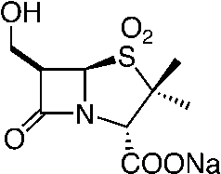
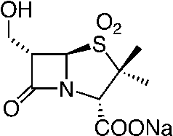
Inhibition of Serine and Metallo-β-lactamases IC₅₀ (μM)
Compound | TEM-1 (class A) (Serine) | P99 (class C) (Serine) | L1 (class B) (Metallo) | BCII (Class B) (Metallo)
Tazobactam | 0.122 | 53.2 | >200 | >200
 | 752 | 409 | >200 | >200
 | 275 | 96.2 | >200 | >200
 | 0.65 | 3.9 | 72.3 | >200
 | 14.6 | 10.0 | >200 | >200

Slide 56
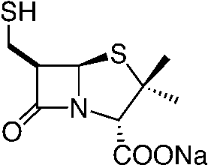
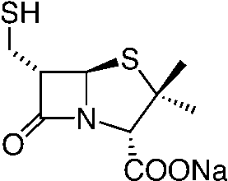
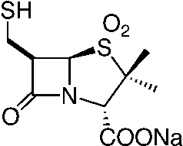
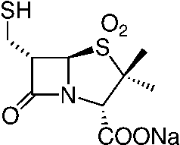
Inhibition of Serine and Metallo-β-lactamases IC₅₀ (μM)
 | TEM-1 (class A) (Serine) | P99 (class C) (Serine) | L1 (class B) (Metallo) | BC1 (Class B) (Metallo)
Tazobactam | 0.122 | 53.2 | >200 | >200
 | 601 | 0.10 | 32.1 | 2.9
 | 648 | 3.75 | 10.9 | 1.7
 | 6.8 | 10.5 | 0.10 | 1.4
 | 51.7 | 7.5 | 0.30 | 2.0

Slide 57
Van den Akker Strategy: Stabilize the E-β-aminoacrylate intermediate in the active site.
Focus Here
Focus Here
  Designed by analogy with acyl-enzyme of Tazobactam.
  This should result in an acyl-enzyme with increased affinity for the site.
  May retain occupancy of the site subsequent to hydrolysis of the covalent ester linkage of the acyl-enzyme.

Slide 58
Design a 2’-substituent that stabilized the E-form of the β-aminoacrylate

Slide 62
Thanks to my collaborators:
Robert Bonomo
Paul Carey
Marion Helfand
Focco van den Akker
And my funding sources:
Robert A. Welch Foundation
National Institutes of Health

