Slide 1
Carbanions: Formation and Reactions Part 1

Slide 2
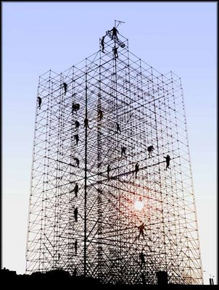
The C-C bonds of a molecule under construction constitute its scaffolding. Reactions which form new C-C bonds are exceptionally useful synthetically. SN2 reactions, which use a carbanion as a nucleophile represent one solution to this problem.

Slide 3
General Types of Carbanions

Slide 4
Formation of Stabilized Carbanions
Note that, for this reaction to succeed, the carbanion must be a weaker base than the base employed to deprotonate its conjugate acid.

Slide 5
Bases often used to form (stabilized) carbanions
Increasing Basicity

Slide 6
Formation of Alkynyl Anions (can be formed by deprotonation)

Slide 7
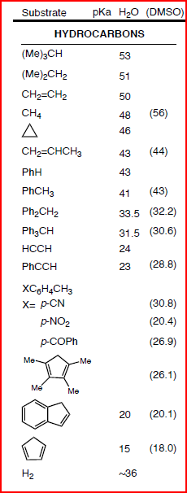
Alkynes

Slide 12
Reactions of Alkynyl Anions

Slide 14
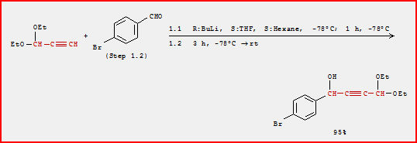

Slide 17
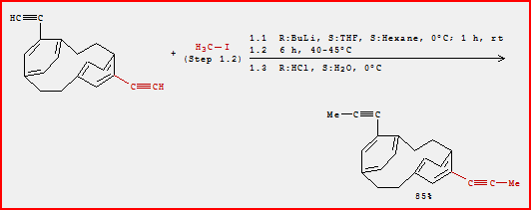

Slide 18
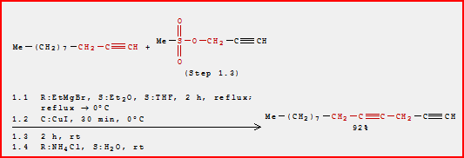

Slide 19
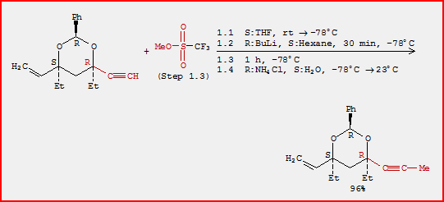

Slide 20
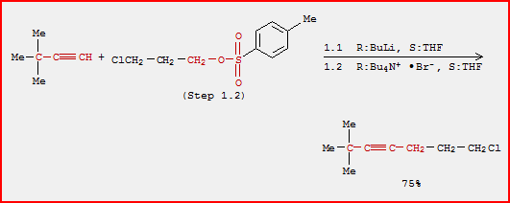

Slide 24
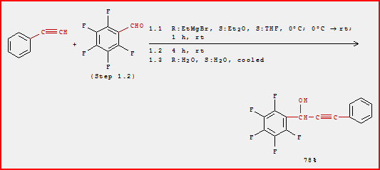

Slide 26
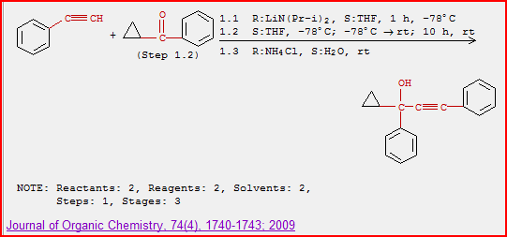

Slide 27
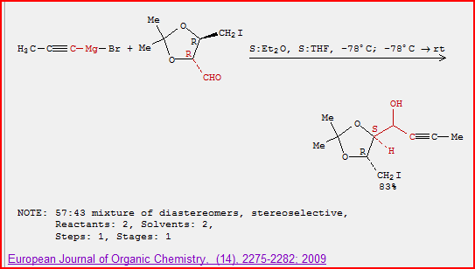

Slide 28
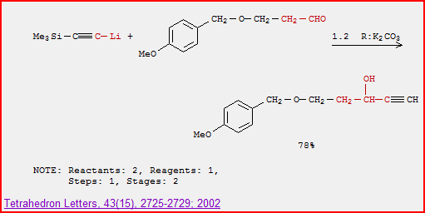

Slide 29
Other Carbanions Formed by Deprotonation
(Enolate Anions)

Slide 30
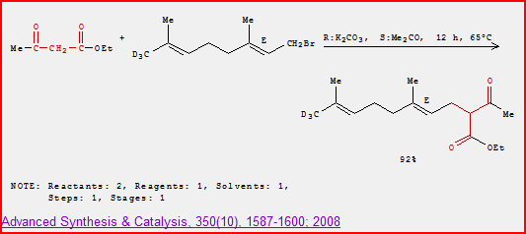

Slide 31
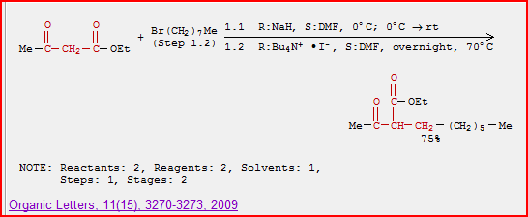

Slide 32
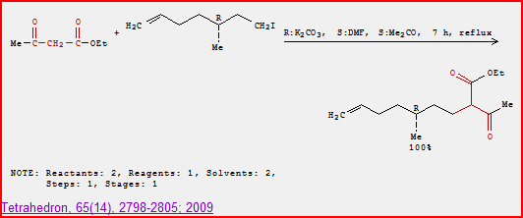

Slide 33
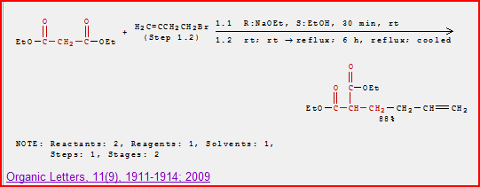

Slide 34
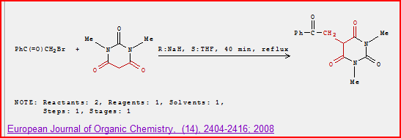

Slide 35
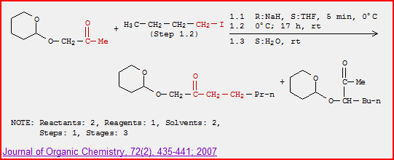

Slide 36
Grignard and Organolithium Species
(Unstabilized Carbanions)

Slide 37
Formation of Organometallics by Reaction of Organohalides with Magnesium and Lithium Metal

Slide 38
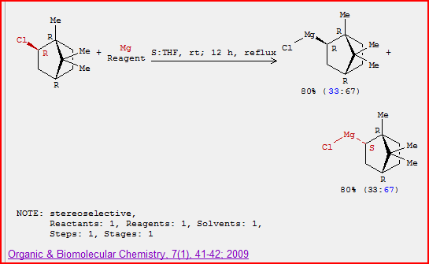

Slide 39
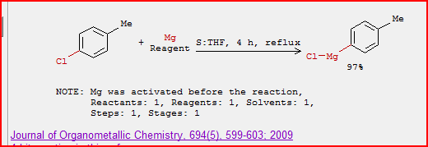

Slide 42
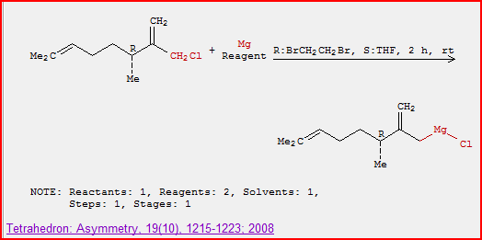

Slide 45
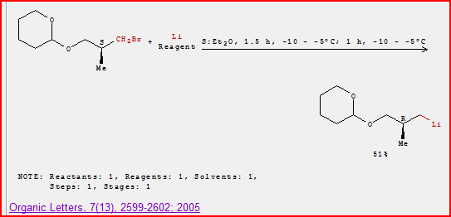

Slide 46
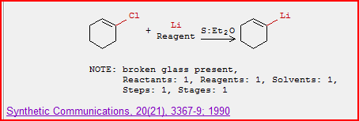

Slide 48
Formation of Carbanions by Halogen-Metal Exchange Reactions
This works when R’-M is a more stable organometallic (carbanion) than R-M.
This reaction is often used to form vinyl- and aryl- carbanions, where the sp² hybridized orbital has more ‘s-character’ than the starting sp³ hybridized orbital.

Slide 50
Formation of Organometallics by Halogen-Metal Exchange

Slide 52
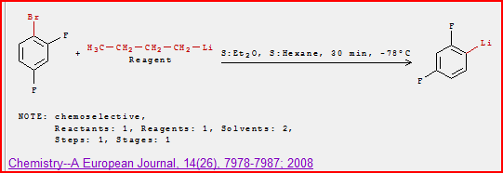

Slide 53
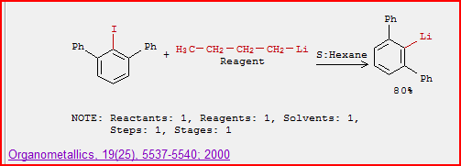

Slide 54
Reactions of Organomagnesium and Organolithium Species

Slide 55
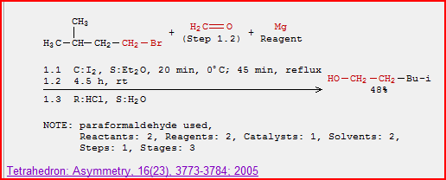

Slide 56
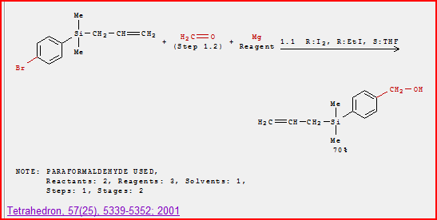

Slide 57
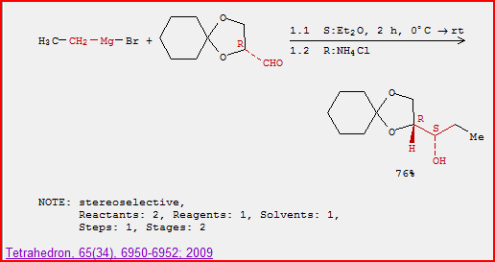

Slide 58
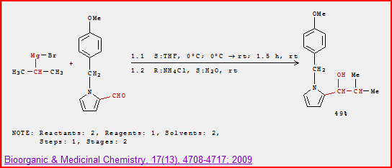

Slide 59
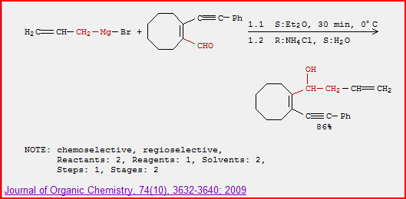

Slide 60
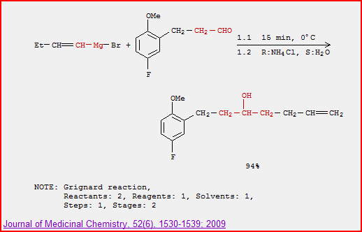

Slide 61
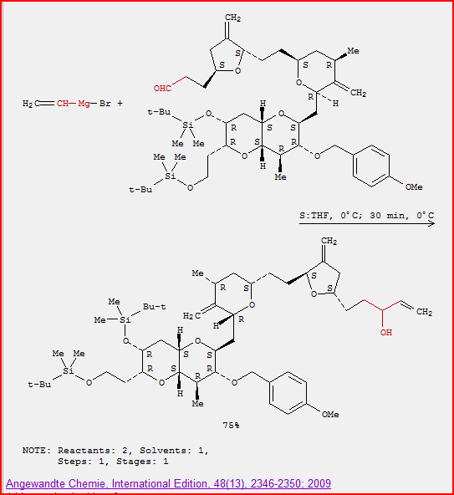

Slide 62
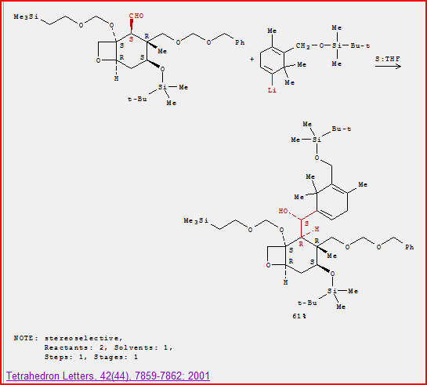

Slide 63
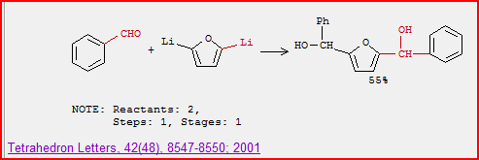

Slide 64
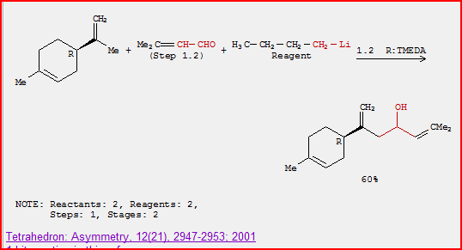

Slide 65
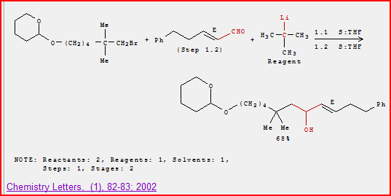

Slide 66
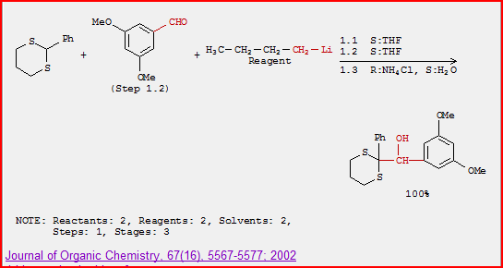

Slide 67
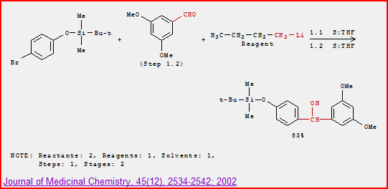

Slide 68
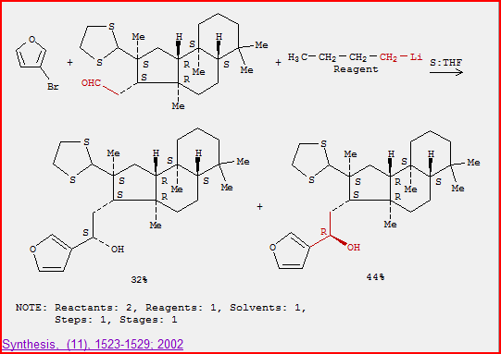

Slide 69
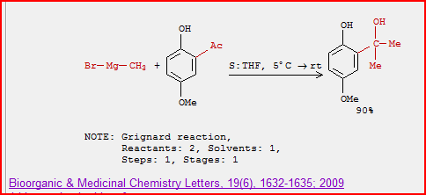

Slide 70
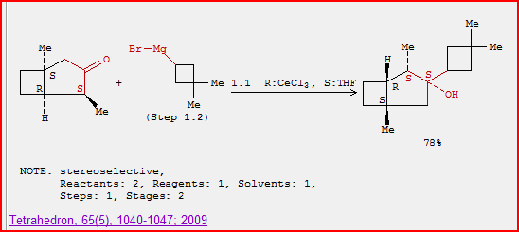

Slide 72
