Slide 1
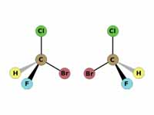
Configuration

Slide 2
Configuration
While conformational isomers are interconvertable through rotations about single bonds, configurational isomers require bond-breaking and reforming for interconversion.
Stereoisomers have identical connectivity, but differ in how the atoms of the molecule are arranged in three-dimensional space.

Slide 3
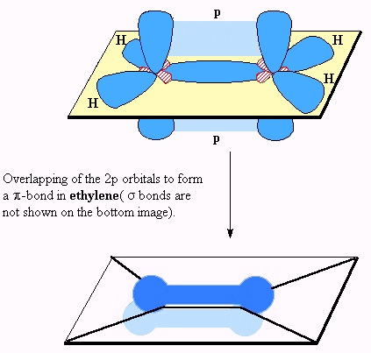
The simplest such system is the isomers of a double bond.
High energy barrier to this type of rotation
Free rotation does not occur about the C=C, due to the fact that such a rotation would necessarily align the two p orbitals in an orthogonal fashion, rather than parallel to one another.
Such a deformation of a simple double bond would involve overcoming an energy barrier of approximately 65 kcal/mole.

Slide 4
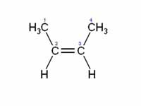
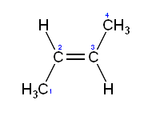
2-Butene, for example, can exist in cis or trans form (not interconvertable). But assigning cis or tans becomes difficult in some cases as seen below.
Cis-2-butene
Trans-2-butene

Slide 5
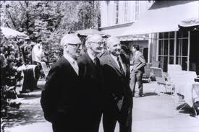
An alternate system of double bond nomenclature uses the letters E (entgegen, opposite) and Z (zussamen, together), to classify the double bond geometry.
The decision as to classify the double bond as E or Z, utilizes the Cahn-Ingold-Prelog priority system to prioritize the relevant substituents.
Vladimir Prelog with R. S. Cahn,
And Sir Christopher Ingold at the 1966 Burgenstock Conference.
Cahn-Ingold-Prelog Prioritization Rules
Elements of higher atomic number receive higher priority.
When there is a tie in atomic number, use substituents at the second position to break the tie. If still a tie, move to third position, etc. to break the tie.

Slide 7
Cahn-Ingold-Prelog Prioritization Rules
Elements of higher atomic number receive higher priority.
When there is a tie in atomic number, use substituents at the second position to break the tie. If still a tie, move to third position, etc. to break the tie.
In the case of a double bond, split the double bond down the middle, and prioritize each half individually. Then compare the two halves. If highest priority groups are on same side of bond, classify as Z, if opposite, then classify as E.

Slide 8
Are these molecules the same or different?
Non-superimposable mirror images are called ‘enantiomers’.

Slide 9
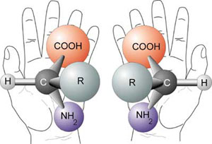
The property of being non-superimposable on one’s mirror image is sometimes referred to as ‘chirality’ from the Greek word for ‘handedness’, referring to the fact that one’s two hands are non-superimposable mirror images.

Slide 10
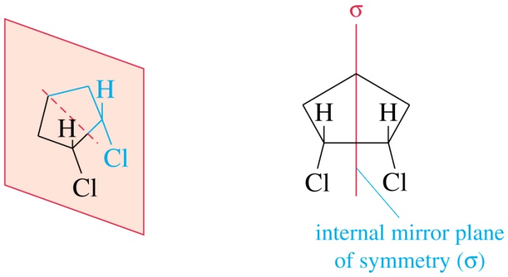
When will a molecule be different (i.e. non-superimposable on) from its mirror image?
A good test for the existence of ‘chirality’ in a molecule is to look for planes of symmetry within the structure. If a molecule has a plane of symmetry, then it is achiral (i. e. not chiral).
Some examples of molecules with planes of symmetry are shown below. These molecules are not chiral (i.e. they are achiral) and they can be superimposed on their mirror images.

Slide 11
If two molecules are different (i.e. non-superimposable), then they need to have different names. Both molecules would be called 1-bromo-1-fluoroethane. However to denote the stereochemistry we utilize the prefixes R (rectus) and S (sinister). Again, we use the Cahn-Ingold-Prelog prioritization scheme.

Slide 12
If the two molecules are different (i.e. non-superimposable), then do they have different physical properties?
R-1-bromo-1-fluoroethane
S-1-bromo-1-fluoroethane
In the case of enantiomers (non-superimposable mirror images) most physical properties (m.p., b.p., etc.) are identical except….

Slide 13
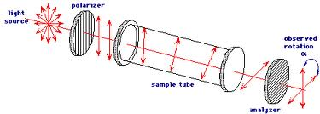
Each of the two molecules (enantiomers, mirror images) will rotate the plane of polarized light by the same amount, but in opposite directions. Note that the direction of rotation of the light has no relationship to the designation as ‘R’ or as ‘S’ (which was assigned based on structure), but must be determined experimentally (and is not possible to predict).
R-1-bromo-1-fluoroethane
S-1-bromo-1-fluoroethane

Slide 14
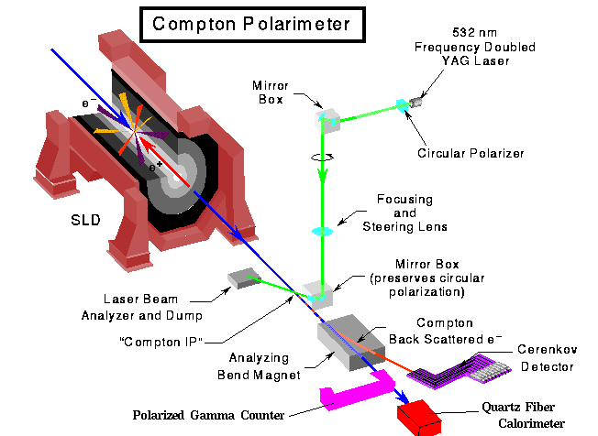
If it is experimentally determined that the rotation of the plane of polarized light is in the clockwise direction, the molecule is classified as (+) or as the lowercase d, for dextrorotatory. If the rotation of the plane of polarized light of the purified enantiomer is in the counterclockwise direction, the molecule is classified as (-) or as lowercase l for ‘levorotatory’.
Caution: Note that the uppercase D and L are utilized for an entirely different purpose, as will be discussed below.

Slide 15
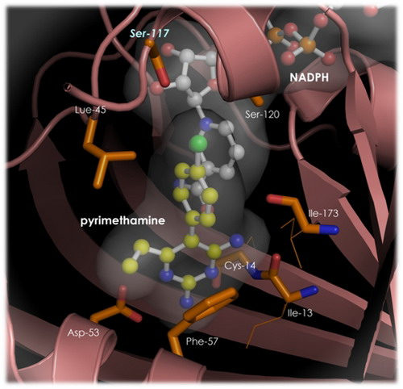
Also, other chiral molecules will interact differently with each of the two enantiomers…
Since proteins are themselves chiral, the two enantiomers of drugs (which most commonly interact with proteins) will have different biological activity. It is not uncommon for one enantiomer to be active and the other inactive, or even for the ‘wrong’ enantiomer to have an undesired side effect.

Slide 16
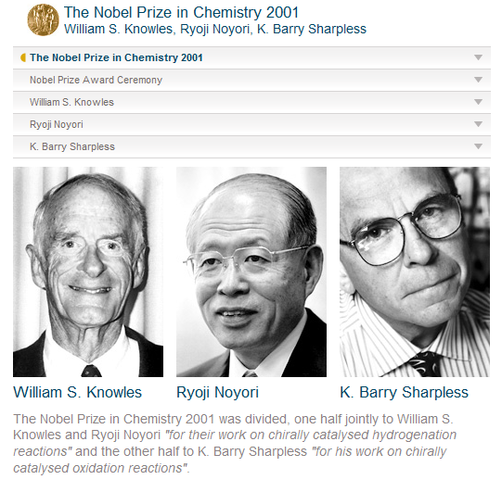
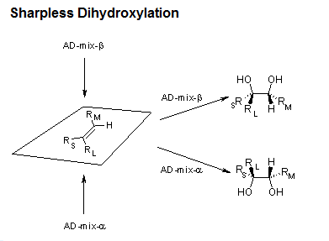
This makes it extremely important for the pharmaceutical companies to synthesize the proper enantiomer. Advances in a field of chemistry known as ‘asymmetric catalysis’ has provided valuable tools for doing this and has resulted in Nobel Prizes for leading scientists in this area.

Slide 17
Racemic Mixtures
If one has a 50:50 mixture of the two enantiomers, then the mixture is called a ‘racemic mixture’.

Slide 18
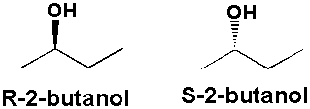
Drawing structures to depict chirality.
A common structural depiction of a stereogenic center is shown above.

Slide 19
Many reactions produce racemic mixtures, due to equal probability of the addition of reagents from either face of a symmetric molecule. For example:

Slide 20
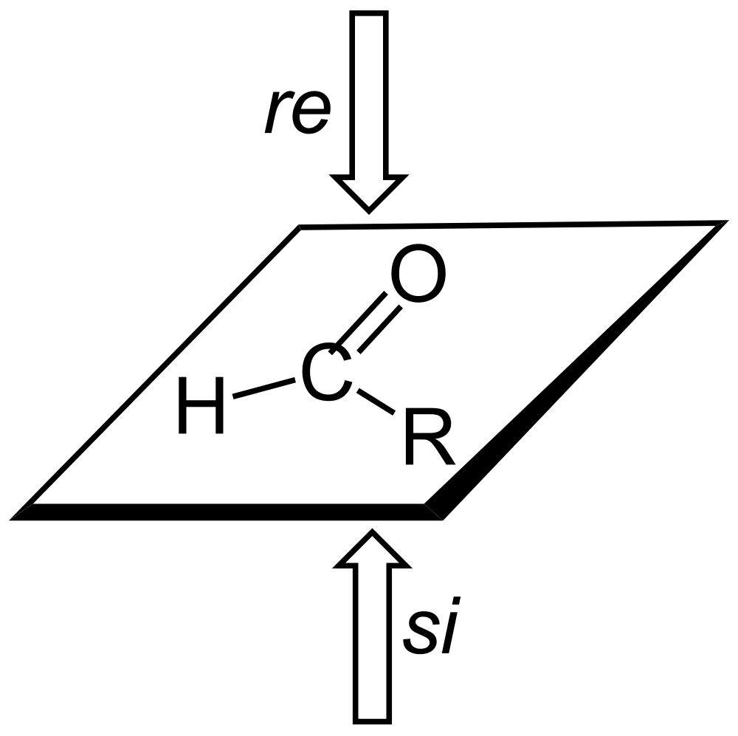
Aldehyde viewed from top face
Clockwise
1
3
2
Aldehyde viewed from bottom face
Counterclockwise

Slide 21
Addition of the reagent from either face will occur with equal probability, producing a racemic mixture
Note that, in this case, addition from the Si face produced the S enantiomer, but it is possible, depending on the specific molecule and reagent, that adding from the Si face, can produce an R enantiomer.

Slide 22
Often the goal of a synthetic process is to produce one or the other of the two possible enantiomers in excess, over the other. We define this quantity, enantiomeric excess as follows:

Slide 23
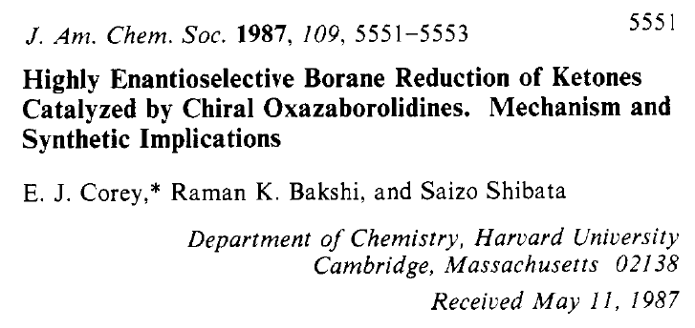
That previous reagent (LiAlD₄), was achiral (not chiral), and thus had no preference for which side of the aldehyde it added to.
However, it is possible to incorporate chirality into the reagent itself, and thus give the reagent the opportunity to distinguish between the two faces of a symmetric carbonyl compound.

Slide 24
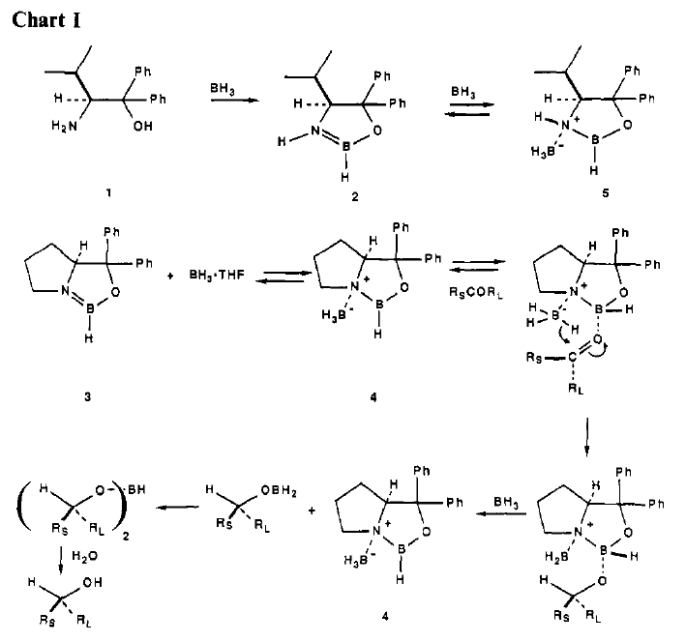

Slide 25
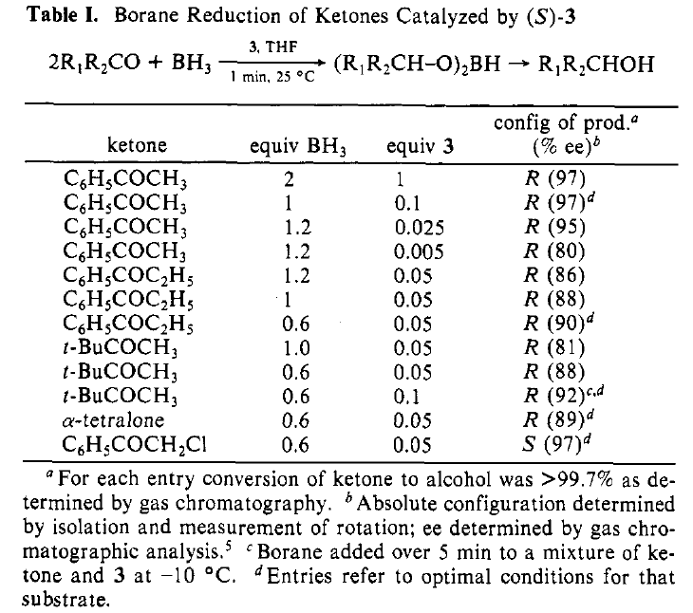

Slide 26
This reagent has become known as the “CBS reagent” after its developers.

Slide 27
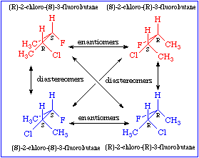
What about molecules with more than one stereogenic center?
A molecule with n stereogenic centers will have a maximum of 2^{n} possible stereoisomers.

Slide 28
Notice that a molecule with two chiral centers, shown below, has two sets of enantiomers (mirror images).
Stereoisomers that are not enantiomers are known as diastereomers.
Note that diastereomers (unlike enantiomers) have DIFFERENT physical properties, including different bp, mp, and different spectra, and different behavior chromatographically.

Slide 29
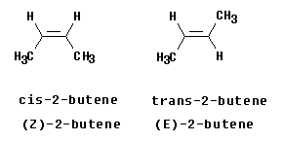
By definition, diastereomers includes geometric isomers of double bonds
Stereoisomers are isomers whose atoms are bonded together in the same order, but differ in how the atoms are arranged in space.
Diastereomers are stereoisomers that are not enantiomers.
Thus, the E and Z isomers of double bonds are considered diastereomers, even though they have a plane of symmetry and are, therefore superimposible on their mirror images.

Slide 30
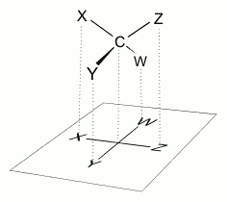
When comparing, and assigning, the chirality of each stereogenic center, in a molecule with multiple such centers, it is important to temporarily ‘freeze’ the rotational state of the rotatable bonds so that an accurate comparison and assigment can be made.
In a molecule with multiple stereogenic centers, like a carbohydrate, this can be difficult to draw.
In 1891, Emil Fischer, working with carbohydrates, came up with a shorthand method to denote the chirality of the various centers. This is now called the Fischer Projection.

Slide 31
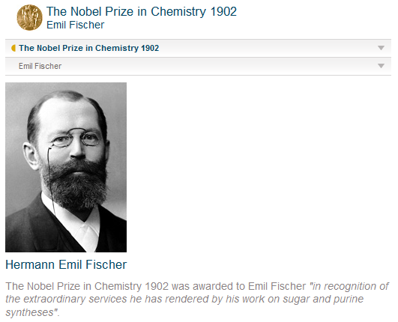

Slide 32
Be CAREFUL!! The Fischer projection is a two-dimensional representation of a three-dimensional structure.
Each half of the horizontal bar of a Fischer projection must always be thought of as projecting toward the viewer, while each half of the verticle bar must be thought of as projecting away from the viewer.
(Note that, because of this, a Fischer projection can never be rotated by 90º. If it is rotated by 90º, the two dimensional representation of the three dimensional structure would not be valid.

Slide 33
Note that, in a molecule with multiple stereogenic centers, this temporary ‘freezing’ of the conformational rotation, actually involves freezing at a very unstable, fully eclipsed, conformation.

Slide 34
Recall that our earlier test for chirality was to look for the presence of a plane of symmetry. If a molecule has such a plane, it is achiral.
The following molecules have more than one chiral center, and are achiral overall, due to the presence of a plane of symmetry.
Such compounds are called ‘meso’ from the Greek for ‘middle’.
meso-tartaric acid

Slide 35
Alternative Nomenclature System: The Fischer-Rosanoff convention
Before the dawn of X-ray crystallography (1951), it was not possible to know the absolute stereochemistry of the molecule. That is, scientists could not correlate the optical rotation and other physical properties with the absolute stereochemistry (orientation of atoms) of the individual centers.
However, Emil Fischer put in place a system for comparing relative stereochemistry of the carbohydrates.
The chemists of the first half of the 20th century used chemical reactions to convert chemicals into one another (without breaking bonds at the chiral center), thus enabling them to compare the stereochemistry.

Slide 36
Initially, for the purpose of drawing structures, a guess was made that D-Glyceraldehyde was of the R-configuration. Fortunately, this proved to be correct.
This nomeclature system is still used today, particularly for amino acids and carbohydrates.

Slide 37
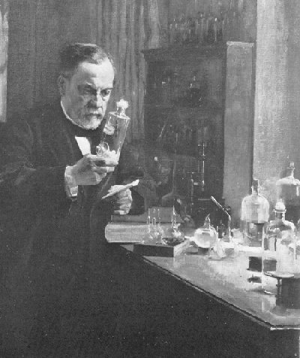
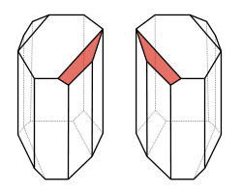
If enantiomers have identical physical properties, can you separate them???
Louis Pasteur did this in 1848, when he noticed that a racemic mixture of d,l-tartaric acid crystallized into two types of crystals, which were mirror images of one another. He separated them (with tweezers) and was able to show that one of the mirror images rotated the plane of polarized light clockwise while the other rotated it counterclockwise.
He also showed that one of the two mirror images can be assimilated by living organisms, while the other cannot.
Louis Pasteur never won the Nobel Prize, since the first Nobel was awarded in 1901 and Pasteur died in 1895.

Slide 38
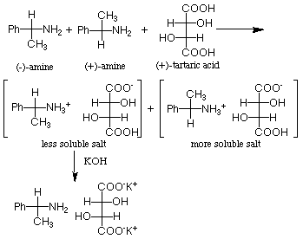
One way to separate enantiomers is to temporarily convert the enantiomeric mixture into a mixture of diastereomers, by reaction with a chiral reagent as shown below.
One can then use the different properties of the diastereomers to separate the complexes, and subsequently convert the diastereomers back into the original (now purified) enantiomer.

Slide 39
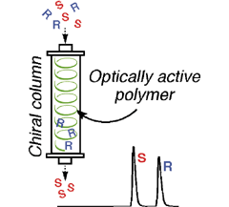
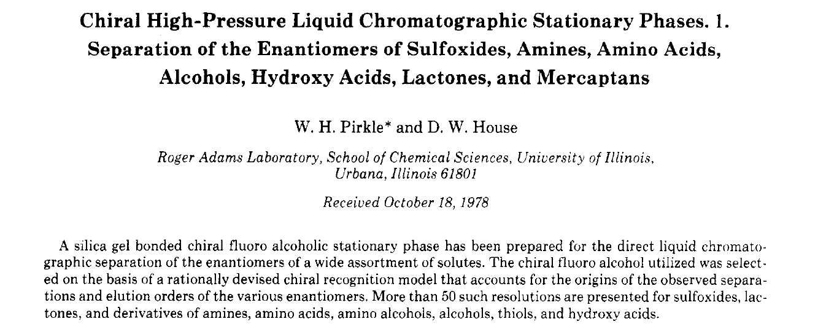
For analytical purposes, it is now common to separate the enantiomers through column chromatography on a column which itself has a chiral stationary phase. These columns are sometimes known as ‘Pirkle columns’ after their developer.

Slide 40
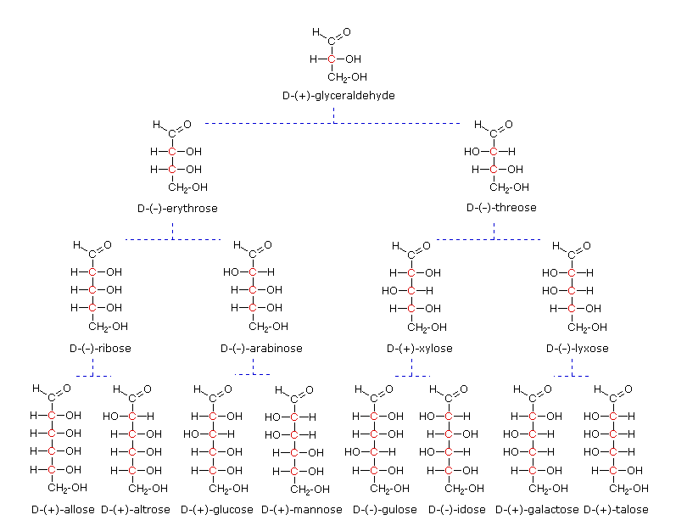

Slide 41
Cyclic Forms of Carbohydrates
As shown below, aldehydes and ketones can undergo addition reactions of alcohols (and water) to the carbonyl group.
However, the product of this reaction, a hemiacetal or hemiketal, is usually unstable toward elimination of the alcohol to regenerate the C=O.
Hemiacetal

Slide 42
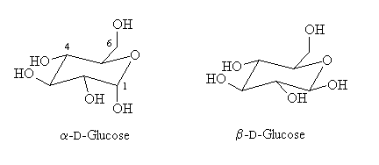
If the hemiacetal form is part of a five- or a six-membered ring, however, the hemiacetal (or hemiketal) may be stable. In this case, favorable entropic and enthalpic factors promote the formation of the cyclic form. Some important such cyclic forms are shown below.
Note that the cyclic form of glucose can exist as two different stereochemical isomers at C1 as shown above.
Compounds with multiple stereogenic centers which are isomeric at only one carbon are called ‘epimers’. In the case of a carbohydrate which is epimeric at the 1-position, the two isomers are called ‘anomers’.

Slide 43
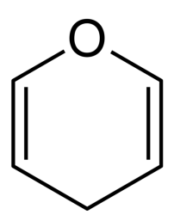
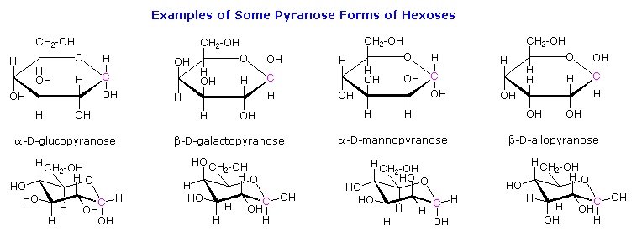
Pyran

Slide 44
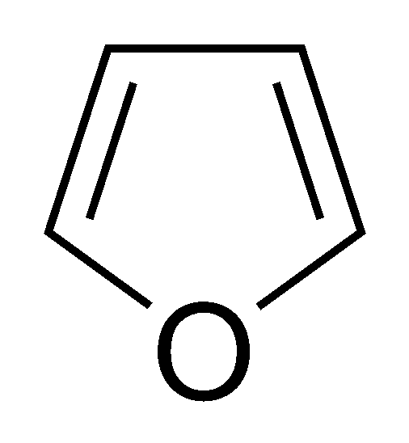
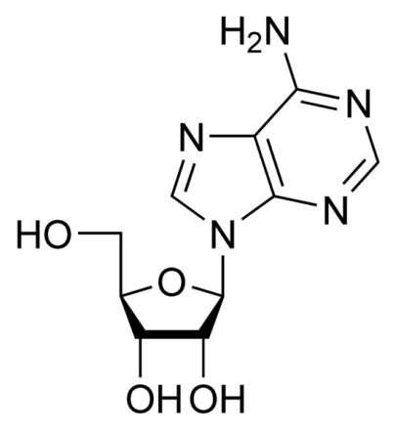
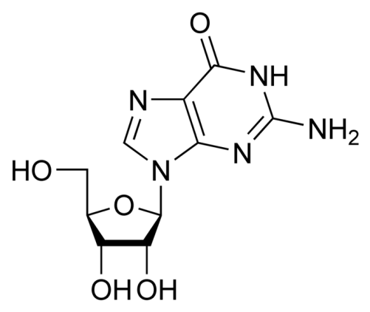
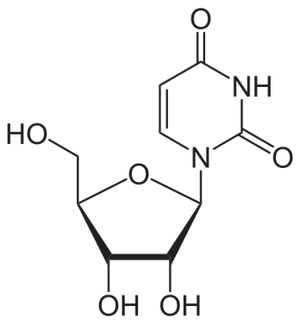
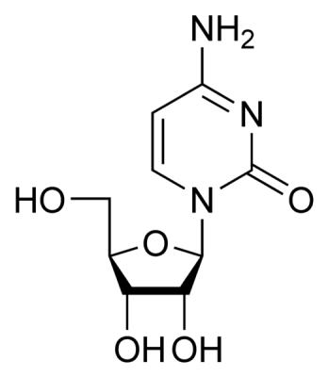
Ribose
Furan
Adenosine
Uridine
Cytidine
Guanosine
RNA Nucleosides

Slide 45
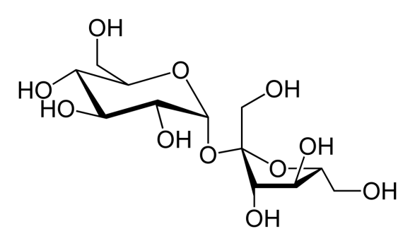
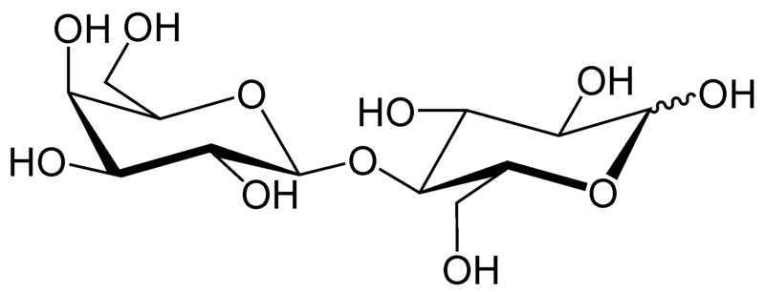
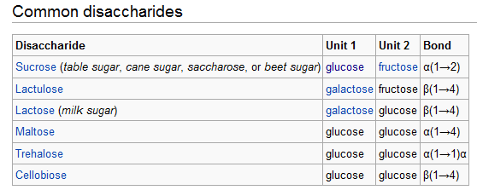
Common Disaccharides
Sucrose
Lactose

Slide 46
Polysaccharides

Slide 47
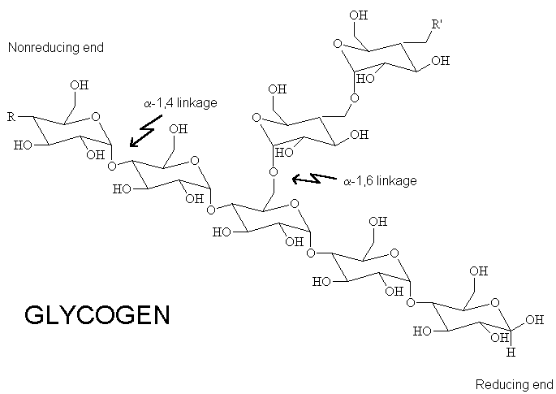
Glycogen, by contrast, utilizes α-1,4-linkages and α-1,6-linkages.

Slide 48
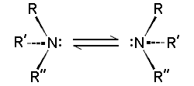
Can a heteroatom be chiral?
In principle, a nitrogen atom (bonded to three different R groups) could display chirality.
However, nitrogen undergoes a process called ‘inversion’ (which equilibrates the two non-superimposible mirror images) too rapidly at room temperature to maintain its chirality.

Slide 49
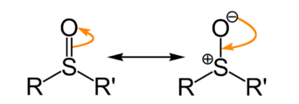
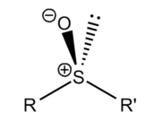
Chiral Sulfoxides
Recall that sp² hybridized CARBON is ‘flat’, thus an sp²-hybridized carbon has a plane of symmetry (the plane of the page) and is achiral (not chiral).
The sulfur participating in a sulfur-oxygen double bond, by contrast, maintains sp³ hybridized character (i.e. tetrahedral geometry), and exists (when R ≠ R’) in two non-superimposible mirror image forms as shown below.
Stereogenic Center

Slide 50
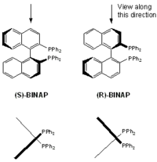
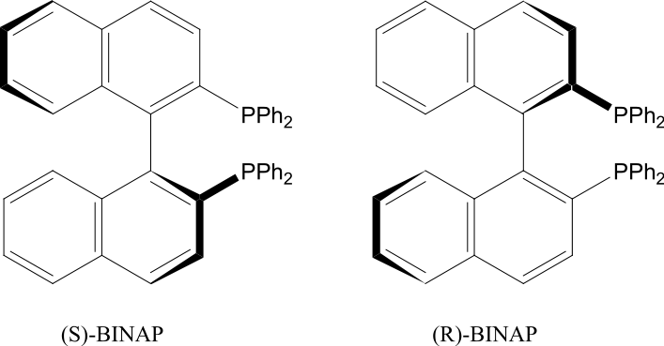
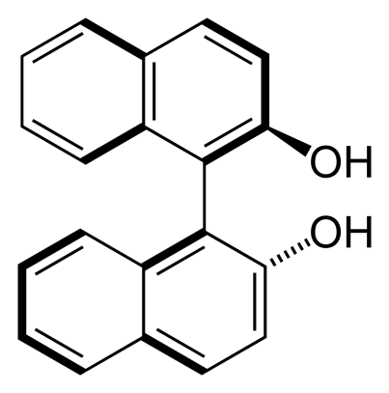
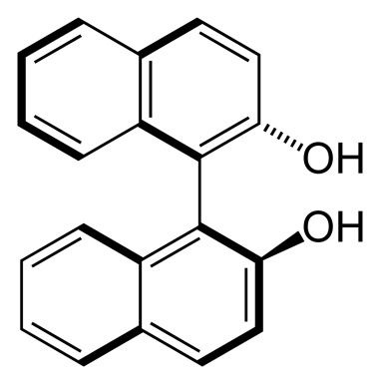
Chirality by Virtue of Hindered Rotation
(Atropisomerism)
(S)-BINOL
(R)-BINOL

Slide 51
Since these chiral bis-phosphines can be utilized as chiral ligands on metals, and certain metals can act in a catalytic manner (i.e. less than stoichiometric amounts required), then one can effectively ‘multiply’ the chirality of the catalyst to produce a much larger quantity of a chiral product.

Slide 52
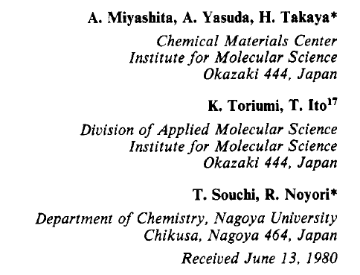
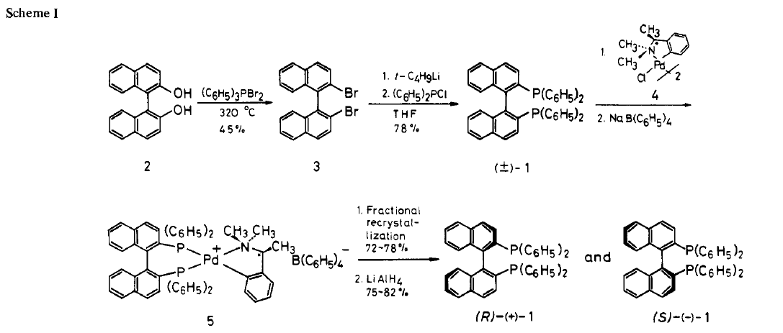

Slide 53
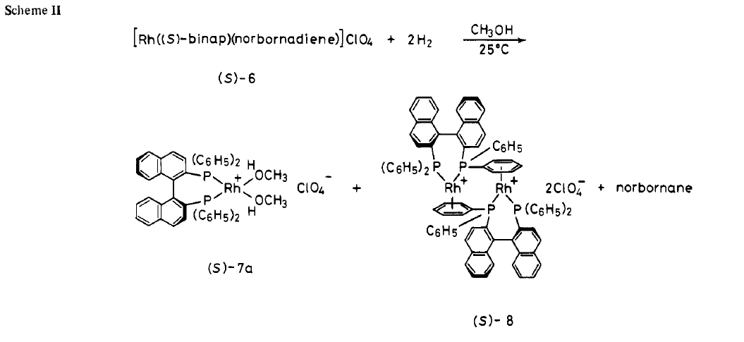
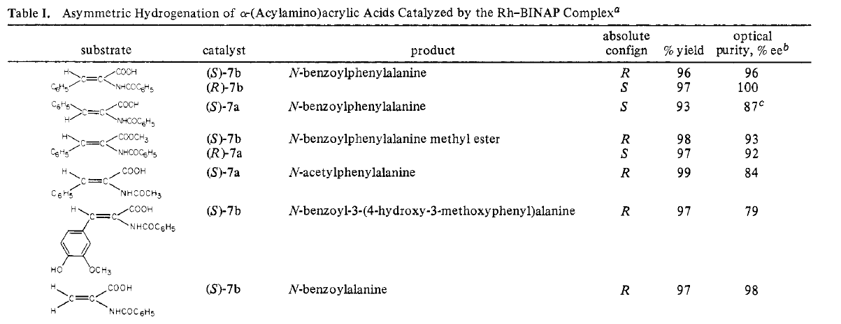

Slide 56
Helical Chirality

Slide 57
Stereospecific or Stereoselective?
In a stereospecific reaction, each stereoisomer (e.g. enantiomer) of the starting material will produce a different stereoisomer of the product. An example of a stereospecific reaction is an Sn2 substitution, which always occurs with inversion of configuration. (A reaction in which the stereochemistry of the reactant completely determines the stereochemistry of the product.)
In a stereoselective reaction, an unequal mixture of stereoisomers is produced (as above) from the starting material, but requirement for opposite stereoisomers of the product being produced from opposite stereoisomers of the starting material may not be met. (An example of a stereoselective reaction would be the dehydrohalogenation of 2-iodobutane, which produces a 3:1 mixture of trans and cis 2-butene, regardless of what the stereochemistry of the 2-iodobutane is.)

Slide 58
Optional Reading
Agranat, I.; Wainschtein, S. R. The Strategy of Enantiomer Patents of Drugs, Drug Discovery Today 2010, 15, 163-170.
Nunez, M. C. et al. Homochiral Drugs: A Demanding Tendency of the Pharmaceutical Industry, Current Medicinal Chemistry 2009, 16, 2064-2074
Clayden, J. et al. The Challenge of Atropisomerism in Drug Discovery, Angewandte Chemie, International Edition 2009, 48, 6398-6401.
Carver, H. et al. Trends in the Development of Chiral Drugs, Drug Discovery Today 2004, 9, 105-110
Agranat, I. et al. Putting Chirality to Work: The Strategy of Chiral Switches Nature Reviews Drug Discovery 2002, 1, 753-768.
See the next slide for instructions on accessing these article from home. All articles are available online.

Slide 59
To view online journals from off-campus
You must use the Virtual Private Network (VPN). To login to the VPN, use the URL: http://www.smu.edu/OIT/Services/Service%20List/VPN.aspx. Click the ‘Login’ button. In the following screen, use your SMU ID # as the user ID, and use your Access password as the password. The screen will display SMU SSL VPN Service. Click the “AnyConnect” button on the left side of the screen (fourth from top). On the following screen click on the “Start AnyConnect” button. If asked to Allow download of software, click on “Allow”. It may take a minute for connection. This will allow you access to the full SMU collection of online journals. Once you are logged in with the VPN, to find journal, use the URL: http://smu.edu/cul/apps/researchcentral/a-z.html. Enter the journal title in the box at the right. This will usually take you to a page where you can enter the volume and page. (you do not need to enter the issue #). This will take you to a page from which you can download the pdf.

