Slide 1
Conformations

Slide 2
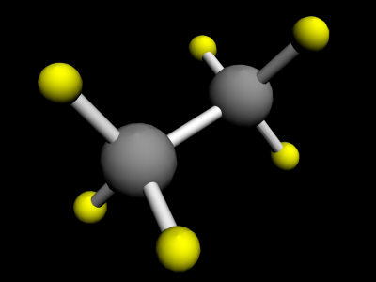
Most single bonds are freely rotating in solution at room temperature, with only very small barriers to free rotation.
Conformations are the various shapes of a molecule that are available to a molecule by single bond rotations and other changes that do not involve bond-breaking.
Conformations are usually rapidly interconverting at room temperature.
Ethane
Link
Link

Slide 3
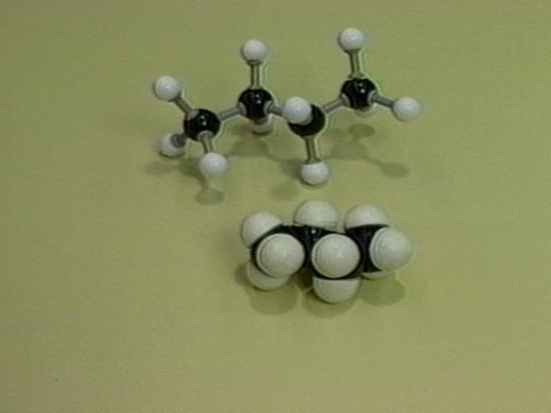
Butane
Link
Link

Slide 4
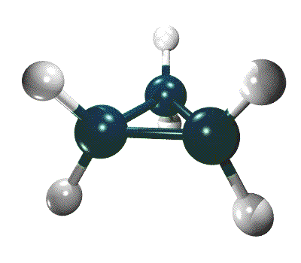
Cyclic Alkanes
Cyclic alkanes (depending on ring size) are constrained from most rotational motion about the single bonds which comprise the ring… But they still try to rotate about these bonds, leading to some motion of the ring, which is particularly noticeable in the larger rings (i.e. > five membered rings).
Cyclopropane

Slide 5
Due to the lack of rotation about the single bonds comprising the ring, there are two non-interconvertible isomers of 1,2-dimethylcyclopropane

Slide 6
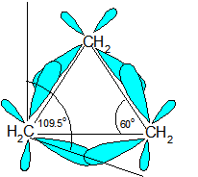
Cyclopropane is also characterized by substantial ring strain, since the ‘normal’ tetrahedral bond angle is 109.5º and the bond angles of an equilateral triangle are 60º. This leads to a ‘bending’ of the single bonds of the ring, as shown below, and also to the bonds of the three-membered ring possessing somewhat more ‘p character’ than the usual single bonds to an sp³ hybridized carbon.

Slide 7
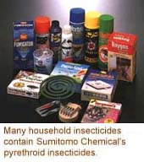
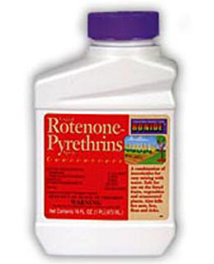
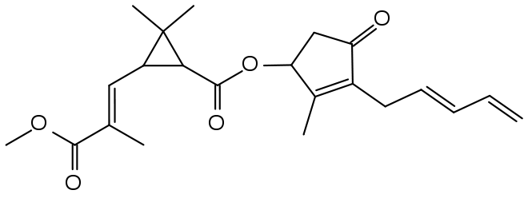
Despite their ring strain, most cyclopropanes are stable at room temperature. The molecule shown above is a pyrethrin, produced by the African Chrysanthemum flower. It is toxic to ants, roaches, mosquitoes, etc., but it breaks down rapidly in the environment. Thus it is considered a natural, relatively non-toxic insecticide.

Slide 8
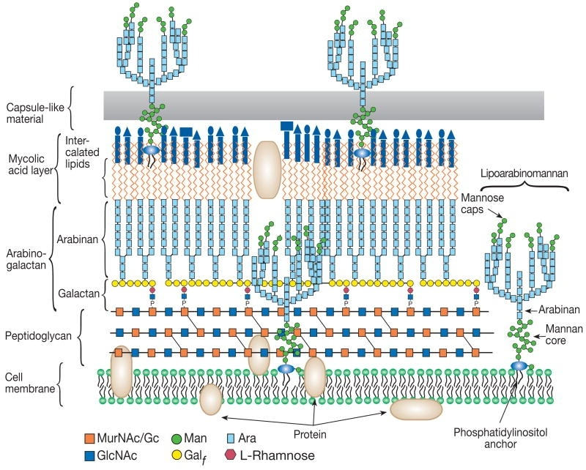
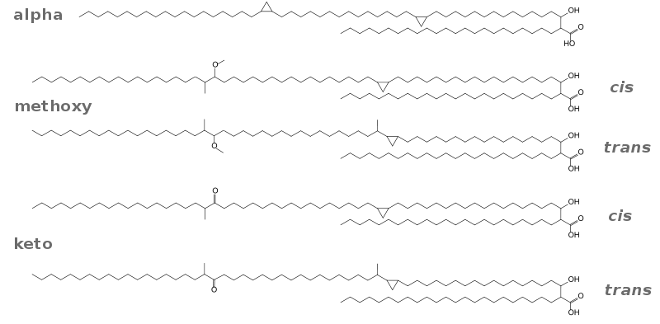
The mycobacterium cell envelope consists of layers of mycolic acids (above left) some of which are cyclopropanated as shown. Mycobacteria are responsible for diseases like tuberculosis and leprosy.

Slide 9
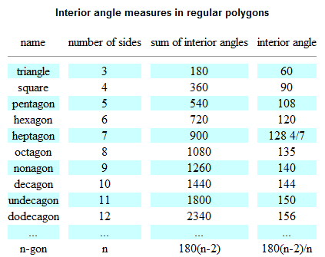
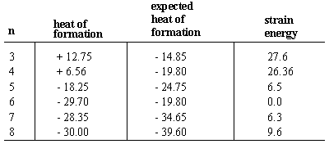
The two dimensional drawings of the cycloalkanes do not present an accurate picture of the actual conformation of the molecule. The total strain energy of a cycloalkane (CH₂)_{n}, is a combination of the angle strain and the unfavorable interactions due to ‘eclipsing’ interaction by substituents on adjacent carbons.
Link

Slide 10
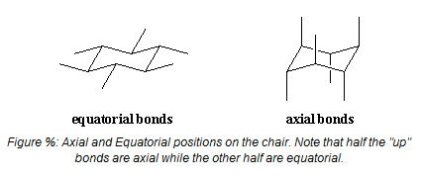
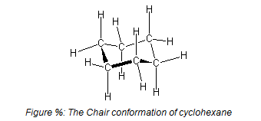
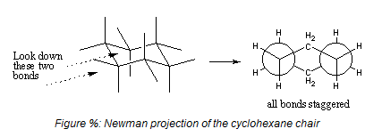
The most discussed cycloalkane is cyclohexane. A normal hexagon has bond angles of 120º. To compensate for the difference from the sp³ hybridized 109.5º, and to alleviate eclipsing interactions, the molecule adopts a chair conformation as shown.

Slide 11
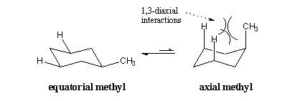
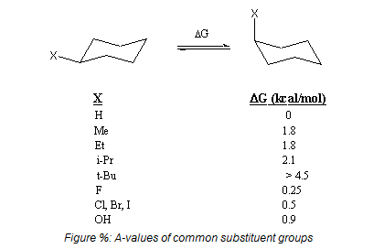
In mono-substituted cyclohexanes, the substituent tend to prefer the equilibrium position (although, through rapid chair-to-chair conformational interconversion, some amount of the axial conformer is always present).

Slide 12
Note that cis and trans dimethylcyclohexane cannot be interconverted by conformational changes.
Link

Slide 13
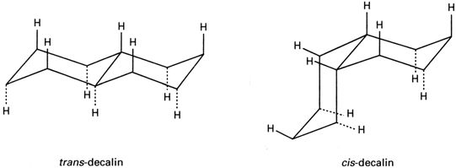
Fusing two cyclohexane rings in either a ‘trans’ or a ‘cis’ fashion can have a dramatic effect on the shape of the resultant molecule.
Note that these two isomers CANNOT be interconverted by conformational change. They are configurational isomers and require bond-breaking to interconvert.

Slide 14
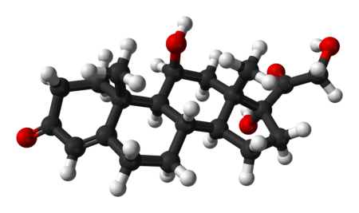
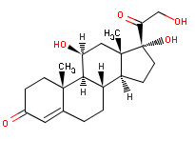
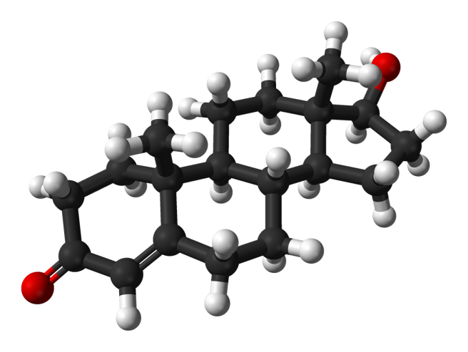
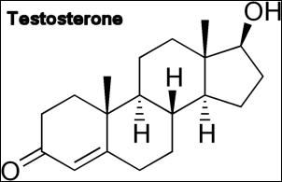
In steroids, the fused rings are in the ‘trans’ configuration, thus resulting in a relatively ‘flat’ molecule.
cortisol
Notice trans fusion at ring junction

Slide 15
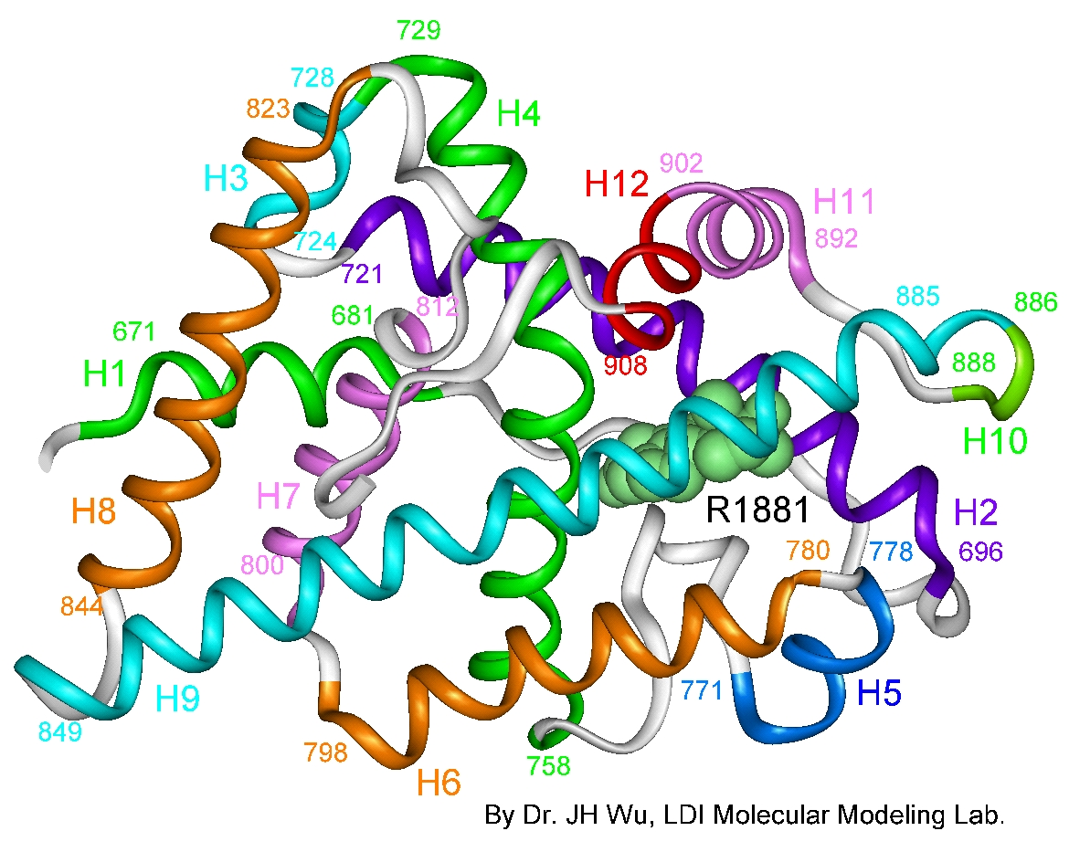
The flat, and relatively rigid, steroid skeleton is crucial to its recognition by the nuclear receptor

Slide 16
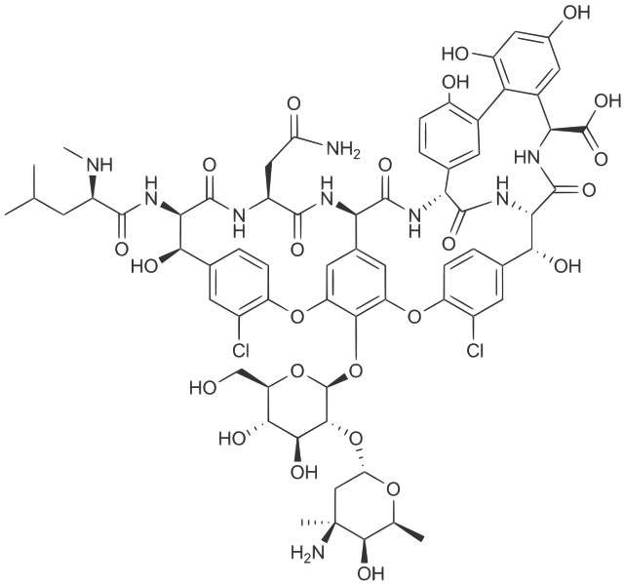
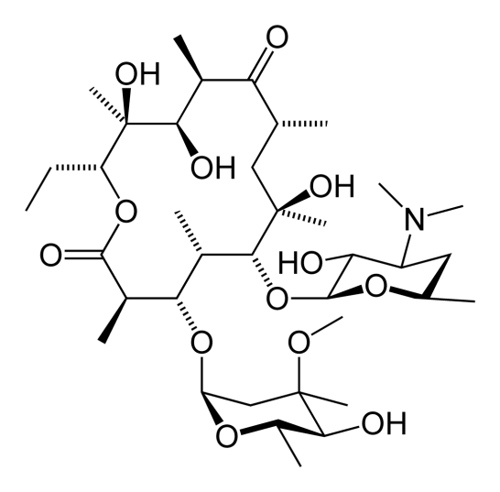
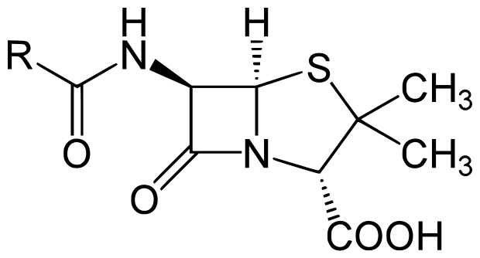
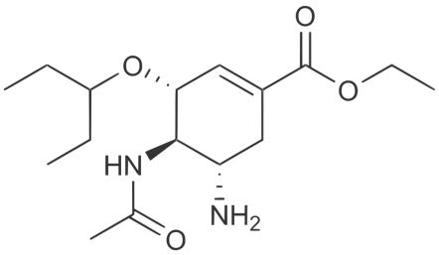
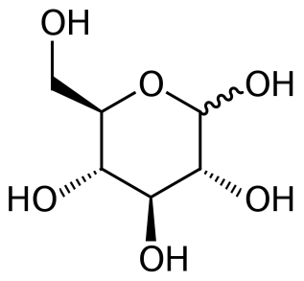
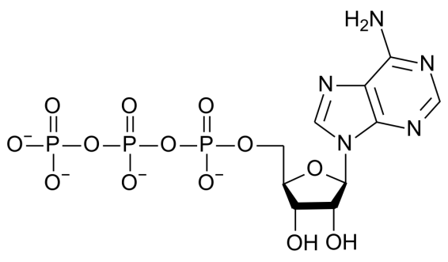
Biologically active molecules frequently contain rings
Vancomycin
Erythromycin
Penicillin
Oseltamavir
(Tamiflu)
Glucose
Adenosine Triphosphate
(ATP)

Slide 17
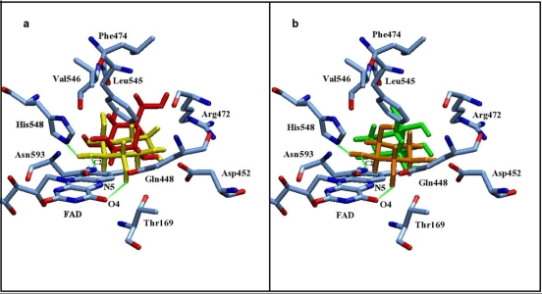
The preferred conformations of these rings, and their conformational flexibility, affect their ability to interact with biological macromolecules.

