Slide 1
Type 2 diabetes
Weirui Chai
4/12/2011

Slide 2
Content
Diabetes – High Blood Sugar
Type 1 and Type 2 Diabetes
Treatments for Type 2 Diabetes
Conclusion

Slide 3
Diabetes – High Blood Sugar
Diabetes mellitus:
A group of metabolic diseases characterized by high blood sugar (glucose) levels that result from defects in insulin secretion, or action, or both.
Types of Diabetes:
Type 1 diabetes: the pancreas - incapable of making insulin.
Type 2 diabetes: the pancreas - can produce insulin, but do so relatively inadequately for their body's needs.
Gestational diabetes: a condition in which women without previously diagnosed diabetes exhibit high blood glucose levels during pregnancy.
Notes:
There are 3 types of diabetes, …, …, and gestational diabetes. It is a special diabetes happened during pregnancy.

Slide 4
Type 1 and Type 2 Diabetes
 | Type 1 Diabetes | Type 2 Diabetes
Symptom | Lack of insulin | Lack of insulin
Can pancreas produce insulin? | × | √
The reason for high blood sugar | immunological destruction of pancreatic β cells | the failure of augmented insulin secretion to compensate for insulin resistance
Inducement | a combination of genetic susceptibility, a diabetogenic trigger and exposure to a driving antigen | a complex interplay between genetic predisposition and environmental factors such as diet, degree of physical activity, and age
Notes:
Let’s see the difference between type 1 and type 2 diabetes. The symptom is the same, but the pancreas of type 1 diabetes can not produce insulin. The inducement of type 2 diabetes including genetic and environmental factors.

Slide 5
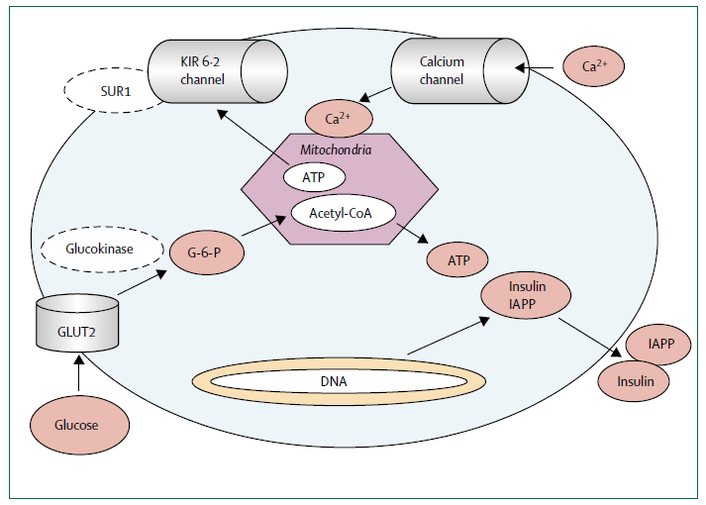
Normal insulin secretion

Slide 6
Insulin Resistance

Slide 7
Pathogenesis of type 2 diabetes. SREBP-1c, sterol response element binding protein 1c.
Notes:
This is the pathogenesis of type 2 diabetes, the bottom behavior may cause the upper response, and finally it becomes diabetes.

Slide 8
Treatments for Type 2 Diabetes
Dietary modifications and exercise;
Metformin, a biguanide for type 2 diabetes;
Thiazolidinediones, including pioglitazone and rosiglitazone, peroxisome proliferator-activated receptor gamma (PPARγ) activators;
α-glucosidase inhibitors that delay intestinal carbohydrate absorption and blunt postprandial glucose excursions;
Sulfonylureas (SU) and non-sulfonylurea (non-SU) insulin secretagogues that stimulate insulin secretion by pancreatic β cells;
Incretin Hormones;
Exogenous insulin;
Bariatric Surgery.
Notes:
What’s a surprise, one of the best way to treat type 2 diabetes is D.M. and exercise.

Slide 9
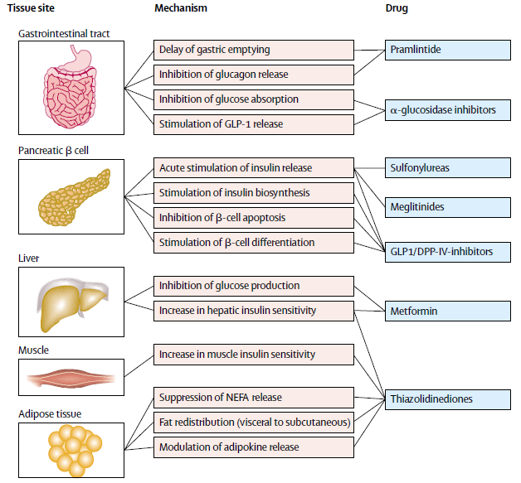

Slide 10
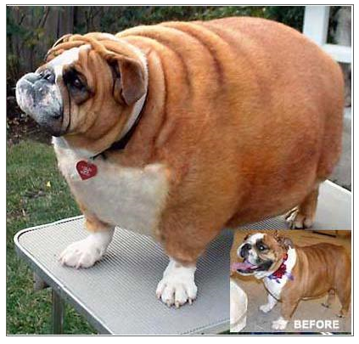
Exercise is important

Slide 11
Lifestyle modifications and exercise
Beneficial effects of endurance exercise:
Weight loss
Increased capacity to generate energy aerobically
Improved insulin action and glucose homeostasis
Improved plasma lipid profiles (e.g., lowered triglycerides, increased HDLc)
Improved cardiac function
Notes:
The benefits of exercise are so much. When the summer comes, it’s time for us to go to gym and have exercise.

Slide 12
Lifestyle modifications and exercise
 | Intervention | Duration (years) | Number of people | Risk Reduction (%)
Daqing (China) ⁽¹⁾ | Lifestyle | 6 | 577 | 42
Diabetes Prevention Program (DPP; USA) ⁽²⁾ | Lifestyle | 3 | 3234 | 58
Diabetes Prevention Study (DPS; Finland) ⁽³⁾ | Lifestyle | 4 | 522 | 58
Pan XR, et al. Effects of diet and exercise in preventing NIDDM in people with impaired glucose tolerance. The Da Qing IGT and Diabetes Study. Diabetes Care 1997, 20:537-544.
Diabetes Prevention Program Research Group. Reduction in the incidence of type 2 diabetes with lifestyle intervention or metformin. N Engl J Med, 2002, 346:393-403.
Tuomilehto J, et al. Prevention of type 2 diatetes mellitus by changes in lifestyle among subjects with impaired glucose tolerance, N Engl J Med, 2001, 344:1343-1350.
Notes:
Data here support the LM and ex really help people reduce the risk of having type 2 diabetes.

Slide 13
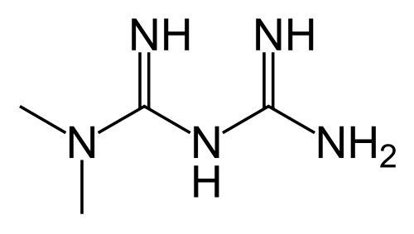
Metformin - Biguanide
First-line drug for treatment of type 2 diabetes:
Intensive glucose control
Few adverse effects - gastrointestinal upset, and a low risk of hypoglycemia
Not associated with weight gain
The only antidiabetic drug that has been conclusively shown to prevent the cardiovascular complications of diabetes

Slide 14
Metformin - Biguanide
Mechanism of action:
Metformin activates AMP-activated protein kinase (AMPK) in primary hepatocytes but has no direct effect on the partially purified enzyme in an in vitro kinase assay.
Note: AMPK - an enzyme that plays an important role in insulin signaling, whole body energy balance, and the metabolism of glucose and fats.
After AMPK activation, a variety of downstream biochemical changes occur, including the down-regulation of SREBP1 expression and consequently decreased hepatic fatty acid synthesis.
In addition, VLDL synthesis decreases as a result of reduced acetyl-CoA carboxylase (ACC) activity.
In the meantime, AMPK activation results in the suppression of hepatic glucose production and increased glucose uptake in skeletal muscle.

Slide 16
Darleen A. et al. Targeting the CNS to treat type 2 diabetes. Nature Reviews Drug Discovery 2009, 8: 386-398.

Slide 17
Thiazolidinediones
TZDs act by binding to PPARs (peroxisome proliferator-activated receptors), a group of receptor molecules inside the cell nucleus controlling the expression of genes involved in adipocyte differentiation and lipoprotein metabolism, specifically PPARγ (gamma).
The ligands for these receptors are free fatty acids (FFAs) and eicosanoids. When activated, the receptor migrates to the DNA, activating transcription of a number of specific genes.
TZDs reduce insulin resistance, increase insulin-stimulated glucose disposal, and improve glycemic control by increasing peripheral glucose uptake and suppressing hepatic glucose production.
Side effects: weight gain and edema.
Notes:
TZDs reduce insulin resistance.

Slide 18
PPARs Enzyme

Slide 19
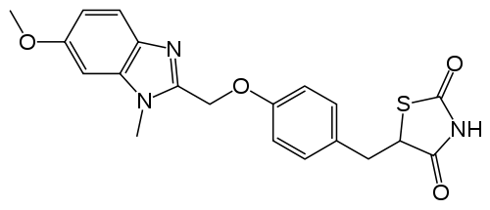
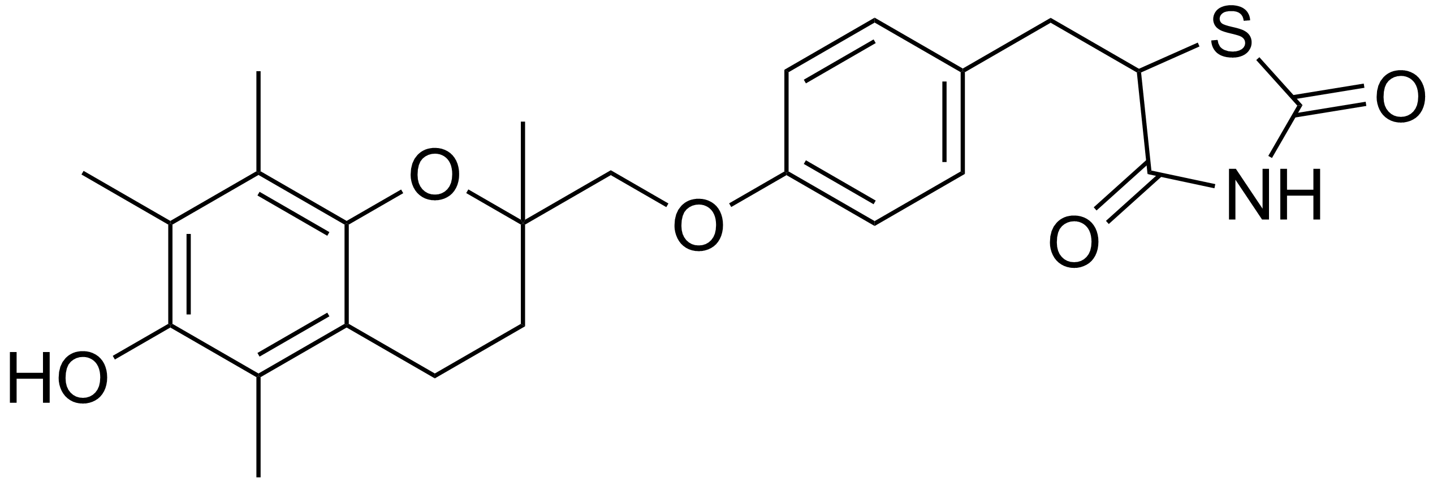
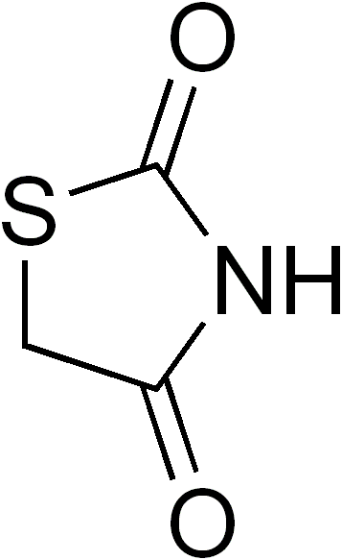
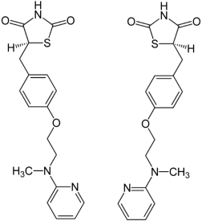
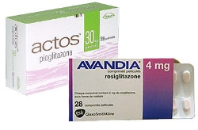
Thiazolidinediones
Rivoglitazone
Troglitazone
Pioglitazone
Rosiglitazone
Notes:
TZDs

Slide 20
α-glucosidase inhibitors
The enzyme is located in the brush border of the small intestine and is required for the final step in the breakdown of carbohydrates such as starches, dextrins, and maltose to absorbable monosaccharides.
As inhibitors of this enzyme, the α-glucosidase inhibitors delay but do not prevent the absorption of ingested carbohydrates and reduce the postprandial insulin and glucose peaks.
Adverse effects: mainly GI symptoms, such as abdominal pain, flatulence, and diarrhea.
Notes:
The adverse effects of α-glucosidase inhibitors are mainly GI symptoms such as abdominal pain, flatulence, and diarrhea.^{[37, 38]} This is due to the passing of the unabsorbed carbohydrates into the large intestine where an osmotic fluid retraction occurs and where GI flora metabolize the sugars to produce gaseous waste products. Starting with a low dose and slowly increasing the dosage can significantly reduce the GI side effects. An advantage of the α-glucosidase inhibitors is that they are not associated with hypoglycemia and weight gain.

Slide 21
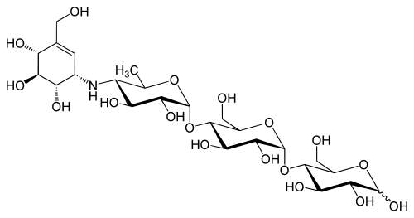
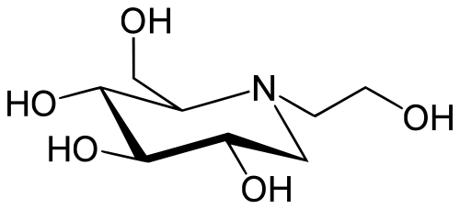
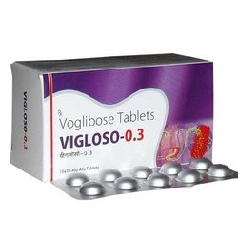
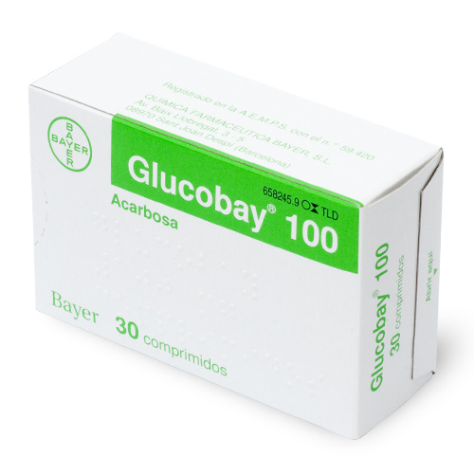
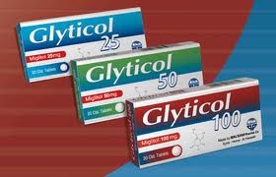
α-glucosidase inhibitors
Voglibose
Acarbose
Miglitol

Slide 22
Sulfonylurea derivatives
Sulfonylurea derivatives act by closing pancreatic cell potassium channels, which leads to enhanced insulin secretion.
Adverse effects: potential of (occasionally severe) hypoglycaemia.
Notes:
The mode of action of sulfonylurea derivatives implies that they also act at low concentrations of plasma glucose, which explains the potential of (occasionally severe) hypoglycaemia.
All sulfonylureas contain a central S-phenylsulfonylurea structure with p-substitution on the phenyl ring and various groups terminating the urea N' end group.

Slide 23
Sulfonylurea Receptor
Mark J. Dunne, et al. Electrophysiology of the β Cell and Mechanisms of Inhibition of Insulin Release. Supplement 21: Handbook of Physiology, The Endocrine System, The Endocrine Pancreas and Regulation of Metabolism. Originally published: 2001.

Slide 24
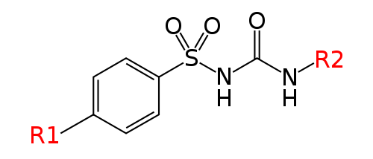
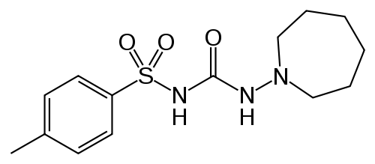
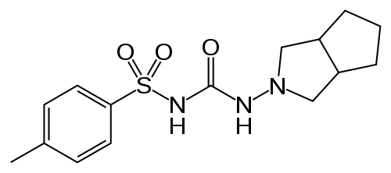
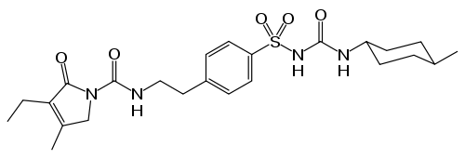
Sulfonylurea derivatives
Chlorpropamide
Tolazamide
Gliclazide
Glimepiride

Slide 25
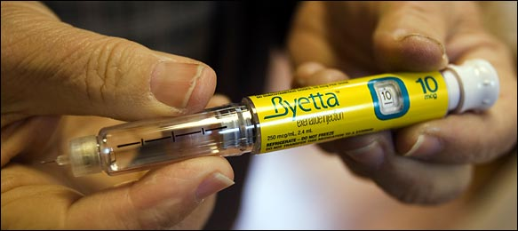
Incretin Hormones
Incretins play an important role in lowering postprandial secretion of glucagon, thereby lowering postabsorbtive glucose levels, reducing oxidative stress, and preventing weight gain.
Although incretin hormones have been shown to preserve β-cell function in animal models, their role in human β-cell preservation remains to be established.
Notes:
Exenatide
http://en.wikipedia.org/wiki/Exenatide

Slide 26
From lizard to lab to human

Slide 27
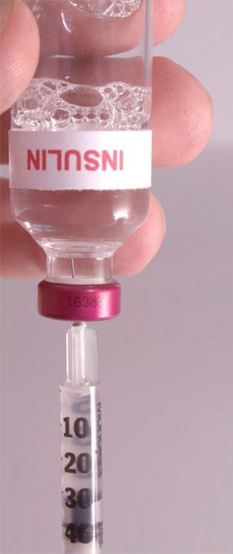
Exogenous insulin
Support the clinical effects of metformin and the thiazolidinediones, and may also have important beneficial effects in reducing inflammatory processes, especially in the vasculature.
It is essential to initiate insulin injections when required to achieve glycaemic targets in type 2 diabetes, possibly in combination with oral insulin sensitisers.
However, combined use of insulin and thiazolidinediones seems to infer an increased risk of oedema and cardiac failure. Therefore, this combination is not allowed in most European countries.
Notes:
Support the clinical effects of metformin and the thiazolidinediones, which are ineffective without adequate insulin availability.

Slide 28
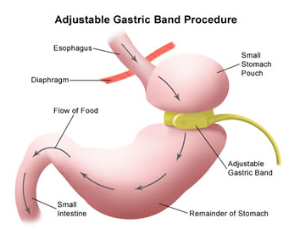
Bariatric Surgery
Bariatric surgery as a means of achieving weight loss has proven to be successful in diabetes prevention.
Bariatric surgery has also been reported to induce remission of existing diabetes.
Notes:
Bariatric surgery is the treatment of obesity. It has direct target, the stomach.

Slide 29
Conclusion
Lifestyle modification is the most effective tool in the prevention or delay of type 2 diabetes.
For patients who are unable to achieve these lifestyle goals:
Metformin has been proven effective, especially in younger obese patients.
α-glucosidase inhibitors confer a moderate risk reduction.
Thiazolidinediones are conflicting, and the reports of cardiovascular and fracture risk make this option less attractive as a prevention strategy.
Notes:
However, none of these medications are as robust in diabetes prevention as the lifestyle intervention strategies, and cost-effectiveness analyses suggest that pharmacotherapy may have greater financial costs.

Slide 30
References
Pan XR, et al. Effects of diet and exercise in preventing NIDDM in people with impaired glucose tolerance. The Da Qing IGT and Diabetes Study. Diabetes Care 1997, 20:537-544.
Diabetes Prevention Program Research Group. Reduction in the incidence of type 2 diabetes with lifestyle intervention or metformin. N Engl J Med, 2002, 346:393-403.
Tuomilehto J, et al. Prevention of type 2 diatetes mellitus by changes in lifestyle among subjects with impaired glucose tolerance, N Engl J Med, 2001, 344:1343-1350.
Michael Stumvoll, et al. Type 2 diabetes: principles of pathogenesis and therapy. Lancet 2005; 365: 1333–46
Stuart A. Ross, et al. Chemistry and Biochemistry of Type 2 Diabetes. Chem. Rev. 2004, 104: 1255-1282.
Darleen A. et al. Targeting the CNS to treat type 2 diabetes. Nature Reviews Drug Discovery 2009, 8: 386-398.

Slide 31
Questions
List 3 kinds of drugs for the treatment of diabetes with structure.
Describe the insulin resistance and the Insulin receptor knock-out models.
What is bariatric surgery?
How the lifestyle modification works for diabetes patients?

Slide 32
Thank you !

