Slide 1
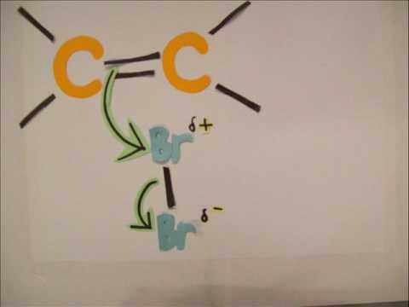
Electrophilic Addition to Alkenes

Slide 2
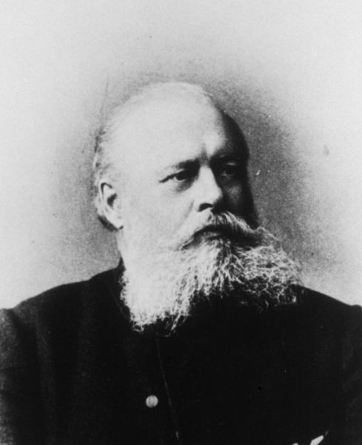
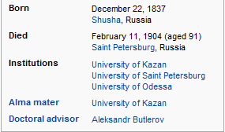
Addition of H-X to the Carbon-Carbon Double Bond:
Markovnikov’s Rule
In its original form, Markovnikov’s rule states that, during the addition of HX to a C=C, the hydrogen atom goes to the side of the alkene which already possesses the most hydrogens.

Slide 3
This is referred to as the ‘regiochemistry’ of the addition reaction (i.e. which ‘region’ of the double bond does the H and the Cl add to).

Slide 4
Mechanistic Explanation for Markovnikov’s Rule

Slide 7
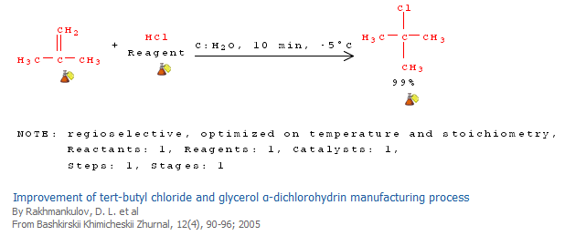

Slide 8
Caveat: Under certain conditions, addition of H-Br (but not H-Cl or H-I) gives the opposite regiochemistry… Why?

Slide 9
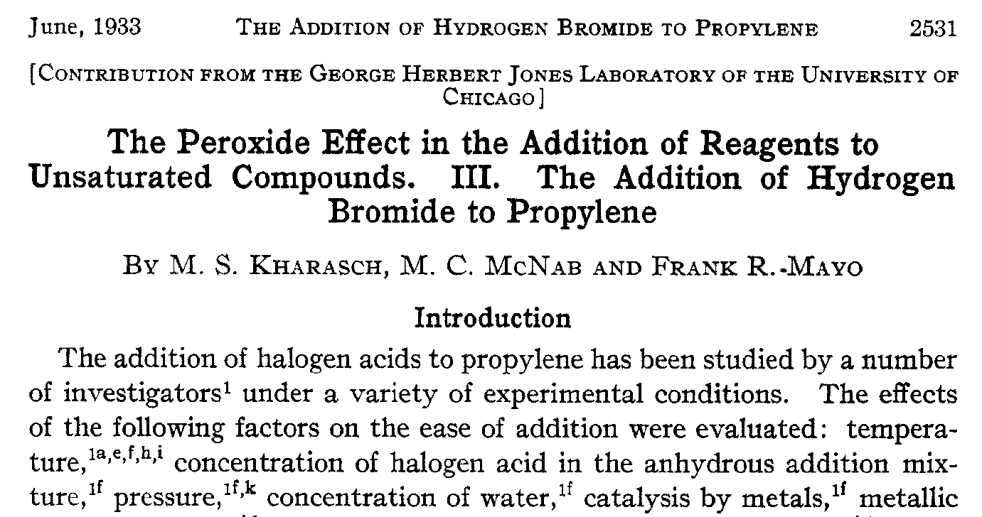

Slide 10
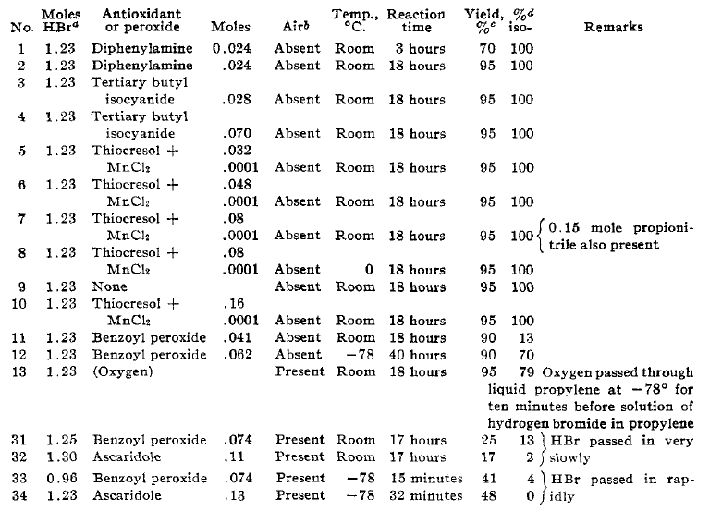

Slide 11
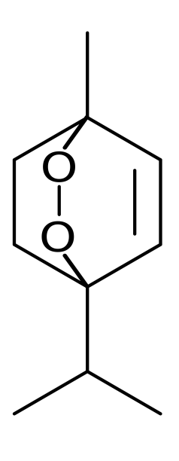
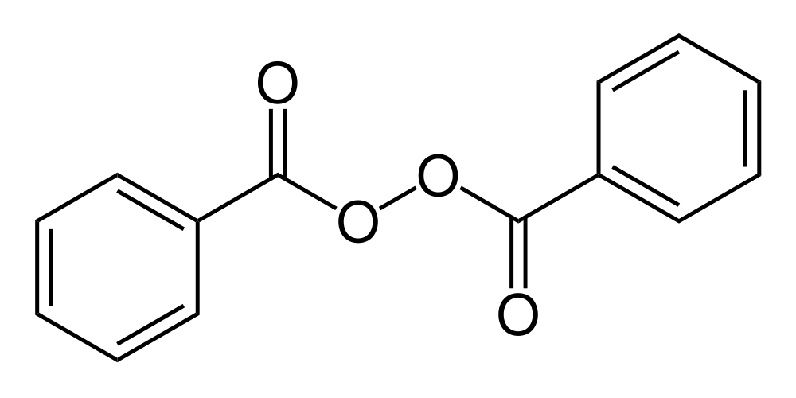
Benzoyl Peroxide
Ascaridole

Slide 12
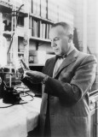
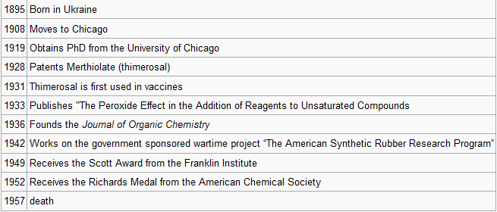
Morris S. Kharasch
LINK

Slide 13
Mechanistic Reason for Effect of Peroxides on the Regiochemistry of Addition of H-Br to the alkene

Slide 15
Likewise, in the presence of very strong acid (non-nucleophilic anions), water, alcohols, and carboxylic acids can add across double bonds. The reaction is often used to form tert-butyl esters of carboxylic acids as shown.

Slide 16
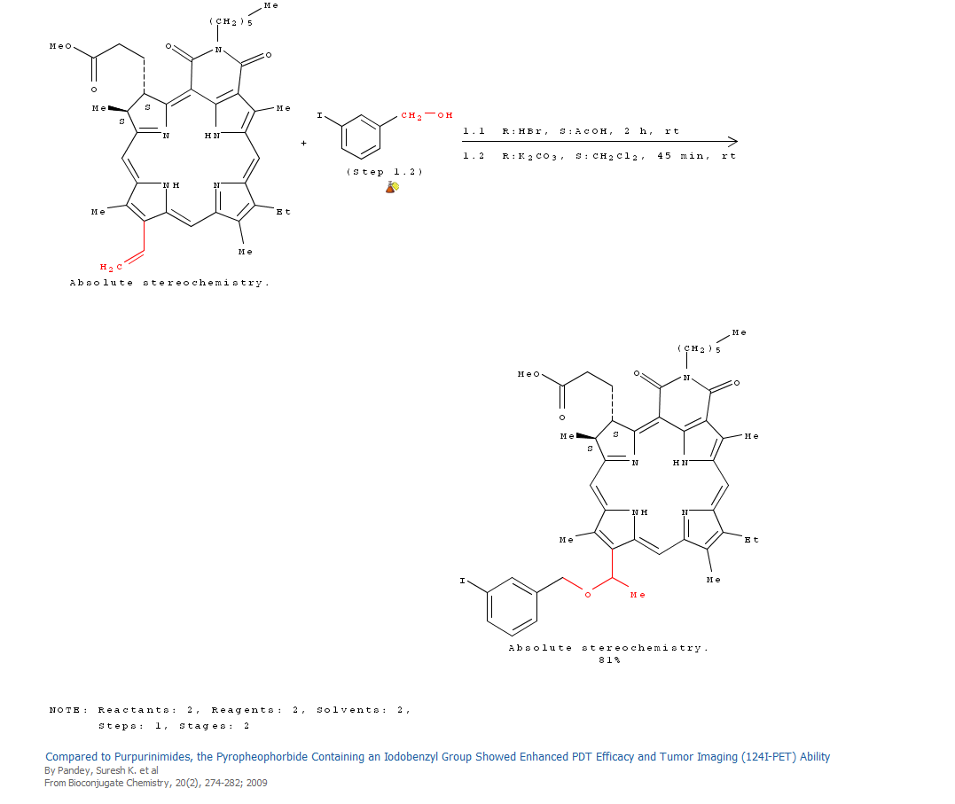

Slide 17
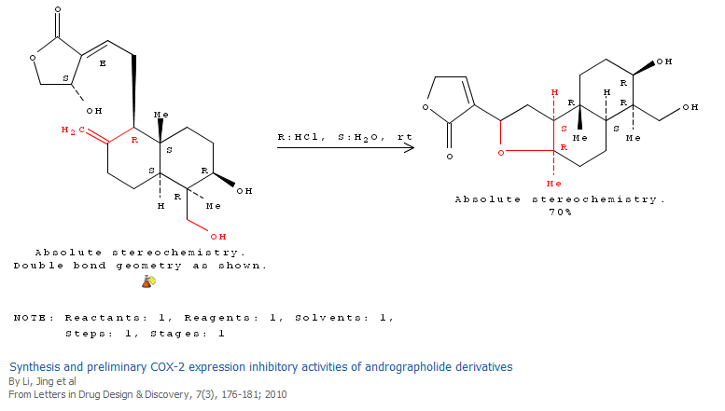

Slide 18
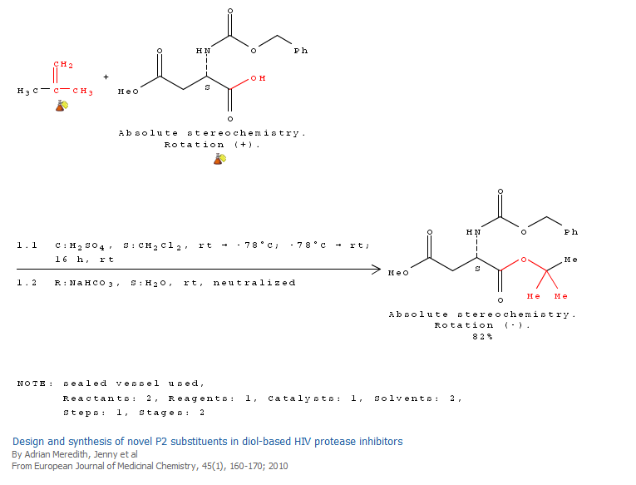

Slide 19
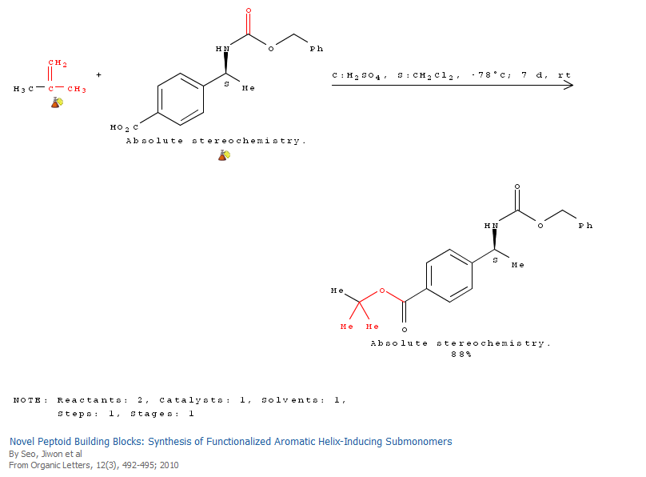

Slide 20
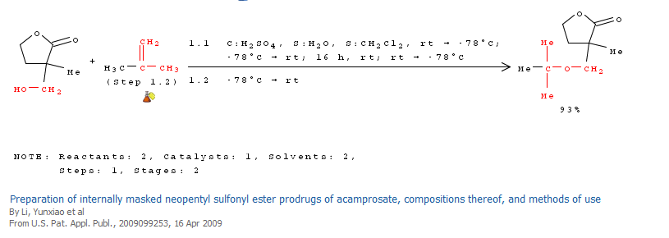

Slide 21
Oxymercuration-Demercuration:
A milder method for hydration of an alkene

Slide 22
Mechanism of Oxymercuration-Demercuration
Notice that Markovnikov’s Rule is followed

Slide 23
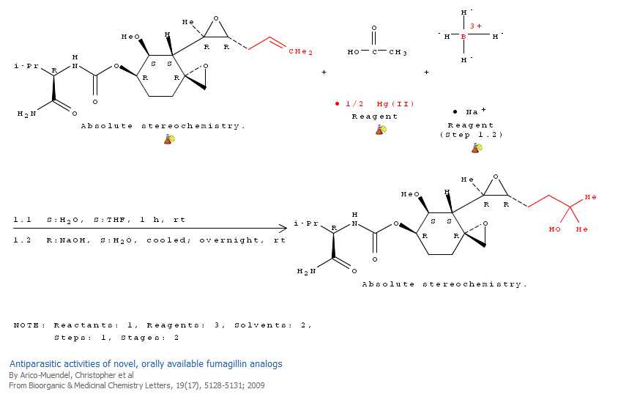
Use of Oxymercuration-Demercuration

Slide 24
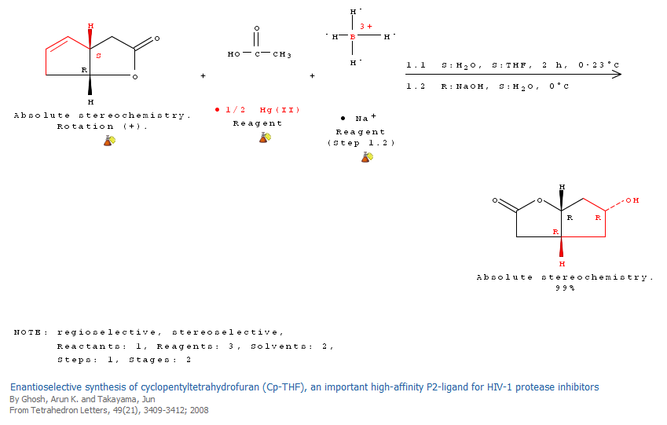

Slide 25
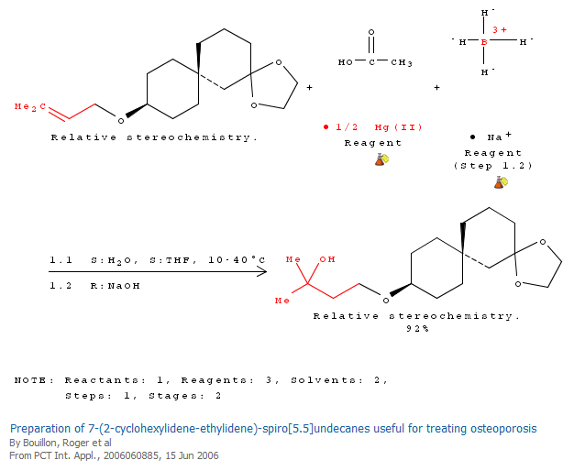

Slide 26
Hydroboration-Oxidation:
Anti-Markovnikov Addition of Water to an Alkene
HBR₂ often equals complexes of borane (BH₃) with THF, or with dimethylsulfide (Me₂S).
Also, HBR₂ may equal dialkylboranes, which tend to give higher regioselectivity.

Slide 27
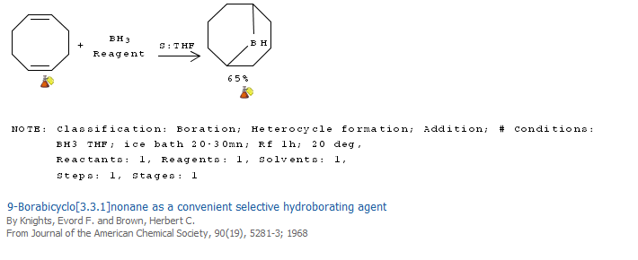
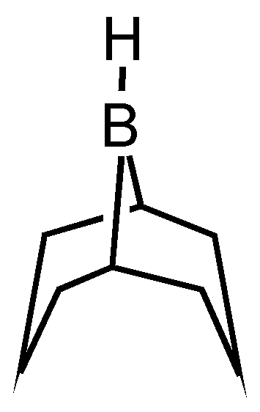
One commonly used dialkylborane is 9-borabicyclononane (9-BBN), which is readily available from the hydroboration of 1,5-cyclooctadiene.

Slide 28
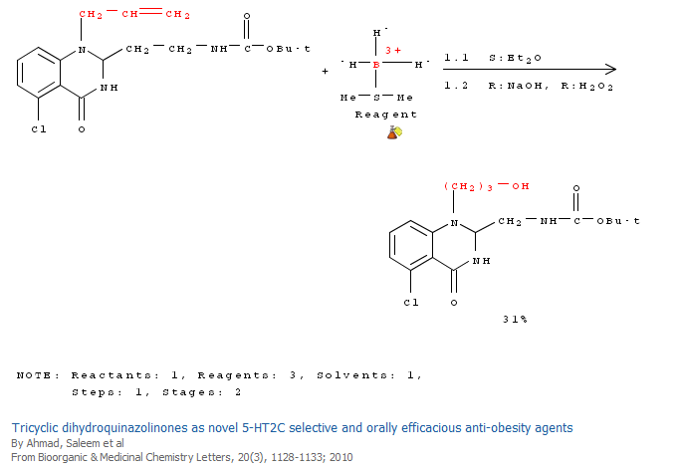

Slide 29
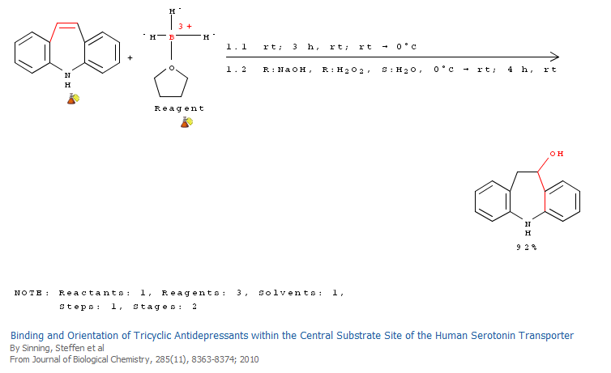

Slide 30
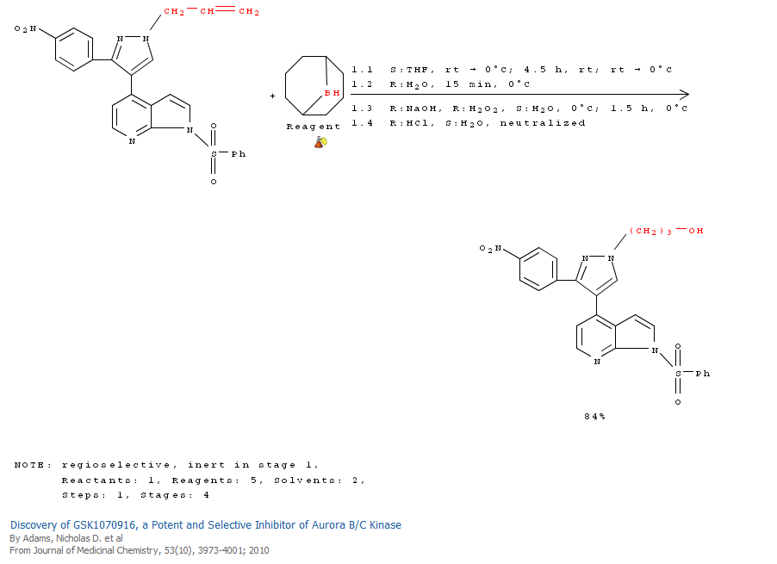

Slide 31
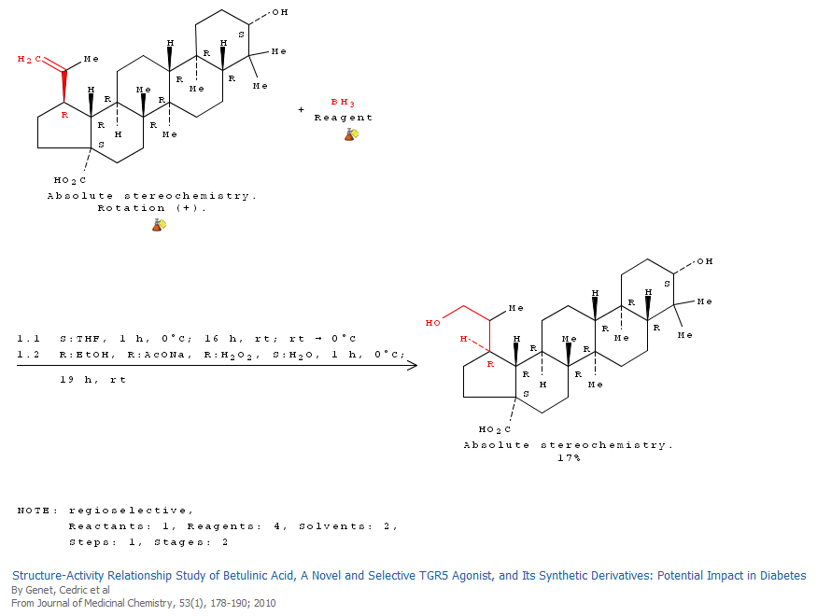

Slide 32
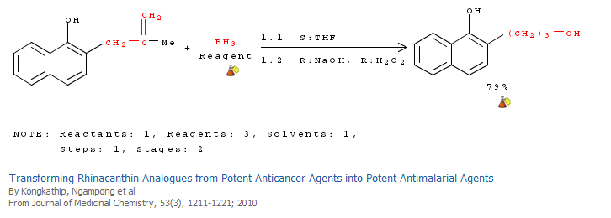

Slide 33
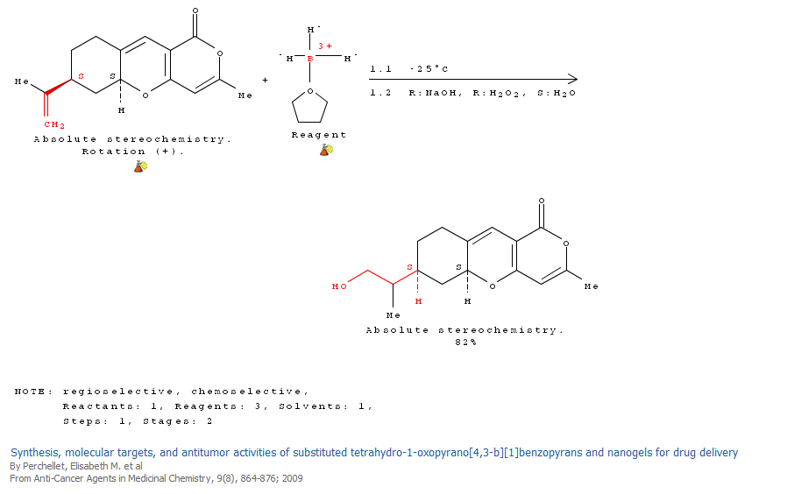

Slide 35
In the following slides, notice that the H and the OH group are added to the double bond from the same face.

Slide 36
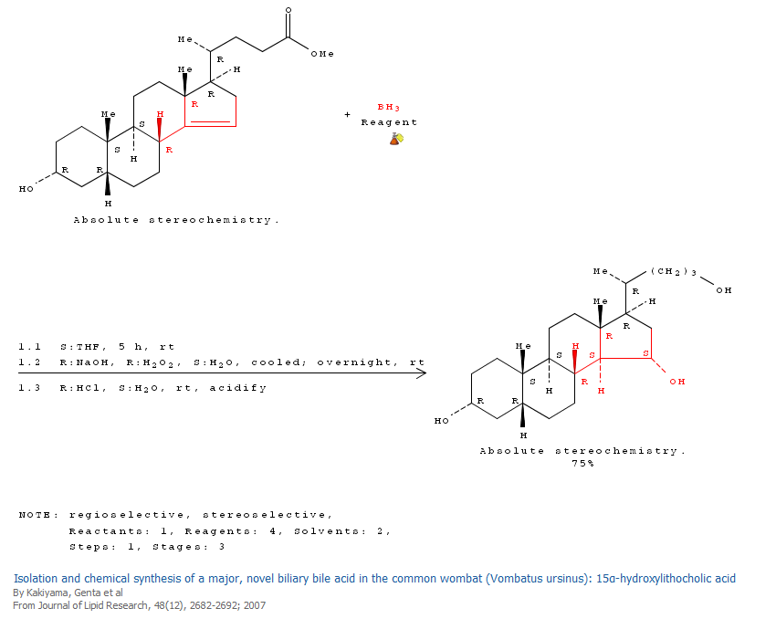

Slide 37
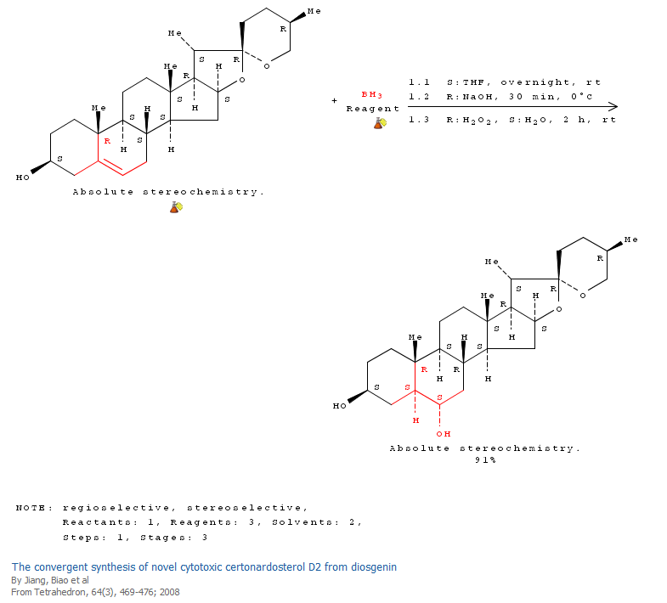

Slide 38
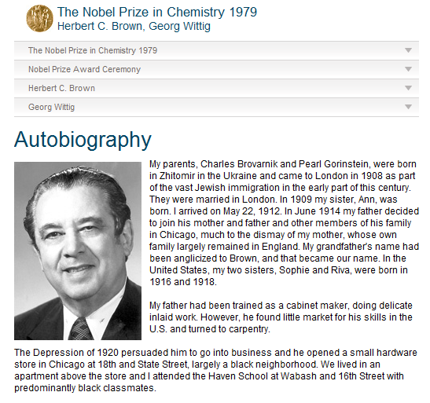

Slide 39
Br₂ reacts rapidly with most alkenes, leading to vicinal dibromides

Slide 40
To a first approximation, the reaction be mechanistically regarded as an electrophilic attack of a highly polarized bromine molecule on the double bond to produce an intermediate carbocation as shown

Slide 41
However, the observed trans geometry of addition to cyclic species (see following slides) suggests that the intermediate carbocation is actually a bridged species.

Slide 42
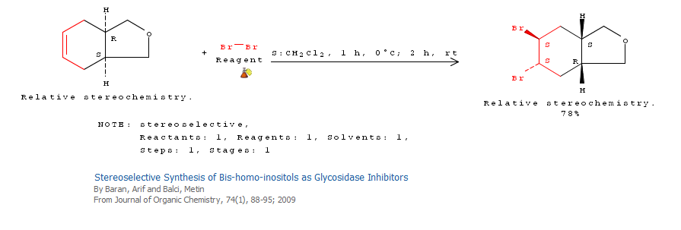

Slide 44
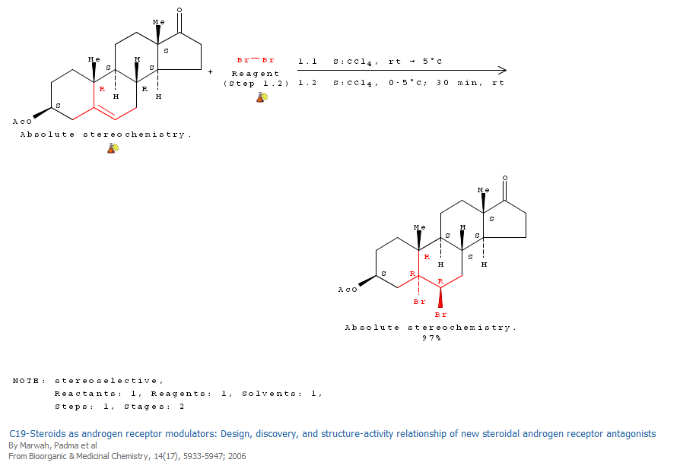

Slide 45
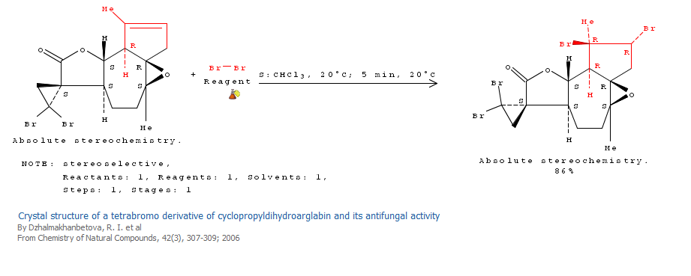

Slide 46
This intermediate bridged bromonium ion can also be intercepted by water and alcohols to form bromohydrin derivatives as shown.

Slide 47
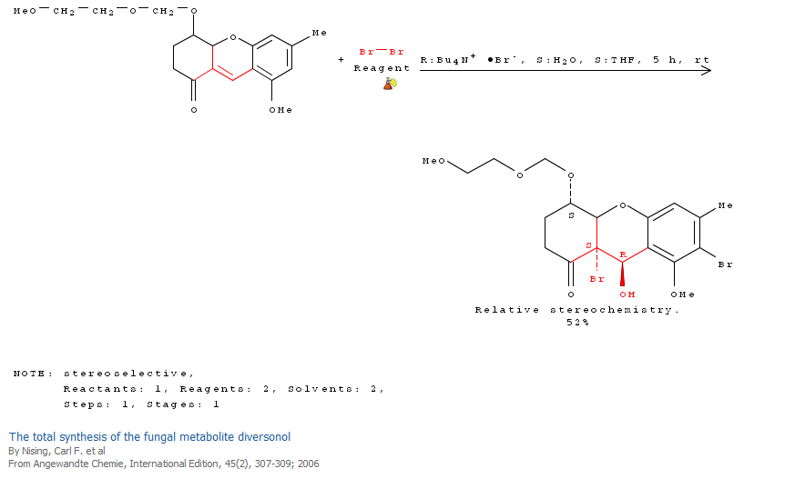

Slide 48
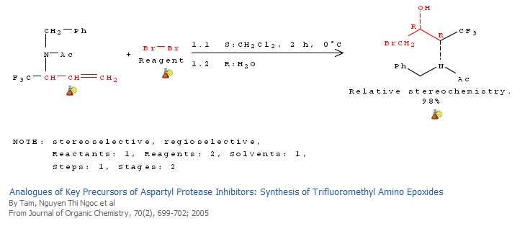
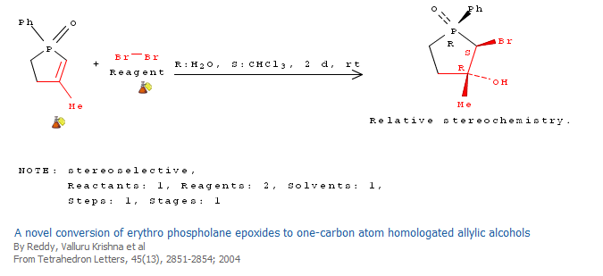

Slide 49
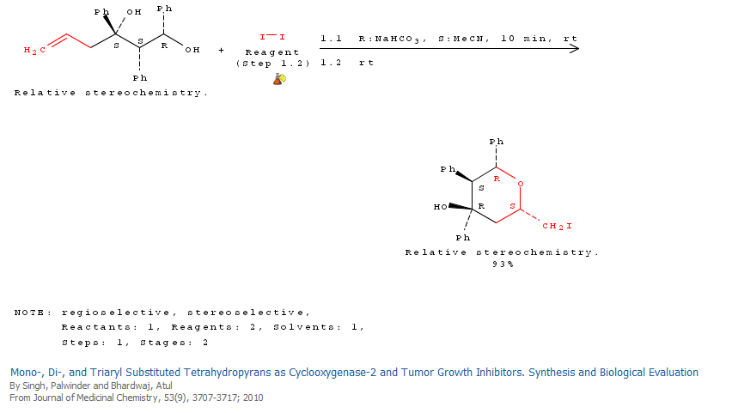

Slide 50
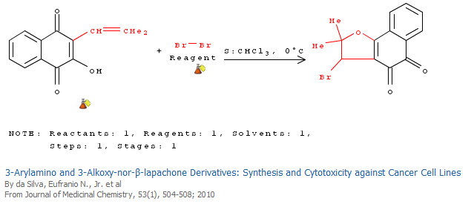
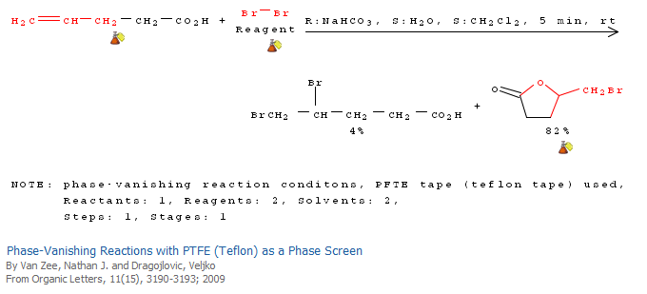

Slide 51
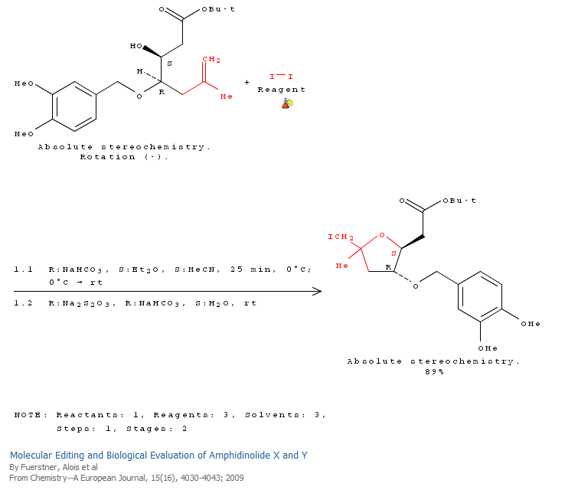

Slide 54
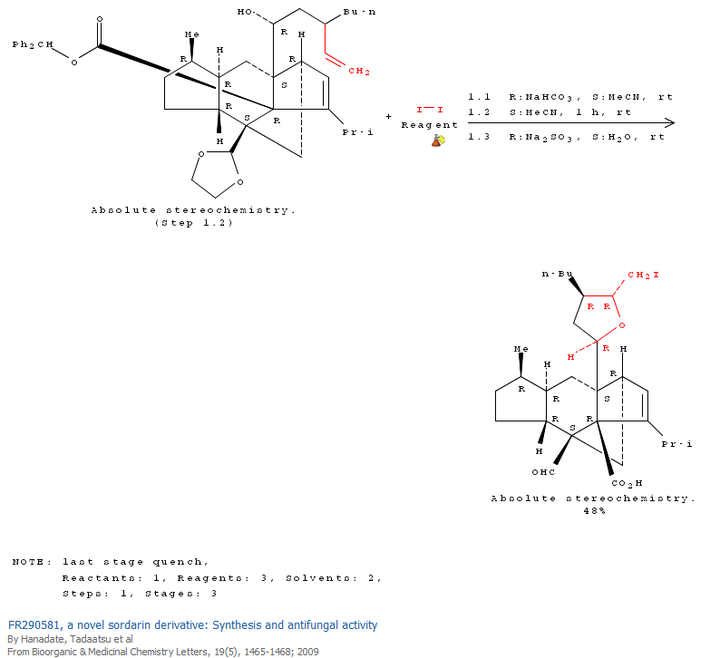

Slide 55
Hydrogenation of Alkenes
The most commonly used catalysts are heterogeneous (do not dissolve) and include Pd, Ni, and Pt. Often the metals are deposited on a support, like carbon.

Slide 56
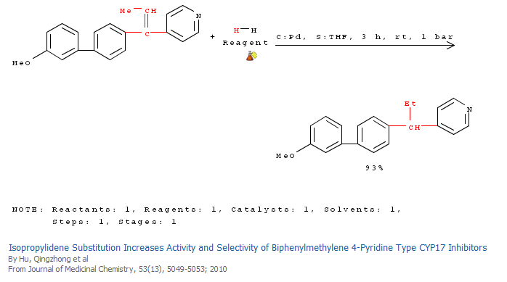

Slide 58
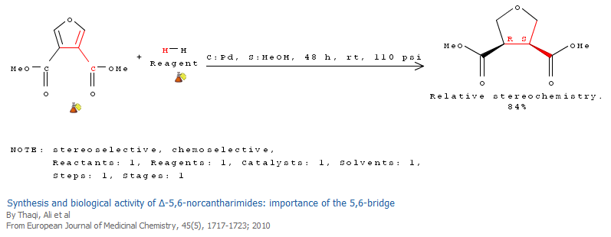

Slide 59
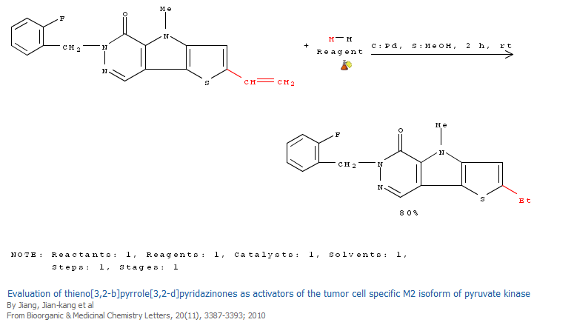

Slide 60
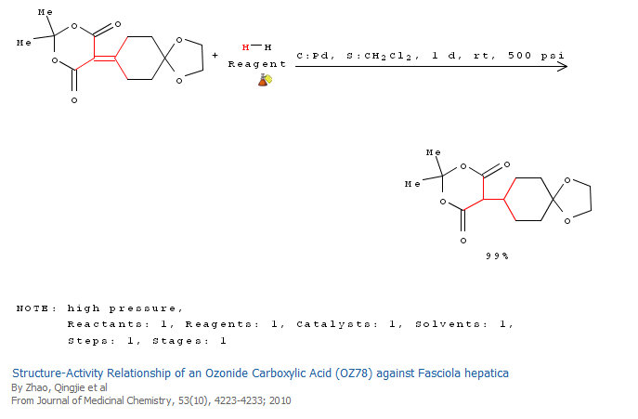

Slide 61
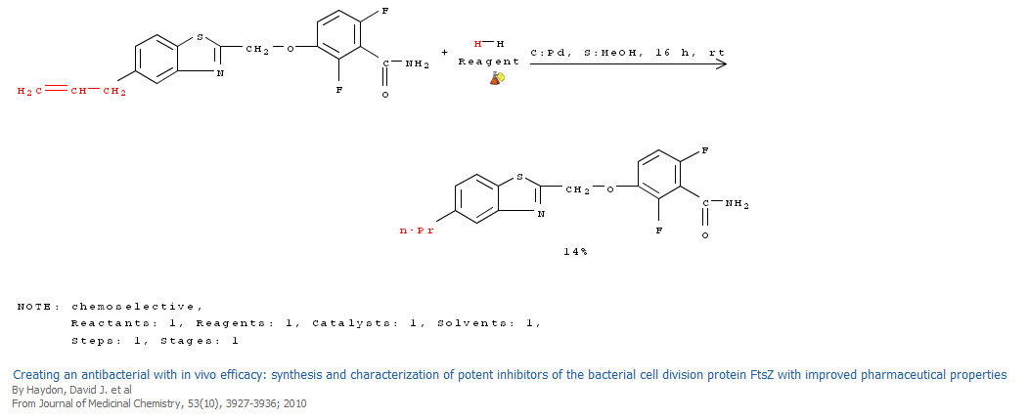
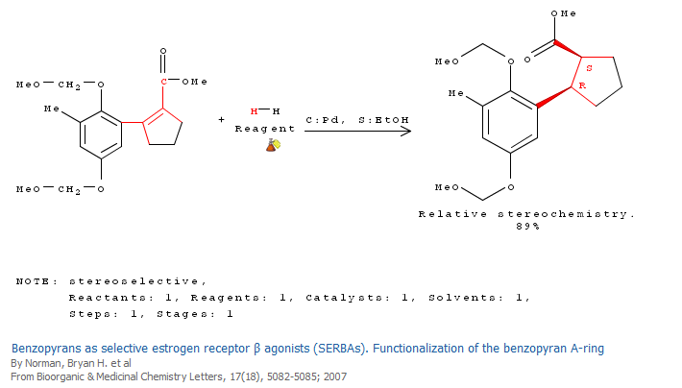

Slide 62
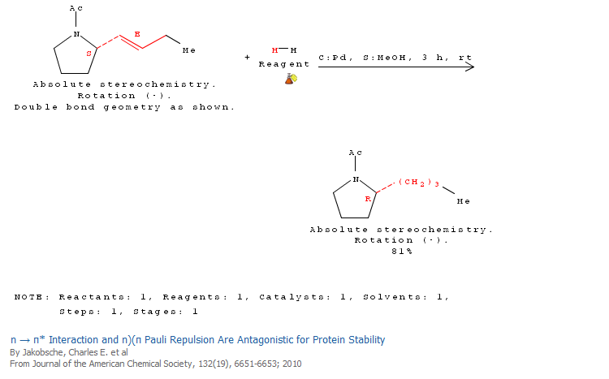

Slide 63
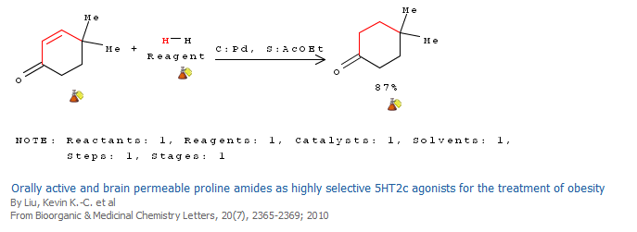

Slide 64
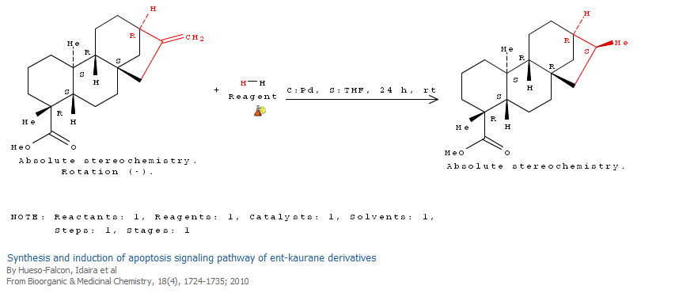

Slide 65
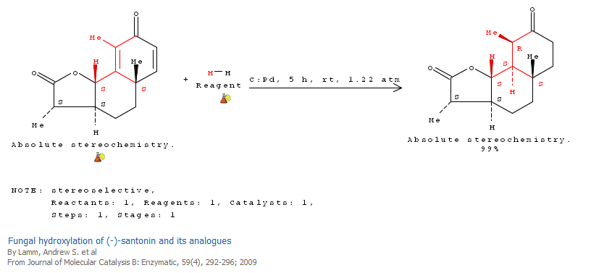

Slide 74
Epoxidation of Alkenes
One of the most commonly employed epoxidizing agents is m-chloroperoxybenzoic acid (mCPBA, shown at right)

Slide 79
Chiral Epoxidation

Slide 83
Allylic Alcohol

Slide 84
Chiral Intermediate for Sharpless Epoxidation

Slide 85
Dihydroxylation of Alkenes
A commonly utilized oxidant is N-methylmorpholine-N-oxide (NMO), shown to right.

Slide 86
Mechanism of Dihydroxylation with Osmium Tetroxide

Slide 91
Sharpless Asymmetric Dihydroxylation

Slide 93
Dihydroxylation of Alkenes is also possible with potassium permanganate (KMnO₄).

Slide 95
Treatment of an alkene with ozone (O₃), followed by a reducing agent (dimethyl sulfide), cleaves the double bond down the center, as shown below.

Slide 96
Structure of Ozone

Slide 97
Ozonolysis Mechanism

Slide 101
Cationic Polymerization

