Slide 1
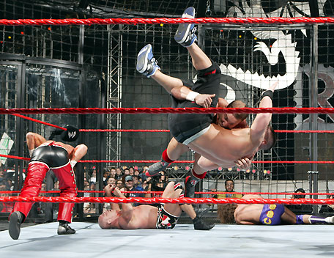
Elimination Reactions
In addition to substitution, alkyl halides can also undergo elimination reactions, which lead to the formation of alkenes.
As with substitution reactions, elimination reactions come in two mechanistic types:
E1 eliminations (a two-step process involving an intermediate carbocation)
E2 eliminations (a one-step process involving a concurrent abstraction of a proton, from an adjacent carbon, and extrusion of the leaving group)
(E1)
(E2)

Slide 2
E1 Elimination
In this, two-step process, the rate of the reaction is dependent on the rate of ionization of the substrate (as was the case in the S_{N}1 reaction)
Rate = k[R-X]

Slide 3
As shown below, the intermediate carbocation may distribute itself between elimination and substitution (and also rearrangement, not shown).

Slide 4
In the case of E1 elimination, as was the case with S_{N}1 substitution, the base (nucleophile for S_{N}1) does not need to be strong. The slow step is formation of the carbocation, and subsequent reactions occur rapidly.

Slide 5
Regiochemistry of E1 Reaction
In cases where more than one regioisomeric double bond is possible, the more substituted double bond may predominate (Zaitsev’s Rule).

Slide 6
E2 Elimination
Like the S_{N}2 substitution, the E2 elimination is a one-step process.
Like the S_{N}2 substitution, the E2 elimination often requires stronger bases (nucleophiles for S_{N}2).
Like the S_{N}2 substitution, the E2 elimination exhibits bimolecular kinetics.
Rate = k[R-X][B⁻]

Slide 7
Geometry of E2 Elimination
Like the S_{N}2 substitution (which requires backside attack), the E2 elimination reaction has a geometric preference for an anti-coplanar orientation of the H-C-C-X bonds.
In some cases, this may result in a stereospecific reaction, where one stereoisomer of the halide results in one geometric isomer of the alkene and the opposite stereoisomer of the halide produces the opposite geometric isomer of the alkene.

Slide 8
Commonly utilized bases to effect elimination reactions

Slide 9
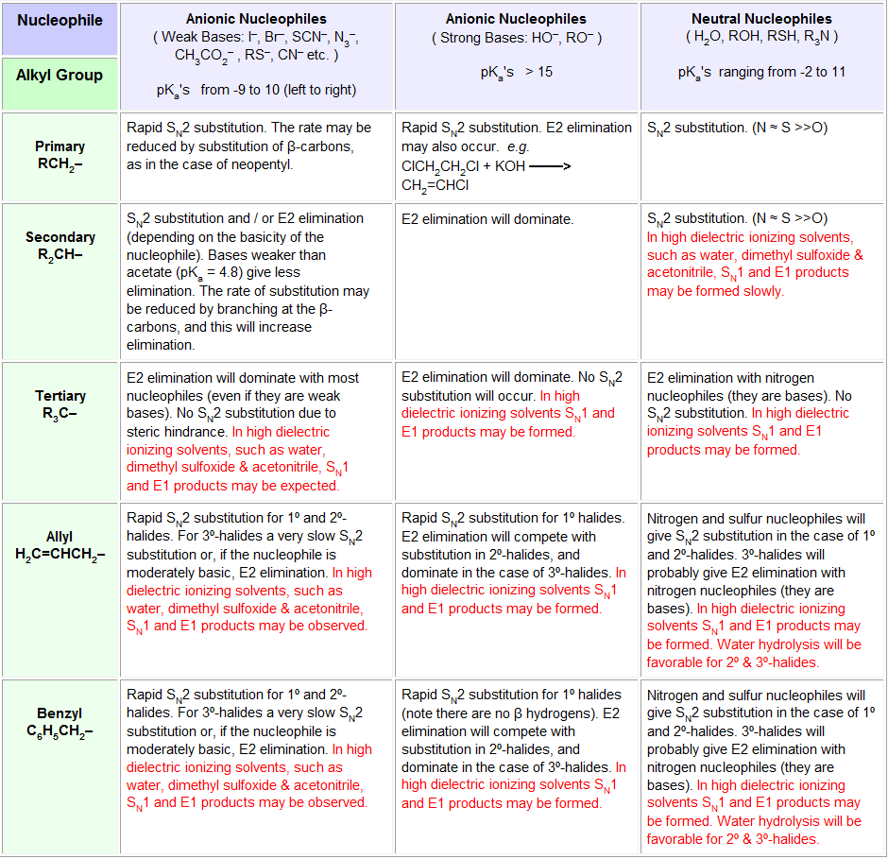

Slide 10
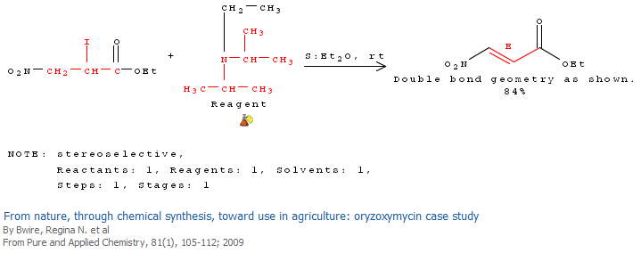
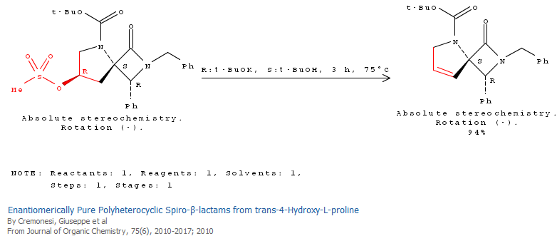

Slide 11
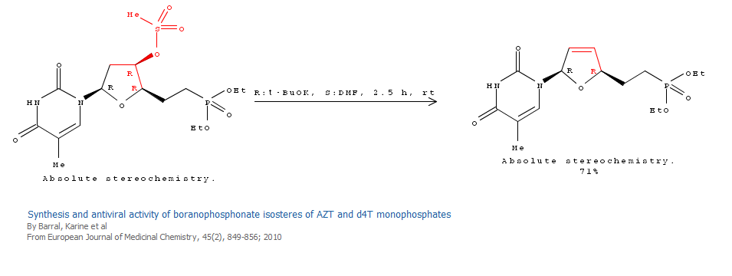

Slide 12
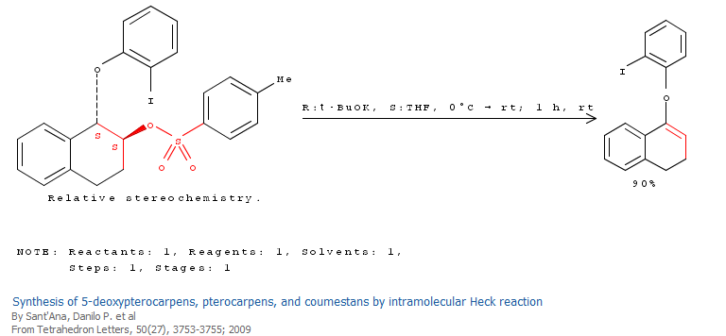

Slide 13
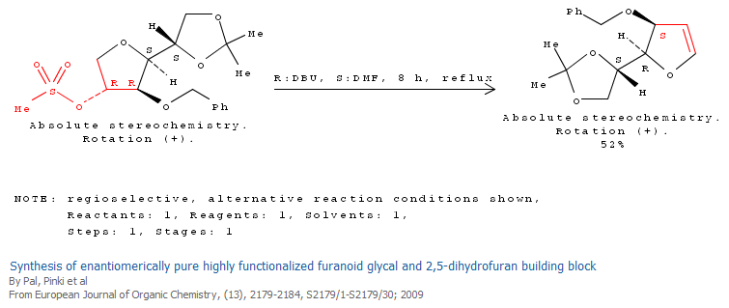

Slide 14
A third mechanistic type of elimination reactions: E1cb (E1 conjugate base)
Recall:
E1 elimination: intermediate carbocation (forms slowly)
E2 elimination: concerted, one step, requires coplanar arrangement of H-C-C-X bonds
In the E1cb mechanistic type, the intermediate is a carbanion.

Slide 15
The E1cb mechanism tends to be operative when there is a carbanion-stabilizing group (electron withdrawing group = EWG) present and when there is a relatively poor leaving group.

Slide 16
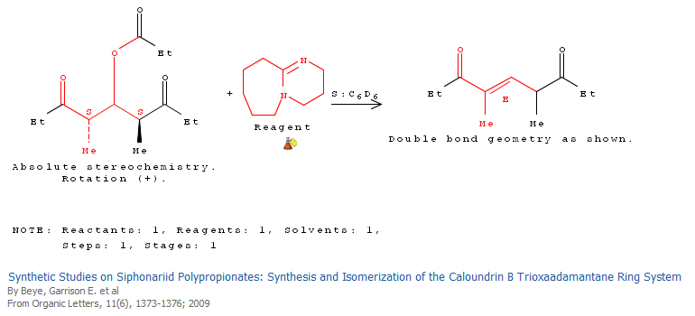

Slide 18
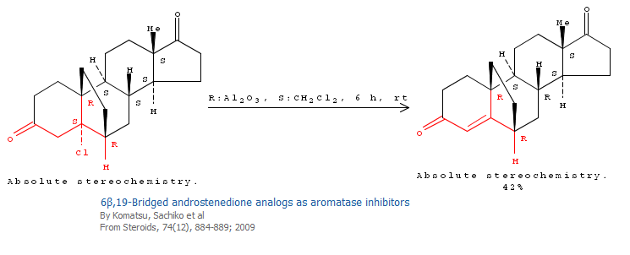

Slide 19
Dehydration of Alcohols
Since hydroxide is a poor leaving group, it is common to first protonate the oxygen of the alcohol with a strong acid. The leaving group is thus the (neutral) water molecule as shown.

Slide 22
Dehydration of Alcohols
Alternatively, one can convert the O-H group to a better leaving group as shown below.

Slide 23
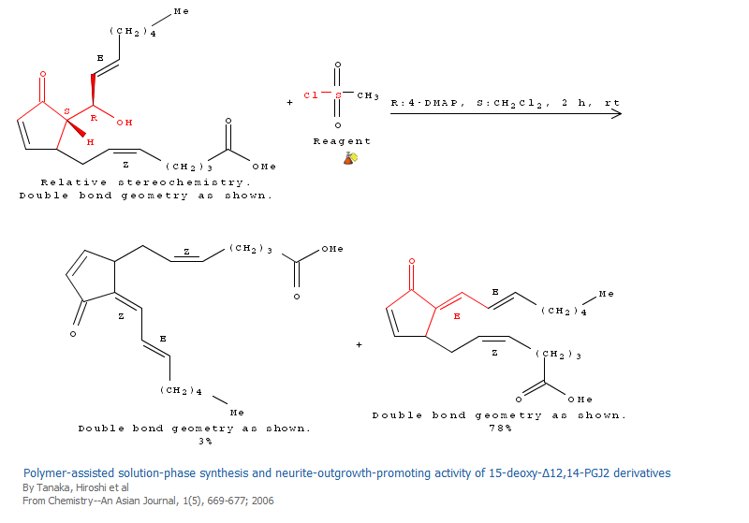

Slide 24
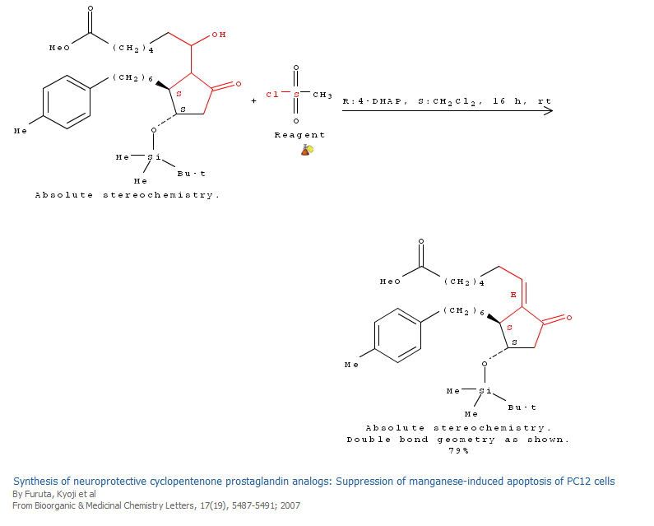

Slide 25
Debromination of Vicinal Dibromides

Slide 26
