Slide 1
Fundamental Concepts
Reactions involve the breaking and formation of bonds
Bonds are comprised of electrons
So, to understand chemical reactivity, we must know where the electrons are.

Slide 2
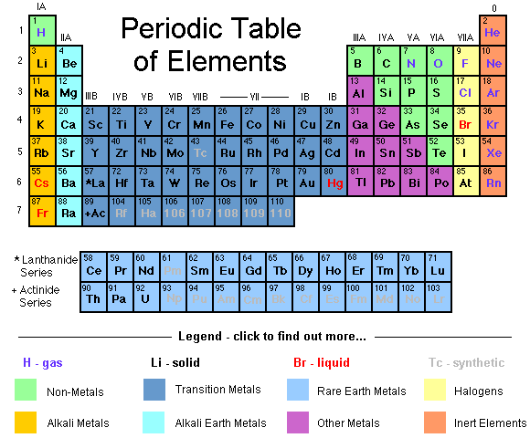
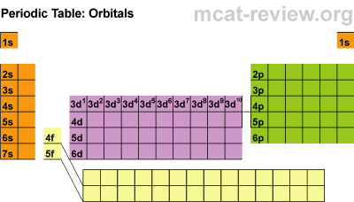
In the elemental state, each element is assumed to possess an equal number of protons and electrons. Thus, as we progress across each row, we add one proton to the nucleus and one electron to the valence shell to maintain charge neutrality.

Slide 3
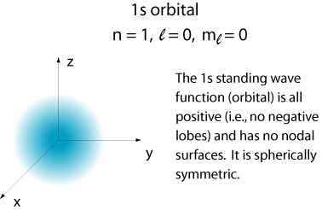
Where do the electrons go?
Elements in the first horizontal row have only the 1s orbital

Slide 4
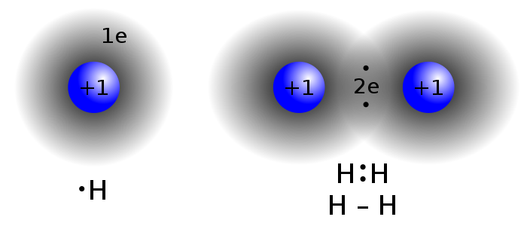
In stable molecules, electrons from individual elements are shared to form covalent bonds as shown
hydrogen radical
Covalent σ bond
s orbitals are spherically symmetric
The electrons in s orbitals lie close to the nucleus

Slide 5
This sharing occurs to produce a more stable state, where, through the sharing of electrons, each element effectively completely fills its valence shell.
One valence electron
One valence electron
Each hydrogen atom has
achieved a full shell of two valence electrons by sharing electrons, thus mimicking the noble gas configuration of helium.

Slide 6
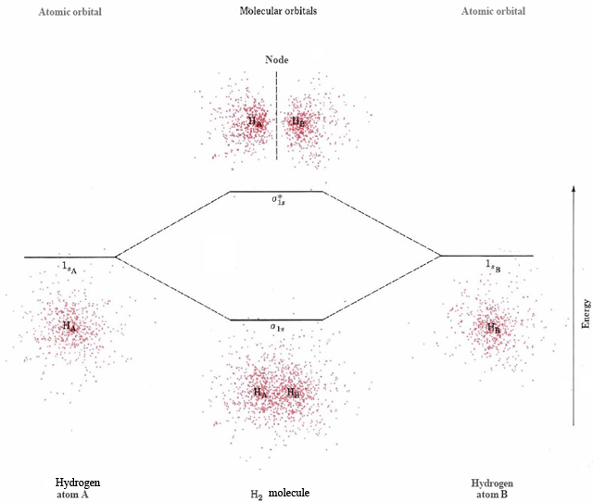

Slide 7
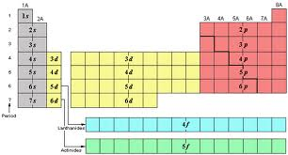
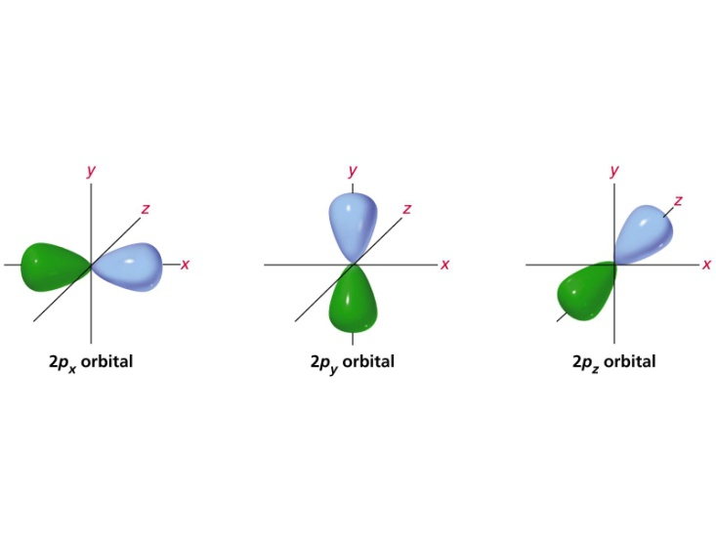
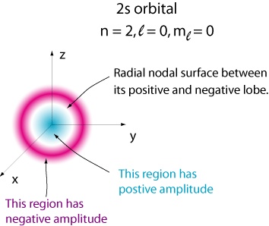
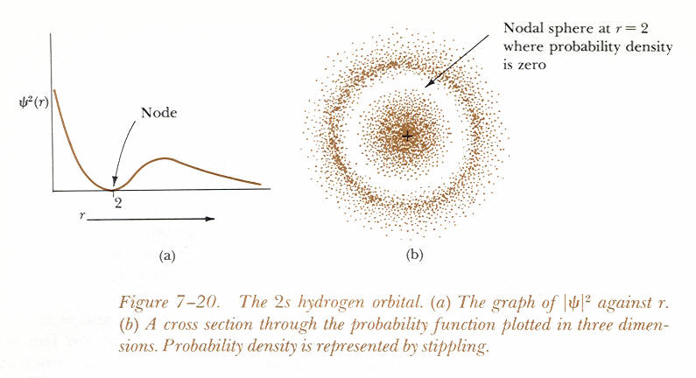
Second row elements will use both 2s and 2 p orbitals…
Link

Slide 8
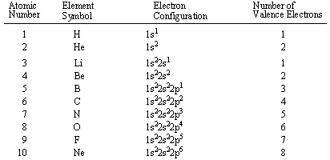

Slide 9
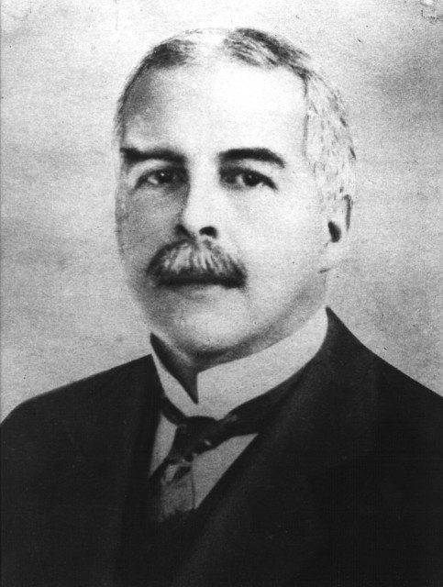
J. Am. Chem. Soc. 1916, 38, 762.
In 1916, G. N. Lewis introduced the concept of the “octet rule” which states that, for second row elements boron through neon, the most stable structures have eight valence shell electrons.

Slide 10
In this publication, Lewis began using elemental representations having four sides with paired dots to represent electron pairs, which have since become known as ‘Lewis Structures’.
J. Am. Chem. Soc. 1916, 38, 762.

Slide 11
Note that each element below has zero charge, since it has exactly the correct number of valence electrons to balance its position in the periodic table.
Third element in second row, has three valence electrons
Fourth element has four valence e-.

Slide 12
Note, however, that each of the elements, with the exception of boron, has achieved a noble gas configuration by sharing electrons. (Notice that, by octet rule counting, the shared pairs are counted twice, as belonging to both of the sharing nuclei, thus helping them to fulfill their respective valency requirements)

Slide 13
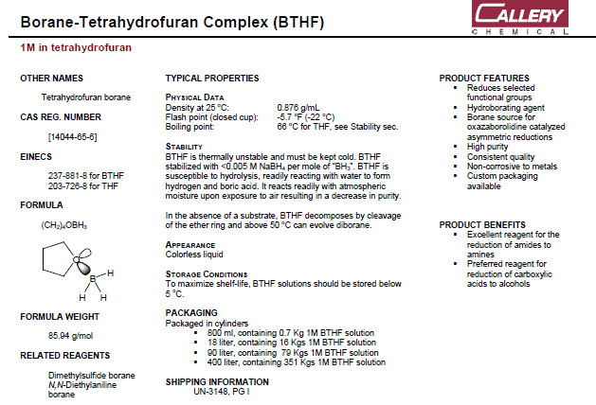
The lack of a complete octet results in enhanced reactivity toward electron rich functionality as shown below.

Slide 14
When drawing structures, it is important to properly assign charge, know where the lone pairs of electrons are, which atoms are lacking a full octet, and to understand the abbreviations used.

Slide 15
When you draw a structure, make sure that you assign the proper charge to the element, and that you know how many valence electrons the element possesses. Recall before, to balance the charge we paired the proper element with the proper number of electrons:
Third element in second row, has three valence electrons
Fourth element has four valence e-.

Slide 16
Thus, when you see a molecule, how can you assign proper charge? How can you count the electrons for each element?
Third element in second row, has three valence electrons
Fourth element has four valence e-.

Slide 17
Counting Electrons to Assign Charge
Reversing the previous process, break the bonds homolytically:

Slide 18
Example: Assigning Charge states of nitrogen:

Slide 19
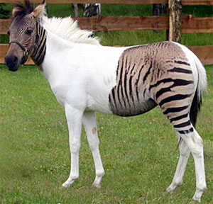
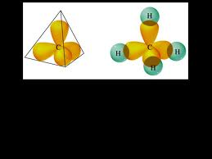
Hybridization
In order to attain maximum stability, the elements employ hybridized states of the second row orbitals. Thus, instead of using one s orbital and three p orbitals, they will employ either:

Slide 20
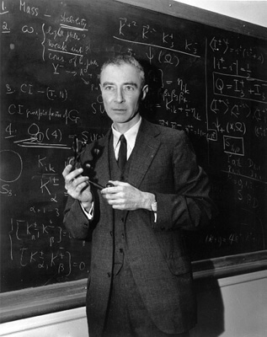
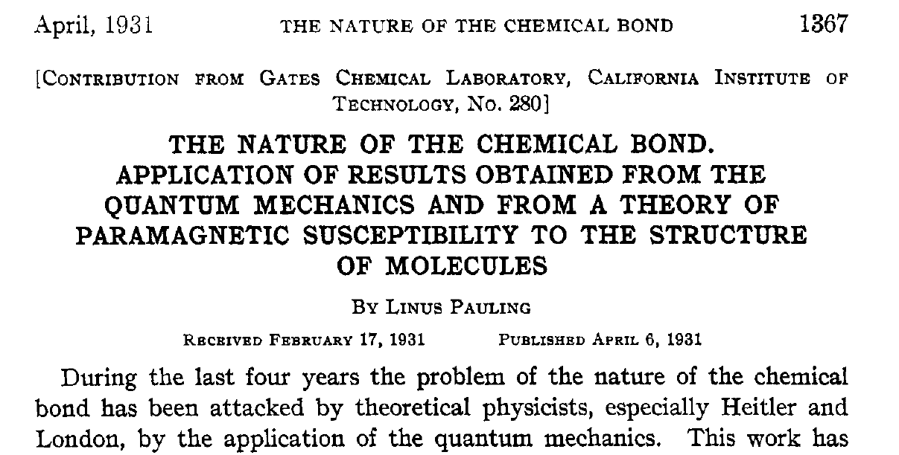
J. Am. Chem. Soc. 1931, 53, 1367.

Slide 21
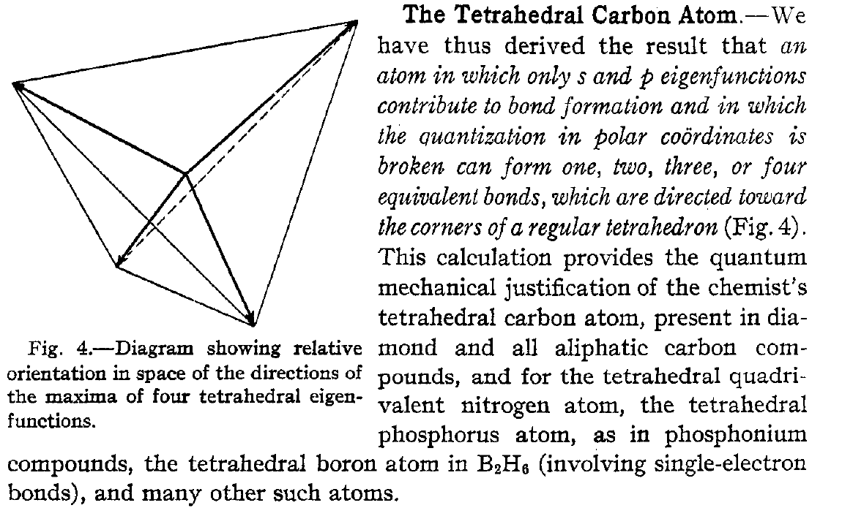
J. Am. Chem. Soc. 1931, 53, 1367.

Slide 22
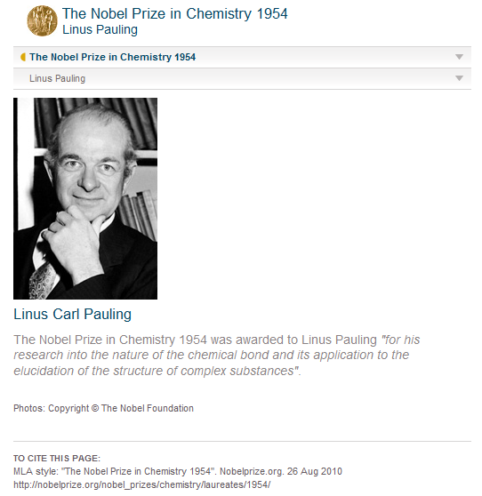

Slide 23
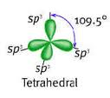
Link

Slide 24
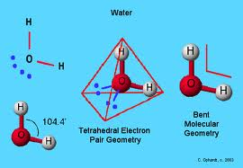
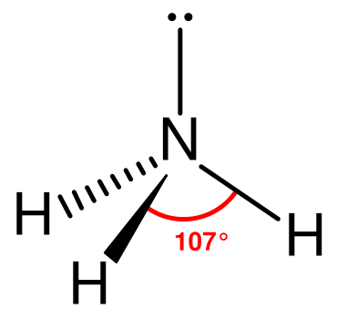
The sp³ hybridization state is the preferred state for heteroatoms, such as nitrogen and oxygen, in functionality such as amines, ethers, and alcohols. (Note however that nitrogen will adapt the sp2 hybridization state when next to a carbonyl, in the case of a carboxamide, for example, as shown later).

Slide 25
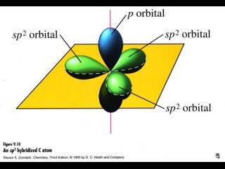
sp² Hybridization

Slide 26
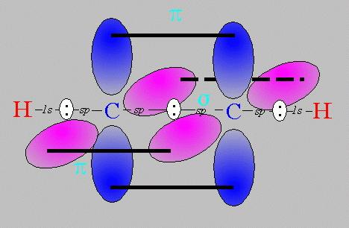
sp Hybridization (see ethyne below)

Slide 27
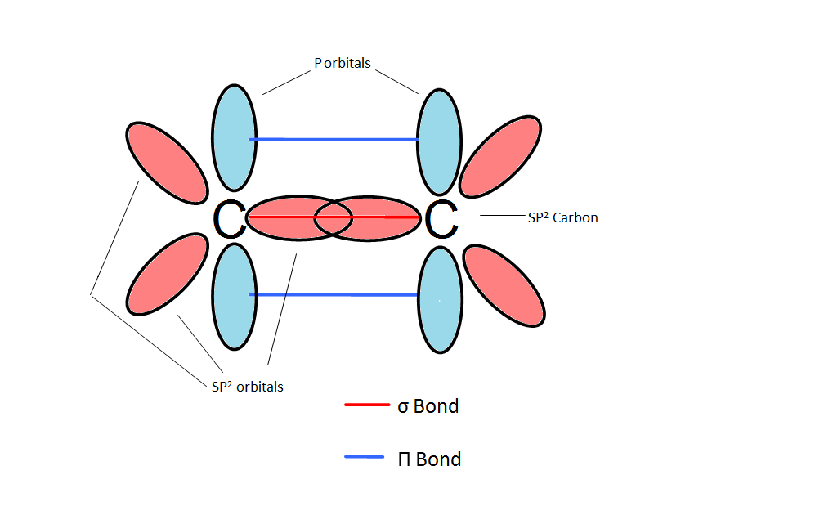
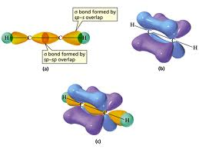
The elements must utilize p orbitals to form multiple bonds (note that the p orbitals must be
parallel to one another)
Link
Link

Slide 28
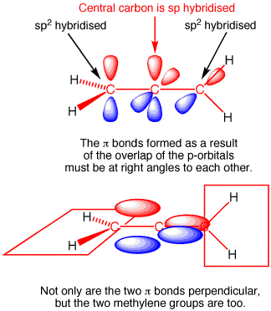
The molecule 1,2-propadiene (allene) is an interesting example of hybridization. The central carbon is sp hybridized, while the terminal carbons are sp2 hybridized. The sp2 orbitals of the terminal carbons are orthogonal to one another due to the fact that the central carbon must utilized a different p orbital to make the two respective double bonds.
Link

Slide 29
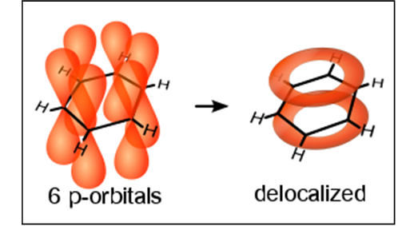
Molecules can utilized a continuous (unbroken) array of parallel p orbitals (on adjacent atoms) to extensively delocalize electrons in a phenomenon called resonance.
Link

Slide 30
Resonance Stabilization: Electrons, including lone pairs, and unpaired single electrons (radicals), as well as positive charge, all benefit from being delocalized over more than one atom. Such delocalization can occur through an unbroken system of parallel p orbitals.

Slide 31
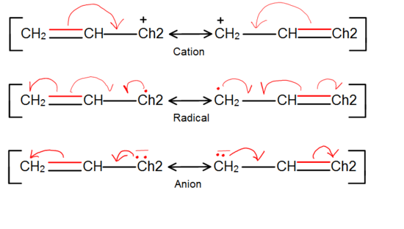
Resonance through adjacent p orbitals is used to delocalize charge, positive or negative, or an unpaired electron, as in the case of a radical.
We use a double headed arrow, to designate that the pictures do NOT represent an equilibrium, but, instead, are two pictures of the same entity, thus indicating that the real depiction is somewhere in between the two pictures. Note that resonance structures always involve ONLY the ‘movement’ of electrons, never of nuclei.

Slide 32
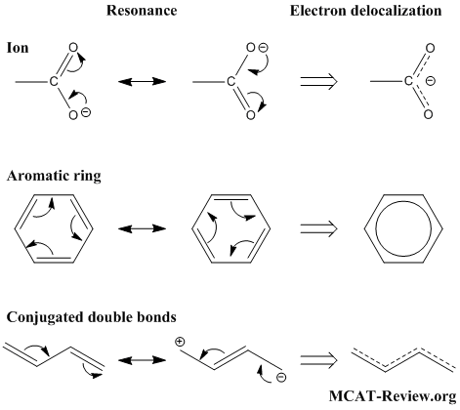

Slide 33
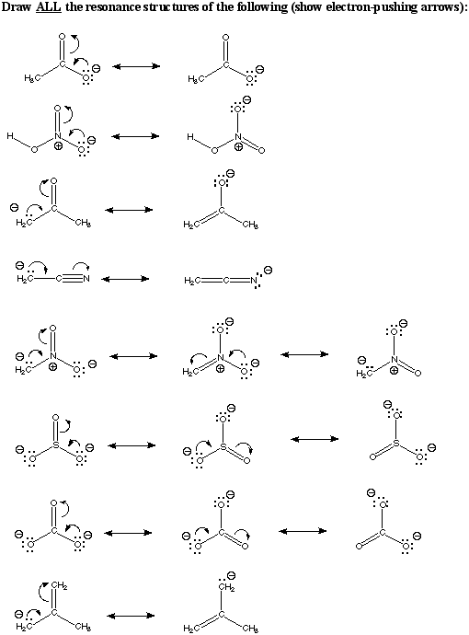
In these examples adjacent pi electrons (C=C) provides stabilization of the anionic charge.

Slide 34
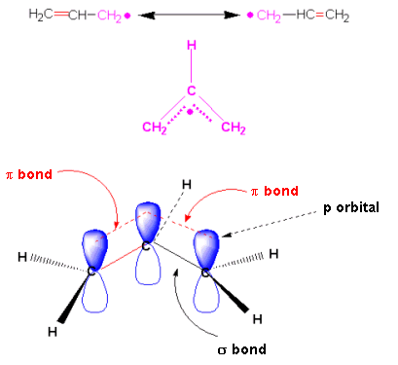
Notice that all the participating atoms must possess a p orbital (which must be oriented parallel to other participating p orbitals). Thus none of the atoms can be sp³ hybridized.
The Allyl Radical

Slide 35
As the traditional resonance forms suggest, the majority of the electron deficiency (for an ally cation, for example) lies at the two terminal carbons, and not at the central carbon. This is demonstrated by the reactivity of such systems.
The Allyl Cation

Slide 36
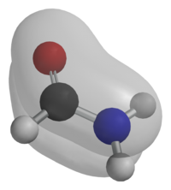
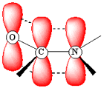
For heteroatoms, the ability to engage in a resonance interaction overrides their normal tendence toward sp³ hyrbidization, resulting in their adopting an sp² hybridized state, so that they will have a p orbital to interact with adjacent p orbitals.

Slide 37
In the following example, resonance stabilization of an intermediate carbocation was provided by the lone pair of electrons on the adjacent oxygen. This heteroatom must, therefore, become sp² hybridized, having the lone pair in a p orbital.

Slide 38
The ability to engage in resonance has chemical and structural consequences:

Slide 39
Hyperconjugation
In some cases, such as that of a carbocation, it is believed that even adjacent s bonds can align themselves partially parallel to the empty p orbital and delocalize their electrons, leading to enhanced stability. This explains the fact that tertiary carbocations are more stable than secondary, which are more stable than primary.
Increasing Carbocation Stability

Slide 40
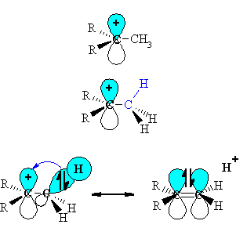
Hyperconjugation

Slide 41
Acids and Bases
Proton transfer, due to a proton transfer between a bronsted acid and a Bronsted base, is usually the kinetically fastest reaction in solution. Thus it is important to understand which types of functionality serve as proton donors and which will serve as proton acceptors.
pK_{a} = -log₁₀K_{a}

Slide 42
From a qualitative standpoint, a useful equation to remember is the Henderson Hasselbalch form shown below.
When [A-] = [HA],
pH = pK_{a}
Thus the pK_{a} equals the pH required to deprotonate exactly half of the acid in solution.

Slide 43
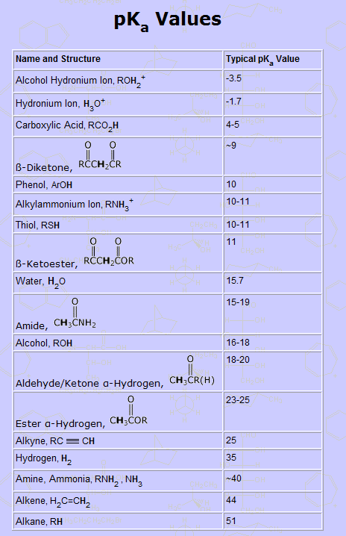
Link
Link

Slide 44
To a first approximation, acidity is related to the inherent electronegativity of the various elements (A). The more electronegative the element, the more acidic is H-A.
C < N < O < F
Increasing electronegativity

Slide 45
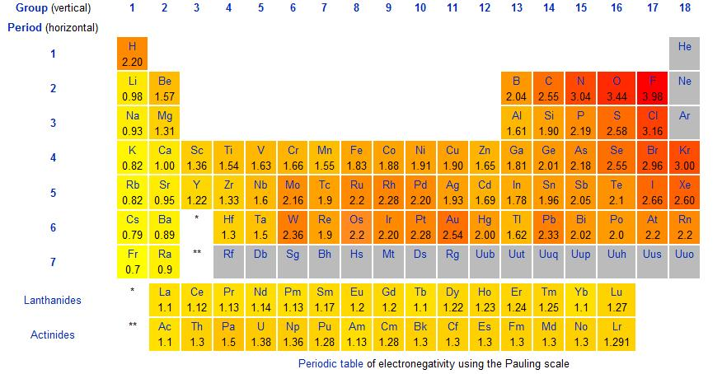
Pauling Scale of Electronegativity

Slide 47
C < N < O < F
Increasing electronegativity
Logically, the stability of the conjugate base is inversely related to electronegativity.
CH₃⁻ < NH₂⁻ < HO⁻ < F⁻
Increasing stability of conjugate base

Slide 48
pKa = 48 38 16 3
CH₄ < NH₃ < HOH < HF
Increasing acidity
CH₃⁻ > NH₂⁻ > HO⁻ > F⁻
Increasing basicity

Slide 49
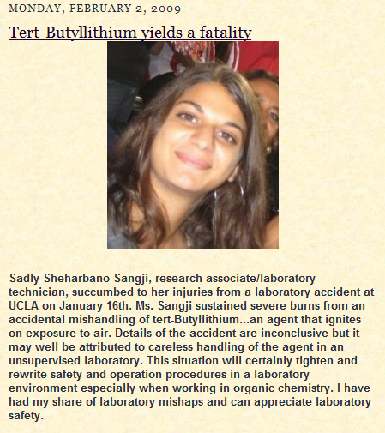
Alkyllithium reagents are extremely basic, and need to be handled with care. (pKa methane = 48). The amount of heat generated on their reaction with water, or with alcohols is enough to cause them to ignite.
Some alkyllithium reagents, like tert-butyllithium are pyrophoric (ignite spontaneously on contact with air).

Slide 50
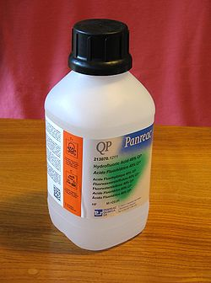
Pauling Electronegativity
But, if electronegativity were the only factor controlling acidity, based on the values at the right, we would expect HF to be the strongest HX acid, but, in fact, the strongest HX acid is HI.
HF, pKa = 3 (weakest acid)
HCl, pKa = -8
HI, pKa = -10 (strongest acid)

Slide 51
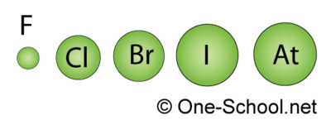
Size Matters!!
In addition to the inherent electronegativity of the element, the negative charge of the halide anion is also stabilized by the increasing size of the atom
HI > HBr > HCl > HF
Increasing Acidity

Slide 52
Link
However, despite its relatively weak acidity, HF is very corrosive, reacting, for example, with glass. Thus solutions of HF are stored in polyethylene bottles.
Also HF is very toxic, and causes severe burns. HF is absorbed quickly, reacting with the calcium in the bloodstream and can cause cardiac arrest.
High concentrations of HF gas can destroy the corneas of the eyes

Slide 53
But the electronegativity (and/or size) of the element on which the negative charge is localized is not the entire story, as shown by the following differences in acidity, when the anion is in each case, an oxygen anion.
Increasing Acidity

Slide 54
Two important factors influencing acidity include:
the ability of the atom on which the negative charge is localized to engage in resonance stabilization (delocalization); and
b) the electronegativity of surrounding functionality

Slide 55
Increasing
Acidity

Slide 56
G. N. Lewis proposed a more broad theory of acidity and basicity, which encompassed elements other than hydrogen.
Lewis Acids are electron deficient (lack their full valence shell) and can thus serve as electron acceptors.
Lewis Bases are electron rich and can thus serve as electron donors.
(notice that the proton, H⁺, qualifies as a Lewis Acid).

Slide 57
Bond Polarity
Note that substantial differences in electronegativity, such as between oxygen and hydrogen, lead to polar bonds, where the electrons are pulled toward the more electronegative element, thus creating a charge separation.

Slide 58
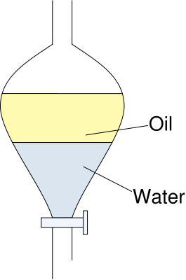
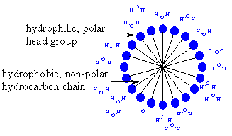
Bond Polarity
This contrasts with the C-H and C-C bonds, which are of (nearly) equal electronegativity, and are thus non-polar. Since ‘like dissolves like’ bond polarity influences many properties, including solubility as well as the ability of drugs to bind in the active sites of proteins.
A micelle

Slide 59
Proteins fold to sequester hydrophobic side chains in their interior

Slide 60
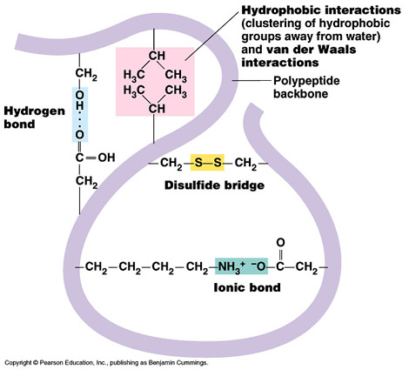

Slide 61
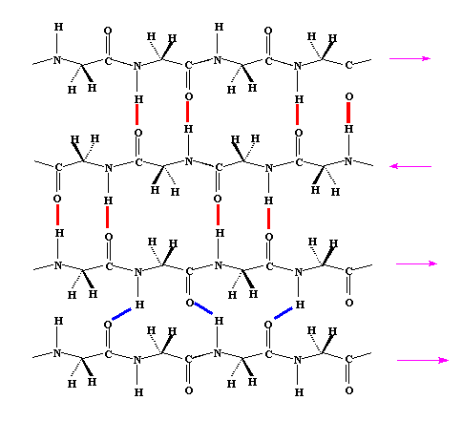
Proteins align adjacent sheets of polypeptides so as to maximize interactions between the sheets (called β-sheets) as shown below.

