Slide 2
Topics
Background
Gastric Acidity
What is GERD?
Factors Leading to GERD
Other Gastric Disorders
Treatment
Pharmaceutical Approaches
Reading Assignments/Questions
References

Slide 3
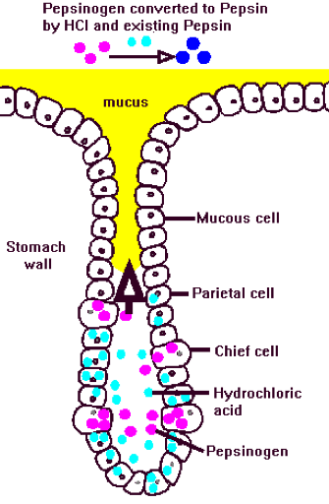
Gastric Acidity
Gastric Acid
Hydrochloric acid (pH ~ 1-2)
Produced by parietal cells
Breaks down proteins directly and indirectly
Gastric Pit

Slide 4
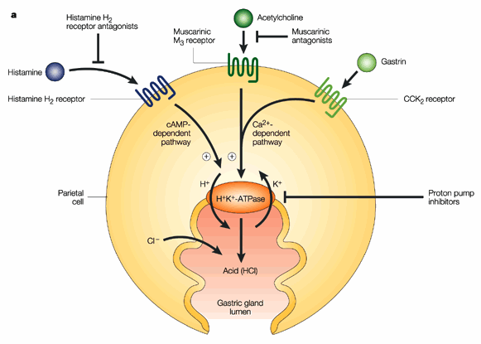
Gastric Acidity
Gastric Acid Pump
H⁺, K⁺–adenosine triphosphatase (H⁺/K⁺–ATPase)

Slide 5
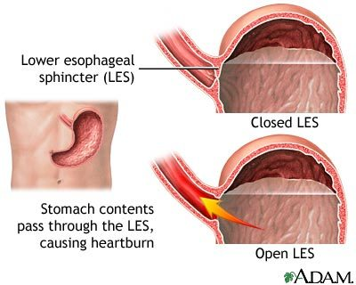
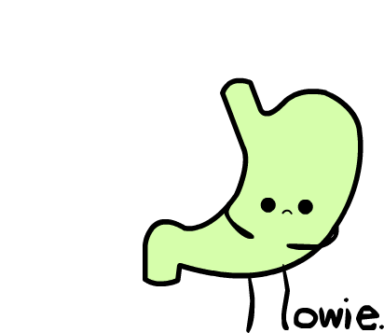
What is GERD?
Defined as “chronic symptoms or mucosal damage caused by stomach acid entering the esophagus”
“Chronic Heartburn”

Slide 6
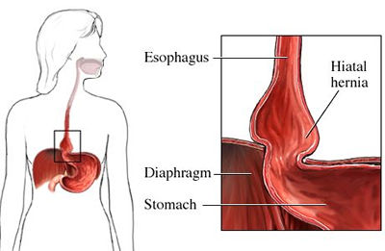
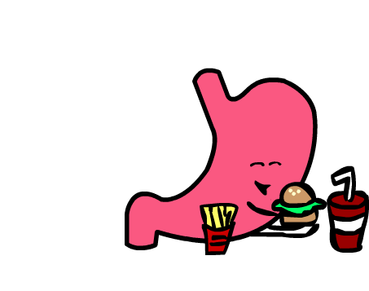
Factors Leading to GERD
Weak lower esophageal sphincter (LES)
Poor diet
Acidic foods/beverages, spicy foods, etc.
Hiatal hernia
Medications
Obesity
Alcohol
Smoking

Slide 7
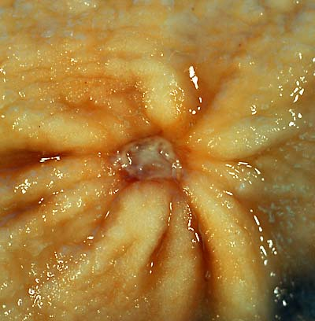
Other Gastric Disorders
Peptic Ulcer Disease
Imbalance between mucosal defense factors and acid
Leads to deterioration of stomach lining.
60 – 90% of cases are due to Helicobacter pylori
Can be caused by stress and worsened by NSAIDs

Slide 8
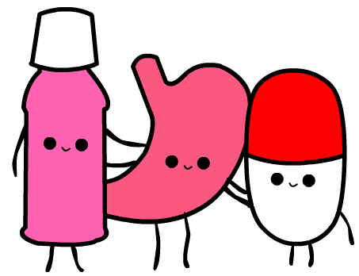
Pharmaceutical Approaches
Proton Pump Inhibitors
H2 Antagonists
Antacids
Sucralfate
Prokinetics

Slide 9
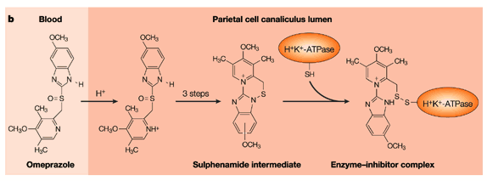
Proton Pump Inhibitors
Substituted benzimidazole prodrugs
Absorbed into blood via small intestine
Protonated in parietal canaliculus
Irreversibly binds to sulfhydryl groups on cysteine residue of H⁺/K⁺–ATPase

Slide 11
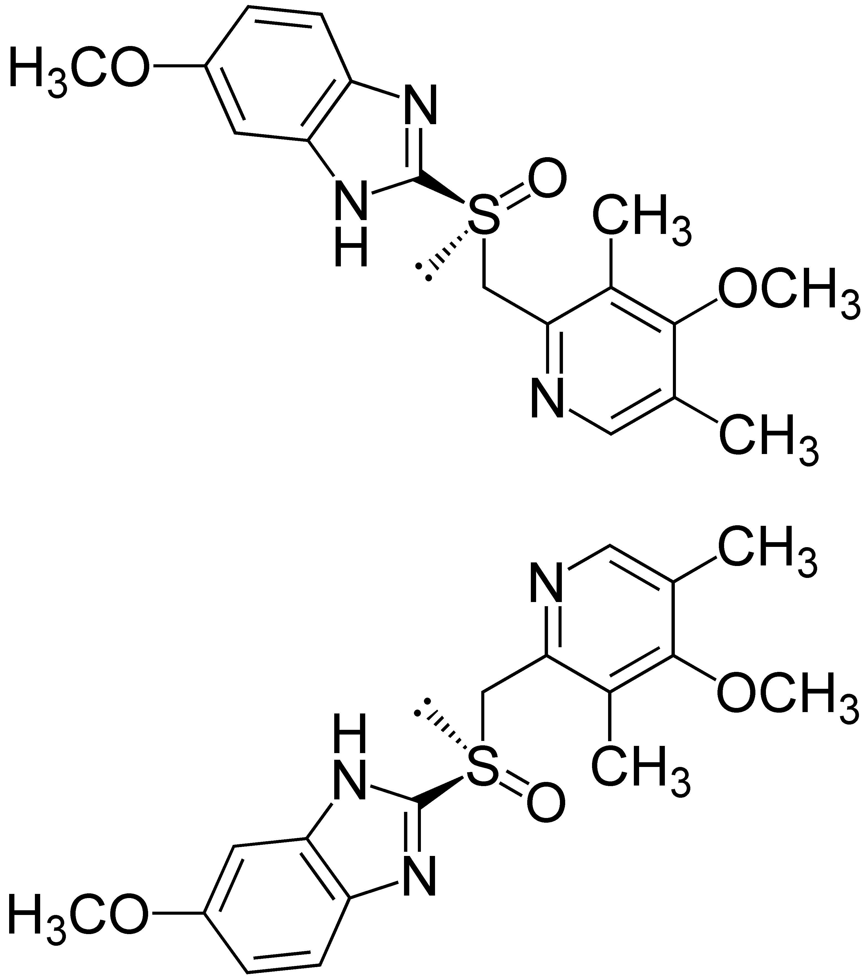
Proton Pump Inhibitors
Omeprazole (Prilosec®)

Slide 12
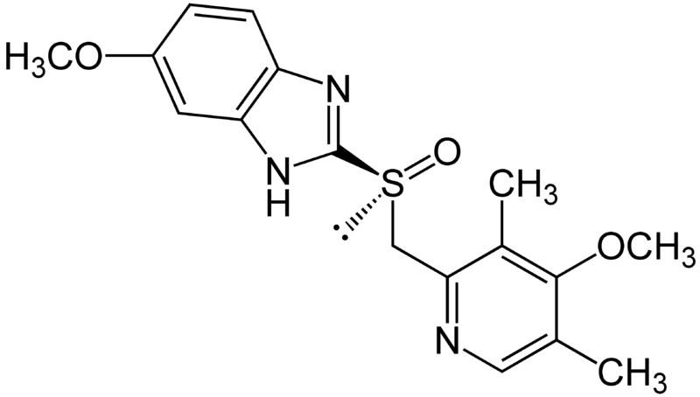
Proton Pump Inhibitors
Esomeprazole (Nexium®)
(S)-enantiomer of omeprazole
Improved efficacy in humans compared to omeprazole

Slide 13
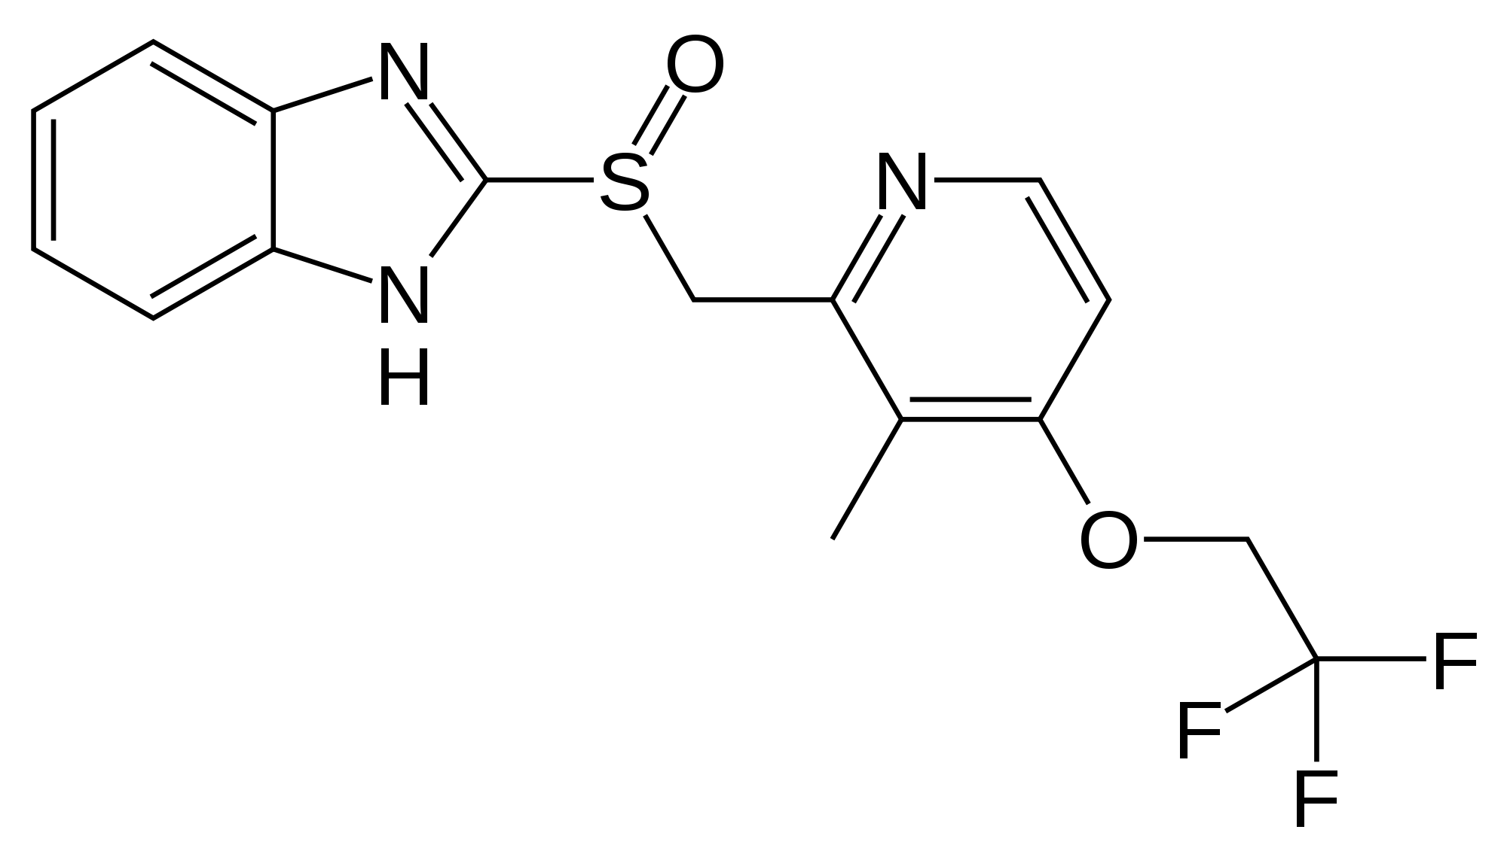
Proton Pump Inhibitors
Lansoprazole (Prevacid®)

Slide 14
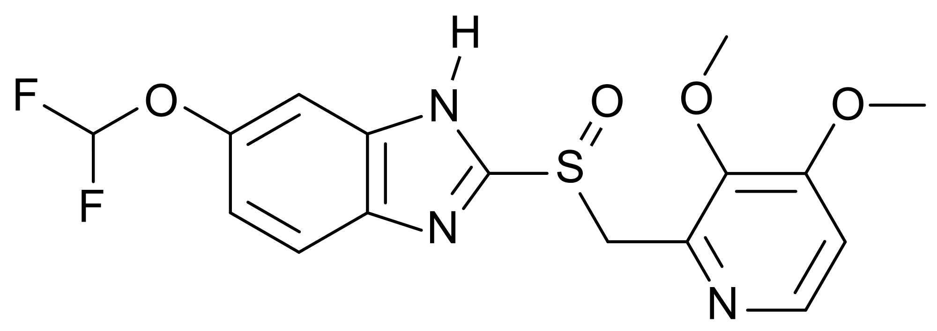
Proton Pump Inhibitors
Pantoprazole (Protonix®)

Slide 15
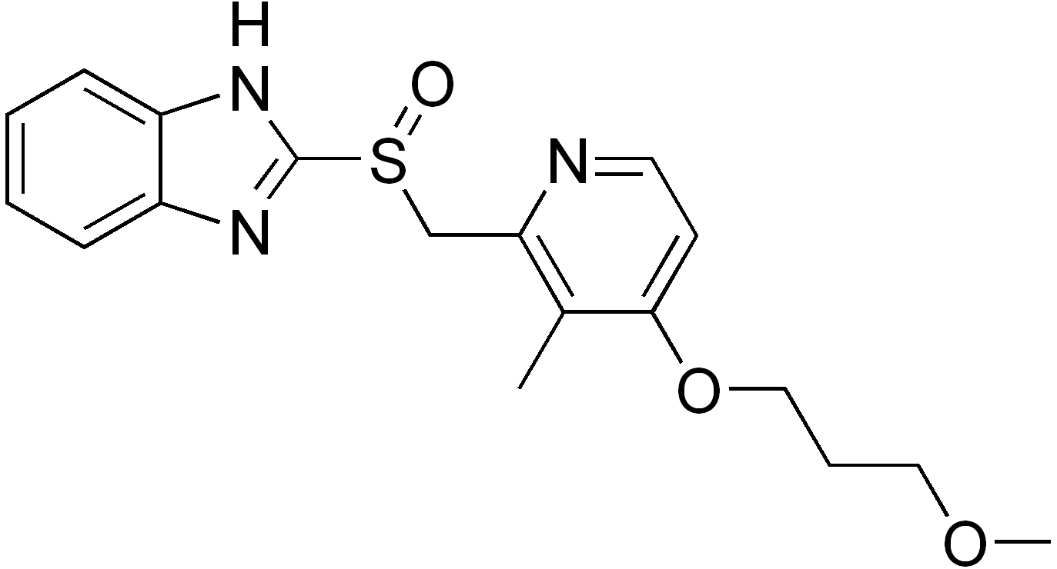
Proton Pump Inhibitors
Rabeprazole (AcipHex®)

Slide 16
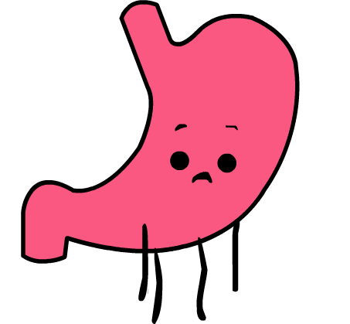
Proton Pump Inhibitors
Disadvantages
Reduced Vitamin B₁₂ uptake
Gastric acid is essential in releasing B₁₂ from food
Increased risk of Clostridium difficile infection
1.7× with once-daily use and 2.4× with twice-daily use
Risks are usually reduced by short-term prescriptions

Slide 17
H₂ Antagonists
Reversible, competitive antagonists of histamine at the parietal H₂ receptor

Slide 18
H₂ Antagonists
Cimetidine (Tagamet®)

Slide 19
H₂ Antagonists
Ranitidine (Zantac®)

Slide 20
H₂ Antagonists
Famotidine (Pepcid®)

Slide 21
H₂ Antagonists
Nizatidine (Tazac®)

Slide 22
H₂ Antagonists
Disadvantages
Provide only temporary relief
Slow onset of action
Body can quickly develop tolerance to them
Can be overcome by food-induced stimulation of acid secretion (gastrin or acetylcholine)
Cimetidine has minor antiandrogen effects
Reversible gynecomastia and possible erectile dysfunction

Slide 23
Antacids
Neutralize gastric acid and reduce pepsin activity
Two Types
Absorbable
Carbonates
Nonabsorbable
Aluminum hydroxide and magnesium hydroxide

Slide 24
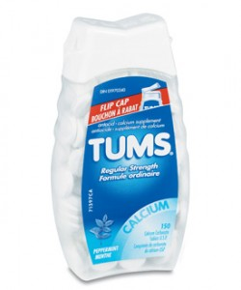
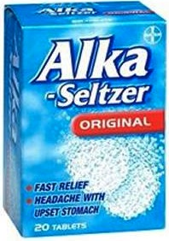
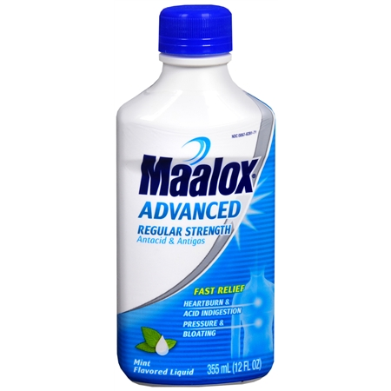
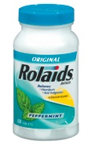
Antacids
Alka-Seltzer
NaHCO₃ and KHCO₃
Tums
CaCO₃
Rolaids
Combination of CaCO₃ and Mg(OH)₂
Maalox
Combination of Al(OH)₃ and Mg(OH)₂

Slide 25
Antacids
Disadvantages
Very short term of relief
Absorbable antacids may cause alkalosis
Should only be used 1-2 days
Aluminum hydroxide may cause phosphate depletion
Aluminum binds with phosphate in GI tract
Magnesium hydroxide may cause diarrhea
Used with aluminum hydroxide to reduce this effect

Slide 26
Sucralfate
Sucrose-aluminum complex
Reacts with gastric acid to form a gel-like material
Acts as an acid buffer
Also serves as protective barrier for ulcers
Has been documented to exhibit trophic effects

Slide 27
Sucralfate

Slide 28
Prokinetics
Increases LES function
Increases peristalsis in esophagus
Release stomach contents by
Activating serotonin receptors
Acting on dopaminergic receptors

Slide 29
Prokinetics
Metoclopramide (Reglan®)

Slide 30
Prokinetics
Domperidone (Motilium®)

Slide 31
Prokinetics
Cisapride (Prepulsid®)

Slide 32
Prokinetics
Disadvantages
Slow onset of action
Short term
Must be taken twice daily
Severe side effects
Fatigue
Tremors
Parkinsonism
Tardive Dyskinesia
Severe cardiac events

Slide 33
References
Berkow, R.; eds. The Merck Manual. Merck Research Labs 1982, 14, 728-730.
Horn, J. Understanding the Pharmacodynamic and Pharmacokinetic Differences between proton pump inhibitors- focus on pKa and metabolism. AP&T 2006, 2, 340-350.
Olbe, L.; et. al. A proton-pump inhibitor expedition: the case histories of omeprazole and esomeprazole. Nat Rev Drug Discov 2003, 2 (2), 132-139.
Pettit, M. Treatment of Gastroesophageal Reflux Disease. Pharm World Sci 2005, 27, 432-435.
Vesper, B. J.; et. al. Gastroesophageal Reflux Diesease, Is there More to the Story?, ChemMedChem 2008, 3, 552-559.

Slide 34
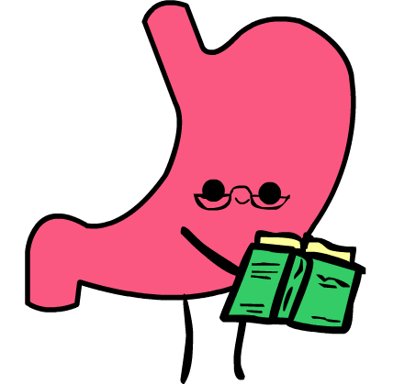
Assigned Reading / Questions
Horn, J. Understanding the Pharmacodynamic and Pharmacokinetic Differences between proton pump inhibitors- focus on pKa and metabolism. AP&T 2006, 2, 340-350.
Vesper, B. J.; et. al., Gastroesophageal Reflux Diesease, Is there More to the Story?, ChemMedChem 2008, 3, 552-559.
Outline the path of a PPI from oral ingestion to its final binding to H⁺/K⁺–ATPase (include any changes to the initial structure of the PPI).
What are 2 consequences of prolonged PPI usage?
What are the various classes of agents used to treat gastric acidity and GERD? List the advantages/disadvantages of using each type.

Slide 35
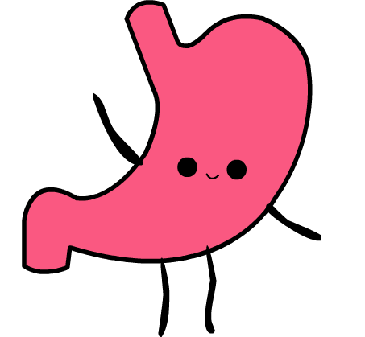
bye!

