Slide 1
Gene and Antisense Therapy
William Brooks
Medicinal Chemistry
March 31, 2011

Slide 2
Outline
Conventional drug design vs. gene therapy
Examples of genetic engineering
Types of gene therapy
Mechanisms
Delivery vectors
Viral
Non-viral
Specific diseases
Questions

Slide 3
A Different Kind of Approach
Historically, a general route to drug design:
Identify disease
Identify drug target
Identify lead compound
Create library of possible drugs
Test and retest to find potential drug
Treat patients with identified compound

Slide 4
A Different Kind of Approach
Gene and Antisense Therapy differs
Identify disease
Search for gene that regulates cause of disease
Transcribe replacement or modifying genetic material
Create vector to delivery DNA or RNA
Test drug
Treat patient with genes and vector

Slide 5
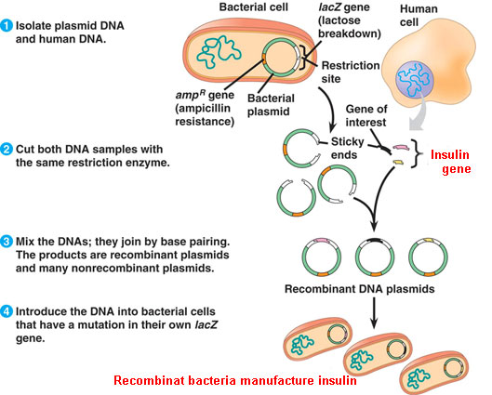
Successful Gene Modification
Have used bacteria to produce desired products

Slide 6
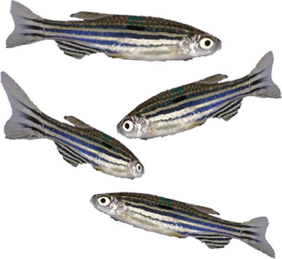
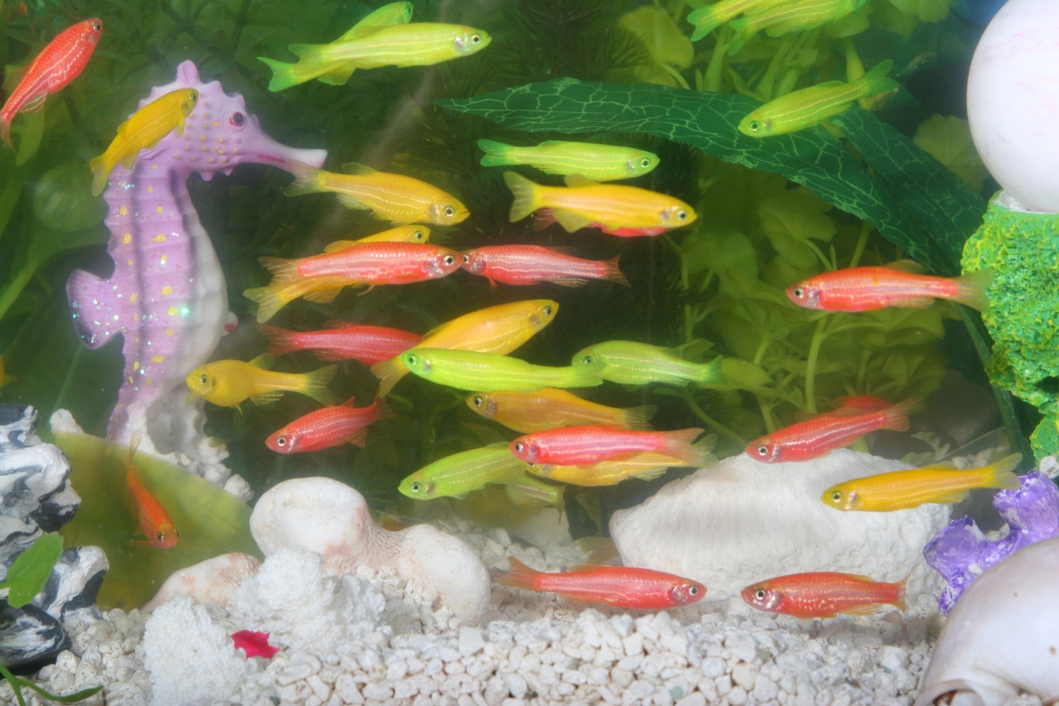
Successful Gene Modification
Modified DNA for aesthetic purposes

Slide 7
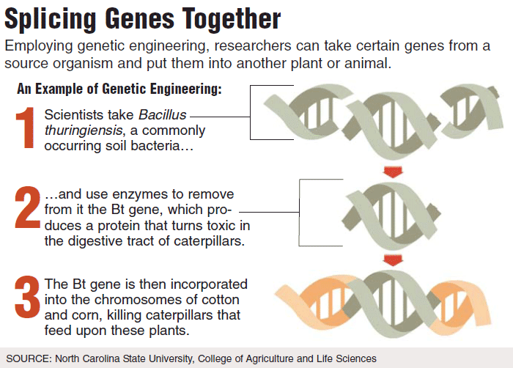
Successful Gene Modification
Modified plants to impart insecticides

Slide 8
Treatable Diseases
Can only treat diseases that have genetic targets
Cystic Fibrosis
Breathing troubles and frequent lung infections
Muscular Dystrophy
Muscle weakness and muscle cell death
Sickle Cell Anemia
Misshapened RBC and reduced life expectancy

Slide 9
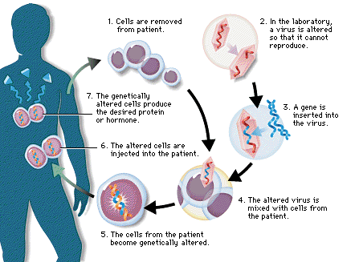
Gene Therapy
Most common technique involves insertion of a gene(s) into somatic cells

Slide 10
Germ Cell Route
Modification of sex cells to modify offspring
New DNA throughout organism
Passed on to all later generations
Possibility of treating hereditary diseases before conception
Very controversial

Slide 11
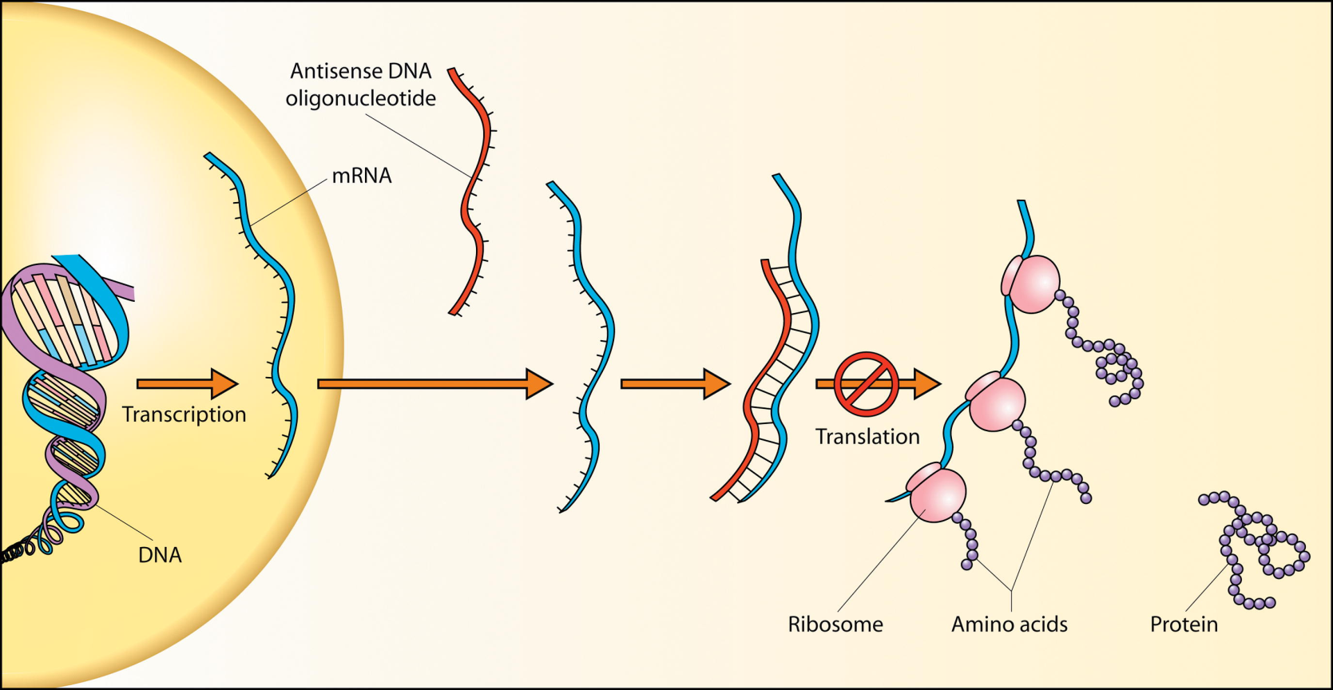
Antisense Therapy
Involves the blocking of gene expression
Often accomplished with siRNA

Slide 12
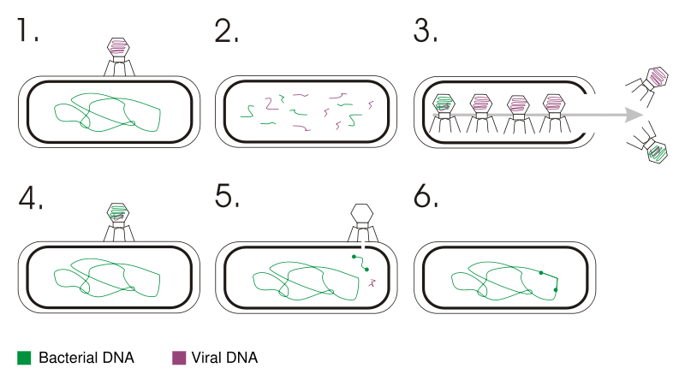
Viral Vectors
Viruses are very efficient at delivery genetic material
Transduction

Slide 13
Factors to Consider
Safety: the viral vector needs to have minimal handling risk
Low toxicity: minimal effect on the physiology of the cell it infects
Stability: Minimize amount of genetic variation in virus.
Cell type specificity: modified to target a specific kind of cell.
Identification: Markers, a common marker is antibiotic resistance to a certain antibiotic.
Cells not modified cannot grow in presence of antibiotics

Slide 14
Retroviruses
Carries RNA as genetic material
Uses enzyme reverse transcriptase to transcribe single-strand RNA into double-stranded DNA
Once DNA is made, must use enzyme integrase to incorporate DNA into host genome

Slide 15
Retroviruses
Unfortunately, integrase doesn’t differentiate
Inserts randomly
Can interrupt proper gene function
Cancer!
Addressed by incorporating Zinc-finger nucleases
Zinc-finger is small protein that coordinates zinc atoms and targets certain DNA sequences

Slide 16
Adenoviruses
Carries double-stranded DNA as genetic material
Introduces DNA into host cell
Does not incorporate into genome of host
Remains free in nucleus
NOT passed on to descendants

Slide 17
Adenoviruses
Jesse Gelsinger
Patient in clinical trial
Ornithine transcarbamylase deficiency
Couldn’t metabolize ammonia
Administered adenovirus
Died 4 days later

Slide 18
Adeno-associated virus
Carries single-stranded DNA as genetic material
Can infect both dividing and non-dividing cells
No known diseases cause by virus, only slight immune response

Slide 19
Adeno-associated virus
Reproducibly insert DNA at AAVS1 on chromosome 19
Has relatively few (4.8K) base pairs so large therapeutics aren’t viable
Possibly affects male fertility though no direct link found yet

Slide 20
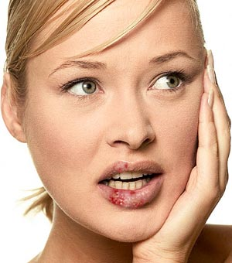
Herpes simplex viruses
Carries double-stranded DNA genetic material
Can infect neurons and the CNS
Once in neurons, evades normal immune response of the body
Complication due to herpes infection are limited

Slide 21
Non-viral vectors
Injection of naked genetic material
Stabilized liposomes
Cholesterol conjugates
Protein delivery
Use of synthetic polymers

Slide 22
Injection of naked genetic material
Large amount of naked DNA in saline injected into mouse tail vein
5 μg in 1.6 mL of saline, injected of ~5-8 sec in 20 g mouse
Gene uptake predominately in liver
Injected in vena cava
100 μg DNA in 0.2 ml buffer for 6 to 8-week-old mice
Focused on tubular epithelial cells in kidney
Detected up to 35 days with no toxicity

Slide 23
Stabilized liposomes
Stabilized liposomes
Created liposome
Conjugated with PEG
Conjugated with transferrin receptor
By conjugating with target, was able to localize treatment to tumor
Very little expression in the liver

Slide 24
Cholesterol Conjugates
Modified siRNA to couple with cholesterol
Increase bioavailability of siRNA from 6 to 95 min.
Downregulated apolipoprotein B (apoB) mRNA
Protein that binds to lipids to form LDL cholesterol
Reduced the total chol. via RNAi-mediated mRNA degradation.

Slide 25
Cholesterol Conjugates
Increased hydrophobicity improved the stability of siRNA , and increased the lipophilicity
enhanced the cellular penetration of the siRNA
Unfortunately, there is a lack of tissue specificity

Slide 26
Protein delivery
Protamine-Fab antibody fusion protein to deliver siRNA to HIV-infected cells or tumor cells
siRNA complexes to cationic peptide
Conjugated anti-bodies for targeting purposes
Specifically delivered to HIV-envelope expressing cells or ErbB2-expressing cancer cells but not to normal tissues
Success show in vivo

Slide 27
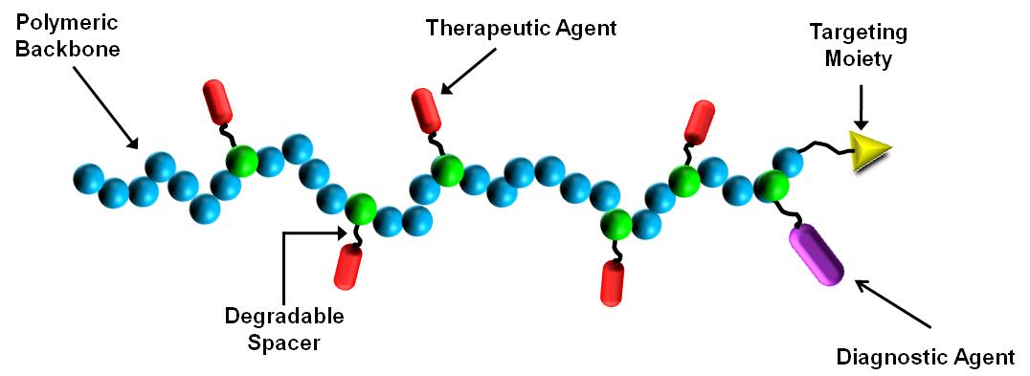
Use of synthetic polymers
Can complex genetic material with synthetic polymers
Polyplexes
Originally presented by Ringsdorf in 1975

Slide 28
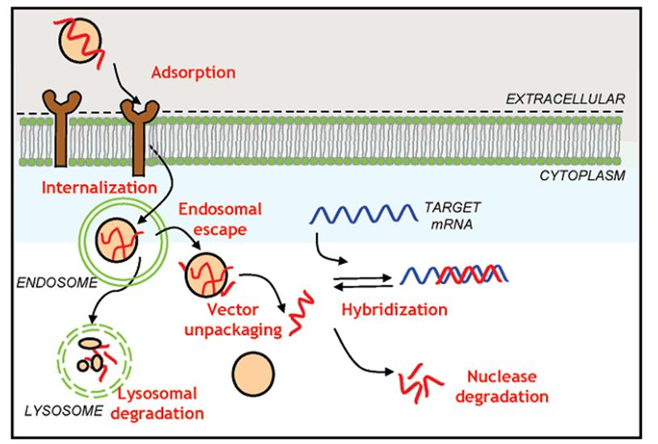
Use of synthetic polymers

Slide 29
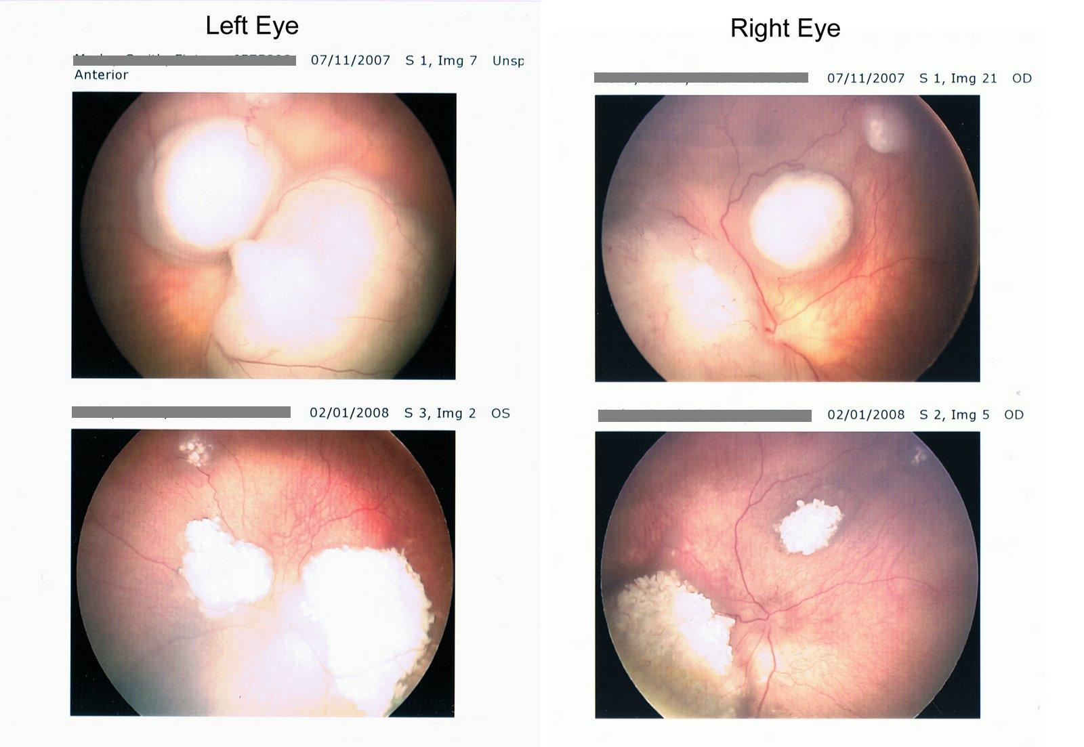
Diseases being investigated
Eye diseases
Retinoblastoma
primary intraocular tumor of childhood
adenovirus-mediated
expressed herpes simplex thymidine kinase gene
Reached stage 1 clinic trials
initially showed promise
Mild inflammation was seen, and ultimately the eyes needed to be removed

Slide 30
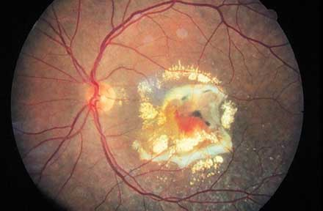
Diseases being investigated
Eye diseases
Age-related macular degeneration
adenovirus-mediated
Expresses anti-angiogenic cytokine pigment epithelium-derived factor (PEDF).
Reached stage 1 clinic trials
Inflammation seen in 25% of patients
No toxicity or major side effects
Possible dose-dependent anti-angiogenic effect
Further trials to come for other diseases

Slide 31
Cystic Fibrosis
One of the first diseases targeted
Adenoviral vectors
absence of the adenovirus receptor in human lungs
Adeno-associated viruses
Reached phase I/II trials, but ultimately failed
Nine non-viral vector routes have reached clinical trials
Showed proof-of-concept
Development has slowed due to difficulty of problem

Slide 32
Duchenne Muscular Dystrophy

Slide 33
Duchenne Muscular Dystrophy
Most common inherited MD
Causes muscle weakness and degradation
Linked to the dystrophin gene
protein that connects the muscle fiber to the surrounding extracellular matrix

Slide 34
Other diseases
Severe combined immunodeficiency
Parkinson’s disease
Coronary artery disease
Huntington’s disease
Alzheimer’s disease
HIV/AIDS
Too many to name…

Slide 35
Reading Assignments
Progress and Prospects: Gene Therapy Clinical Trials, Gene Therapy (Part 1), (2007) 14, 1439–1447
Progress and Prospects: Gene Therapy Clinical Trials, Gene Therapy (Part 2), (2007) 14, 1555–1563

Slide 36
Questions.
Questions: -Name three viral vectors. -Name three non-viral vectors. -What does siRNA stand for, and is it used for gene or antisense therapy? -What type of disease is Duchenne, and what gene is it associated with? -What type of disease is treated by "suicide gene therapy"?

