Slide 1
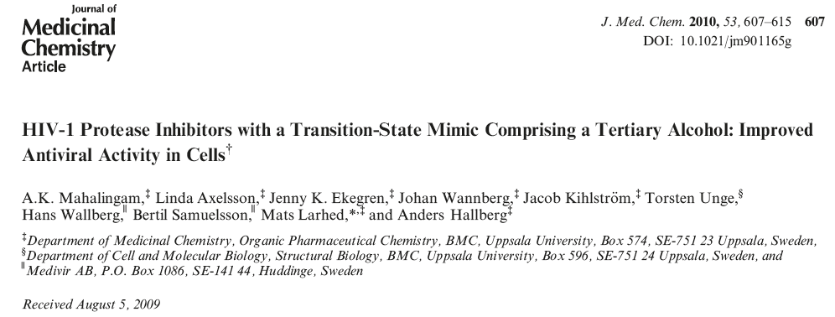
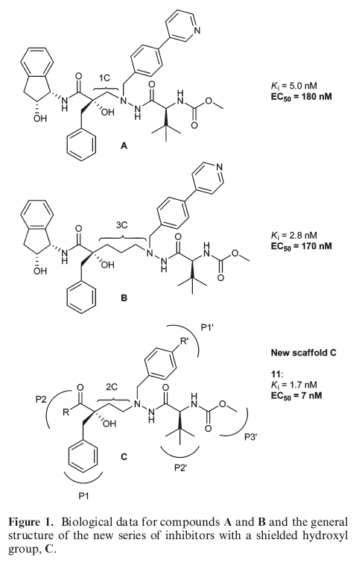

Slide 2
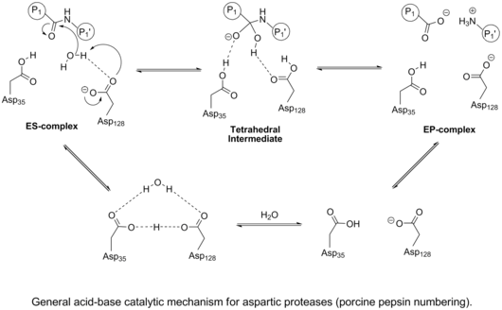
Mechanism of an Aspartyl Protease
LINK

Slide 3
Modeling an inhibitor after the transition state may result in a tighter-binding inhibitor
But the actual transition state (in box above) is chemically unstable, so a number of more stable “transition state isosteres” have been devised.

Slide 4
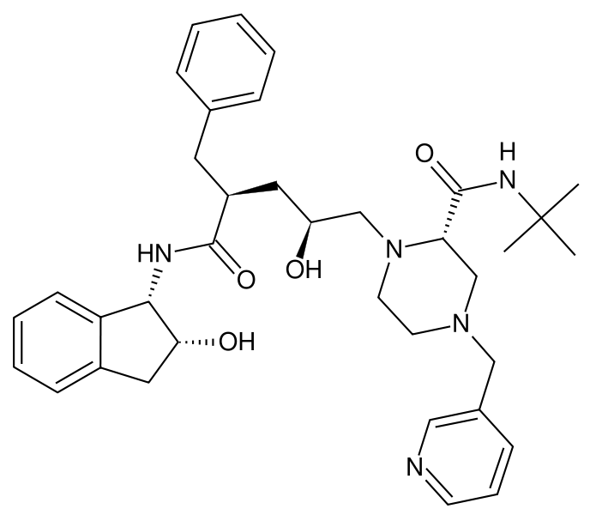
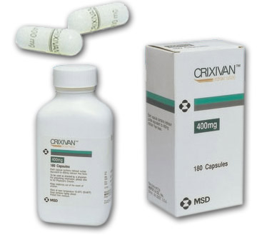
HIV Protease Inhibitors
Indinavir/Crixivan

Slide 5
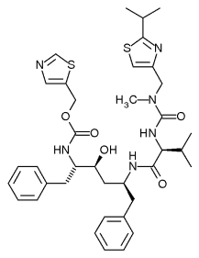
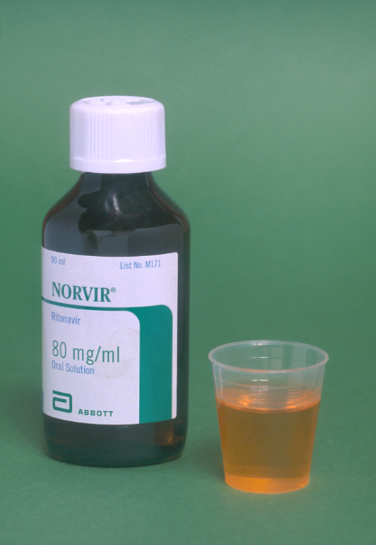
HIV Protease Inhibitors
Ritonavir/Norvir

Slide 6
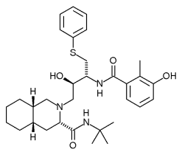
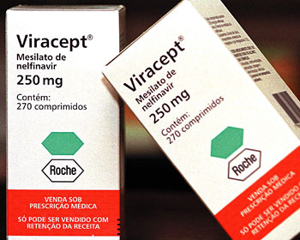

HIV Protease Inhibitors
Nelfinavir/Viracept

Slide 7
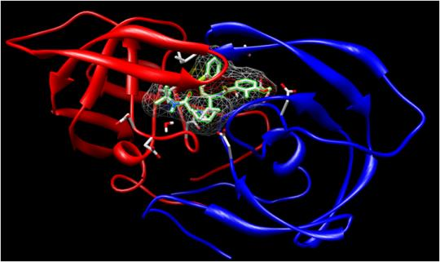

Slide 8
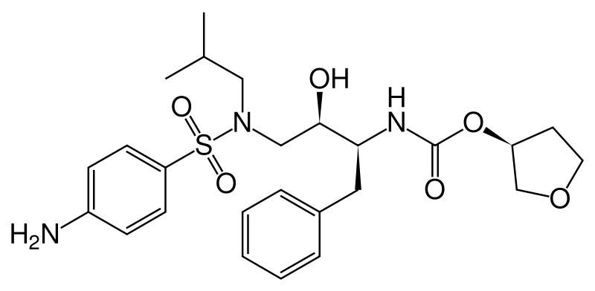
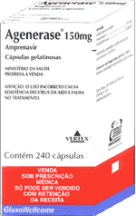
Amprenavir
(Agenerase)

Slide 9
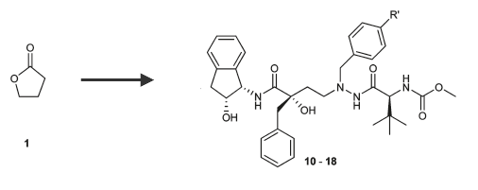

Slide 10
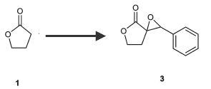
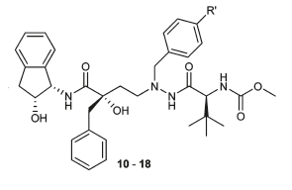

Slide 11


Slide 13

The Aldol Condensation

Slide 14
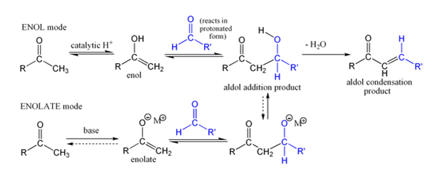
Mechanism of the Aldol Condensation

Slide 15
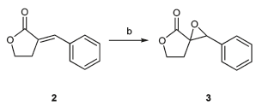

Slide 16
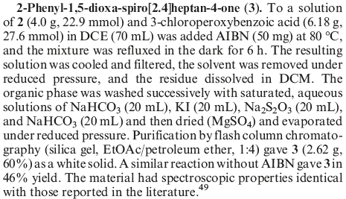

Slide 17
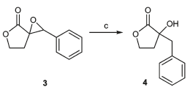

Slide 19
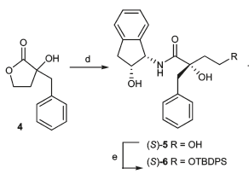

Slide 21
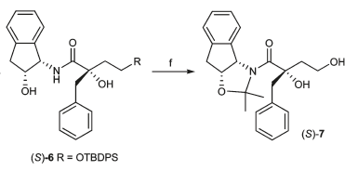

Slide 23


Slide 24


Slide 25
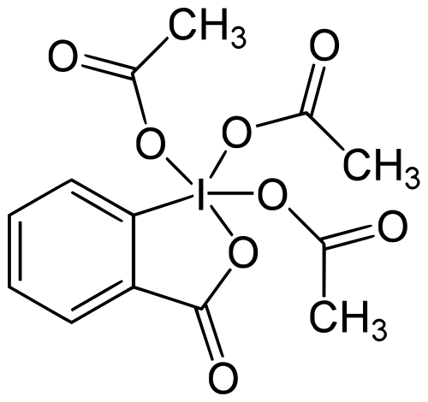
Dess-Martin Periodinane

Slide 26
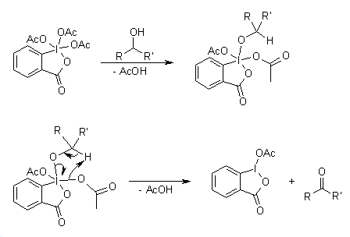
Mechanism of the Dess-Martin Oxidation

Slide 27

Reductive Amination
Note that other reducing agents can be used on the intermediate imine
The most commonly used reducing agents include NaBH₃CN and NaBH(OAc)_{3,} since these borohydrides are stable in the presence of mild acid (like AcOH), which promotes formation of the imine and also protonates the imine, thus activating it toward addition of the hydride anion.

Slide 28
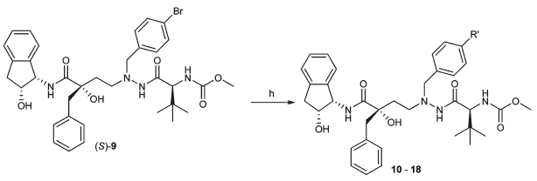

Slide 29
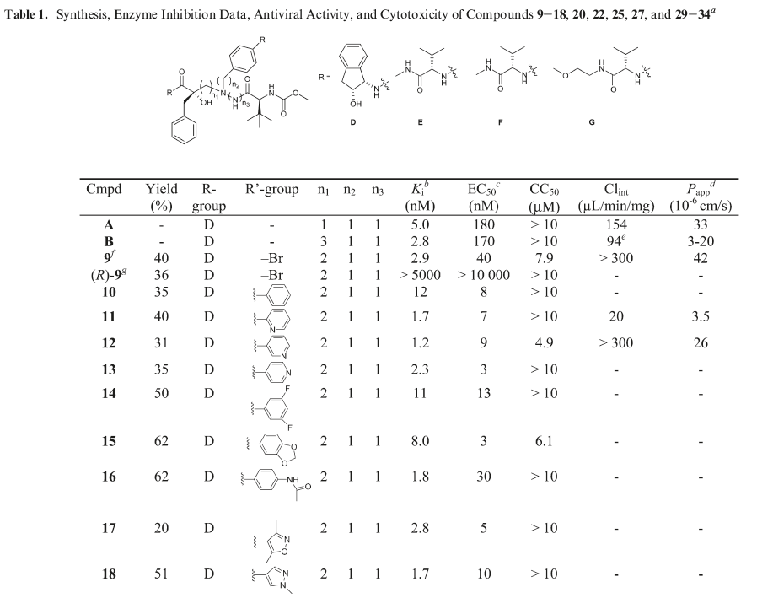

Slide 30

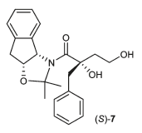

Slide 31


Slide 32
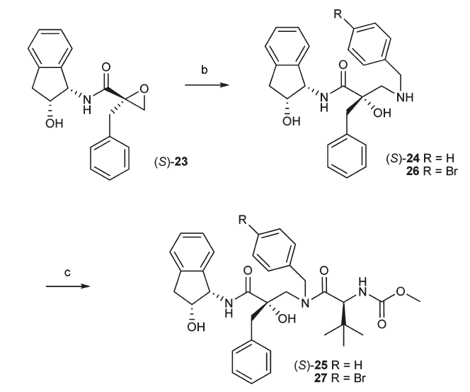

Slide 33


Slide 34
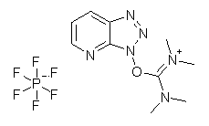

Slide 35
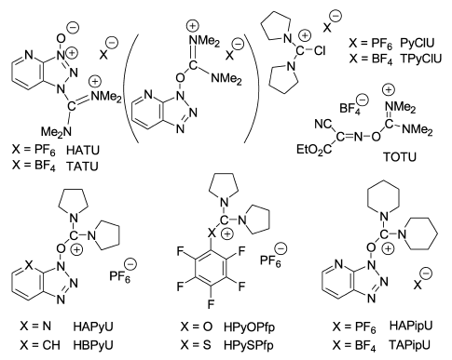
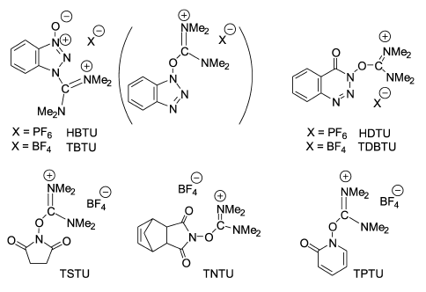
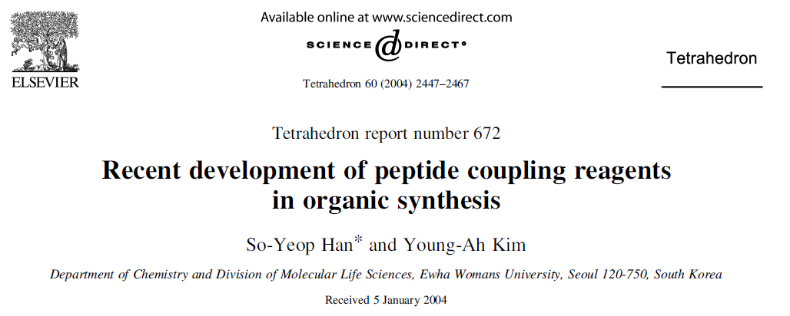
Guanidinium-derived Peptide Coupling Agents

Slide 36
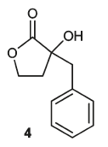
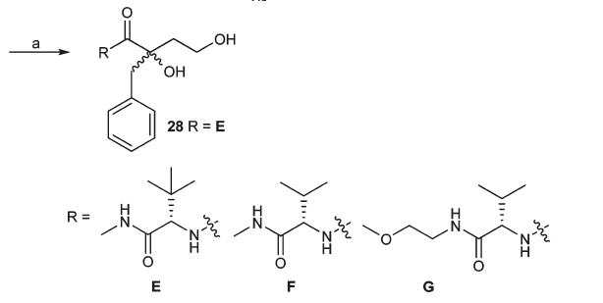

Slide 37


