Slide 1
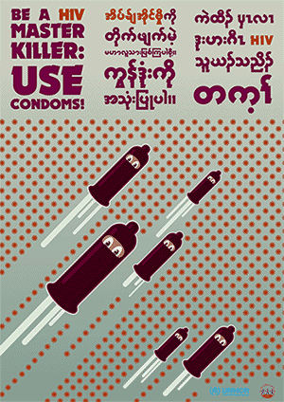
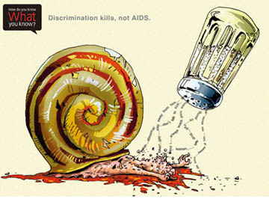
Antiretroviral Agents: HIV & AIDS
Shaw Vonder Hoya

Slide 2
Worldwide Prevalence

Slide 3
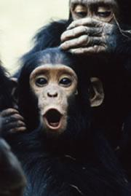
Types of HIV
HIV type 1:
Most common
Originated from chimpanzee SIV
High infectivity and virulence
HIV type 2:
Mostly confined to West Africa
Came from sooty mangabeys
Lower infectivity and virulence
Still leads to AIDS

Slide 4
Viral Structure

Slide 5
HIV has nine genes
Gag – group antigen gene, makes 3 proteins
Pol – polymerase, makes 3 proteins
Env – envelope, makes 2 proteins
Tat – transactivator
Rev – regulation of viral expression
Vif – virus infectivity factor
Nef – negative regulator factor
Vpr – virus protein R
Vpu – virus protein U

Slide 7
Tropism
HIV infects helper T-cells of the immune system
Binds MHCII receptor CD4 and a coreceptor, either CXCR4 or CCR5
Can also infect macrophages

Slide 8
Methods of Infection
Sex
Needle sharing
Contact with infected blood products
Mother to child

Slide 9
High risk groups
Homosexual men
Intravenous drug users
Commercial sex workers
More prevalent among low income groups

Slide 10
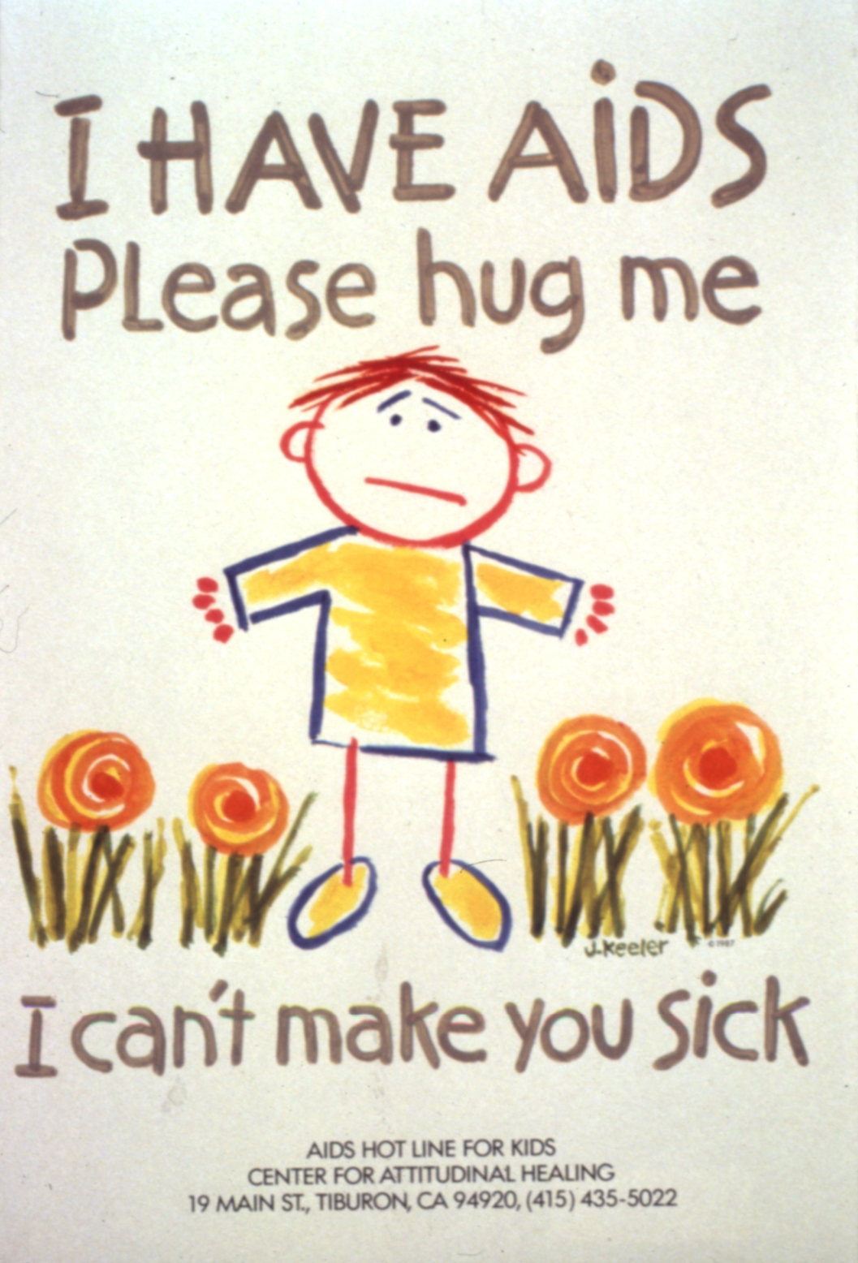
Disease Progression
Primary Infection: flu-like symptoms 2-4 weeks after infection that resolve within a month, not experienced by everyone
Latent infection: disease free period that lasts several years
Clinical AIDS: characterized by the development of one or more opportunistic infections

Slide 11
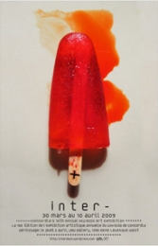
Testing
ELISA – detects HIV antibodies
Fourth Generation Tests – ELISA to test for p24 antigen (don’t rely on seroconversion) and HIV antibodies
Rapid tests that give results in 30 minutes are available

Slide 12
Confirming a Positive Test
If a test comes back positive…
The same test should be repeated on the sample
A different test should be performed
A new sample should be taken for testing

Slide 13
Clinical AIDS
CD4+ count below 200 cells/mm³
Virtually nonfunctional immune system
Opportunistic infections begin to appear

Slide 15
Characteristic AIDS Illnesses
Tuberculosis – infection with Mycobacterium tuberculae
Pneumocystis carinii pneumonia – opportunistic fungal infection at CD4 counts <100 cell/mm³
Kaposi’s sarcoma – a cancer of the connective tissue that presents as skin lesions
Cytomegalovirus – a member of the herpes family
Hepatitis
HIV-associated dementia – impairment in neurological function as a result of HIV infection in the brain

Slide 16
HIV is a Retrovirus
Reverse transcriptase transcribes DNA from RNA
The DNA gets inserted into a host cell chromosome by integrase

Slide 17
Life Cycle

Slide 18
Treatment
There is no cure for HIV/AIDS, but treatment can slow the progress of disease
Most drugs aim at controlling some aspect of viral replication or cell-to-cell spread
Accepted method of treatment since 1996 has been Highly Active Antiretroviral Therapy (HAART)

Slide 19
When to Start Treatment?
Guidelines say:
CD4+ count <350 cells/mm³
AIDS-associated infection appears
Viral loads >30,000 copies/mL as determined by a test detecting HIV RNA
CD4+ count is falling rapidly

Slide 20
Why HAART?
HIV has a VERY high mutation rate
Virus can quickly become resistant to drugs used alone
HAART decreases the likelihood of resistance

Slide 21
Disadvantages of Therapy
First generation HAART regimens had high pill loads
Anti-HIV drugs can be toxic, creating adherence issues
Expensive, few generics available ($12,000 a year)
Hard to obtain in disadvantaged areas

Slide 22
Drug Classes
Nucleoside Reverse Transcriptase Inhibitors (NRTIs)
Non-nucleoside Reverse Transcriptase Inhibitors (NNRTIs)
Integrase Inhibitors
Protease Inhibitors
CCR5 Inhibitors
Fusion Inhibitors

Slide 23
Nucleoside reverse transcriptase inhibitors
Target reverse transcriptase through binding active site
Prevent elongation of DNA chain
Nucleoside analogs
3 phosphates added by cellular kinases during metabolism to active drug

Slide 24
Azidothymidine (Zidovudine)
AZT
Thymidine

Slide 25
Azidothymidine
First anti-HIV drug discovered (1985)
Competitive inhibitor/alternative substrate for Reverse Transcriptase
Retains some activity even in resistant viral populations
Side effect: fat redistribution/lipoatrophy, risk of lactic acidosis

Slide 26
Other NRTIs and their Side Effects
Tenofovir – renal toxicity
Abacavir – hypersensitivity in HLA-B 5701 positive patients
Zidovudine*
Stavudine* - lipoatrophy
Lamivudine
Emtricitabine
* Higher toxicity

Slide 27
Non-nucleoside RT Inhibitors
Allosteric inhibitors of RT
RT generally only needs a mutation in one amino acid to develop resistance
Well tolerated
RT with NNRTI binding site in yellow

Slide 28
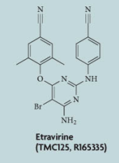
NNRTIs
Efavirenz – teratogenic, short term CNS toxicity
Nevirapine – hepatic toxicity in patients with early stages of HIV
Etravirine – higher barrier to resistance

Slide 29
Integrase Inhibitors
Inhibit strand transfer during integration into host genome, which interferes with viral expression and replication
A newer class of anti-HIV drugs (2007)

Slide 30
Raltegravir
Currently, the only approved integrase inhibitor
Minimal side effects, though still a new drug
Very potent
Diketo acid

Slide 31
Protease Inhibitors
HIV protease cleaves protein precursors into mature polypeptides
Important in early HAART regimens
Can cause lipoatrophy
Built from hydroxyethylene group to mimic peptide linkage
Competitive inhibitors

Slide 32
Protease Inhibitors
Fosamprenavir
Atazanavir
Darunavir
Lopinavir
Saquinavir
Ritonavir
*Can cause increased plasma lipid concentrations and risk of cardiac episodes

Slide 33
Ritonavir
Usually used in combination with another protease inhibitor
Given to inhibit cytochrome P450, thereby boosting the effects of the second protease inhibitor

Slide 34
CCR5 Inhibitors
Bind CCR5 coreceptor and induce a conformational change, making it unrecognizable to HIV
Currently no CXCR4 inhibitors

Slide 35
Maraviroc
FDA approved in 2007
Only drug in the class
Highly specific for CCR5
May not be as effective in late-stage patients with CXCR4 and CCR5 variants
Increase in CD8 T-cells

Slide 36
Fusion Inhibitors - Enfuvirtide
Blocks HIV entry into host cells
Peptide with a sequence corresponding to that of HIV gp160 precursor polypeptide
Injected twice daily in addition to HAART
Generally reserved for treatment-experienced patients
Low barrier to resistance
EXPENSIVE

Slide 37
Enfuvirtide Mechanism

Slide 38
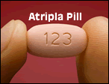
First Line HAART Regimen
Usually 2 NRTIs and a third drug
One pill a day:
Atripla = tenofovir + emtricitabine + efavirenz
But not if you’re pregnant!
NRTI formulations:
tenofovir + emtricitabine
abacavir +lamivudine (not as safe)

Slide 39
What is the Third Drug?
Usually ritonavir boosted protease inhibitor, NNRTI, or integrase inhibitor
Raltegravir (integrase inhibitor) works well, but must be taken twice a day

Slide 40
Treatment Failure
Often due to nonadherence or preexisting resistance
CD4 counts may not rebound to a safe level, especially if treatment is started at advanced stages of the disease
Second and third line regimens may be more toxic and less effective, but in many cases they can control disease progression

Slide 41
Readings
De Clercq, Eric. (2008). Anti-HIV drugs: 25 compounds approved within 25 years after the discovery of HIV. International Journal of Antimicrobial Agents. 33, 307-320.

Slide 42
Questions
Why is a multidrug approach to treating HIV necessary?
What are the different classes of HIV drugs and how do they work?
What types of drugs are typically used in first line HAART?
What determines the host cell tropism for HIV?

Slide 43
Resources
http://aids.gov
http://www.avert.org
http://www.aafp.org/afp/980115ap/chesebro.html
Volberding, Paul A. and Deeks, Steven G. (2010). Antiretroviral Therapy and Management of HIV Infection. Lancet. 376, 49-62.
De Clercq, Eric. (2007). The Design of Drugs for HIV and HCV. Nature Reviews: Drug Discovery. 6, 1001-1018.

