Slide 1
Commonly Used Hydride Reagents

Slide 2
Hydride acting as a base.
Hydride acting as a nucleophile toward the carbonyl group.
Several forms of hydride (H-) find use in organic chemistry, including NaH, CaH₂, LiAlH₄, NaBH₄, and NaBH₃CN (and several others).
The reactivity of hydride varies considerably, depending on the nature of the element to which it is attached. It can function as either a base (e.g. NaH) or as a nucleophile (particularly toward addition to the carbonyl (C=O) group) when formulated as LiAlH₄ and NaBH₄.

Slide 3
H₂ has a pKa value of 42, thus the conjugate base (hydride) is extremely strong, easily deprotonating alcohols, for example. Sodium Hydride, NaH, is used exclusively as a strong base.
Calcium Hydride, CaH₂, is used nearly exclusively as a drying agent, reacting with moisture in solvents to generate hydrogen gas and calcium hydroxide. The solvent is then distilled to separate the dry solvent from the solid calcium hydroxide.
One needs to handle more reactive forms of hydride (e.g. NaH and LiAlH₄) extremely carefully, since reaction with water or alcohols will generate hydrogen gas with enough exothermicity to start a fire (or cause an explosion).

Slide 4
Reactions of NaH
Sodium hydride is relatively insoluble, and is usually used in DMF or THF solvent.

Slide 5
NaH is used almost exclusively as a base (not as a nucleophile) to generate oxygen, nitrogen, and carbon anions.
EWG = Electron Withdrawing Group, C=O, CN, etc.

Slide 6
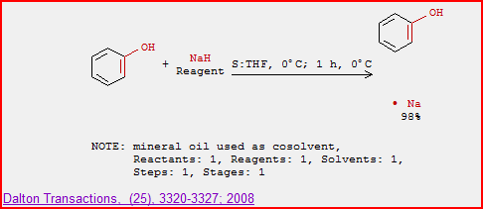

Slide 7
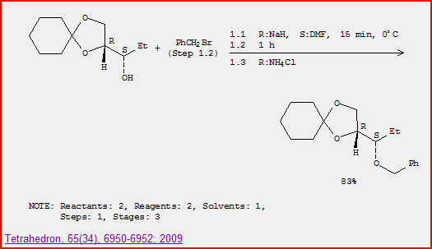
Williamson Ether Synthesis

Slide 9
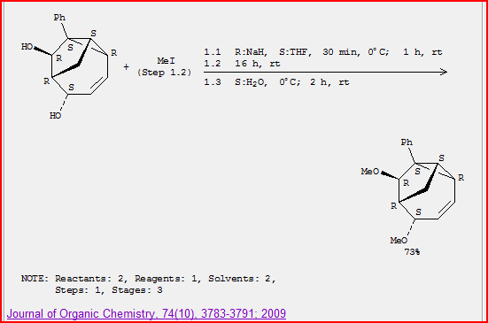

Slide 10
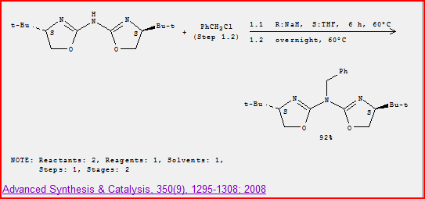

Slide 12
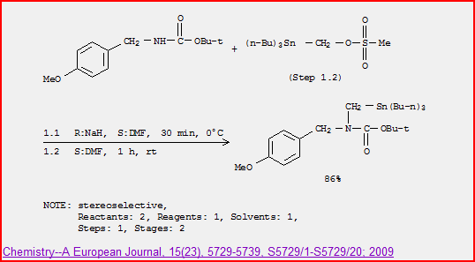

Slide 13
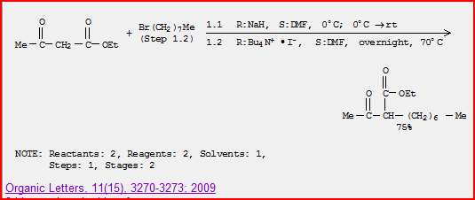

Slide 14
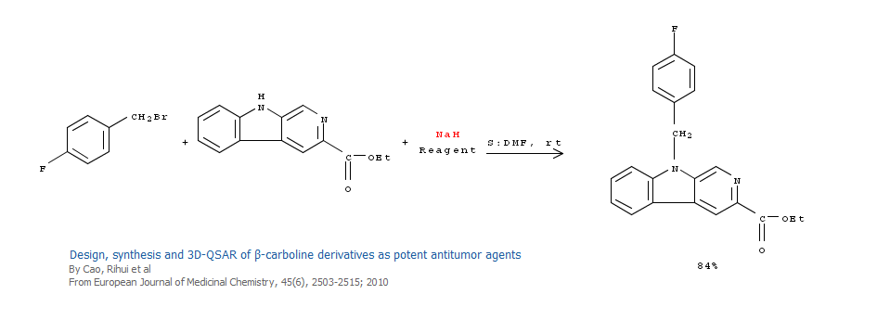

Slide 17
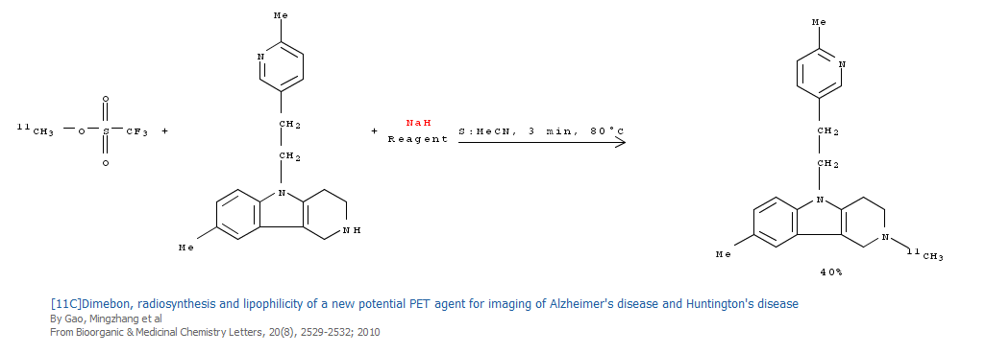

Slide 18
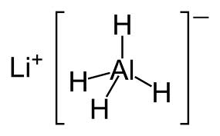
Reactions of Lithium Aluminum Hydride
LiAlH₄ is more soluble and can be used in the solvents diethyl ether or THF.

Slide 19
Lithium Aluminum Hydride is a potent reducing agent.

Slide 20
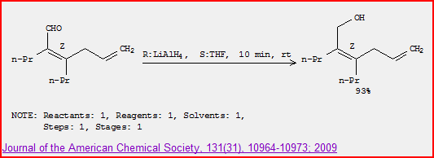

Slide 21
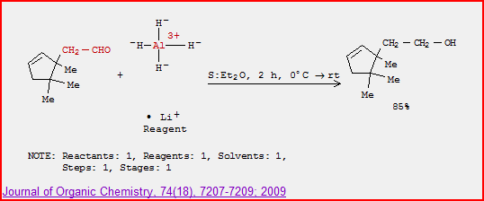

Slide 22
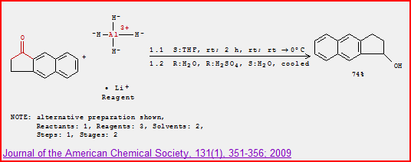

Slide 23
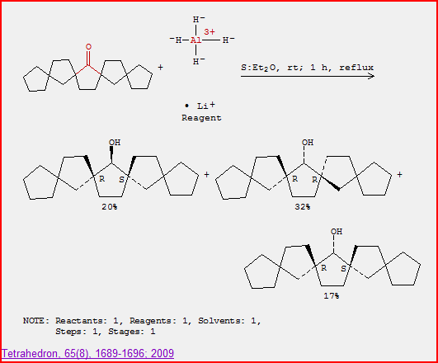

Slide 24
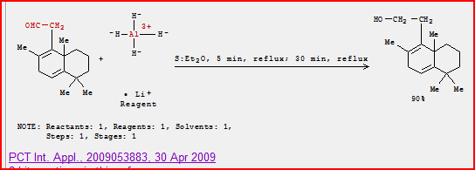

Slide 25
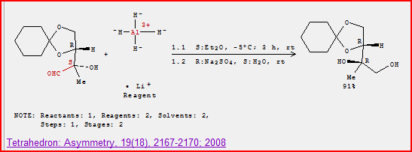

Slide 26
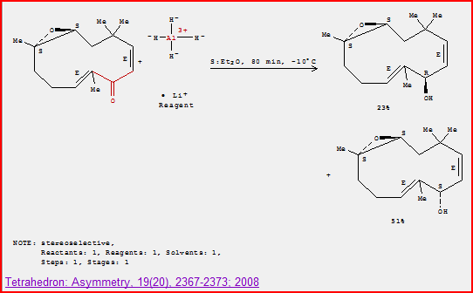

Slide 27
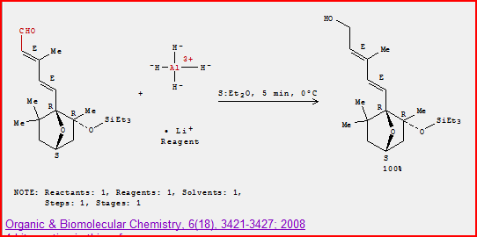

Slide 28
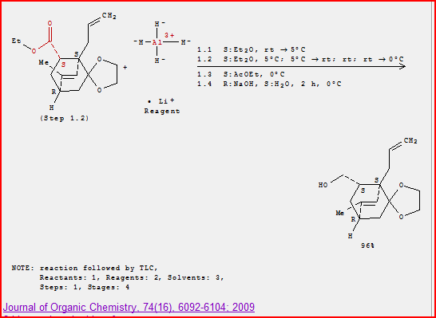

Slide 29
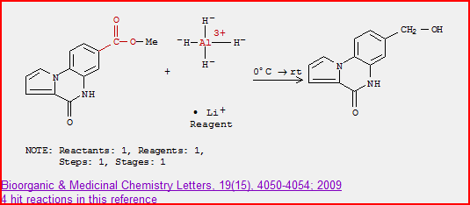

Slide 30
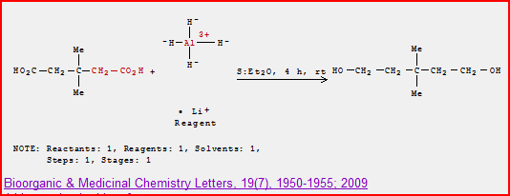

Slide 31
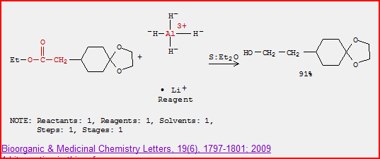

Slide 32
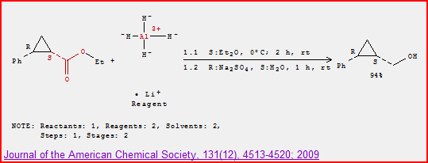

Slide 33
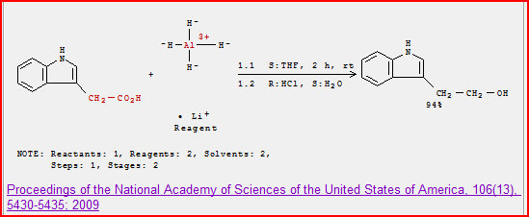

Slide 35
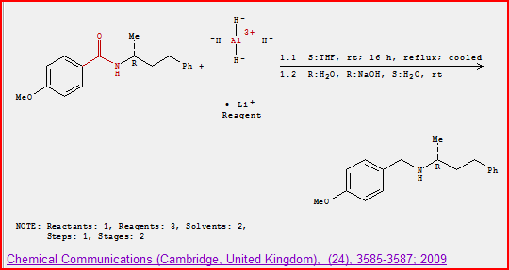

Slide 36
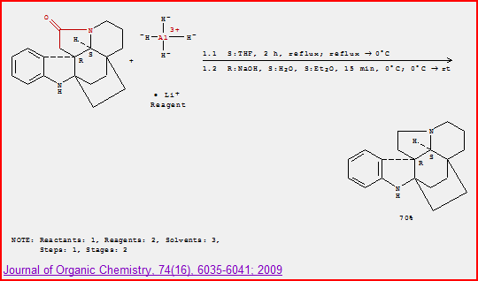

Slide 37
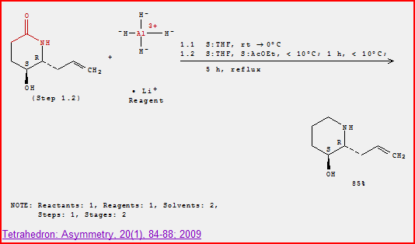

Slide 39
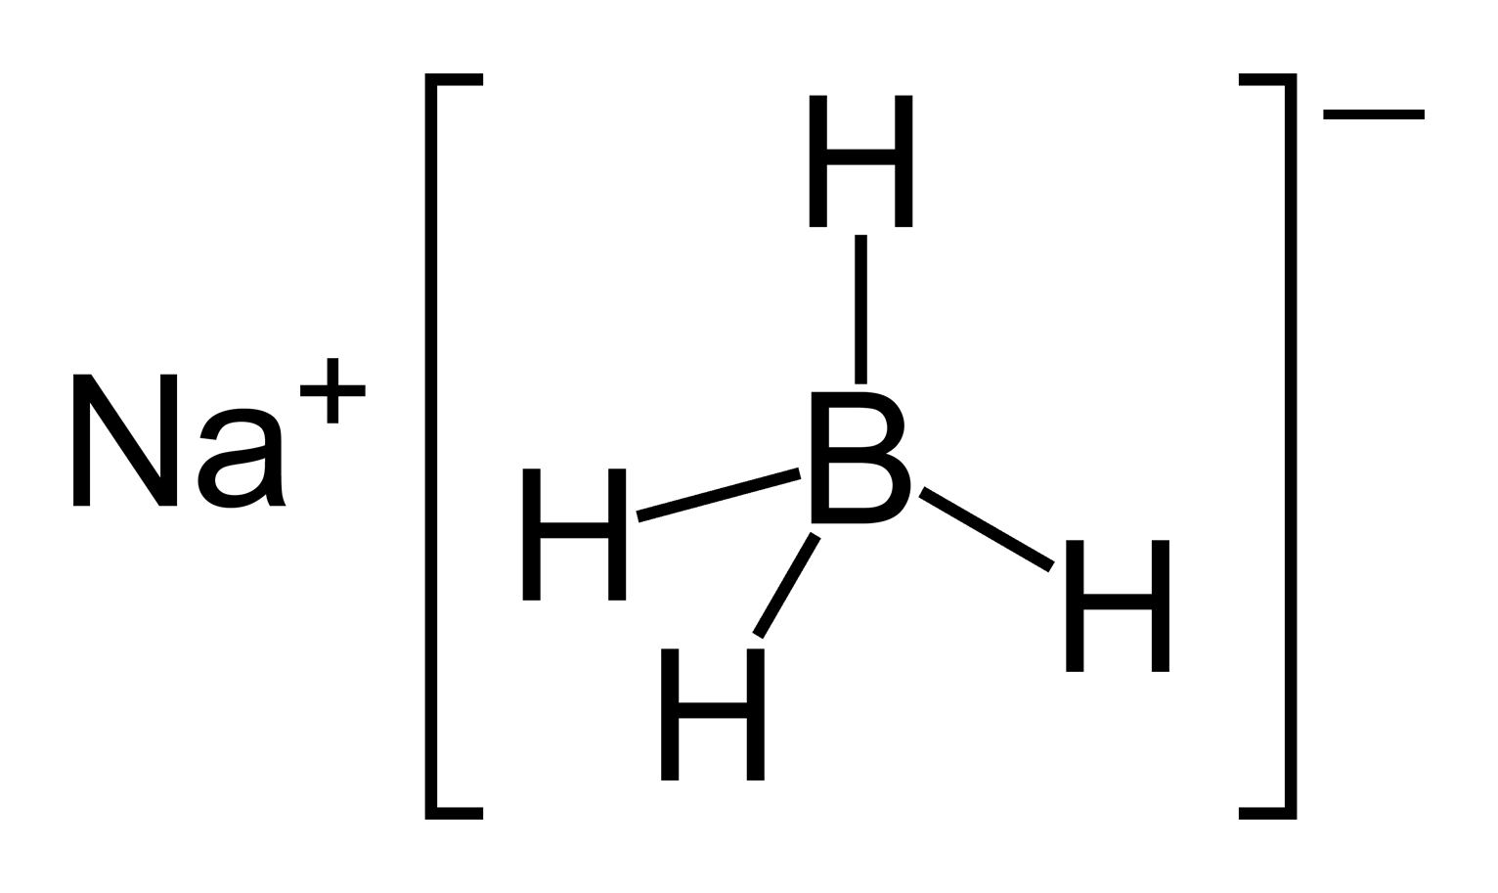
Reactions of Sodium Borohydride
Sodium borohydride (NaBH₄) is both less reactive and less soluble than LiAlH₄. Thus, it is frequently used in alcoholic solvents, although it has a limited lifetime in such solvents (due to its reaction as a base with the ROH.)

Slide 40
NaBH₄ is less reactive than LiAlH₄ and does not reduce esters or amides

Slide 41
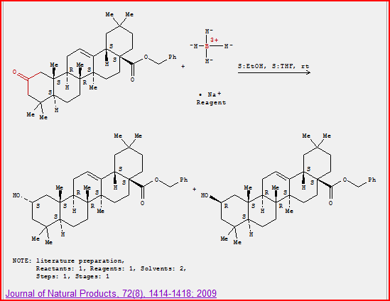

Slide 42
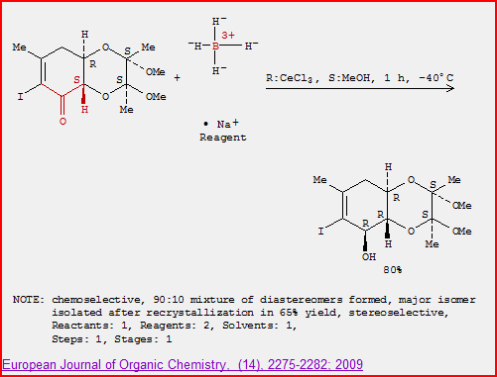

Slide 43
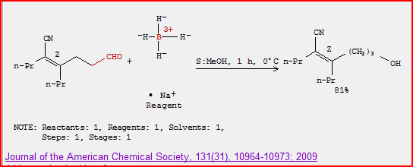

Slide 44
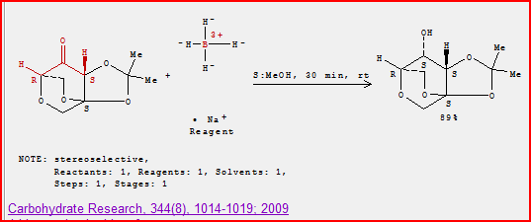

Slide 45
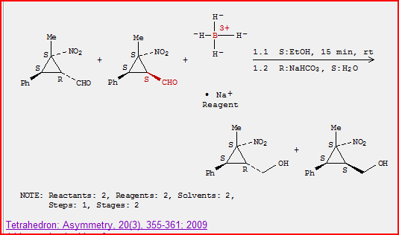

Slide 46
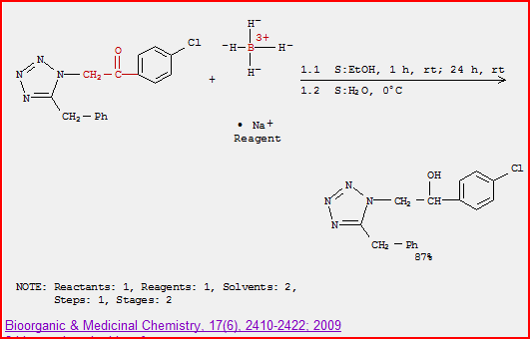

Slide 47
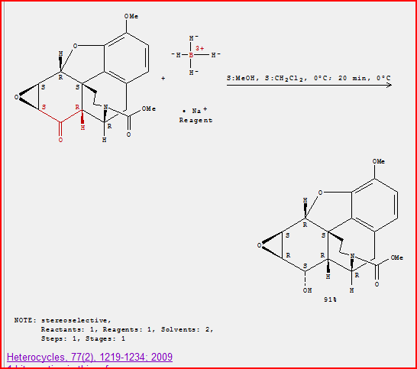
Notice that NaBH₄ can selectively reduce ketone in presence of ester and epoxide.

Slide 48
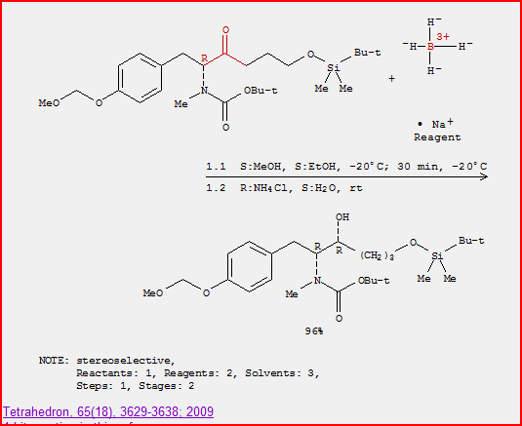

Slide 49
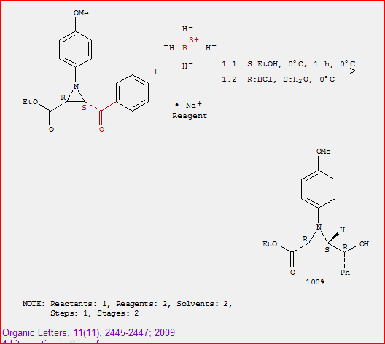
Notice that NaBH₄ can reduce ketone in presence of ester
(and aziridine)

Slide 50
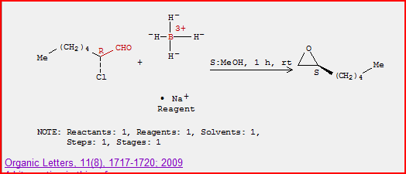

Slide 51
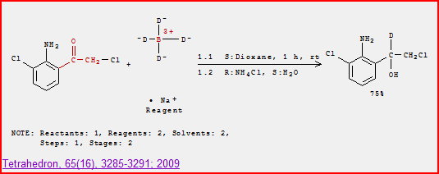

Slide 52
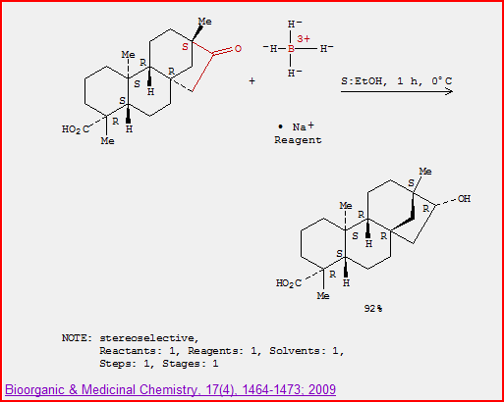

Slide 53
