Slide 1
Agents to treat Insomnia
Yuan Yang

Slide 2
Contents
1
Definition
2
Causes and co-morbidities
3
Diagnose
4
Treatment

Slide 3
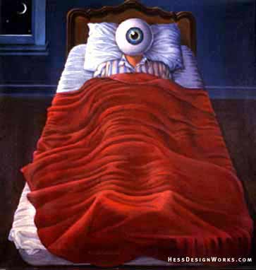
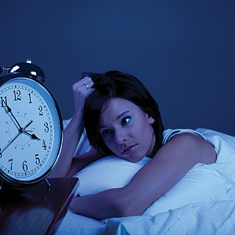
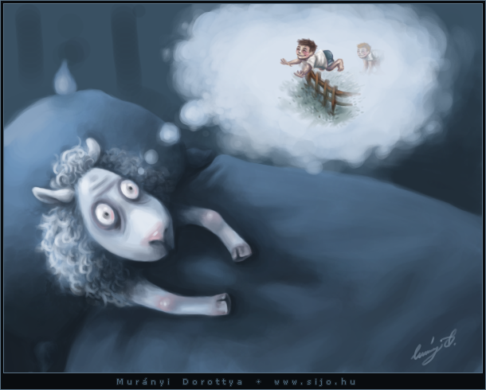
Introduction
Insomnia is a sleep disorder that is characterized by difficulty falling and/or staying asleep.
People with insomnia have one or more of the following symptoms:
Difficulty falling asleep
Waking up often during the night and having trouble going back to sleep
Waking up too early in the morning
Feeling tired upon waking
Notes:
Some people who have insomnia may have trouble falling asleep. Other people may fall asleep easily but wake up too soon. Others may have trouble with both falling asleep and staying asleep.
As a result, insomnia may cause you to get too little sleep or have poor-quality sleep. You may not feel refreshed when you wake up.

Slide 4
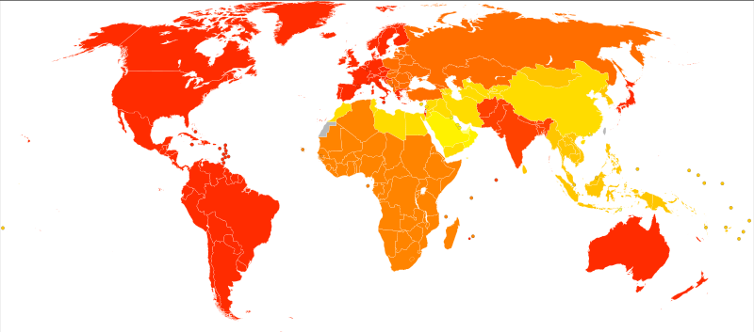
Introduction
Prevalence
Insomnia world map
“58% of adults in the U.S. experienced symptoms of insomnia a few nights a week or more.”-------National Sleep Foundation's 2002 Sleep in America
Notes:
The National Sleep Foundation's 2002 Sleep in America poll showed that 58% of adults in the U.S. experienced symptoms of insomnia a few nights a week or more.

Slide 5
Classification
Primary insomnia
The inability to sleep is not caused
by other health problems.
Secondary insomnia
Due to other health conditions that interfere
with sleep. It is also called “co-morbid insomnia.”
Notes:
There are two types of insomnia: primary insomnia and secondary insomnia
More than 8 out of 10 people who have insomnia are believed to have secondary insomnia.
Certain medical conditions, medicines, sleep disorders, and substances can cause secondary insomnia.
Secondary insomnia often resolves or improves without treatment if you can stop its cause—especially if you can correct the problem soon after it starts. For example, if caffeine is causing your insomnia, stopping or limiting your intake of the substance may cause your insomnia to go away.
In contrast, primary insomnia isn't due to a medical problem, medicines, or other substances. It is its own disorder. A number of life changes can trigger primary insomnia, including long-lasting stress and emotional upset.

Slide 6
Causes and co-morbidities
Causes of Secondary Insomnia?
Emotional disorder
Neurological disorder diseases (Alzheimer's disease and Parkinson's disease )
Conditions that cause chronic pain, such as arthritis and headache disorders
Conditions that make it hard to breathe, such as asthma and heart failure
Stroke
Sleep disorders, such as restless legs syndrome and sleep-related breathing problems
Notes:
This type of insomnia often is a symptom of an emotional, neurological, or other medical or sleep disorder.
depression, anxiety

Slide 7
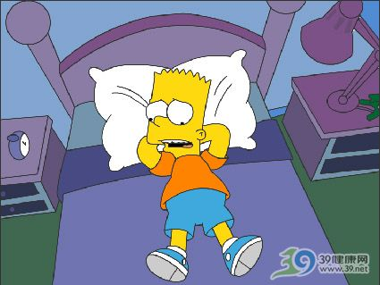
Classification
Insomnia is often categorized by how long it lasts:
Transient insomnia lasts for a few days.
Short-term insomnia lasts for no more than 3 weeks.(acute insomnia)
Chronic insomnia occurs at least 3 nights per week for 1 month or longer
Notes:
Insomnia also varies in how long it lasts and how often it occurs。。。Insomnia can be chronic or acute. Chronic insomnia means having symptoms at least 3 nights a week for more than a month. Acute insomnia lasts for less time.

Slide 8
Diagnose
Acute to Chronic
Some people with insomnia may complain of difficulty falling asleep or waking up frequently during the night. The problem may begin with stress. Then, as you begin to associate the bed with your inability to sleep, the problem may become chronic
Notes:
insomnia is often defined as a positive response to either of two questions

Slide 9
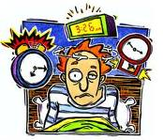
Causes and co-morbidities
What Causes Acute Insomnia?
Significant life stress
Illness.
Emotional or physical discomfort.
Environmental factors like noise, light that interfere with sleep.
Some may interfere with sleep.
Interferences in normal sleep schedule (jet lag or switching from a day to night shift, for example).
Notes:
(job loss or change, death of a loved one, divorce, moving

Slide 10
Causes and co-morbidities
Medication Related Insomnia
Certain over-the-counter cold and asthma preparations.
The prescription varieties of these medications may also contain stimulants and thus produce similar effects on sleep.
Some medications used to treat high blood pressure have also been associated with poor sleep.
Some medications used to treat depression, anxiety, and schizophrenia
Notes:
Certain medications have been associated with insomnia. Among them are:

Slide 11
Causes and co-morbidities
Other Causes of Insomnia
Common stimulants associated with poor sleep include caffeine and nicotine. You should consider not only restricting caffeine and nicotine use in the hours immediately before bedtime but also limiting your total daily intake.
People often use alcohol to help induce sleep, as a nightcap. However, it is a poor choice. Alcohol is associated with sleep disruption and creates a sense of non-refreshed sleep in the morning.
A disruptive bed partner with loud snoring or periodic leg movements also may impair your ability to get a good night's sleep.
Notes:
insomnia is often defined as a positive response to either of two questions

Slide 12
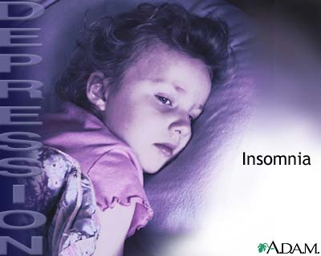
Causes and co-morbidities
Causes of chronic insomnia include:
Depression and/or anxiety.
Chronic stress.
Pain or discomfort at night.
.

Slide 13
Causes and co-morbidities
High Risk Groups for Insomnia
.
•Travelers
•Shift workers with frequent changing of shifts
•Seniors
•Adolescents or young adult students
•Pregnant women
•Women in menopause
•People who use abuse drugs
•Alcoholics
Notes:
In addition to people with the above medical conditions, certain groups may be at higher risk for developing insomnia:
Insomnia affects women more often than men. The condition can occur at any age. However, older adults are more likely to have insomnia than younger people.

Slide 14
Diagnose
Lie awake long before fall asleep
Signs
and
Symptoms
Sleep for only short periods
Be awake for much of the night
Feel as if you haven't slept at all
Wake up too early
Notes:
Lie awake for a long time before you fall asleep

Slide 15
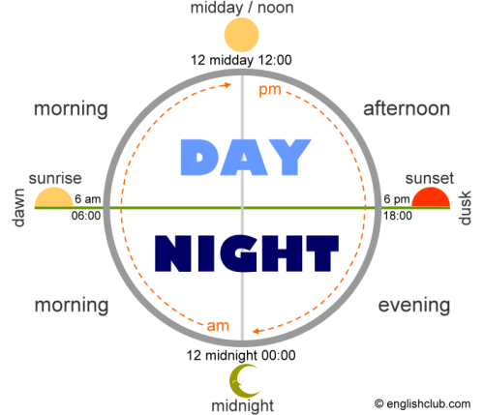
Diagnose
Daytime problems caused by insomnia include the following:
Poor concentration and focus
Difficulty with memory
Impaired motor coordination (being uncoordinated)
Irritability and impaired social interaction
Motor vehicle accidents because of fatigued, sleep-deprived drivers
Notes:
Most often daytime symptoms will bring people to seek medical attention.

Slide 16
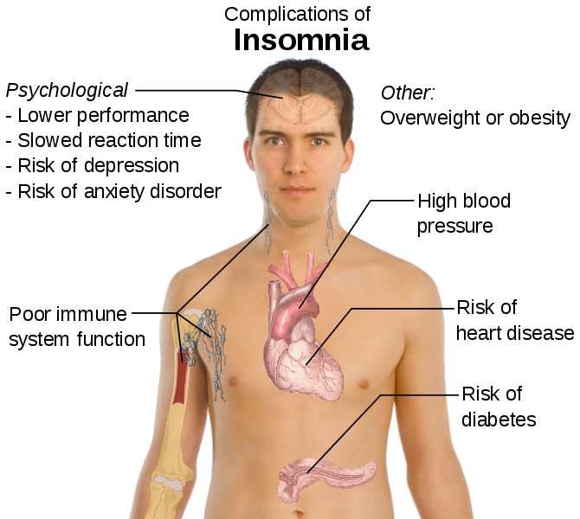
Diagnosis
Notes:
insomnia is often defined as a positive response to either of two questions

Slide 17
How is insomnia treated?
Sleep Hygiene
Medication
CBT-I
Treatment of insomnia
Notes:
Lifestyle changes often can help relieve acute (short-term) insomnia. These changes may make it easier to fall asleep and stay asleep.
A type of counseling called cognitive-behavioral therapy (CBT) can help relieve the anxiety linked to chronic (ongoing) insomnia. Anxiety tends to prolong insomnia.
Several medicines also can help relieve insomnia and re-establish a regular sleep schedule. However, if your insomnia is the symptom or side effect of another problem, it's important to treat the underlying cause (if possible). Your doctor also may prescribe medicine to help treat your insomnia.

Slide 18
Treatment
Sleep Hygiene
Lifestyle changes often can help relieve acute insomnia. These changes may make it easier to fall asleep and stay asleep.
Avoid caffeine, alcohol, or nicotine before bed.
Don't take daytime naps.
Eat at regular times each day (avoid large meals near bedtime).
Exercise at least 2 hours before going to bed.
Go to bed at the same time every night.
Keep comfortable sleeping conditions.
Remove the anxiety that comes with trying to sleep by reassuring yourself that you will sleep or by distracting yourself.
Notes:
insomnia is often defined as a positive response to either of two questions

Slide 19
Treatment
Cognitive-Behavioral Therapy
A recent study found that Cognitive Behavioral Therapy for Insomnia (CBT-I) is more effective than hypnotic medications in controlling insomnia.
unrealistic sleep expectations (e.g., I need to have 8 hours of sleep each night),
misconceptions about insomnia causes (e.g., I have a chemical imbalance causing my insomnia)
amplifying the consequences of insomnia (e.g., I cannot do anything after a bad night's sleep)
performance anxiety after trying for so long to have a good night's sleep by controlling the sleep process.
Notes:
Numerous studies have reported positive outcomes of combining cognitive behavioral therapy for insomnia treatment

Slide 20
Treatment
Medication
Prescription Sleep Aids
•Benzodiazepine sedatives: Six of these sedative drugs have been used to treat insomnia. There are reports of subjective improvement of quality and quantity of sleep when using these medications. Examples include, temazepam (Restoril), flurazepam (Dalmane), triazolam (Halcion), estazolam (ProSom, Eurodin), lorazepam (Ativan), and clonazepam (Klonopin).
•Nonbenzodiazepine sedatives: Examples include, eszopiclone (Lunesta), zaleplon (Sonata), and zolpidem (Ambien).
•Ramelteon (Rozerem) is a prescription drug that stimulates melatonin receptors. Ramelteon promotes the onset of sleep and helps normalize circadian rhythm disorders. Ramelteon is approved by the US Food and Drug Administration (FDA) for treatment of insomnia characterized by difficulty falling asleep.
•Some antidepressants (for example, amitriptyline [Elavil, Endep] and trazodone [Desyrel]) have been used for the treatment of insomnia in patients with co-existing depression because of some sedative properties. Generally, they may not be helpful for insomnia in people without depression.
Notes:
There are numerous prescription medications to treat insomnia.
Generally, it is advised that they should not be used as the only therapy and that treatment is more successful if combined with non-medical therapies

Slide 21
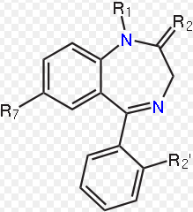
Treatment
Benzodiazepines
Benzodiazepines work by increasing the efficiency of a natural brain chemical, GABA, to decrease the excitability of neurons. This reduces the communication between neurons and, therefore, has a calming effect on many of the functions of the brain
Notes:
fusion of a benzene ring and a diazepine ring

Slide 22
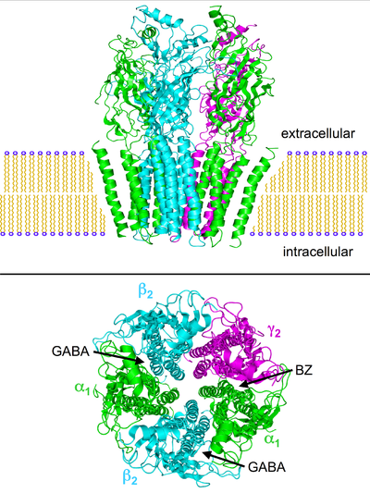
Treatment
GABA and GABA receptor:
GABA controls the excitability of neurons by binding to the GABA receptor.. The GABA receptor is a protein complex located in the synapses of neurons.
Benzodiazepines do not bind to the same receptor site on the protein complex as the endogenous ligand GABA.
Upon activation, the GABA_{A} receptor selectively conducts Cl⁻ through its pore, resulting in hyperpolarization of the neuron.
Notes:
insomnia is often defined as a positive response to either of two questions

Slide 23
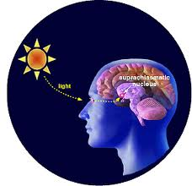
Treatment
Medication
Over the Counter (OTC) Medications
Antihistamines with sedative properties [for example, diphenhydramine (Benadryl) or doxylamine] have also been used in treating insomnia as they may induce drowsiness, but they do not improve sleep and should not be used to treat chronic insomnia.
Melatonin: Melatonin is secreted by the pineal gland, a pea-sized structure at the center of the brain. Melatonin is produced during the dark hours of the day-night cycle (circadian rhythm). Melatonin levels in the body are low during daylight hours. At night, melatonin is produced to help your body regulate your sleep-wake cycles. The amount of melatonin produced by your body seems to decrease as you get older.

Slide 24
Thank You !

