Slide 1
Miscellaneous Reactions of Synthetic Importance

Slide 2
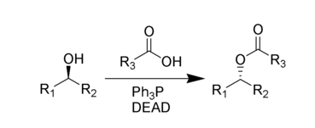
Mitsunobu Reaction
The Mitsunobu Reaction constitutes a reliable way to activate an alcohol as a leaving group, thus allowing an Sn2 substitution by selected nucleophiles.
The nucleophile is introduced as its conjugate acid, with the conjugate acids of the best nucleophiles having pKa < 7.

Slide 5
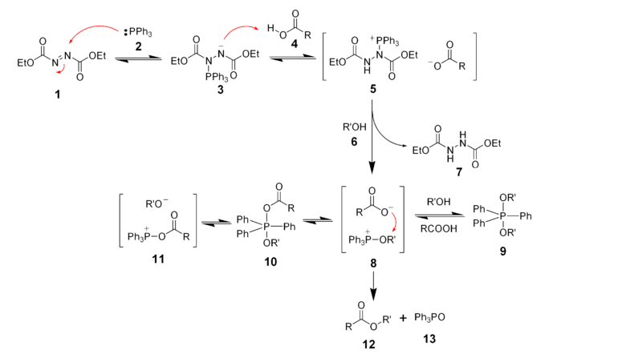

Slide 6
The Wittig Reaction

Slide 7
Mechanism
As a rule of thumb, ‘stabilized’ ylides (those having additional carbanion-stabilizing groups) produce alkenes of E geometry, while ‘unstabilized’ ylides produce alkenes of Z geometry.

Slide 8
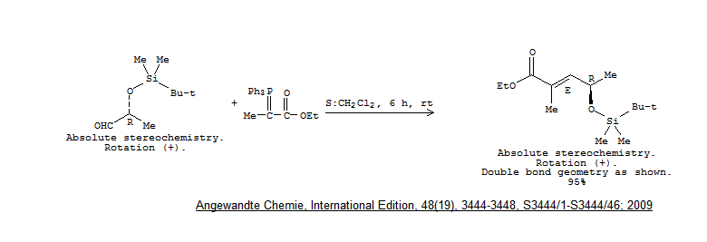

Slide 11
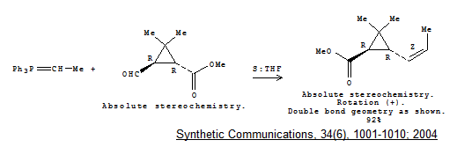

Slide 13
Horner-Wadsworth-Emmons Reaction

Slide 16
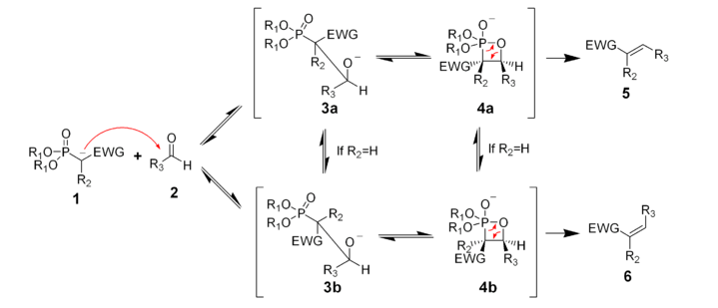
Mechanism
Under the usual conditions, the HWE reaction tends to prefer formation of the alkene with the E geometry.

Slide 19
However, under specialized conditions, shown below, the alkene of the Z geometry can be produced.

