Slide 2
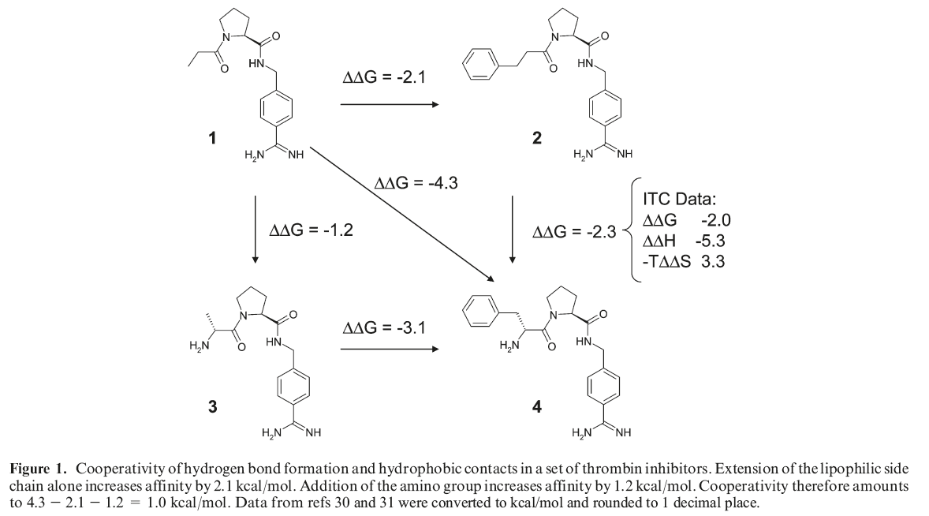
Note the effect of cooperativity in the example below.
The addition of the aryl group is worth ΔΔG = -2.1 alone, but it is worth more in the presence of the amino group (and vice versa)

Slide 3
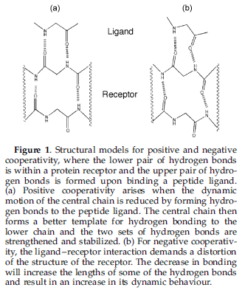
It has been shown that, in some cases, the ‘packing’ of the enzyme is improved in the presence of the ligand.

Slide 4
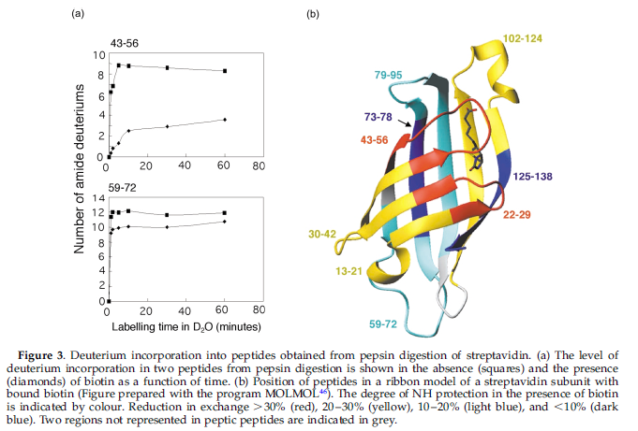
Deuterium exchange in the streptavidin-biotin complex (one of the strongest enzyme ligand complexes) indicate that the ligand is actually improving the overall packing of the enzyme (relative to that of the apoenzyme).

Slide 5
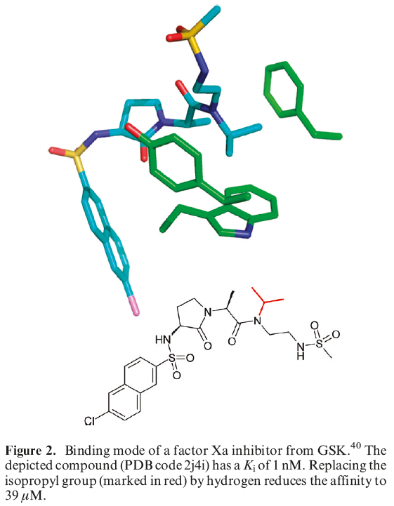
Hydrophobic region
When one considers the ligand-binding process, one needs to remain cognizant of the solvation state of both the binding pocket and also the ligand.
Hydrophobic regions of the binding pocket may be poorly hydrated in the apoenzyme, and thus the interaction of hydrophobic regions of the ligand with these regions contributes much binding affinity.

Slide 6
The problem of bound water
Some water molecules are visible in the crystal structures of all proteins.
Those water molecules that are visible are usually favorably hydrogen-bonded to the protein.
One strategy for ligand design is to design the ligand to replace bound water.
However it may be difficult to accurately replace water which is extensively H-bonded to the protein.

Slide 7
Assessing protein flexibility and repulsive interactions
One approach is to examine the PDB for multiple structures of the same protein complexed with several different ligands.
This can allow one to know the range and limitations of protein flexibility.

Slide 8
Hydrogen bonds are the most important specific interactions in biological recognition processes.

