Slide 1
Nucleophilic Substitution Reactions
(Substitution at sp³-hybridized Carbon)

Slide 2
Halides are electronegative elements. Thus, in the case of an alkyl halide, R-X the halide atom can leave from carbon, taking the shared pair of electrons with it.

Slide 3
In its place, a nucleophile enters, coming in with its pair of electron to re-fill the valency of the carbon, and replace the pair lost to the leaving group. This is called a nucleophilic substitution.
Notice that each of the curved arrows shown above is intended to represent the movement of two electrons.
Arrows of this type are a ‘bookkeeping’ system used by organic chemists to account for electrons and to aid in rationalizing the behavior of the system. Notice that the electrons ‘flow’ toward the more electronegative atom.

Slide 5
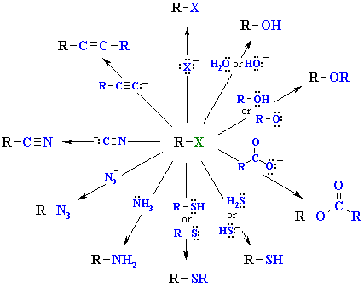
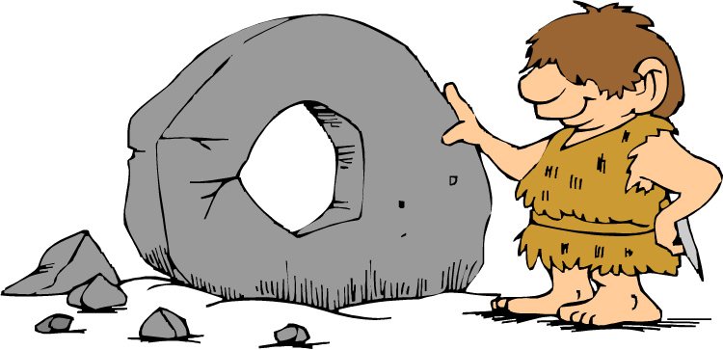
With the proper leaving group, nucleophilic substitution at sp³ hybridized carbon occurs easily and in high yield and is a synthetically useful reaction!!

Slide 6
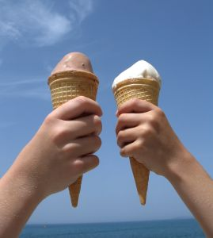
To a first approximation, nucleophilic substitution comes in two flavors, S_{N}2 and S_{N}1. The difference is in the ‘timing’ of the leaving group departure.

Slide 7
The S_{N}2 Reaction
The S_{N}2 reaction is so-named because it exhibits bimolecular kinetics (i.e. the rate of the reaction depends on the concentrations of both the nucleophile and the alkyl halide) , as shown in the rate expression below.
Rate = k[Nu⁻][R-X]

Slide 8
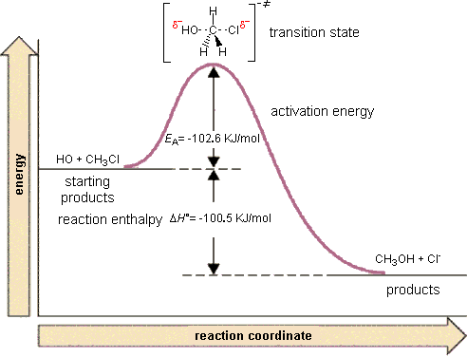
This reaction is now known to occur in one step and by ‘backside’ attack as shown below.
LINK

Slide 9
In reactions in which the leaving group is attached to a stereogenic center, the backside attack of the nucleophile results in inversion of configuration.
LINK

Slide 10
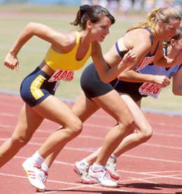
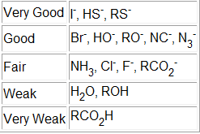
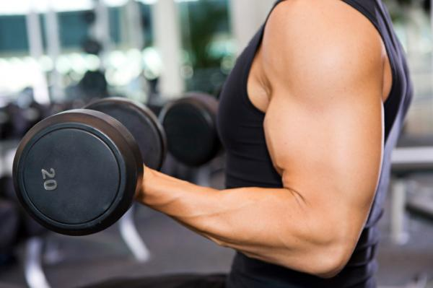
Q: What will increase the rate of an S_{N}2 reaction?
A1: The rate of an S_{N}2 reaction depends on the strength of the nucleophile.
Strength of the Nucleophile
Notice that, provided the element is the same, the negatively charged atom (conjugate base) is always a stronger nucleophile than the corresponding conjugate acid. Thus S_{N}2 reactions frequently occur under basic conditions.

Slide 11
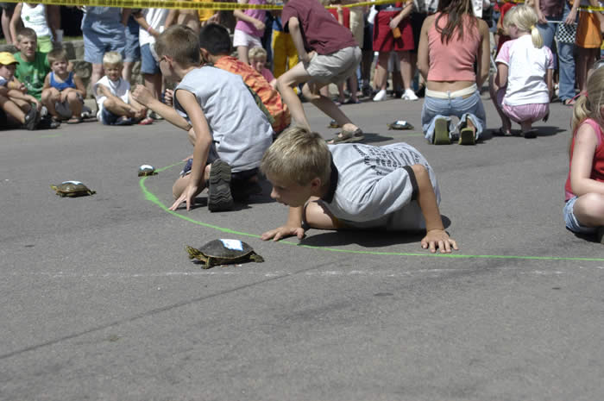
Q: What will increase the rate of an S_{N}2 reaction?
A2: The rate of an S_{N}2 reaction depends on the size (steric bulk) of the nucleophile.

Slide 12
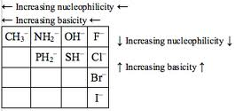
An Exception to the Size Rule?
As we move down the periodic table, atoms are farther from the nucleus and thus these valence electrons are more free to move toward the nucleus and generate a greater amount of partial bond in the transition state.

Slide 13
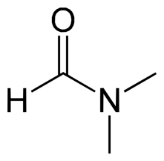
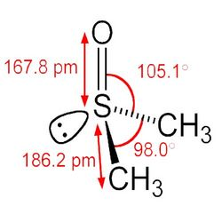
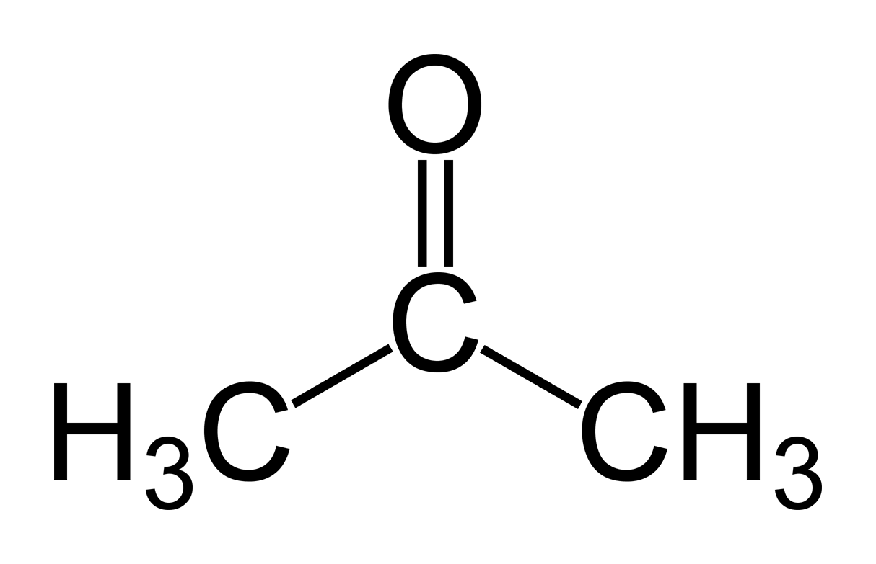
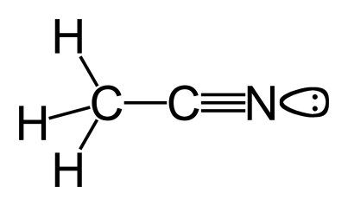
Q: What will increase the rate of an S_{N}2 reaction?
A3: The rate of an S_{N}2 reaction depends on the solvent of the reaction. The best solvents for S_{N}2 reactions are polar, aprotic solvents.
Acetone
Dimethylformamide (DMF)
Acetonitrile
(MeCN)
Dimethylsulfoxide
(DMSO)

Slide 14
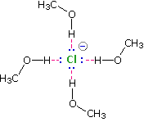
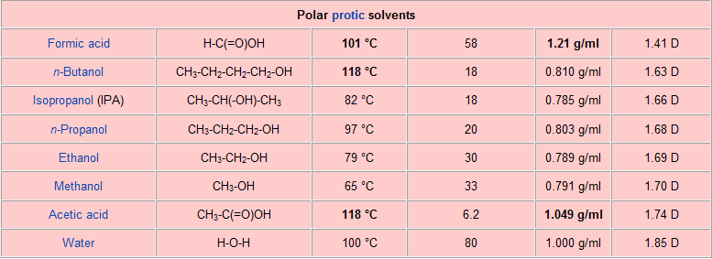
By contrast, PROTIC solvents interact strongly with negatively charged nucleophiles, stabilizing them and thus slowing the reaction.

Slide 15
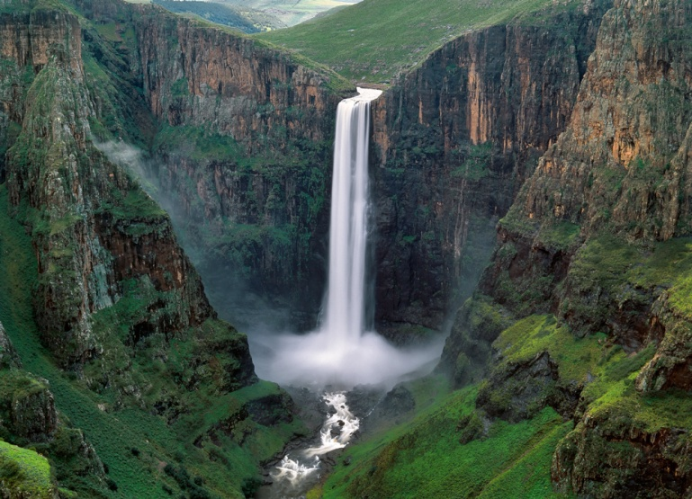
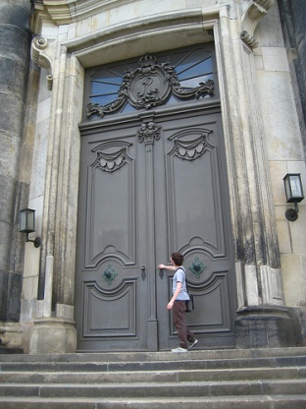
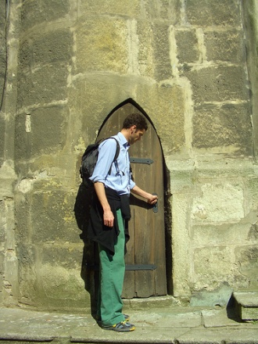
Q: What will increase the rate of an S_{N}2 reaction?
A4: The rate of an S_{N}2 reaction depends on the amount of steric hindrance at the carbon to which the leaving group is attached. (i.e. the best S_{N}2 SUBSTRATES are PRIMARY halides)
Increasing rate of S_{N}2
R-X = (Fastest) CH₃X > 1º > 2º > 3º (slowest)

Slide 16
The Finkelstein Reaction
The exchange of one halide for another, at an sp³ hybridized carbon, is called the Finkelstein Reaction, for the German chemist, Hans Finkelstein, who reported the reaction in 1910.
The classic Finkelstein reaction makes an alkyl iodide from an alkyl chloride by using acetone as solvent, since sodium iodide is soluble in acetone, but the product, sodium chloride is not.

Slide 17
How fast is this S_{N}2 reaction?
Relative Rates of the Finkelstein Reaction
Note that the reaction does not proceed at an aryl or at a vinyl halide.

Slide 18
S_{N}2 Rate Acceleration at Allylic and Benzylic Position

Slide 19
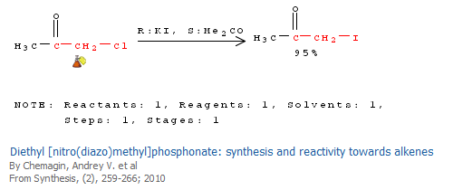
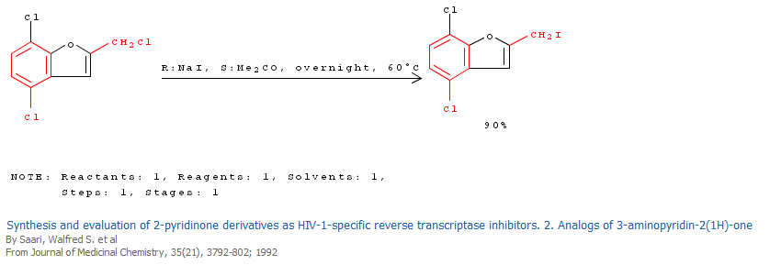
In the following reaction, notice that the sp³-hybridized halide is substituted, while the sp² hybridized halide is not.

Slide 20
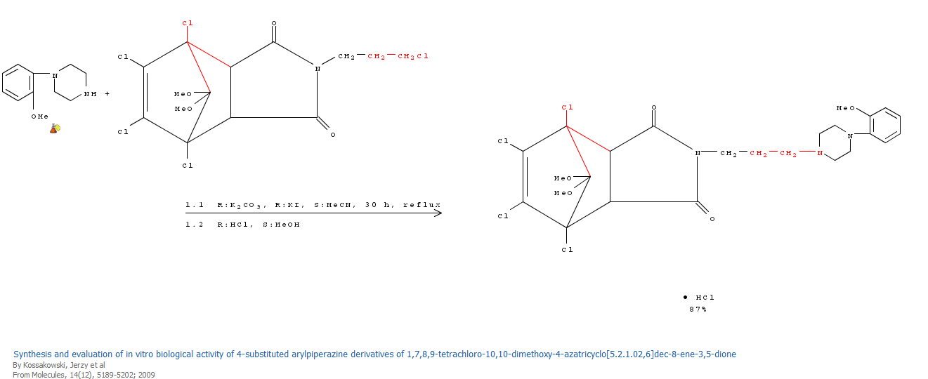
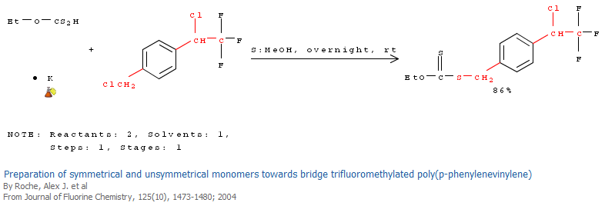
In the following reactions, notice that the less substituted sp³ hybridized halide is substituted more rapidly.

Slide 21
Q: What will increase the rate of an S_{N}2 reaction?
A5: The best SUBSTRATES for S_{N}2 reactions have excellent LEAVING GROUPS.
(fastest substrate) R-I > R-Br > R-Cl > R-F (slowest substrate)
(weakest base) I⁻ < Br⁻ < Cl⁻ < F⁻ (strongest base)
The best leaving groups are usually the weakest bases (i.e. best able to stabilize the increase in electron density which will occur as the LG departs with its pair of electrons).

Slide 22
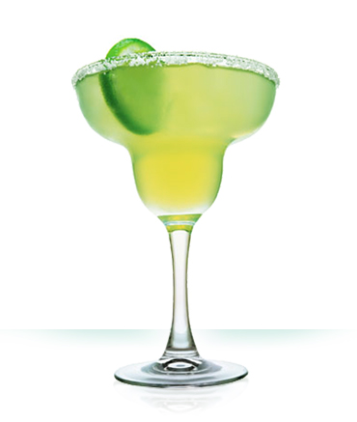
Strong base and poor leaving group
Alcohols are readily available and inexpensive, but the –OH group is NOT a good leaving group for nucleophilic substitution, since hydroxide is much too strong a base to be a good leaving group.

Slide 23
Like hydroxide, alkoxide (RO⁻) is a poor leaving group, thus ethers are relatively unreactive toward nucleophiles (and toward strong bases) and therefore make good (unreactive) solvents.
Ethers commonly used as solvents:

Slide 24
Under strongly acidic conditions, however, the OH group is protonated, thus turning it into a much better leaving group (H₂O) as shown.

Slide 25
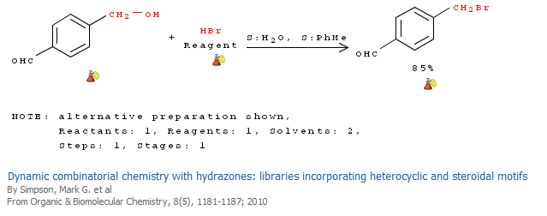

Slide 26
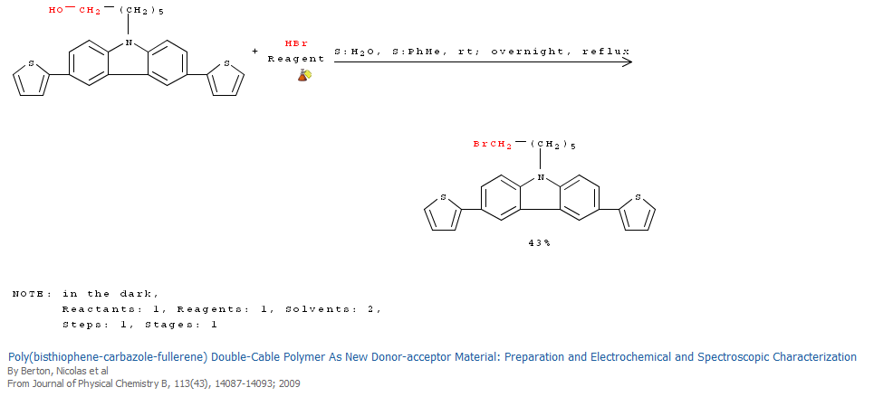

Slide 27
A more chemoselective way to convert an alcohol into a good leaving group is to turn it into a sulfonate:
Alkyl tosylate
pKa = 5.21

Slide 28
Commonly Used Alkyl Sulfonates

Slide 30
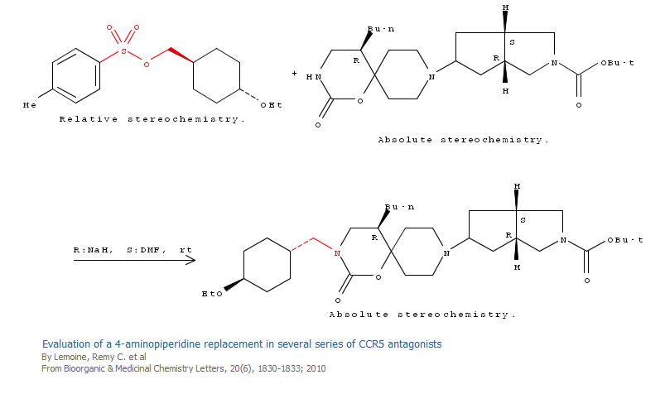

Slide 31
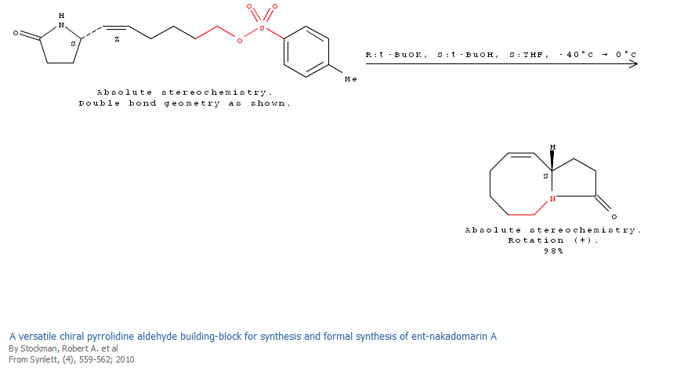

Slide 32
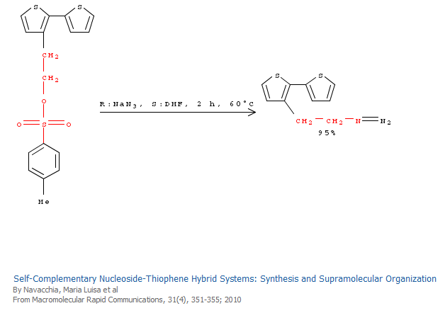

Slide 33
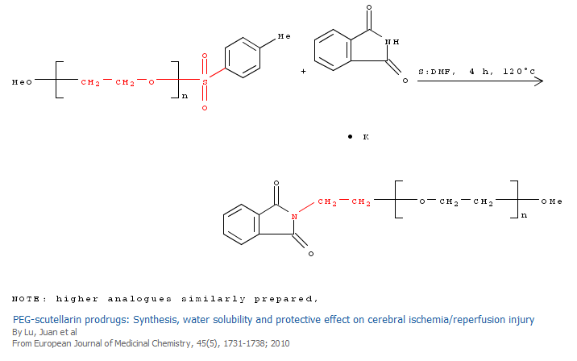

Slide 34
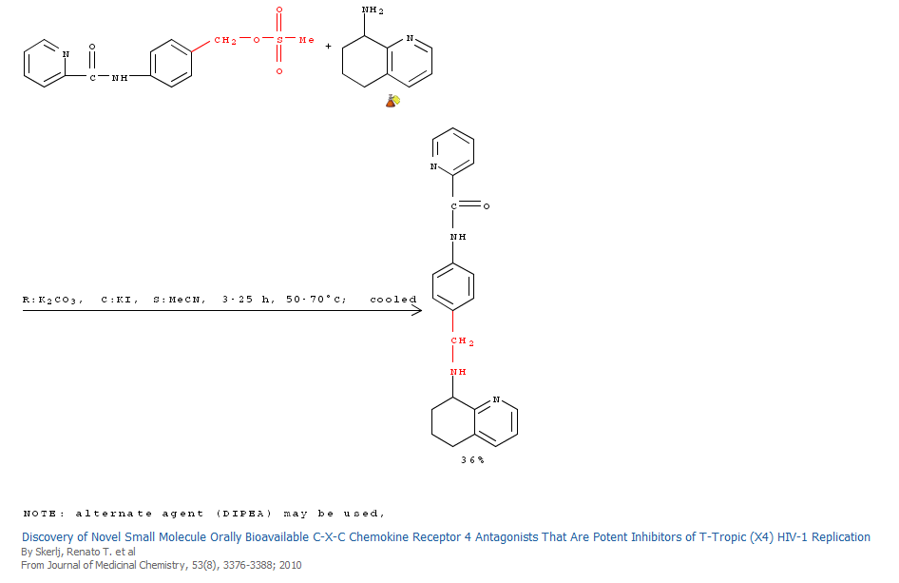

Slide 35
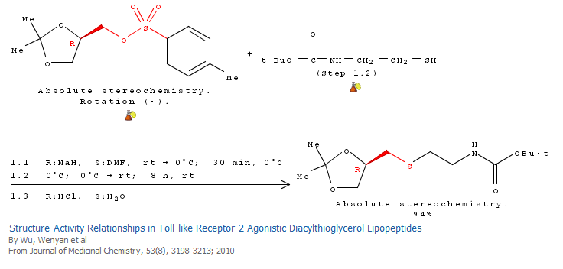

Slide 36
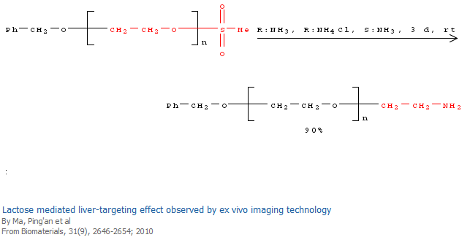

Slide 37
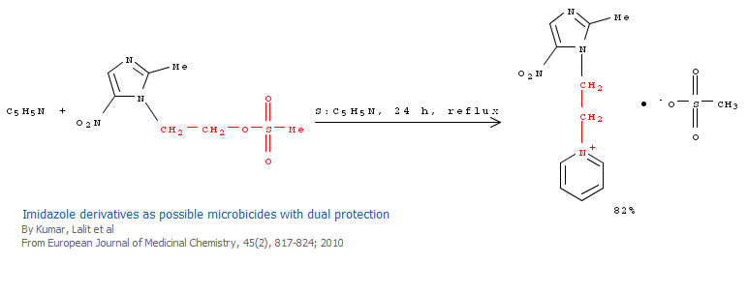

Slide 38
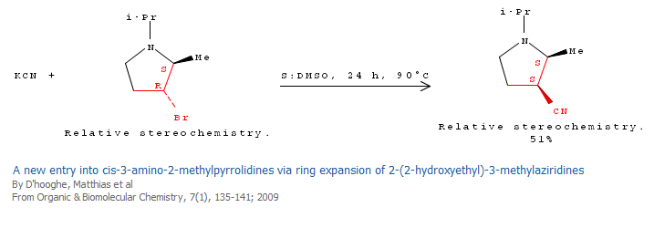

Slide 39
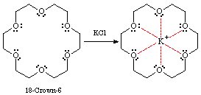
Crown Ethers
15-Crown-5
18-Crown-6
Crown ethers are sometimes used with a salt, M⁺X⁻, to increase the solubility of the salt in non-polar solvents, and/or to improve the nucleophilicity of the anion, by selectively complexing the cation as shown at the right.
The size of the cavity determines which ions will be selectively complexed. 18-crown-6 is selective for potassium, while 15-crown-5 is used for sodium.

Slide 40
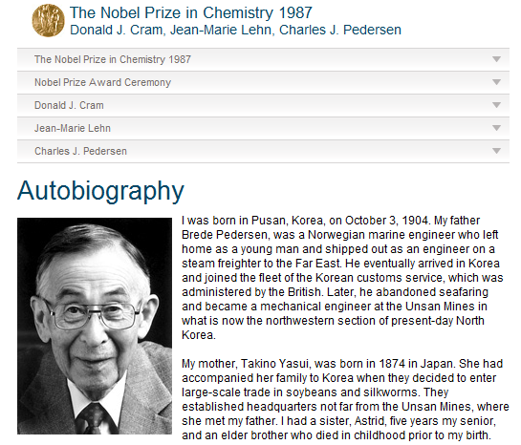
Charles J. Pedersen
Charles J. Pedersen, who first discovered crown ethers while working at Dupont, shared the Nobel Prize for this work, in 1987.

Slide 41
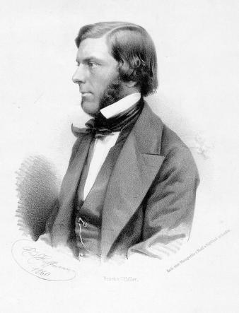
Williamson Ether Synthesis
The Williamson ether synthesis, shown below is an S_{N}2 substitution.
It usually requires both strong nucleophiles (alkoxide anions) and good leaving groups (e. g. alkyl iodides or tosylates).
Alexander William Williamson (1824-1904)

Slide 42
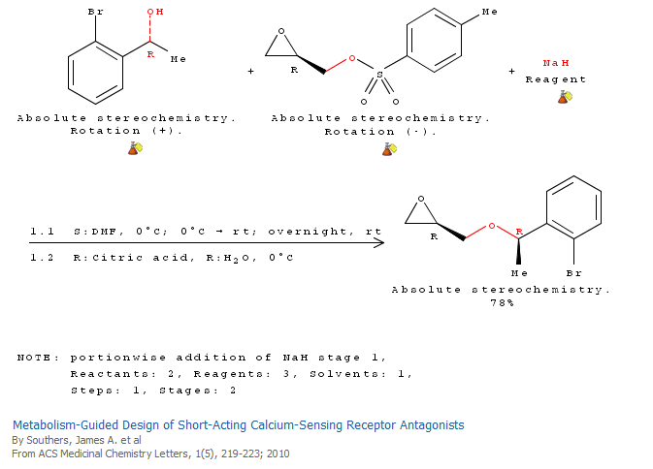

Slide 43
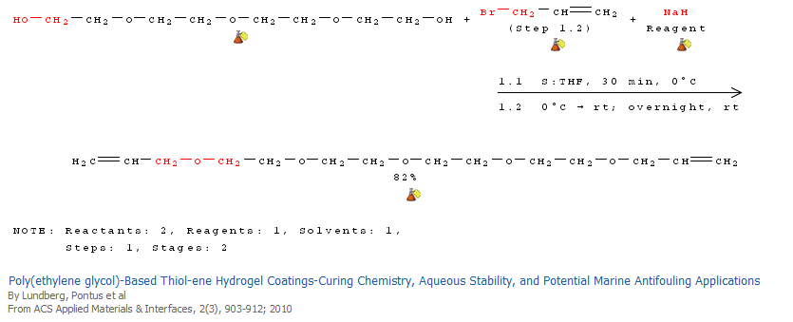

Slide 44
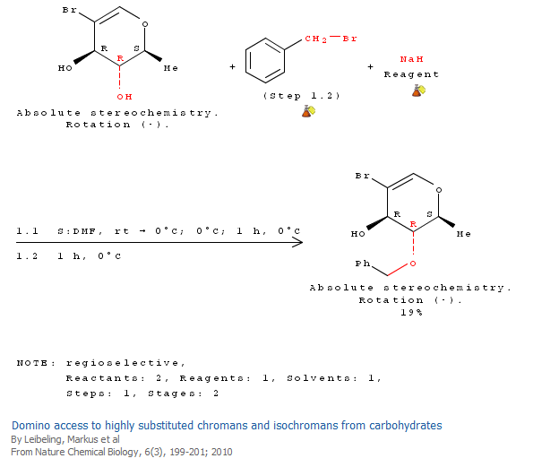

Slide 45
The S_{N}1 Substitution Reaction
The S_{N}1 reaction is so-named because it exhibits unimolecular kinetics (i.e. the rate of the reaction depends only on the concentrations of the alkyl halide) , as shown in the rate expression below.
Rate = k[RX]

Slide 46
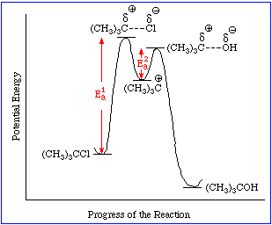
The S_{N}1 Reaction is a two-step process, with the rate of the overall reaction dependent on the rate of the first step, which is the rate-determining-step (rds).

Slide 47
The S_{N}1 reaction mechanism is usually operative in cases where the carbocation is relatively stable, and when nucleophiles are relatively weak.
Stability of Carbocations
R ≠ H
Tertiary Carbocation
(Most stable)

Slide 48
Tertiary carbocations are stabilized by hyperconjugation with the nine adjacent C-H bonds as shown below.

Slide 49
S_{N}1 reactions do not require strong nucleophiles (unlike S_{N}2).
A reaction in which the solvent itself is the nucleophile is called a ‘solvolysis’.
In the case above, methanol, the solvent, is a very weak nucleophile (weaker than the corresponding conjugate base, methoxide).
The use of methoxide, however, would have produced exclusively elimination as shown below, since tertiary halides are poor substrates for S_{N}2.

Slide 50
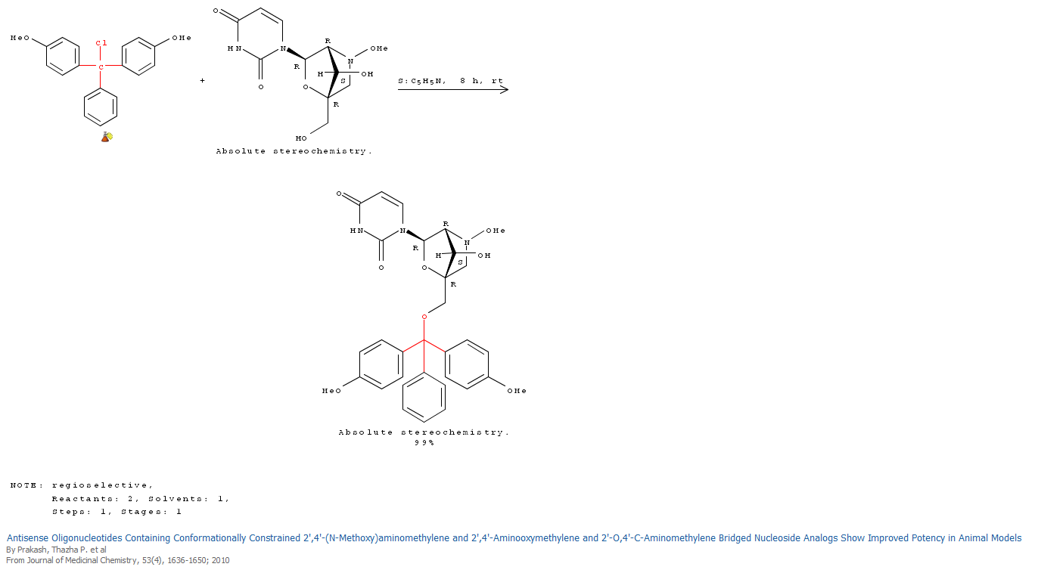

Slide 51
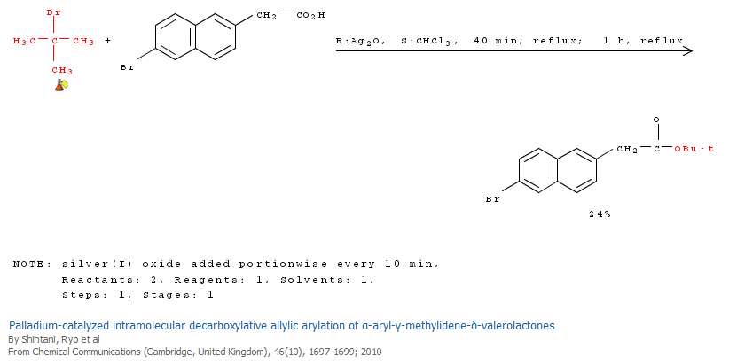

Slide 52
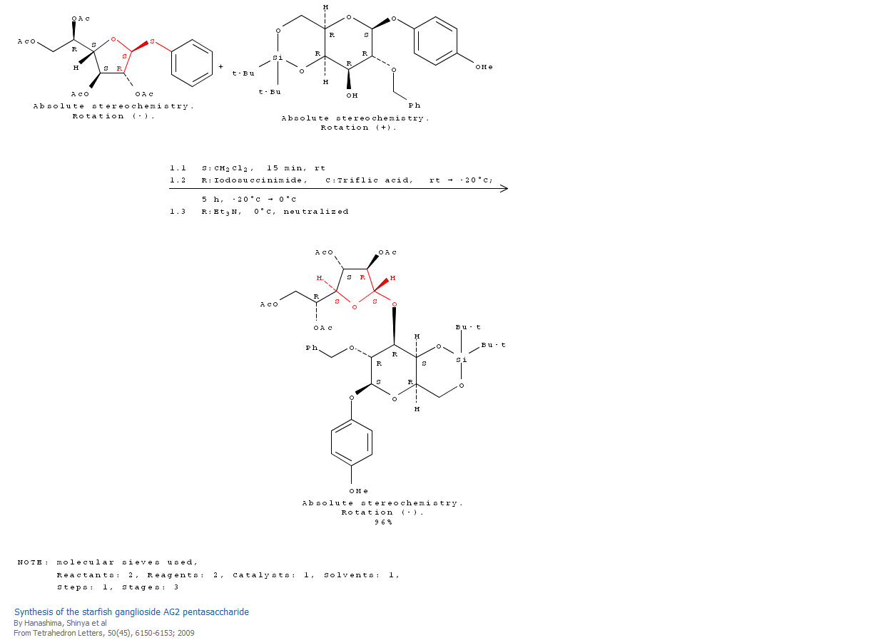

Slide 53
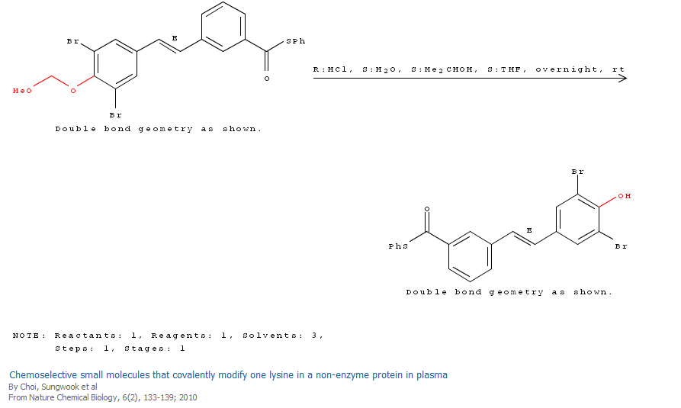

Slide 54
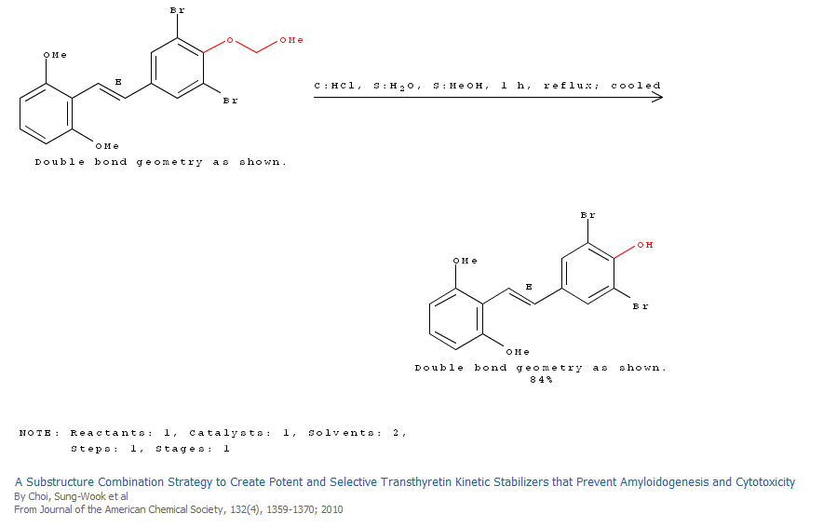

Slide 55
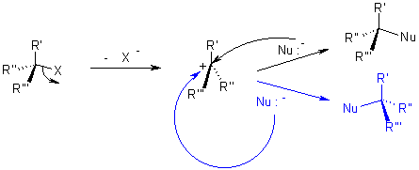
From a stereochemical perspective, an S_{N}1 reaction proceeds with racemization of configuration

Slide 56
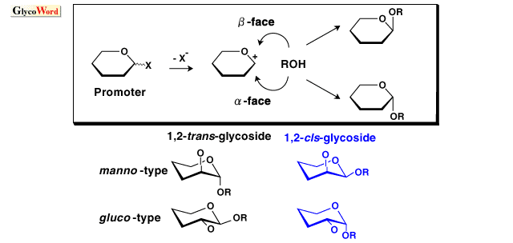
Chemical Glycosylation

Slide 58
Neighboring Group Assistance
(Anchimeric Assistance)

Slide 59
Why is this reaction faster and why does this reaction proceed with retention of configuration???
(Recall that the S_{N}2 reaction proceeds with inversion and the S_{N}1 reaction proceeds with racemization.
Thus, we do not have a mechanism type that proceeds with retention!)

Slide 60
Answer: The ionization of the tosylate group is assisted by a backside displacement of the tosylate by the oxygen of the adjacent acetate group.
This same assistance is not possible in the cis derivative, since both the acetate and the tosylate are on the same face of the cyclohexane (and thus backside attack of the acetate oxygen on the tosylate carbon is disfavored.
Thus we are seeing an overall retention of configuration, as the result of two successive inversions.)
Notice the strong preference for substitution reactions to occur from the backside.

Slide 61
Carbocation Rearrangements
Carbocations are highly reactive intermediates and numerous side reactions can interfere with substitution
One such reaction involves a rearrangement, as shown below.

Slide 62
Mechanism of This Carbocation Rearrangement
~H
The electrons migrate to the adjacent carbocation generating (in most cases) a more stable carbocation, as seen above.
This type of rearrangement is called a hydride shift and sometimes abbreviated with the symbol ~H.
Such rearrangements, where one carbocation is transformed into another, are sometimes referred to as “Wagner-Meerwein Rearrangements”

Slide 63
An unexpected result involving carbocations:

Slide 64
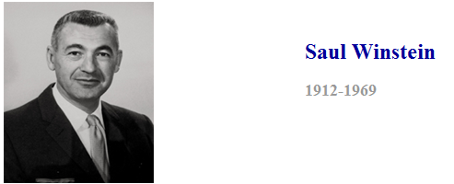
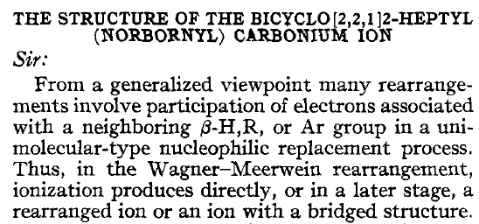
J. Am. Chem. Soc. 1949, 71, 2953.

Slide 66
Winstein proposed an unusual answer…
That the intermediate was not a traditional carbocation, but was a carbocation with two ‘half bonds’ as shown below. Such an intermediate is symmetric (as stated below) and would prefer attack from only the exo face.

Slide 67
Some chemists disagreed…
H. C. Brown, who won the Nobel prize in 1979 for his work on organoboron compounds, said that the result was best explained not by a single intermediate with ‘half bonds’ but by two rapidly equilibrating traditional carbocations, as shown below.

Slide 68
The debate was finally settled through the use of a special medium, which allowed the observation of carbocations (magic acid: SbF₅-SO₂-SOF₂), and the use of variable temperature NMR (which allowed one to distinguish between rapidly equilibrating compounds versus single species).
J. Am. Chem. Soc. 1973, 95, 8698.

Slide 69
For his extensive work on carbocations, George Olah won the Nobel Prize in 1994.

Slide 70
Use of Nucleophilic Substitution Reactions in Ring-forming Reactions

Slide 71
Notice that the fastest rings to form are the five and the three membered rings.
Why?

Slide 72
S-Adenosylmethionine (SAM or AdoMet), a biological methylating agent
Active methyl (transferred to biological nucleophiles)

Slide 74
Optional Reading:
Fontecave, M.; et al. S-adenosylmethionine: nothing goes to waste, Trends in Biochemical Sciences 2004, 29, 243-249.

