Slide 1
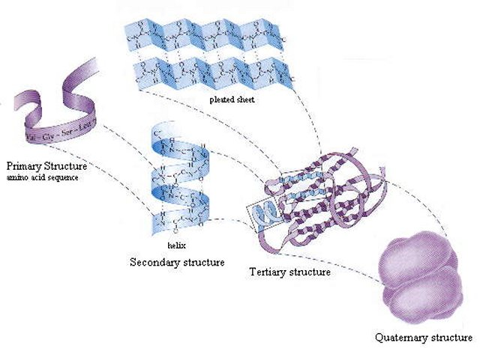

Protein therapeutics
Soma Mukherjee
SMU,Chemistry
5th April’2011

Slide 2
Contents:
Introduction : Protein & important structural features for therapeutics.
Development
Classification
Examples of Protein as targeted delivery device
Conclusion & Future direction

Slide 3
What are therapeutic proteins?
These are the proteins that has an effect of healing or use inside our body, e.g
nutrition: the use of albumin (its the same in all human beings
Globulins: the example is gamma globulin that boosts your defenses against infectious diseases (gamma globulin is a mixture of antibodies)
Synthetic proteins: antibodies against inflammatory components (infliximab), or against tumor components (trastuzumab)

Slide 4
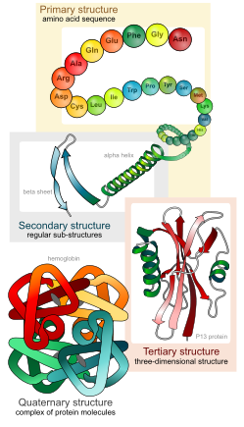
Protein structures & its attractive features for therapeutics :

Slide 5
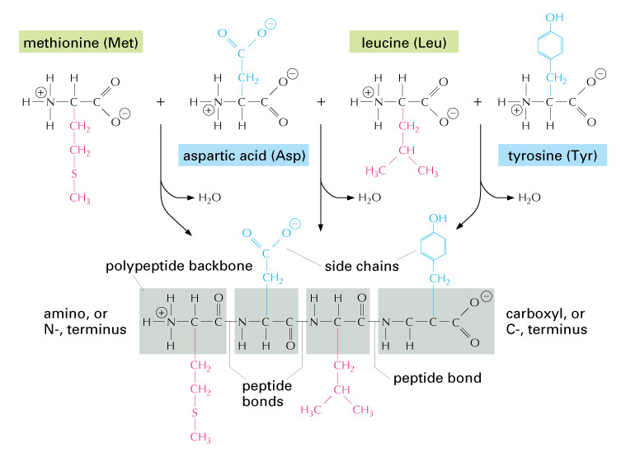
What is inside???

Slide 6
Attractive features :Why Protein against small drug molecules?
The diversity of functional groups in protein : free thiols on cystein residue & amine on the N-terminus or on lysin residue
Scope for functionalization by Micheal addition /Thiol disulfide exchange.
Highly specific function less chance of being mimicked by simple chemical compounds.
High specificity in action less potential for protein to interfere with normal biological processes –hence least adverse effects.
The body naturally produces many of the proteins that are used as therapeutics, & hence are often well tolerated and are less likely to elicit immune responses.
Comparatively faster clinical development and FDA approval time than that for small molecule drugs.
Easier to obtain far-reaching patent protection for protein therapeutics.

Slide 7
Protein discovery: History
Proteins were recognized as a distinct class of biological molecules in the 18th century by Antoine Fourcroy and other.
They are found to be able to coagulate in distinct conditions e.g albumen from egg whites, blood serum albumin, fibrin, and wheat gluten.
The elemental analysis of protein by Gerhardus Johannes Mulder & use the name ‘Protein’ coined by Jöns Jakob Berzelius in ~1839 in his papers.

Slide 8
The evolution of Protein therapeutics :
1953 First accurate model of DNA suggested
1982 Human insulin, created using recombinant DNA technology
1986 Interferon alfa and muromonab-CD3 approved
1993 CBER's Office of Therapeutics Research and Review (OTRR) formed
1997 First whole chimeric antibody, rituximab, and first humanized
antibody, daclizumab, approved
2002 Market for biotechnology products represents approximately $30
billion of $400 billion in yearly worldwide pharmaceutical sales
2006 An inhaled form of insulin (Exubera) approved, expanding protein
products into a new dosage form.

Slide 9
Classification of Protein therapeutics
Group I: protein therapeutics with enzymatic or regulatory activity
Ia: Replacing a protein that is deficient or abnormal
Ib: Augmenting an existing pathway
Ic: Providing a novel function or activity
Group II : protein therapeutics with special targeting activity
IIa: Interfering with a molecule or organism (TABLES 6,7).
IIb: Delivering other compounds or proteins
Group III : protein vaccines
IIIa: Protecting against a deleterious foreign agent.
IIIb: Treating an autoimmune disease.
IIIc: Treating cancer.
Group IV : protein diagnostics

Slide 10
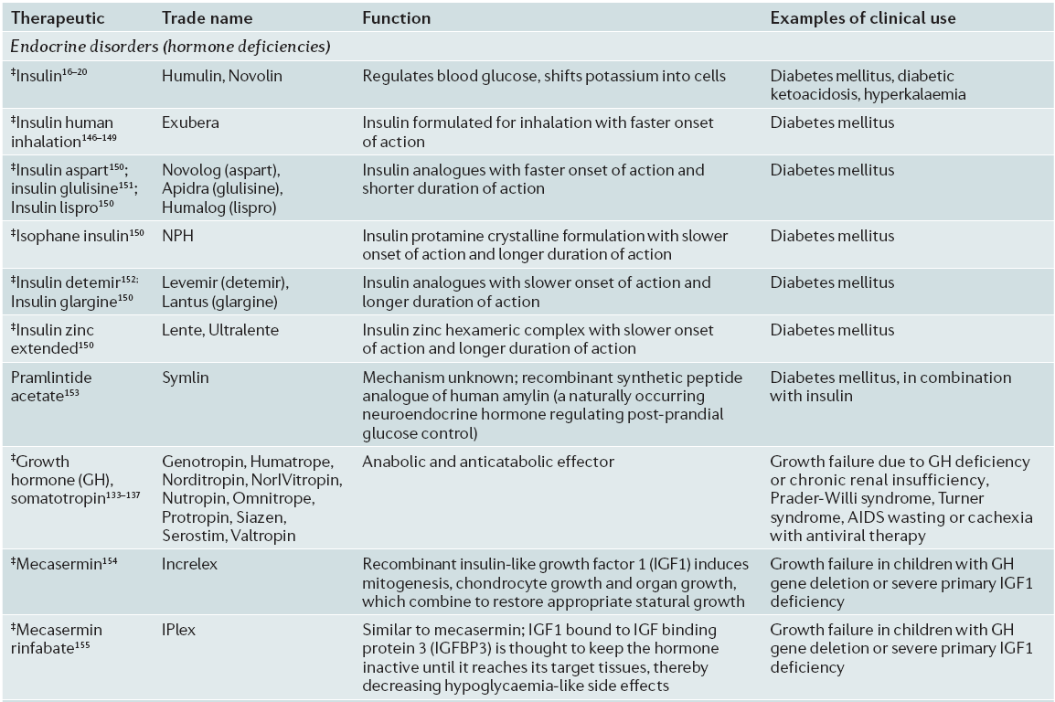
Protein therapeutics replacing a protein that is deficient or abnormal (Group Ia)

Slide 11
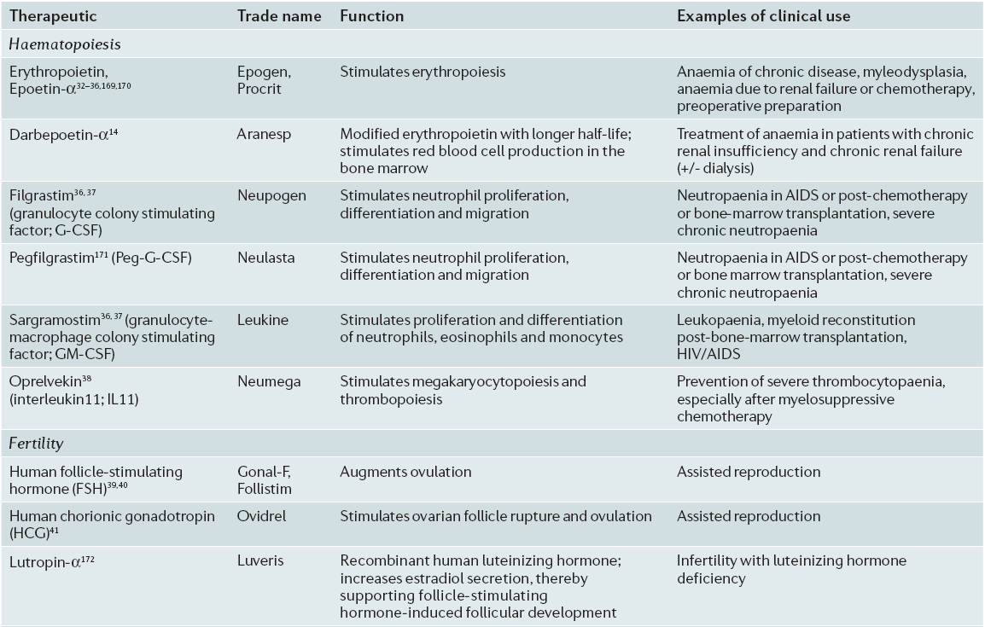

Protein therapeutics augmenting an existing pathway (Group Ib)

Slide 12
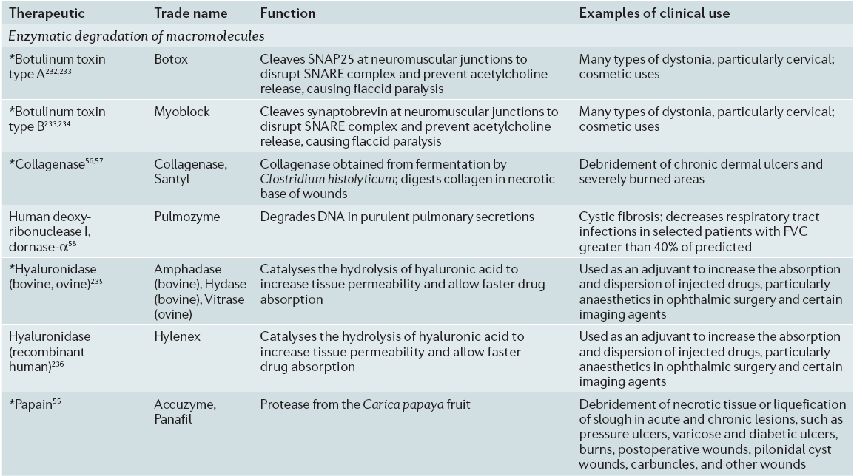

Protein therapeutics providing a novel function or activity(Group Ic)

Slide 13
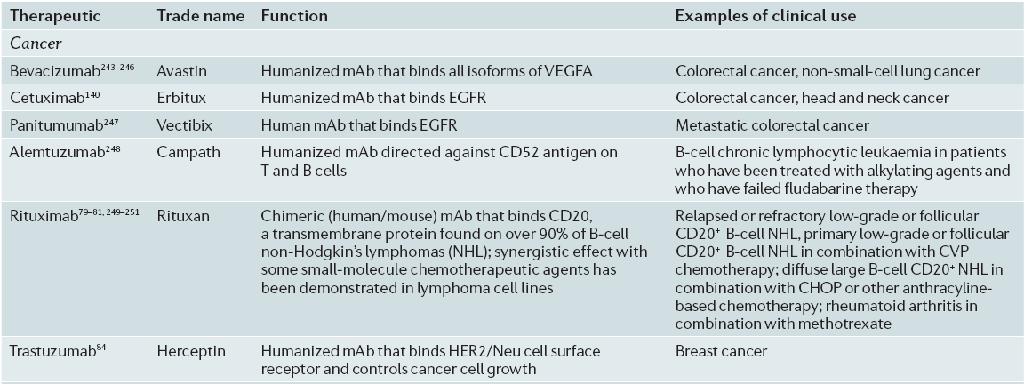
Protein therapeutics that interfere with a molecule or organism (Group II a)*

Slide 14
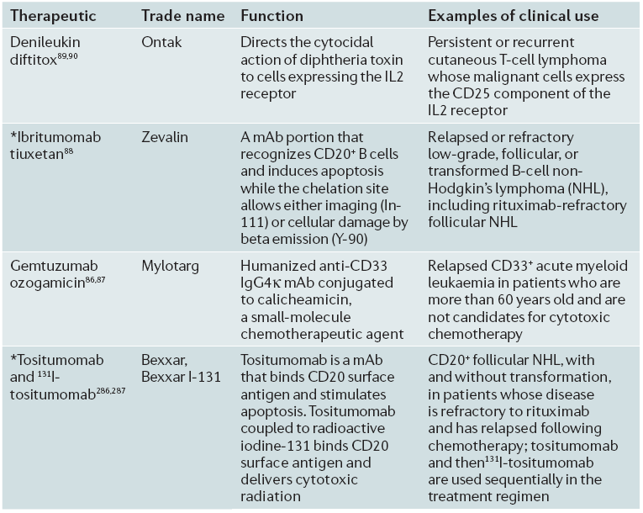
Protein therapeutics that deliver other compounds or proteins (Group II b)

Slide 15
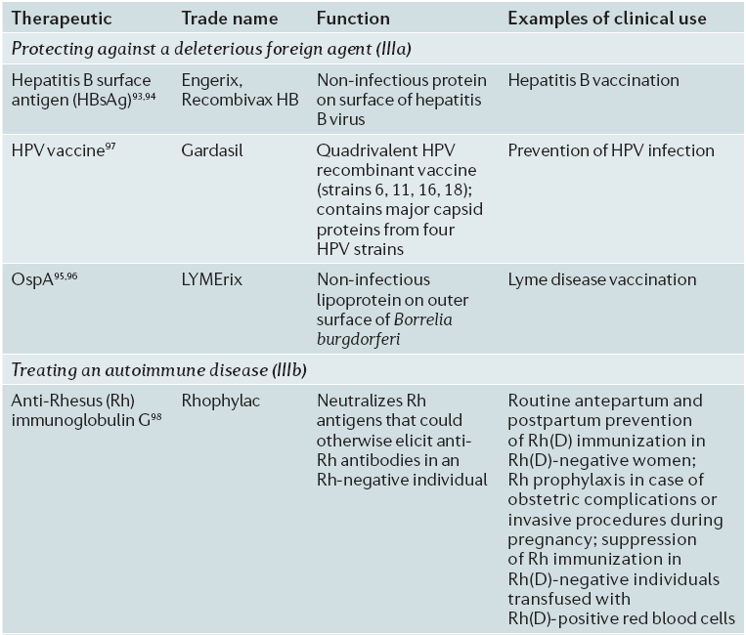
Protein vaccines (Group III )

Slide 16
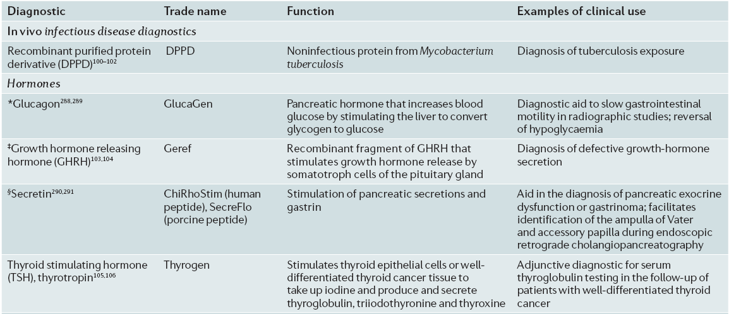
Protein diagnostics (Group IV )

Slide 17
Intracellular protein delivery system :Amphipatheic peptide carrier & Protein cargos
Covalent modification of proteins with a peptide sequence that shows the capability to translocate membrane rapidly, usually termed as ‘‘cell penetrating peptide(CPP) or protein trunsduction domain(PTD) .
Modification involves –
1>direct expression of recombinant fusion protein from a vector containing DNA sequence of the CPP sequence.
2> protein or chemical conjugation of CPP to the protein through linker such as disulfide bond linkage that is cleavable under reductive environment.
To protect protein from protease degradation & Strategy to improve
delivery efficiency noncovalent encapsulation with different
cargos with synthetic peptide.

Slide 18
Development of peptide based biomaterial for delivery :
Why peptide?
1>Easy to synthesize
2>easy charecterization
3>less toxic & has higher immunogenicity than high mol wt polymers.
4>Due to its amphipathic character of peptides can associate rapidly with protein cargos in solution in self-assembly manner, possibly through noncovalent hydrophobic interaction.

Slide 19
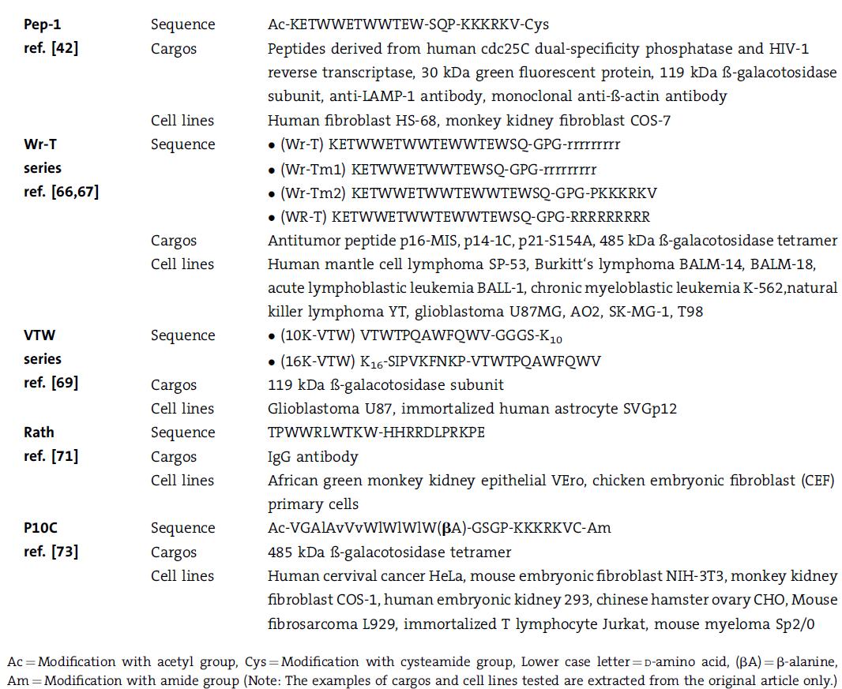

Amphipathic peptides involved in intracellular delivery of proteins/peptides

Slide 20
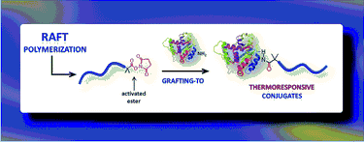
Targetted delivery : Protein polymer conjugate
Most commonly employed polymer : Polyethylene glycol(PEG) & Poly(N-isopropylacrylamide) (PNIPAM)
These polymers that alter their solubility or propensity for self-assembly when exposed to changes in pH or temperature allow their responsive nature to be conferred to the protein to which they are attached.
Functionalizable with active esters & hence can be conjugated with protein amine.

Slide 21
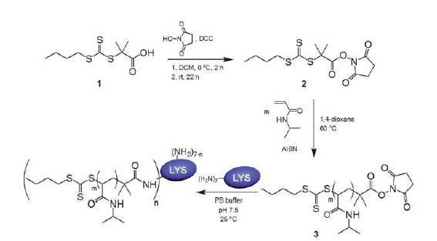
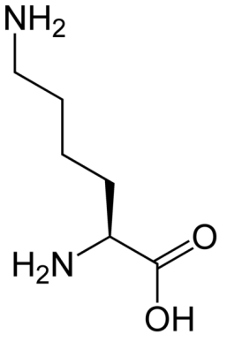
An NHS-containing trithiocarbonate RAFT agent that can be employed to prepare polymers for selective functionalization of protein amines in water
LYS served as a convenient model for conjugation to NHS-functional polymers, as it has seven primary amines, including six lysine residues and the N-terminus)
Lysine

Slide 22
Conclusion & Future direction :
Challenge for protein polymer conjugate : a>mixing ratio,
b>protein loading capacity,
c>study of uptake efficiency with different inhibitors for different cellular entry mechanism for maximum delivery efficiency.
Cost & storage

Slide 23
Assigned reading:
Protein therapeutics: a summary and pharmacological classification,
enjamin Leader, Quentin J. Baca & David E. Golan
Nature Reviews Drug Discovery 7, 21-39 (January 2008) | doi:10.1038/nrd2399
Intracellular Protein Delivery Systems Formed by Noncovalent Bonding Interactions between Amphipathic Peptide Carriers and Protein Cargos,
by, Seong Loong Lo, Shu Wang*
Macromol. Rapid Commun. 2010, 31, 1134–1141

Slide 24
Questions :
What are the advantages of Protein therapeutics over the small molecule drugs?
What are the different types of protein therapeutics? Give examples.
What are recombinant proteins? What are their benefits over nonrecombinant proteins?
Explain with example the strategy of development of protein therapeutics for targeted delivery. What features of proteins are important in this context?

Slide 25
Thank you!
☺

