Slide 1
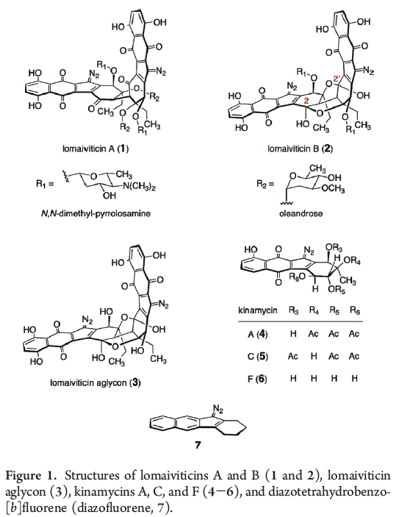

Slide 2
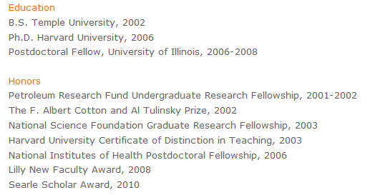

Slide 4
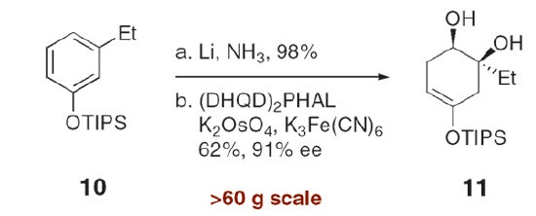

Slide 5
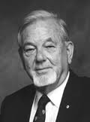
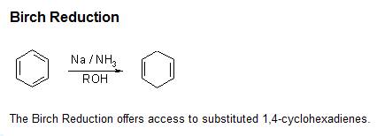

Slide 7
Substituent Effects on the Birch Reduction
Electron Donating Substituents
Note that these substituents seem to direct the carbanion away from the carbon having the (electron-donating) substituent to produce the more highly substituted double bond.

Slide 8
Substituent Effects on the Birch Reduction
Electron-withdrawing Substituents
Note that the electron-withdrawing substituents ‘direct’ the carbanion to the carbon on which they are attached.

Slide 9
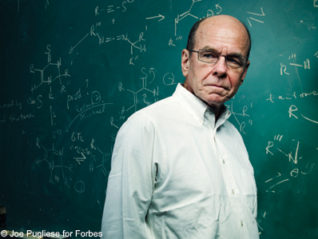
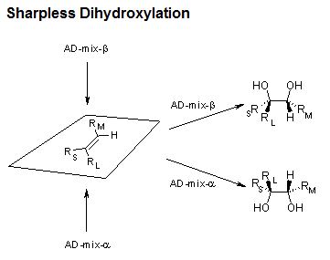

Slide 10
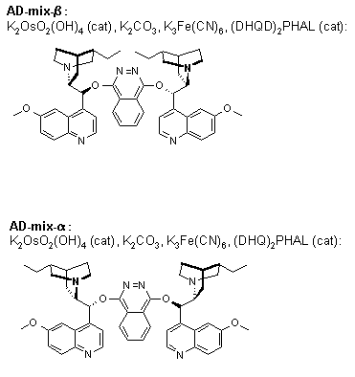

Slide 11
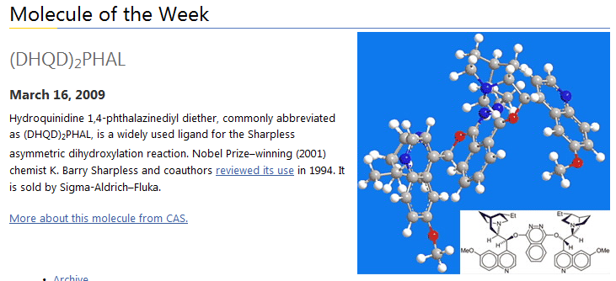

Slide 12
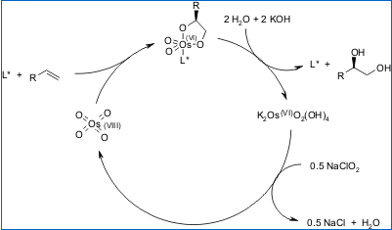
Mechanism of the Sharpless Dihydroxylation

Slide 14
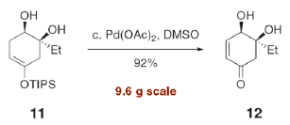

Slide 15
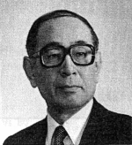
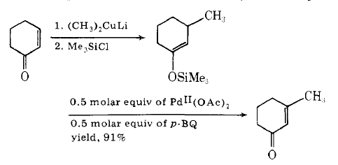

Slide 16
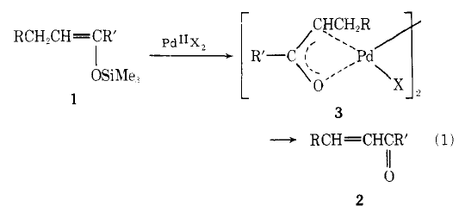

Slide 17
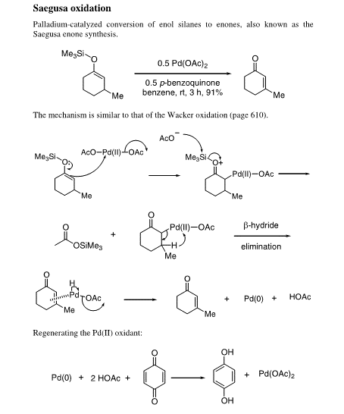

Slide 19
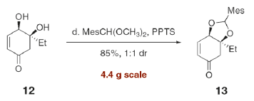

Slide 22
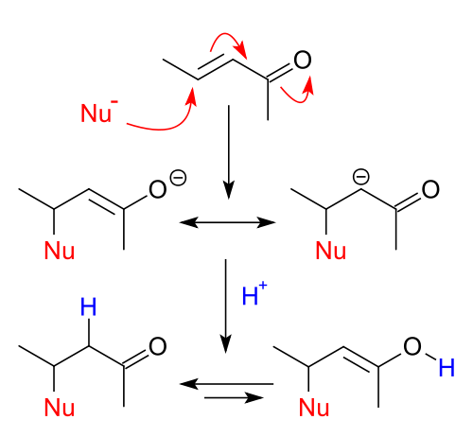
Nucleophilic Conjugate Addition
Such conjugate additions are promoted by Cu(I), and the resultant copper enolate can be trapped with trimethylsilyl chloride.

Slide 23
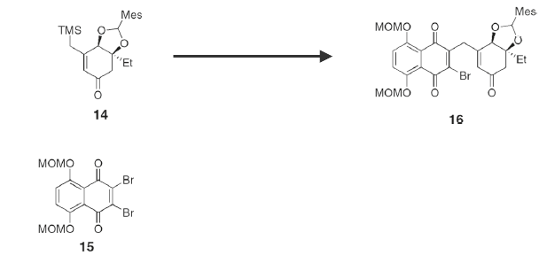

Slide 24
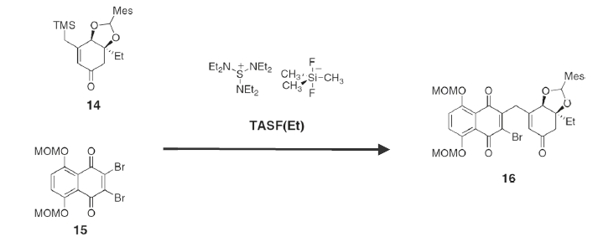

Slide 25
The TASF reagent, shown above, represents a good source of anhydrous fluoride anion. Most sources of fluoride (i.e. TABF), come with some water, due to the high propensity of fluoride to complex with water.

Slide 28
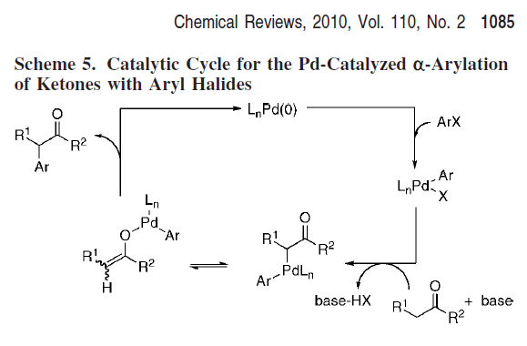

Slide 29
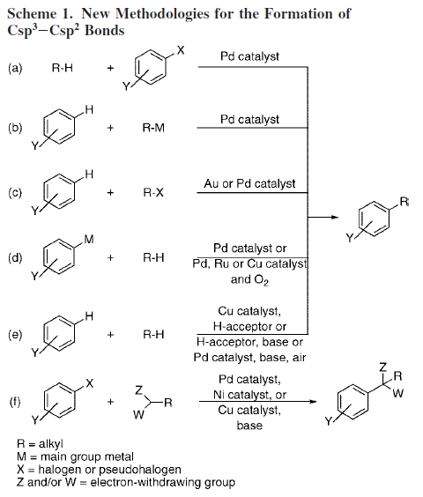

Slide 30
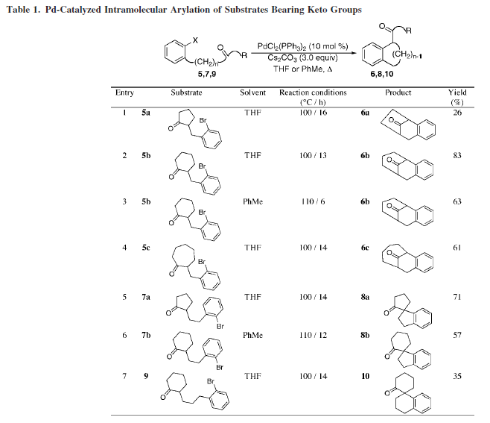

Slide 33
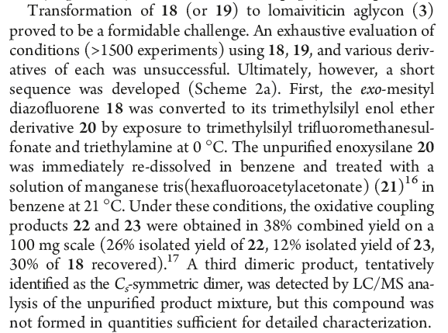

Slide 34
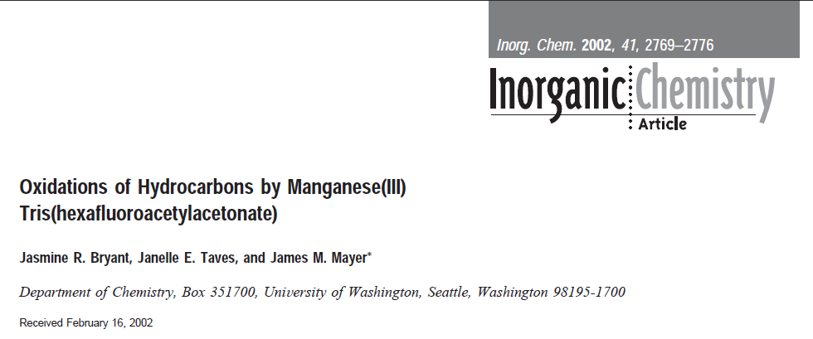
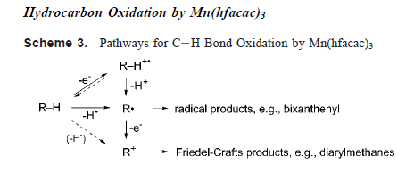

Slide 35
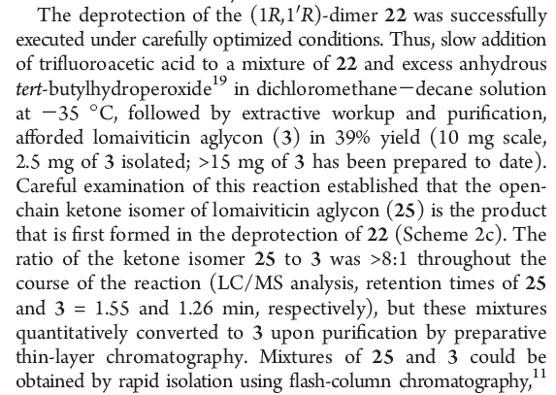

Slide 36
