Slide 1
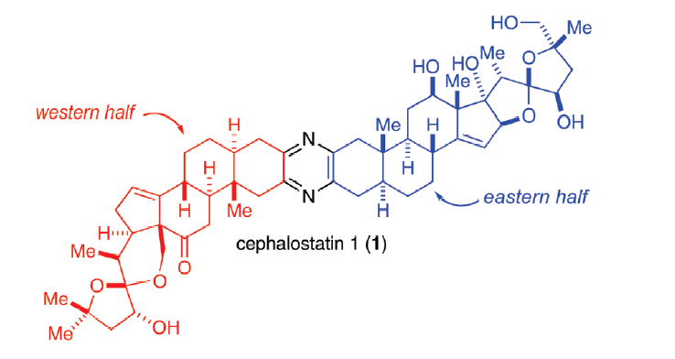
Fortner, Kevin C.; Kato, Darryl; Tanaka, Yoshiki; Shair, Matthew D. Enantioselective Synthesis of (+)-Cephalostatin 1. Journal of the American Chemical Society (2010), 132(1), 275-280.

Slide 2
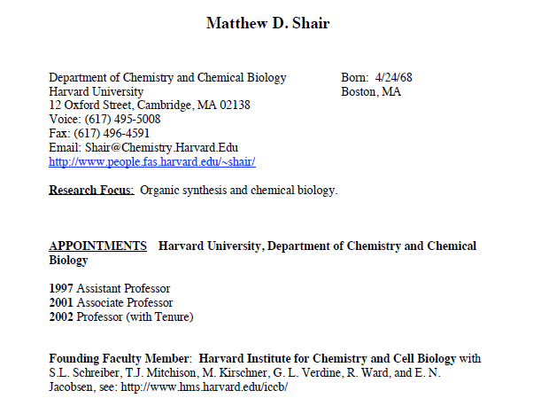
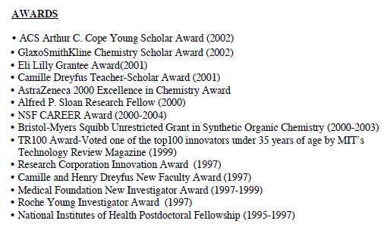

Slide 3
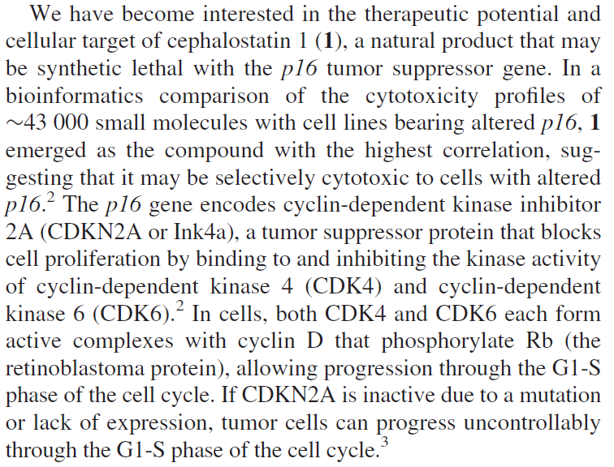

Slide 4
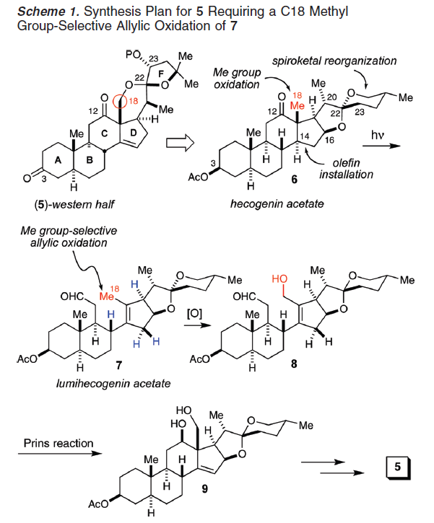

Slide 7
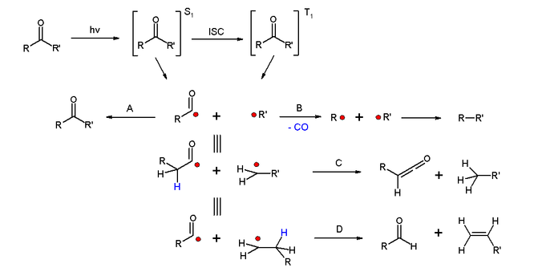
Norrish Type I Cleavage

Slide 11
The Alder Ene Reaction

Slide 12
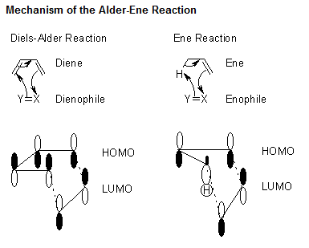

Slide 13
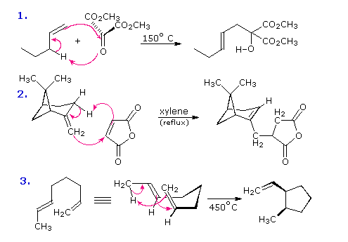
Examples of Ene Reactions

Slide 14
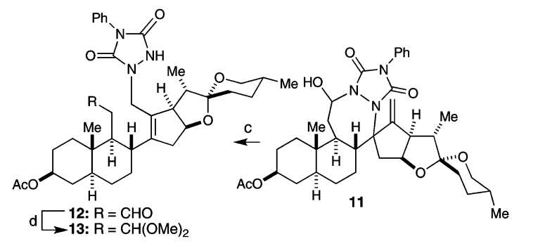

Slide 18
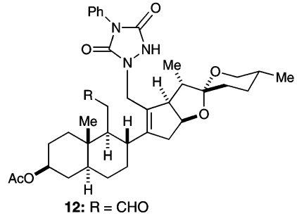
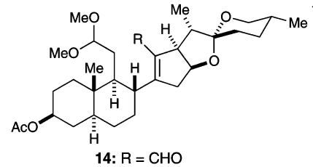

Slide 19
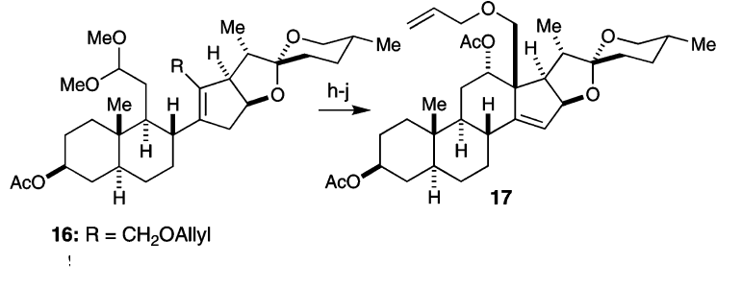

Slide 20
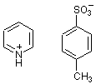
PPTS = pyridium p-toluenesulfonate =

Slide 25
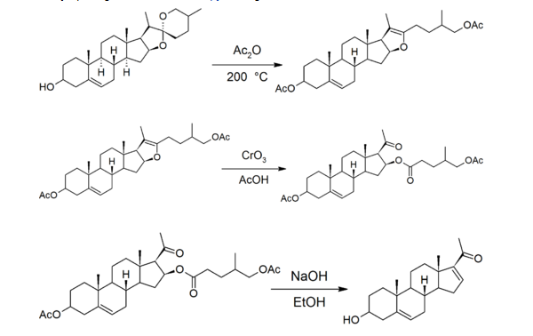
The Marker Degradation
The Marker Degradation allowed the production of steroids, such as sex hormones, from plant steroids, readily available in large quantities.
This allowed the production of oral contraceptives, and was a catalyst for the development of the Mexican chemical industry.

Slide 26
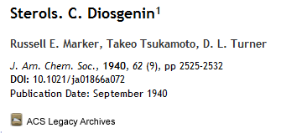

Slide 27
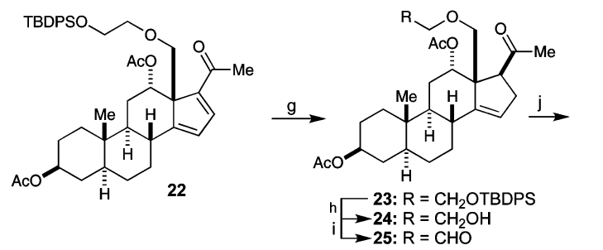

Slide 29
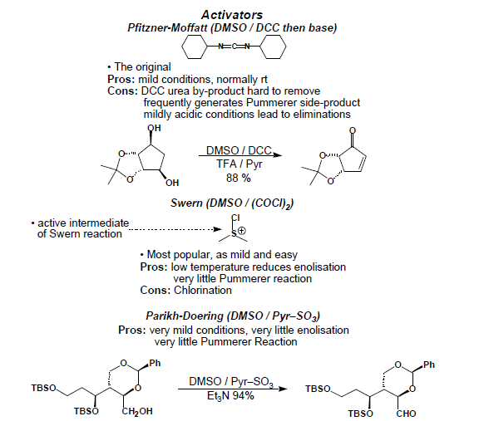
Reagents which result in an ‘activated’ form of DMSO

Slide 30
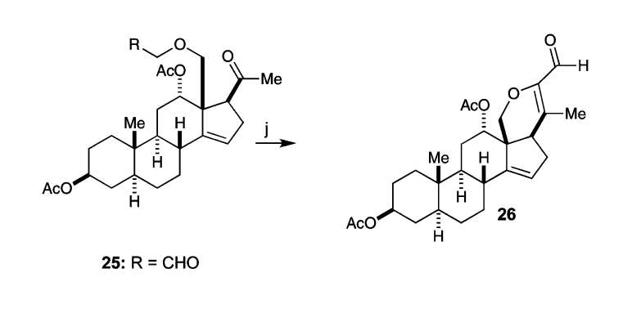

Slide 32
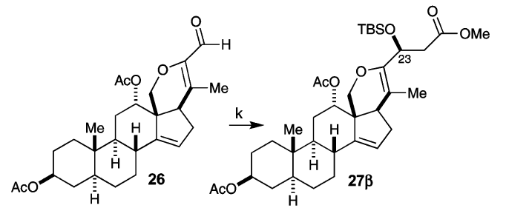

Slide 34
Mukaiyama Aldol Addition

Slide 35
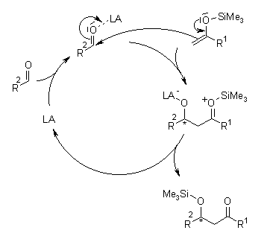
Mechanism of the Mukaiyama Aldol Addition

Slide 36
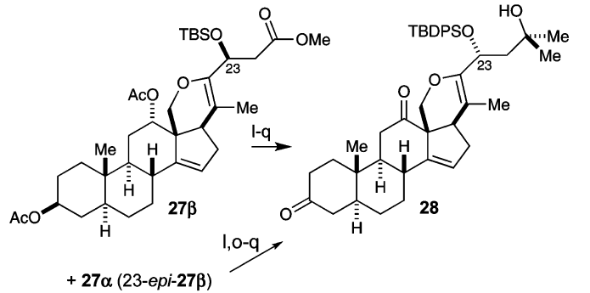

Slide 37
HDTC = Hydrazinedithiocarbonate =

Slide 38
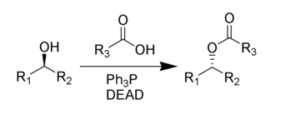
The Mitsunobu Reaction
The Mitsunobu Reaction involves an Sn2 type substitution, thus occurs with inversion of configuration

Slide 39
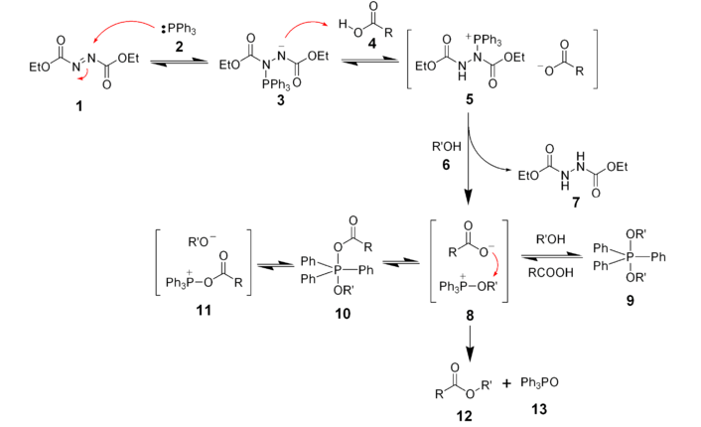
Mechanism of the Mitsunobu Reaction

Slide 41
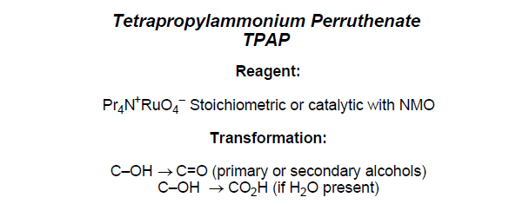

Slide 42
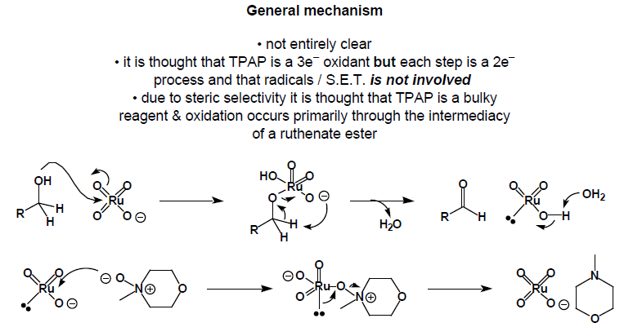

Slide 43
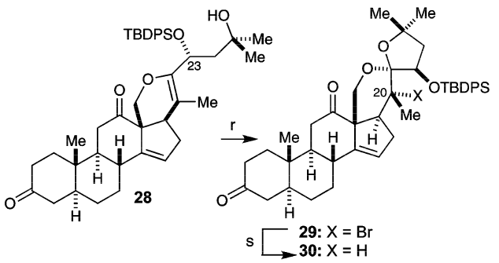

Slide 45
