Slide 1
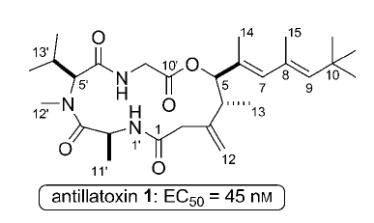
Okura Ken; Matsuoka Shigeru; Goto Ryosuke; Inoue Masayuki The twisted side chain of antillatoxin is important for potent toxicity: total synthesis and biological evaluation of antillatoxin and analogues. Angewandte Chemie (International ed. in English) (2010), 49(2), 329-32.

Slide 2
Antillatoxin is a marine cyanobacterial toxin that potently activates voltage-gated sodium channels.
Link
Link
Link

Slide 3
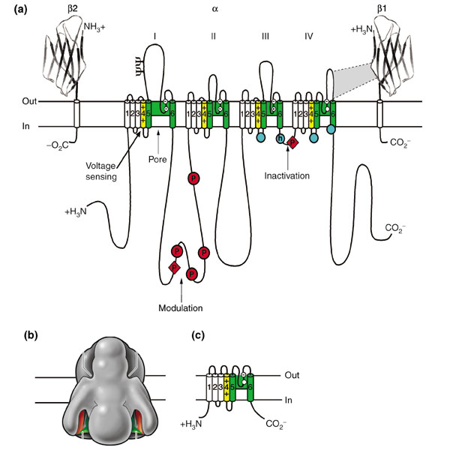

Slide 4
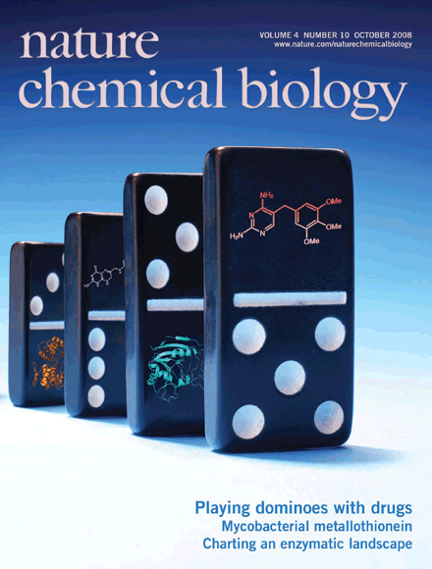
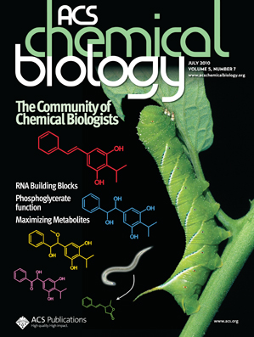
Chemical biology is the use of chemistry, usually through small molecules made synthetically, to solve biological problems and to manipulate biological systems.

Slide 5
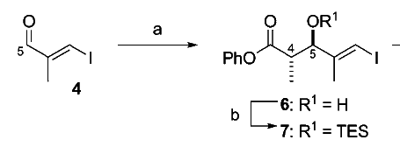
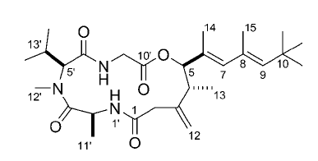

Slide 6
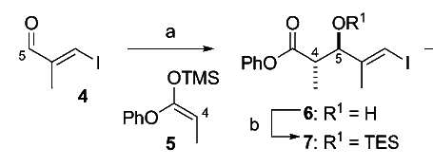

Slide 7
Mukaiyama Aldol Addition

Slide 8
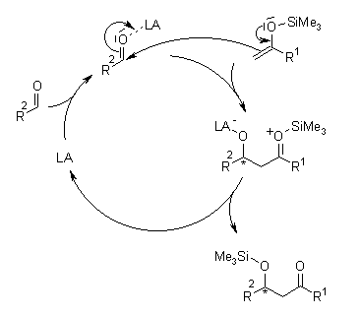
Mechanism of the Mukaiyama Aldol Addition

Slide 9
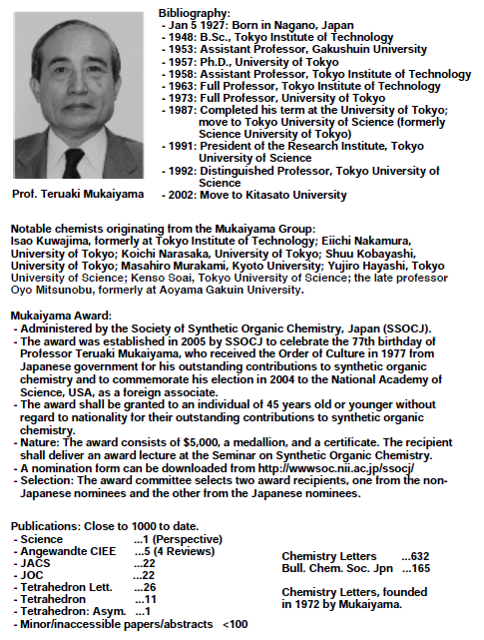

Slide 10
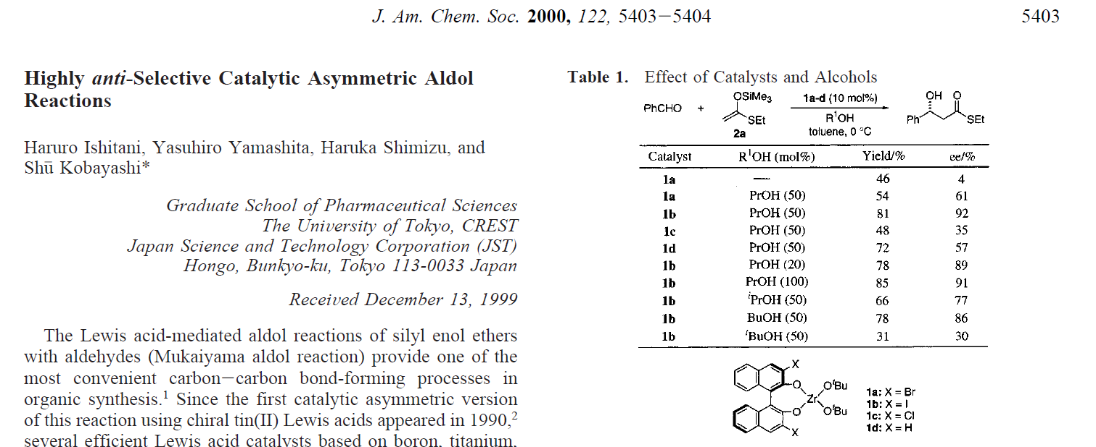
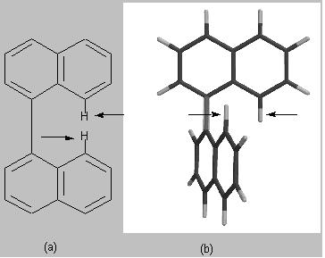

Slide 11
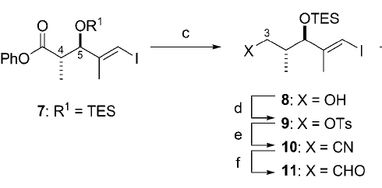

Slide 13
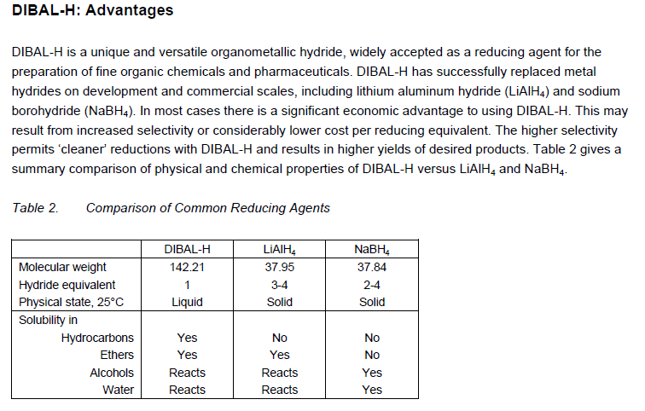

Slide 14
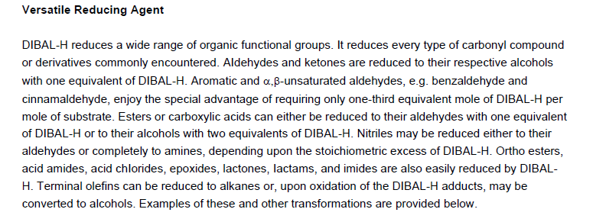

Slide 15
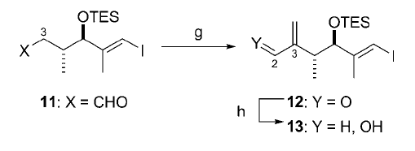

Slide 16
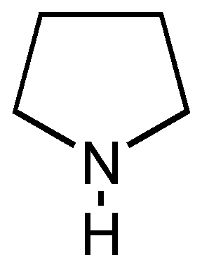
Pyrrolidine =

Slide 17
Enamine Formation
Link

Slide 18
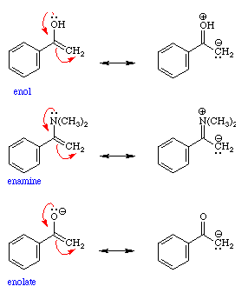
Reactivity: Similar Trends for Reactivity of Enols, Enamines, and Enolates

Slide 19
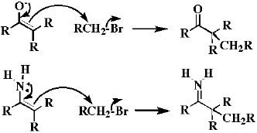
Reactivity of Enamines parallels that of Enolates

Slide 23
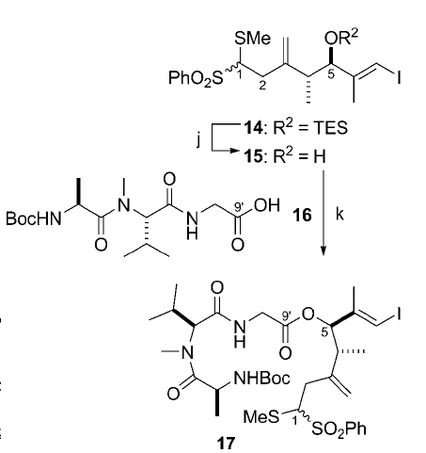

Slide 25
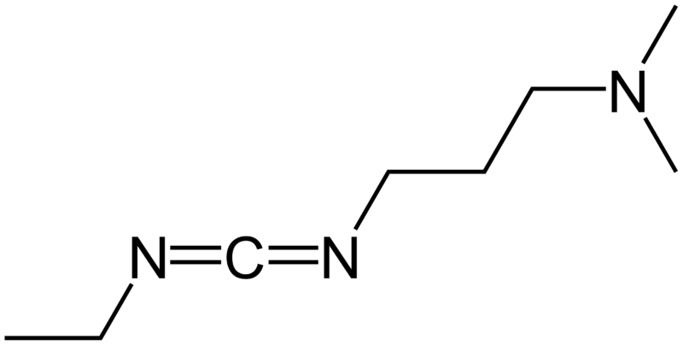
EDC = 1-Ethyl-3- (Dimethylaminopropyl)carbodiimide

Slide 27
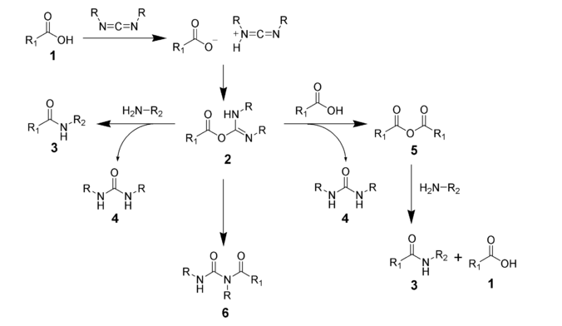

Slide 30
mCPBA = meta-chloroperoxybenzoic acid

Slide 31
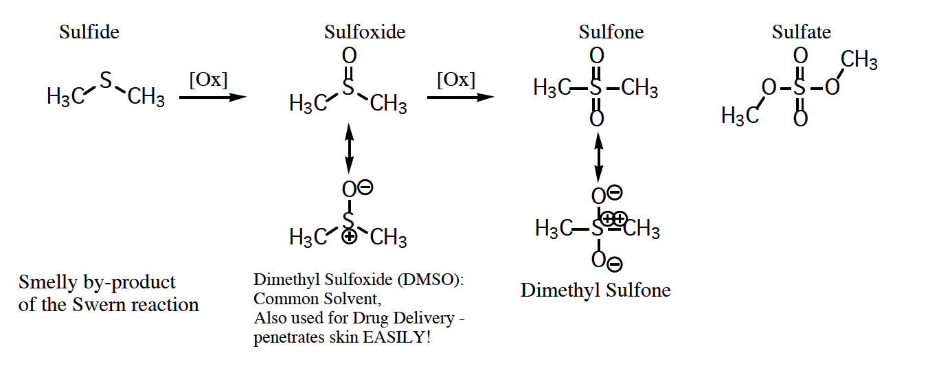

Slide 32
Pummerer Rearrangement

Slide 33
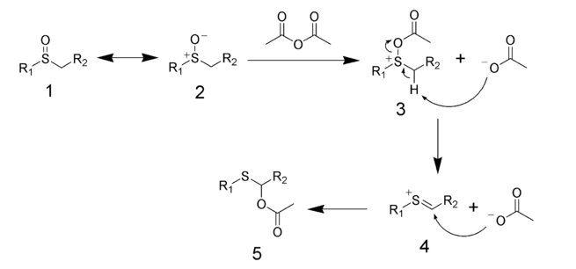
Mechanism of the Pummerer Rearrangement

Slide 34
BOC protecting group

Slide 38
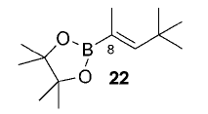
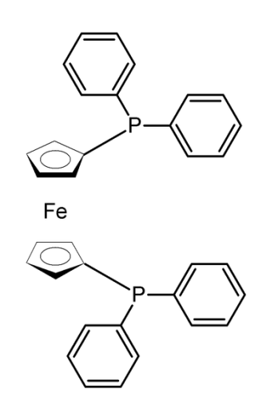
Dppf = Diphenylphosphinoferrocene

Slide 39
Suzuki Coupling Reaction
Miyaura, Norio; Yamada, Kinji; Suzuki, Akira. A new stereospecific cross-coupling by the palladium-catalyzed reaction of 1-alkenylboranes with 1-alkenyl or 1-alkynyl halides. Tetrahedron Letters (1979), (36), 3437-40.

Slide 40
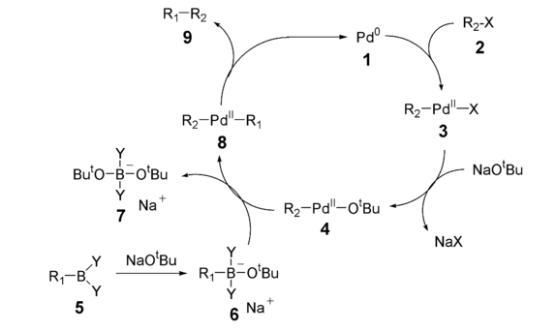
Mechanism of Suzuki Coupling Reaction

Slide 42
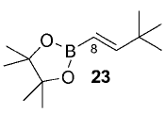

Slide 44
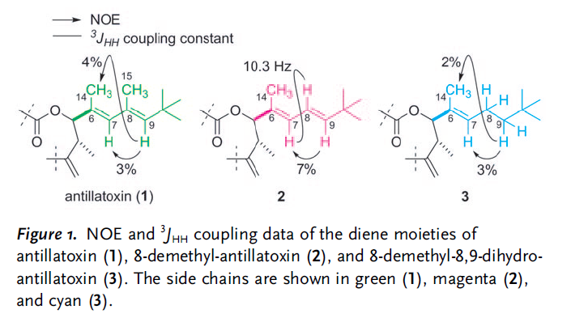

Slide 45
