Slide 1
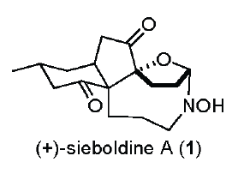
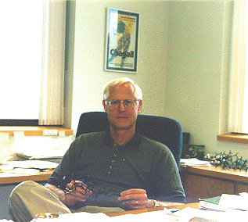

Slide 2
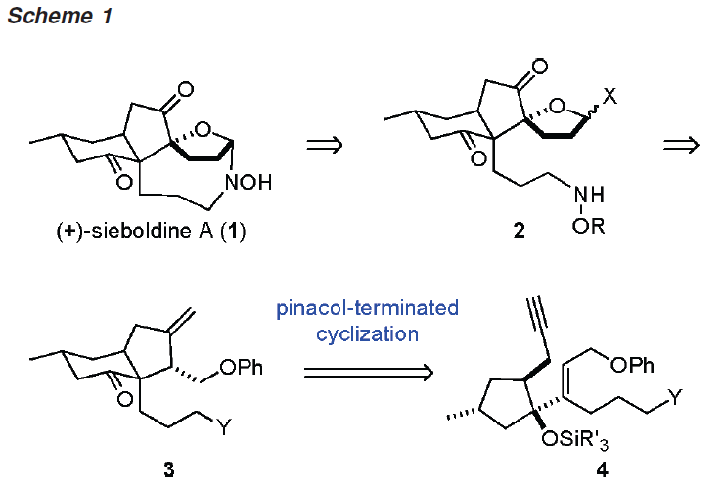

Slide 3
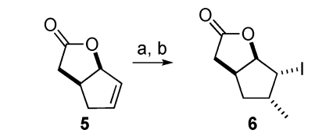

Slide 5
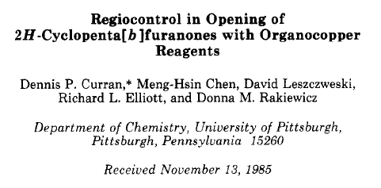

Slide 6
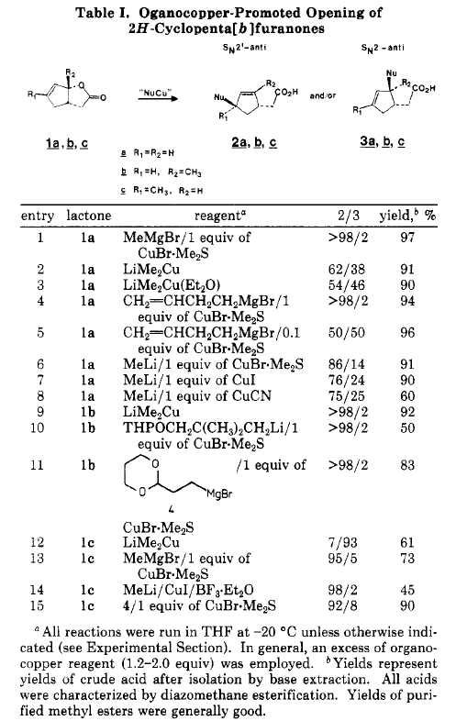

Slide 7
Iodolactonization

Slide 8
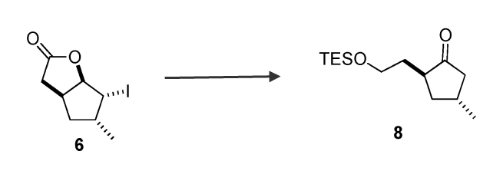

Slide 9
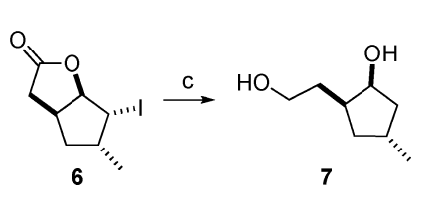

Slide 11
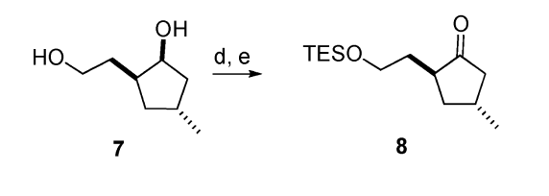

Slide 17
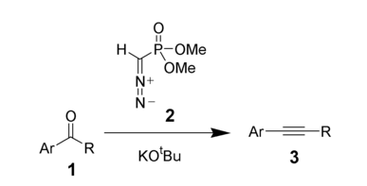
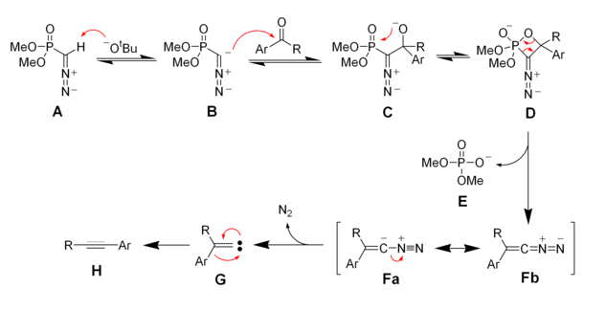
Seyferth-Gilman Homologation

Slide 18
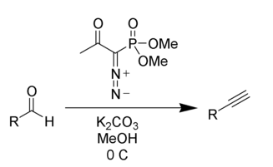
Bestmann Modification

Slide 21
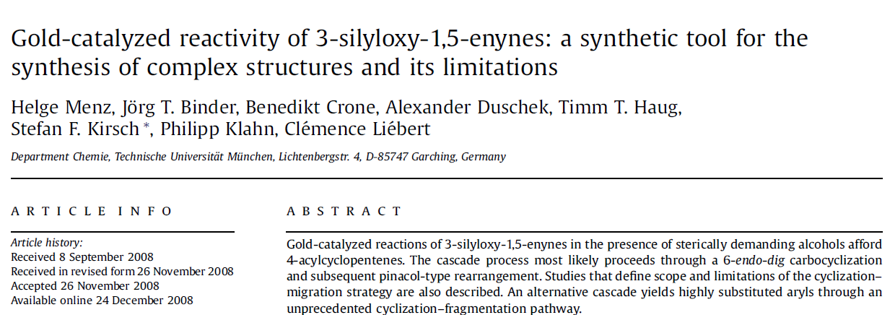

Slide 22
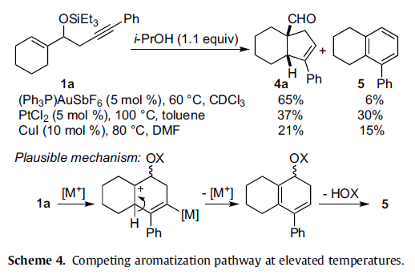

Slide 23
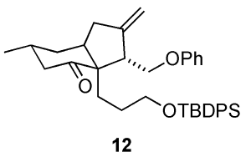
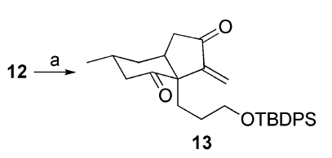

Slide 24
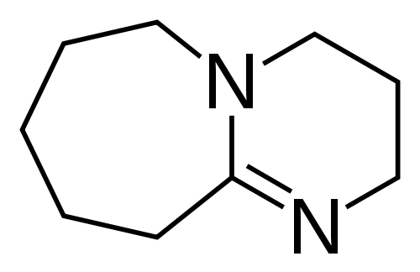
pKa = 12

Slide 26
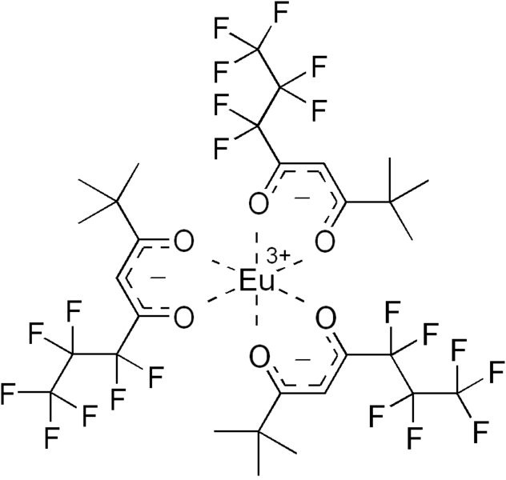

Slide 31
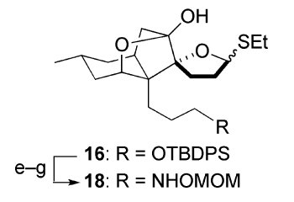

Slide 33
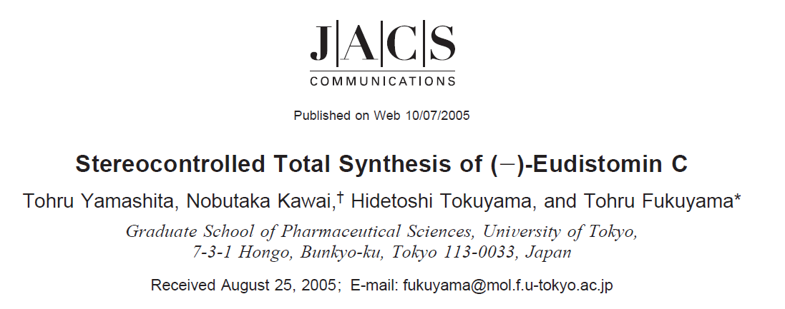

Slide 34
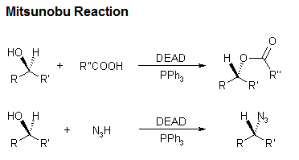
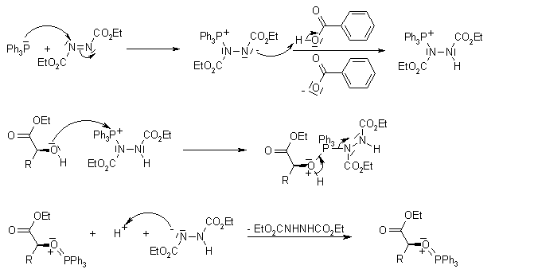

Slide 35
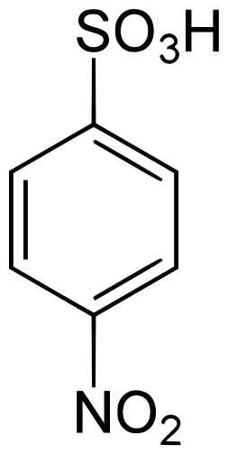
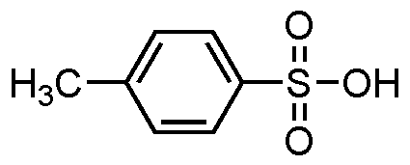
The Mitsunobu Reaction only works when the attacking nucleophile is acidic. Apparently the nosyl group imparts another log unit of acidity to the nitrogen atom of the reagent, relative to the more commonly used tosyl group. A comparison of the two acids is shown. Also, because of its higher electronegativity, the nosyl group may be easier to cleave in the final step.
pKa = -0.43
pKa = -1.38

Slide 36
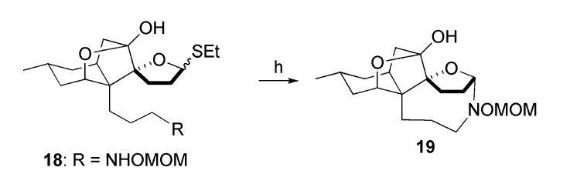

Slide 37
DMTST = Dimethylmethylthiosulfonium Triflate =
DTBMP = 2,6-di(tert-butyl)-4-methylpyridine =

Slide 40
