Slide 1
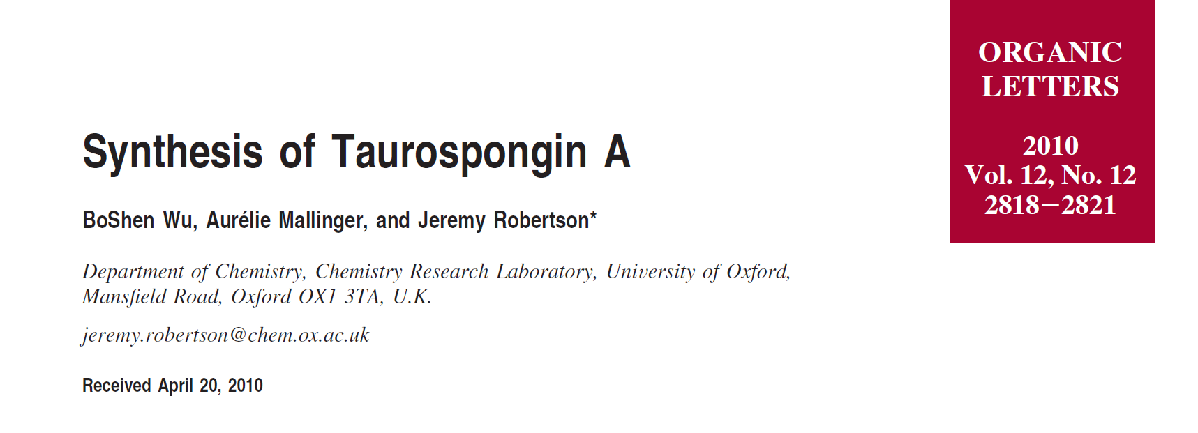
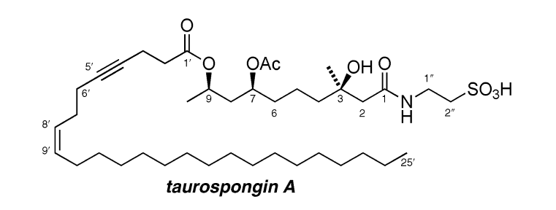

Slide 2
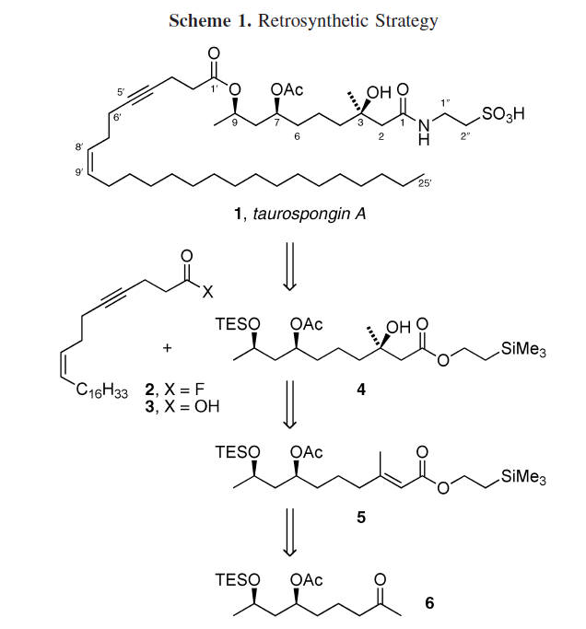

Slide 6
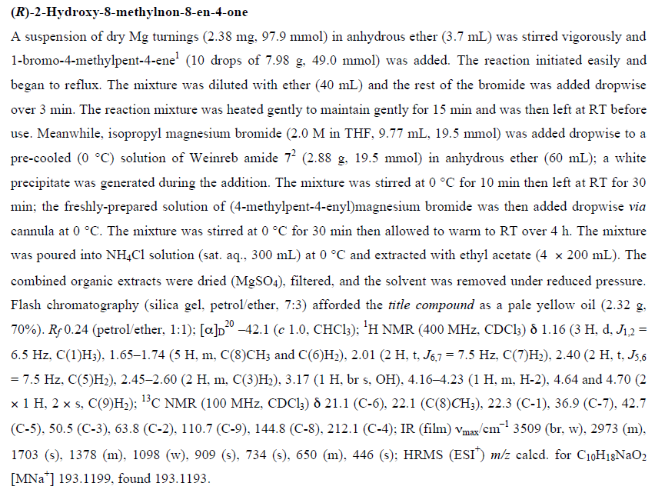

Slide 7
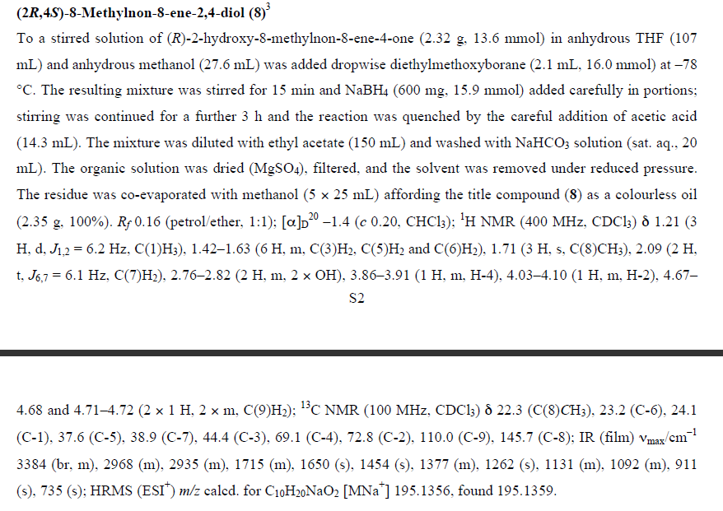

Slide 8
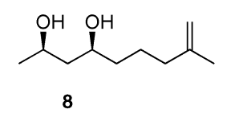

Slide 10
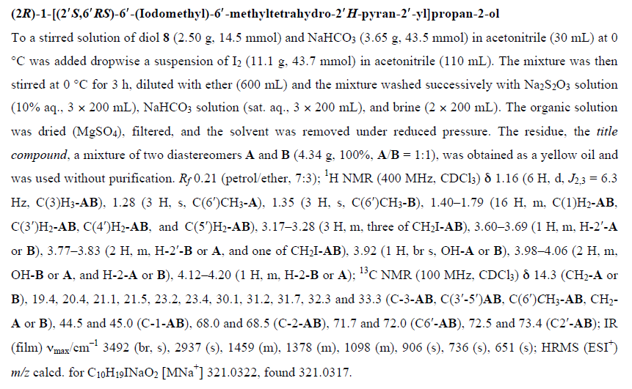

Slide 11
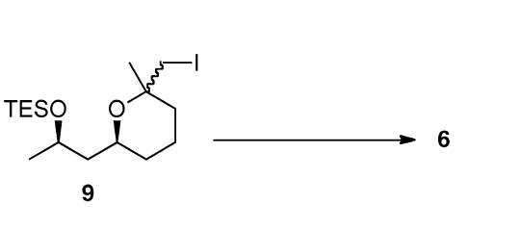

Slide 12
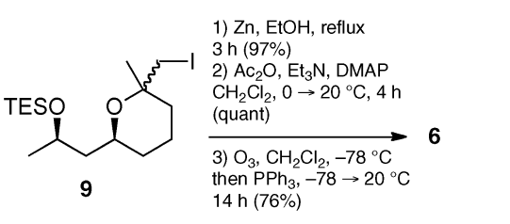

Slide 15
Horner-Wadsworth-Emmons Reaction

Slide 16
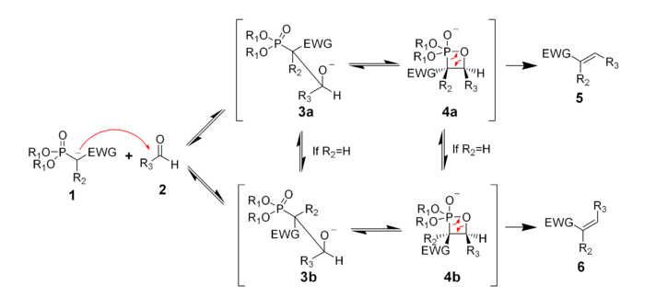
Mechanism of the Horner-Wadsworth-Emmons Reaction

Slide 18
Sharpless Asymmetric Dihydroxylation

Slide 19
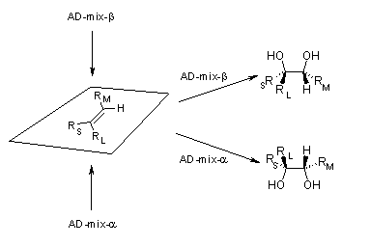
Sharpless Asymmetric Dihydroxylation

Slide 20
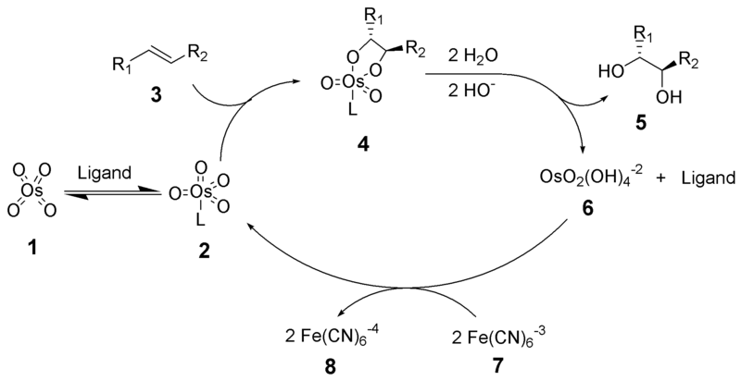
Mechanism of the Sharpless Asmmetric Dihydroxylation

Slide 22
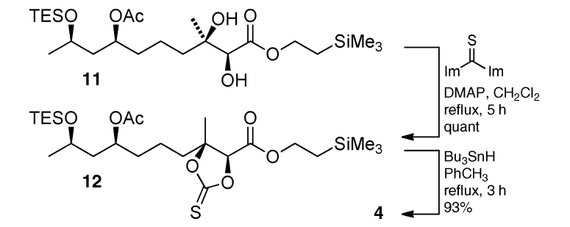

Slide 23
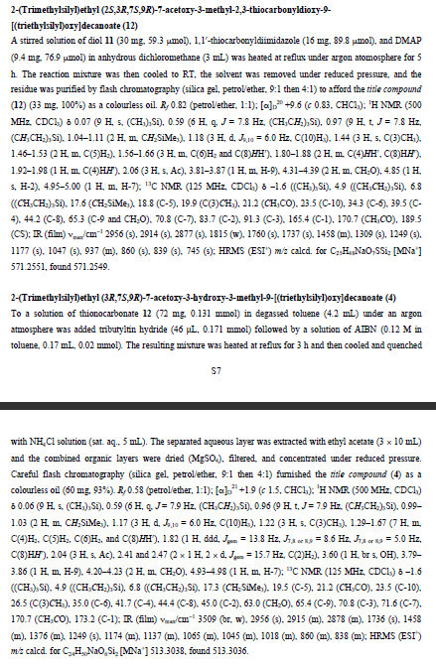

Slide 29
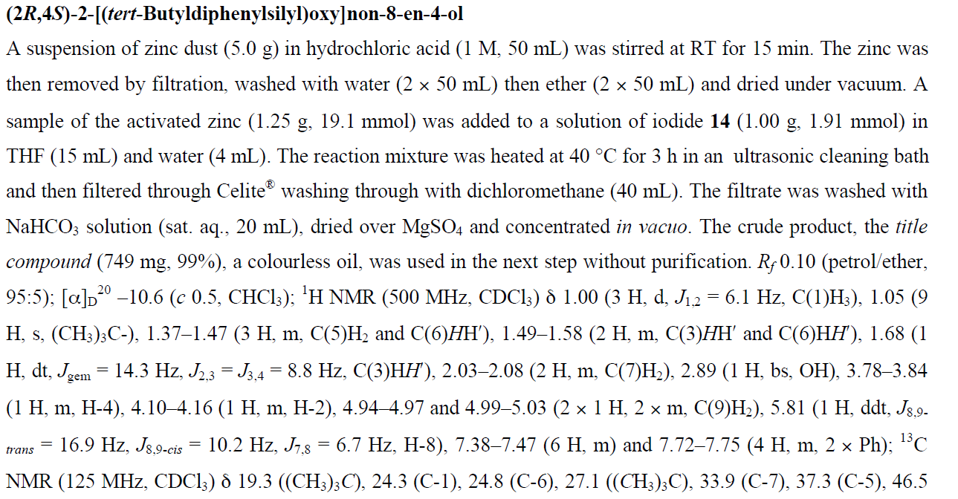

Slide 30
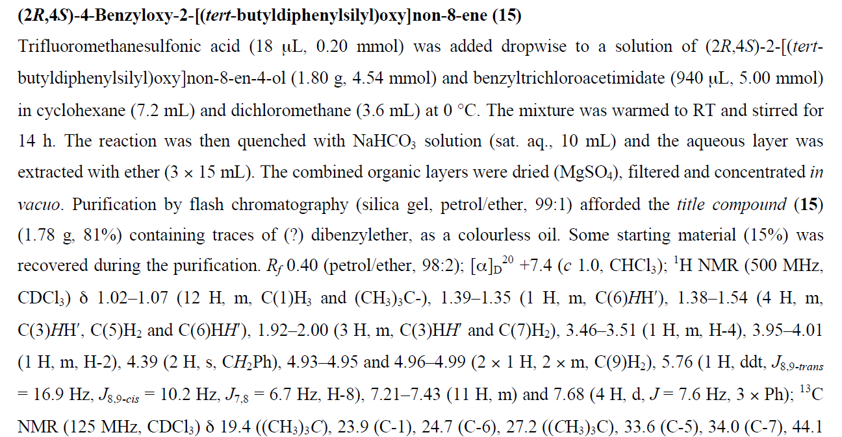

Slide 33
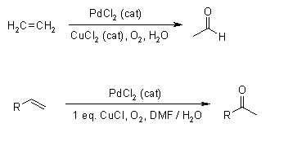
The Wacker Oxidation

Slide 34
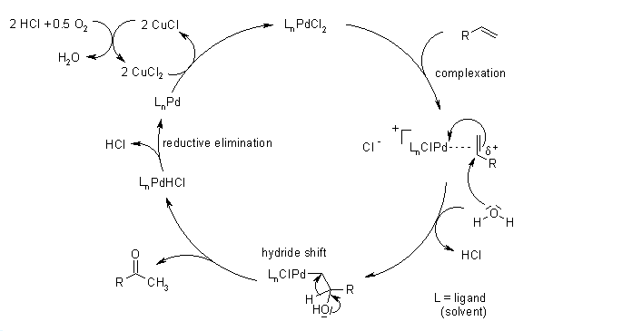
Mechanism of the Wacker Oxidation

Slide 37
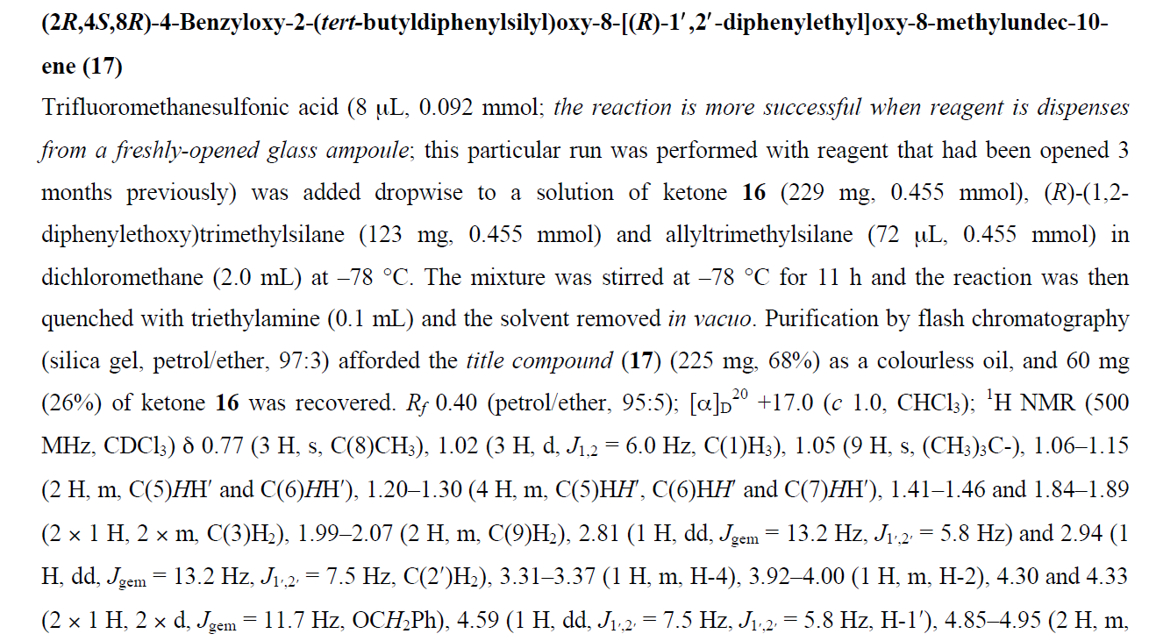

Slide 38
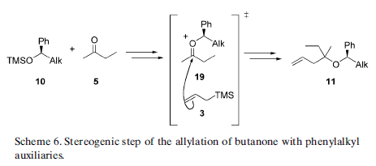

Slide 45
Wittig Reaction

Slide 46
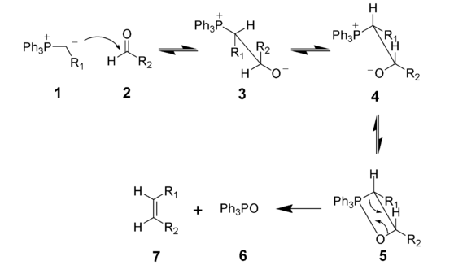
Mechanism of the Wittig Reaction

Slide 47
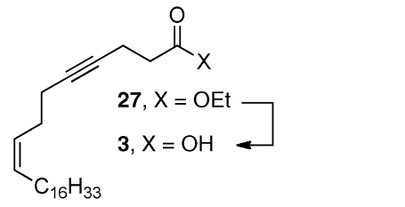

Slide 48
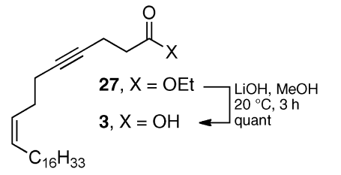

Slide 50
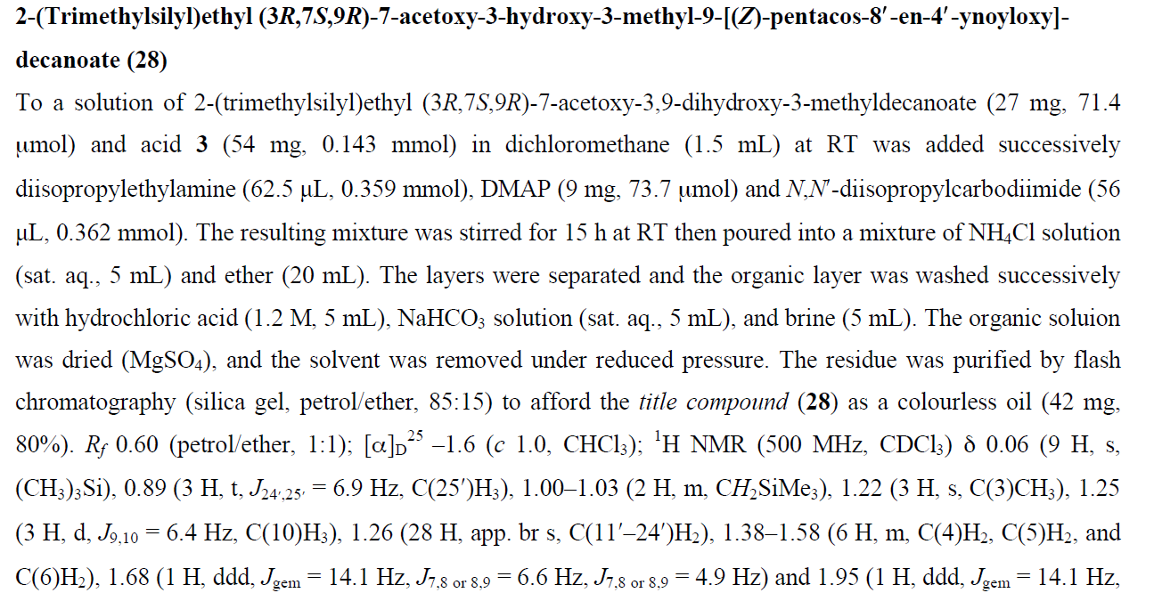

Slide 53
TASF = tris(dimethylamino)sulfonium difluorotrimethylsilicate

