Slide 1
Hypothesis Testing and P-values
Eco 5375
Economic and Business Forecasting
Fall 2014

Slide 2
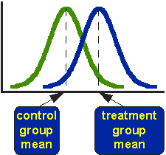
Comparison of Two Populations: Example of Hypothesis Testing Source of this and next three slides: http://www.socialresearchmethods.net/kb/stat_t.php
The T-Test assesses whether the means of two groups are statistically different from each other.
This analysis is appropriate whenever you want to compare the means of two groups, and especially appropriate as the analysis for the posttest-only two-group randomized experimental design.

Slide 3
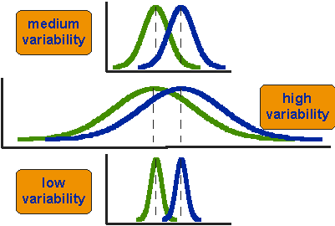
The Notion of Statistical Distance
Be Careful!

Slide 4
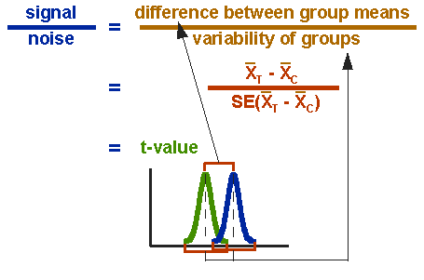
Difference in Group Means Adjusted for Variability of Groups

Slide 5
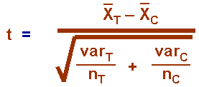
Ingredients of T-statistic

Slide 6
Reference Distributions for Hypothesis Testing
By Reference Distribution we mean the Sampling Distribution of a test statistic, say the sample mean, in repeated sampling assuming that the null hypothesis is true.
A Sampling Distribution is the probability density function of many repeat measures of the test statistic in repeated samples assuming that the null hypothesis is true.
For example, the previous t-statistic has a Reference (Sampling) Distribution of the T-distribution with $n_{T}+ n_{C}−2$degrees of freedom, assuming that the distributions of the observations of the control and treatment groups are Normally distributed with equal variances but possibly unequal means.

Slide 7
An Example
$H_{0}: μ_{T}= μ_{C}$
$H_{1}: μ_{T} > μ_{C}$
Suppose that, with the given data on the treatment and control group outcomes, we get t = 1.45 with 16 degrees of freedom. What is the p-value associated with this test statistic? It is (in EXCEL) tdist(1.45,16,1) = 0.083189. See the following slide. For a two-tail p- value we would get tdist(1.45,16,2) = 2x0.083189 = 0.166378. See the slide after next for the representation of this p-value.
Then, under the assumed truth of the null hypothesis, there would be only a 8.3% chance that you would get a larger t-value in repeated samples. With a 10% level of the test, we would reject the null hypothesis. However, with a 5% level of the test, we would accept the null hypothesis.

Slide 8
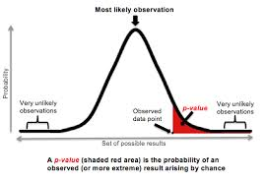
One-tail P-value: For One-sided Null Hypotheses

Slide 9
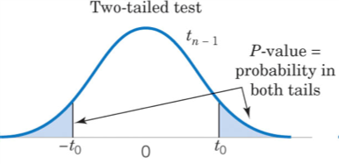
Two-tail P-value: For Two-sided Null Hypotheses

Slide 10
Calculator for P-Values
http://graphpad.com/quickcalcs/PValue1.cfm

