Slide 1
Eco 6380 Predictive Analytics For Economists Spring 2016
Professor Tom Fomby
Department of Economics
SMU

Slide 2
Presentation 10 Judging Classifier Performance in the Presence of Information on the Payoff Matrix (The Optimal Threshold (Cutoff) Value Need not be equal to 0.5.) See Chapter 5 in SPB

Slide 3
Note: In the discussion that follows we are going to take the data partition sequence to be Training Data Set, then Validation Data Set, and, finally, the Test Data Set (the SAS EM and XLMINER Convention)

Slide 4
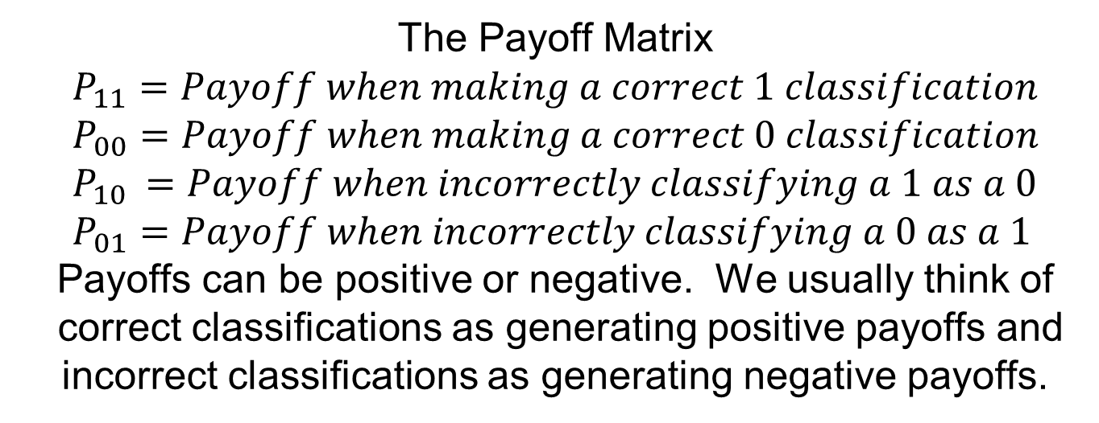
The Payoff Matrix $$P_{11}=Payoff when making a correct 1 classification \\ P_{00}=Payoff when making a correct 0 classification \\ P_{10 }=Payoff when incorrectly classifying a 1 as a 0 \\ P_{01}=Payoff when incorrectly classifying a 0 as a 1$$ Payoffs can be positive or negative. We usually think of correct classifications as generating positive payoffs and incorrect classifications as generating negative payoffs.
 |  | Predicted Value
 |  | 1 | 0
Actual value | 1 | P₁₁ | P₁₀
 | 0 | P₀₁ | P₀₀

Slide 5
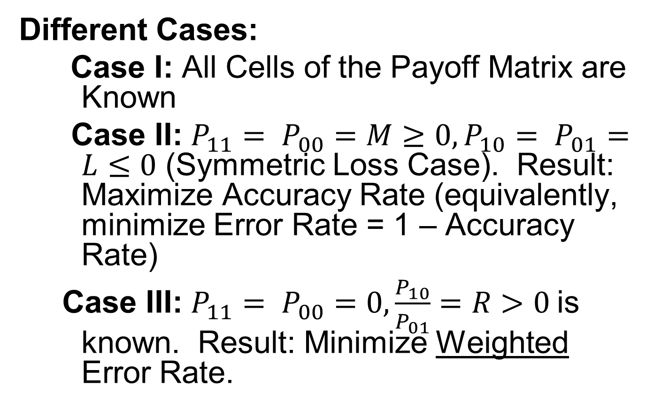
Cases Where We Have At Least Some Information on the Payoff Matrix
Different Cases:
Case I: All Cells of the Payoff Matrix are Known
Case II: $P_{11}= P_{00}=M≥0, P_{10}= P_{01}=L≤0$ (Symmetric Loss Case). Result: Maximize Accuracy Rate (equivalently, minimize Error Rate = 1 – Accuracy Rate)
Case III: $P_{11}= P_{00}=0,\frac{P_{10}}{P_{01}}=R>0$is known. Result: Minimize Weighted Error Rate.

Slide 6
Case I: All Cells of the Payoff Matrix are Known
Our objective is to maximize the total payoff: $P= P_{11}∙n_{11}+ P_{00}∙n_{00}+ P_{10}∙n_{10}+ P_{01}∙n_{01}$ .
For each classifier we examine the Validation Data Set payoff (P) for a range of the threshold values and choose the threshold value that maximizes the total payoff, P.
We repeat this exercise for the other competing classifiers.
We then compare the Test Data Set Payoffs for the competing classifiers using their own validation-data-set- determined thresholds and choose the classifier and its threshold that maximizes the Test Data Set Payoff.

Slide 7
Case II: $P_{11}= P_{00}=M≥$ $0, P_{10}= P_{01}=L≤0$ (Symmetric Loss Case)
Our objective is to maximize payoff (minimize the loss) $P=M\left(n_{11}+ n_{00}\right)+L\left(n_{10}+ n_{01}\right)=MN+(L−M)(n_{10}+ n_{01})$.
Therefore, in this case, a good classifier is one that minimizes the Error Rate = $(n_{10}+ n_{01})/N$ or, equivalently, maximizes the Accuracy Rate = ${(n}_{11}+ n_{00})/N$.
Minimizing the error rate invariably implies a Cutoff (threshold) of 0.5.
In this case, when comparing across competing classifiers, we want to choose the classifier that has the greatest accuracy rate in the Test Data Set.
As far as most classifier problems are concerned, the symmetric loss case is the one that is usually assumed. It offers a nice “convenient” solution to the optimal cutoff (threshold) problem.

Slide 8
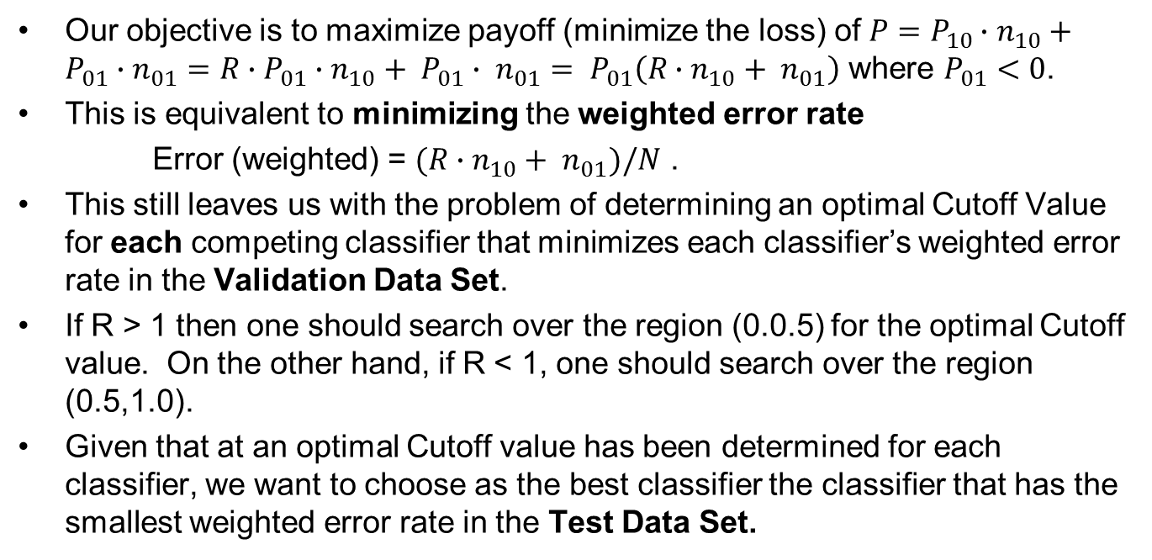
Case III $P_{11}= P_{00}=0,\frac{P_{10}}{P_{01}}=R>0$ is known (Known Relative Loss Case)
Our objective is to maximize payoff (minimize the loss) of $P=P_{10}∙n_{10}+P_{01}∙n_{01}=R∙P_{01}∙n_{10}+ P_{01}∙ n_{01}= P_{01}\left(R∙n_{10}+ n_{01}\right)$ where $P_{01}<0$.
This is equivalent to minimizing the weighted error rate
Error (weighted) = $(R∙n_{10}+ n_{01})/N$ .
This still leaves us with the problem of determining an optimal Cutoff Value for each competing classifier that minimizes each classifier’s weighted error rate in the Validation Data Set.
If R > 1 then one should search over the region (0.0.5) for the optimal Cutoff value. On the other hand, if R < 1, one should search over the region (0.5,1.0).
Given that at an optimal Cutoff value has been determined for each classifier, we want to choose as the best classifier the classifier that has the smallest weighted error rate in the Test Data Set.

Slide 9
Next We Move to PPT11 and examine the situation where we want to compare classifiers when we have a specific purpose in using a classifier as in Target Marketing.

Slide 10
Classroom Exercise: Exercise 9

