Slide 1
Eco 6380 Predictive Analytics For Economists Spring 2016
Professor Tom Fomby
Department of Economics
SMU

Slide 2
Presentation 12 Classification and Regression Trees: CART and CHAID Chapter 9 in SPB

Slide 3
Some Basic Facts about Recursively-Built Decision Trees
Decision Trees are made up of a “Root” node, followed by “decision” nodes and, lastly, ending in “final” nodes.
The basic algorithm that is used to fit decision trees to data (either interval or categorical, it doesn’t matter) is recursive partitioning of the input space in the Training data set.
This algorithm grows a tree, one decision node at a time. The order in which these nodes are added (and hence the “building” sequence) is UNIQUE. Once a node enters a tree it remains there (in its order) forever with the decision tree “split points” for each node staying the same as the tree grows. (Hence the term “recursive.”) This is shown in the following set of three slides that describe the recursive partitioning of the Boston Housing Data with the interval variable “medv” being the target variable.

Slide 4
First Split First Decision Node

Slide 5
Second Split Second Decision Node

Slide 6
Third Split Third Decision Node

Slide 7
The Uniqueness of the Tree
Notice, as this tree is being built recursively, the nodes enter in a particular order and the “split” points (node 1 = 9.54 on LSTAT then node 2 = 7.141 on RM, and then node 3 = 14.985 on LSTAT) remain unchanged as the tree grows larger. That is, as the tree is being built by recursive partitioning, the order of previous nodes and their respective split points stay the same. (In essence this is a Directed Search and Fitting of the Data.)
In the first split the mean of all of the response points in the training set input space such that LSTAT > 9.54 is 17.736111 while the mean of the response points in the training set with LSTAT < 9.54 is 30.0666055. (See the final node values.)
In the second split the input space is partitioned into 3 regions with the means of the training set response points of each of the input regions defined by the two splits being 26.568293, 40.688889, and 17.736111.
The third split leads to the input space being partitioned into 4 regions with the means of the training set response points in each of the input regions defined by the three splits being 26.568293, 40.688889, 20.955714, and 14.690541. (Notice the number of terminal nodes always exceeds the number of decision nodes by one.)
The sequence of the splits (and hence the dividing up of the input space) is done in such a way as to maximize the reduction in the sum of squared errors of the tree’s fit to the training data with each split where each partition of the input space uses the mean of the training set responses in that particular region. Notice, in this case, the target variable is a numeric value. We discuss the determination of splits for binary classification problems in the next slide.
For more detailed discussion of the mathematical representation of this step function representation of output data via decision trees see the PDF titled “Regression and Classification Trees_Fomby.pdf” on the class website.

Slide 8
Determining Splits for Classification Trees
At least three criteria can be used to decides on splits in building a classification tree: Accuracy Rate, Entropy, and Gini Coefficient. These measures are called impurity measures. What one wants to do is choose a split so as to reduce the impurity of the classifications in the final nodes of the tree as much as possible.
These impurity measures for the tree t are defined in the following slide.

Slide 9
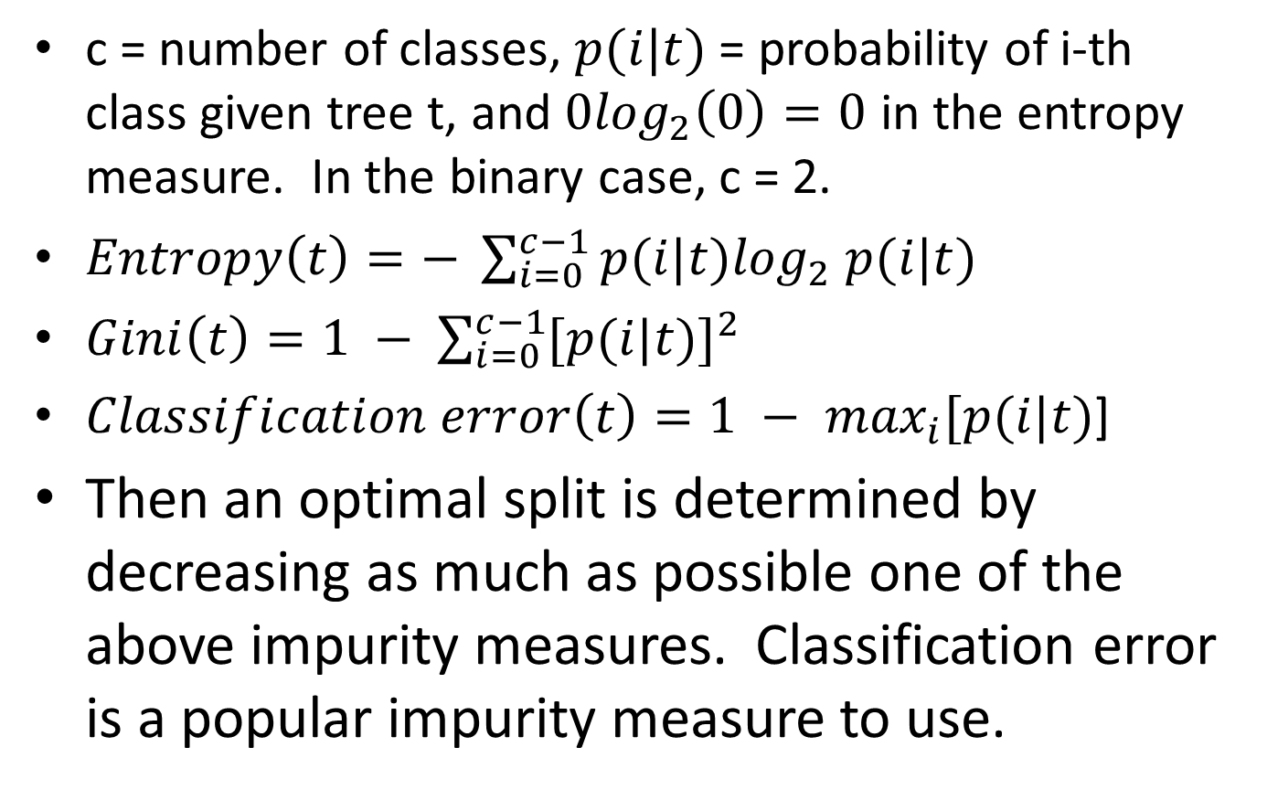
Impurity Measures
c = number of classes, $p(i|t)$ = probability of i-th class given tree t, and $0\log_{2}\left(0\right)=0$ in the entropy measure. In the binary case, c = 2.
$Entropy\left(t\right)=− \sum_{i=0}^{c−1}{p(i|t)\log_{2}}$ $p(i|t)$
$Gini\left(t\right)=1 − \sum_{i=0}^{c−1}{{[p(i|t)]}^{2}}$
$Classification error\left(t\right)=1 − \max_{i}[p(i|t)$]
Then an optimal split is determined by decreasing as much as possible one of the above impurity measures. Classification error is a popular impurity measure to use.

Slide 10
Pruning Trees How do you keep from overtraining a decision tree? Answer: You prune it.
The idea behind pruning is that a very large tree is likely to overfit the training data set in the sense that if a “full” tree is used to score an independent data set its accuracy is likely to be significantly attenuated.
There are essentially two ways of pruning a full tree: (1) the pre-pruning (early stopping rule) approach as in the CHAID model or (2) the post-pruning approach as in the CART model. In the pre-pruning approach the tree-growing algorithm is halted before generating a fully grown tree that perfectly fits the entire training data set. Unfortunately, it is sometimes difficult to choose the right threshold for early termination. Too high of a threshold will result in underfitted models, while a threshold that is set too low may not be sufficient to overcome the model overfitting problem. In the post-pruning approach, the decision tree is initially grown to its maximum size. This is followed by a tree-pruning step that trims the fully grown tree in reverse order in order to obtain an “optimal” trimmed tree.
XLMINER provides the user two possible pre-pruning approaches. The user can limit the growth of the tree by utilizing tuning parameters that can limit the size of a tree. Two popular tuning parameters are (1) the minimum number of cases that are required of all final nodes and (2) the maximum number of decision nodes that are allowed in building the tree. XLMINER supports both of these tuning parameters.

Slide 11
CART and CHAID
The CART (Classification and Regression Tree) method uses the training data set to build a “full” tree with many, many decision nodes and since there is a unique sequence in which the tree was build, it can be pruned in reverse sequence giving rise to a sequence of “pruned” trees each of which has one less decision node than its previous family member. The pruning of the tree stops when one finds a minimal VALIDATION RMSE pruned tree for prediction or maximum validation accuracy tree in categorical modeling). These models are called the minimum mean square error trees for prediction of a numeric target variable or maximum accuracy rate trees for classification. In turn they can be used in scoring the Test data set and thereby be compared to other prediction or classification models. Thus the “tuning” parameter of the CART method is the number of decision nodes to use in the tree to optimize Validation data set performance. This pruning exercise on the Validation data set is, of course, intended to prevent the building of an over-trained decision tree that would perform poorly on an independent data set.
The CHAID (Chi-Squared Automatic interaction Detection) method, on the other hand, uses the in-sample (training set) statistical significance of adding additional nodes to see if, in fact, another node should be added. This also is intended to prevent the over-training of the decision tree. The tuning parameter of the CHAID method is the chosen level of significance of the statistical test. The greater the significance level ( i.e. the smaller the p-value) of the statistical test (a Chi-square statistic) of the reduction in impurity arising from the new split, the fewer the decision nodes of the final tree and vice versa. The CHAID chosen tree can then be used to score the Validation and Test data sets independently.
In the next two presentations we discuss two additional classifiers, the Naïve Bayes Classifier and the Logit Classifier. Two other classification methods that we don’t discuss are the C4.5 and SVM (Support Vector Machines) classifiers. See P. Tan, M. Steinbach, and V. Kumar, Introduction to Data Mining (Pearson, 2006) for more details on these two classifiers.

Slide 12
More information on Decision Trees: For a discussion of how Regression Trees can be viewed as regression models on indicator variables, see the pdf file “Trees as Indicator Regressions.pdf” on the class website. Other pdf files that you might look at are “Regression and Classification Trees_ Fomby.pdf” and “Regression and Classification Trees.pdf,” an excerpt from The Elements of Statistical Learning by T. Hastie, R. Tibshirani, and J. Friedman on the class website

Slide 13
Classroom Exercise: Exercise 9

