Slide 1
Eco 6380 Predictive Analytics For Economists Spring 2016
Professor Tom Fomby
Department of Economics
SMU

Slide 2
Presentation 16 Association Rules (aka Affinity Analysis) Chapter 13 in SPB

Slide 3
First go read the pdf file “Association Rules_v3.pdf” on the Class Website for a detailed discussion of Association Rules and an illustrative example of the method. In this PowerPoint we only provide a set of short notes on the basic concepts of Association Rule Analysis.

Slide 4
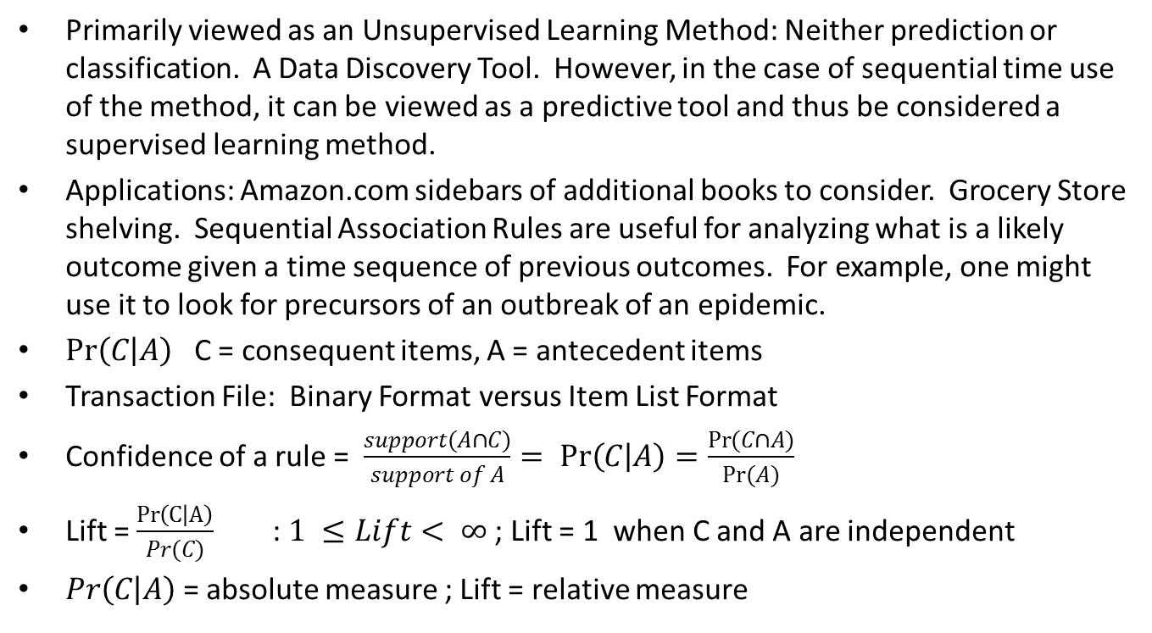
Some Basics
Primarily viewed as an Unsupervised Learning Method: Neither prediction or classification. A Data Discovery Tool. However, in the case of sequential time use of the method, it can be viewed as a predictive tool and thus be considered a supervised learning method.
Applications: Amazon.com sidebars of additional books to consider. Grocery Store shelving. Sequential Association Rules are useful for analyzing what is a likely outcome given a time sequence of previous outcomes. For example, one might use it to look for precursors of an outbreak of an epidemic.
$Pr\left(C | A\right)$ C = consequent items, A = antecedent items
Transaction File: Binary Format versus Item List Format
Confidence of a rule = $\frac{support(A∩C)}{support of A}= Pr\left(C | A\right)=\frac{Pr(C∩A)}{Pr(A)}$
Lift = $\frac{Pr\left(C | A\right)}{Pr(C)}$ : $1 ≤Lift< ∞$ ; Lift = 1 when C and A are independent
$Pr\left(C | A\right)$ = absolute measure ; Lift = relative measure

Slide 5
The Apriori Algorithm (Agrawal and Srikant (1994))
In the first phase build up the item sets that meet the minimum support requirement. First, collect together all of the one-item sets that have minimum support. Then form two-item sets built from the previous minimum support one-item sets and then retain the two-item sets that have minimum support. Then form three-item sets built from the retained one-item and two-item sets and then choose those three-item sets that have minimum support. One continues this process building up larger and larger minimum support item sets until at say the K-item set level none of the K-items sets meet the minimum support requirement. Then the first phase is complete. Then in the second phase one examines all of the retained one, two, … (K-1) item sets for possible Association Rules that have minimum confidence. In the making of the Association Rules it must be remember that the consequent (C) and antecedent(A) item sets must be disjoint.
Two tuning parameters:
a) minimum support (t) of k-item sets
b) minimum confidence of Association Rule
The choice of “top” Rules (Associations) is sensitive to the choices of the above tuning parameters. The larger (smaller) the choices of the tuning parameters, the more simple (complex) the resulting Rules. You should examine the robustness of the “top” Rules over various choices of tuning parameter values. Rules need to make sense given our domain-specific knowledge, otherwise you shouldn’t use them.

Slide 6
Classroom Exercise: Exercise 12

