Slide 1
Eco 6380 Predictive Analytics For Economists Spring 2016
Professor Tom Fomby
Department of Economics
SMU

Slide 2
Presentation 3 Treatment of Missing Observations and Exploratory Data Analysis Chapter 2 in SPB

Slide 3
Treatment of Missing Observations
Delete any record (case) that has a missing observation for any variable with respect to the case. (Can sometimes be a very “severe” rule. You might not have any observations left!)
Impute values for the missing observations. Alternative methods include (i) using a chosen fixed value selected by the user, (ii) using the mean or median of the observations that are available for the variable with the missing observation, (iii) model the variable that has the missing observation as a target variable and, using all of the other variables as inputs, utilize a multiple linear regression or CART model to fill in the missing observations.
See the SPSS modeler “Data Audit” Node for handling Missing Observations.

Slide 4
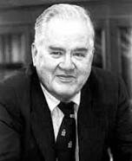
Exploratory Data Analysis (EDA)
Coined by Prof. John Tukey (1915-2000)
a chemist-turned-topologist-turned statistician
Seminal Work:
Exploratory Data Analysis
(1977, Addison-Wesley)

Slide 5
Some Exploratory Data Analysis Tools
I. Charts
(a) Box-Plot: a vertical plot that summarizes the variation in a given variable. The “box” in the plot represents the data ranging from the first quartile to the third quartile. The notch in the box represents the mean while the horizontal line across the box represents the median. Other “non-extreme” observations are between the “whiskers” of the plot and the box. Any observation outside of the whiskers is considered an “outlier.” Such observations should be examine further for possible coding errors or consideration for deletion from any analysis as the observation might be from another “population” and not of the population representing the rest of the observations on the variable.
(b) Histogram: A plot of the data of a variable by intervals such that the height of the histogram represents the number of observations in a given interval.
(c) Matrix Plots: Pairs of Bivariate Scatter plots that summarize the associations between variables.
(d) Summary Statistics: Mean, median, standard deviation, kurtosis, and skewness of individual variables.
(e) QQ and PP plots: Allows you to determine to what degree the variation in a variable does or does not conform to a specified distribution, e.g., the normal distribution.

Slide 6
The Box Plot:
Let us take a look at the typical Box-Plot that XLMinerTM generates:
○
○
○
○
Outlier
Outlier
Max
Max
Q3
Q3
Mean
Mean
Q2(Median)
+
Q2(Median)
+
Notch
Notch
Q1
Q1
Min
Min
○
○
Copyright ® XLMINER

Slide 7
The Box extends from Q1 to Q3, includes Q2. The other non-extreme points are included in its “whiskers”. This means the box includes the middle one-half of the data. The mean value is shown with a plus sign. The distance “d” between the values that the notch specifies is --> d = Confidence interval around the mean.
The significance of the Box-plot is that it is not strongly influenced by the outliers. XLMinerTM constructs the Box-plot by extending its “whiskers” only to the most extreme “non-outliers”. It uses two explicit rules to define the outliers and marks them with dots.
Copyright ® XLMINER

Slide 8
The rules used are
Cutoff1 = Q1-1.5*(Q3-Q1)
Cutoff2 = Q3+1.5*(Q3-Q1)
On the Box-plot,
Min = The actual minimum value in the dataset which is just above the Cutoff1.
Max = The actual maximum value in the dataset that is just less than Cutoff2.
All the values that are less than the Min value, and the ones
that are great than the Max value are treated as the Outliers.
Copyright ® XLMINER

Slide 9
Two Good EDA Tools in SPSS Modeler
“Graphboard” node in the Graphs Group
“Data Audit” node in the Output Group
See the stream “Car_sales_EDA.str” for a demo on the use of the Graphboard node.
See the stream “telco_dataaudit.str” for a demo on the use of the Data Audit node and the treatment of missing observations and outliers.

Slide 10
Variable Importance
Variable Importance is measured by the bivariate association between specified target variable and input variables of interest
This measure of association will depend on the nature of the target variable (interval or categorical) as well as the nature of the input variable being considered. You have the 4 cases: (target variable, input variable) = (interval, interval); (interval, categorical); (categorical, interval), and (categorical, categorical). For the measures of association of these various cases see the IBM/SPSS Modeler manual Modeler 15 AlgorithmsGuide.pdf, Chapter 17 “Feature Selection Algorithm.”

Slide 11
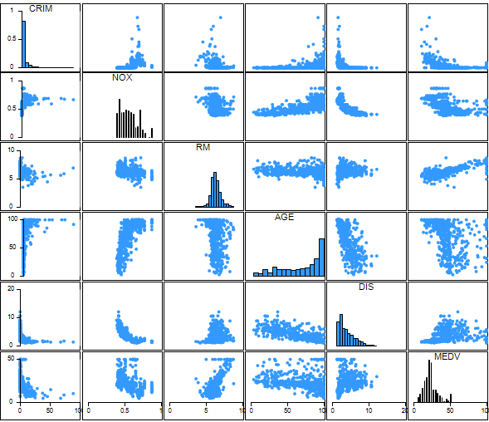
XLMINER Correlation Matrix Plot to Uncover Variable Importance

Slide 12
Other Variable Importance Methods
MLR Subset Selection Methods: Forward, Backward, and Stepwise Selection.
MLR with Lasso Constraint: Minimize sum of squared errors subject to the constraint that the sum of the absolute values of the coefficients not exceed a given constant, c.
Regression and Classification Trees and the variables that make up a cross-validated tree
Could take an Intersection of the Importance Variable Sets determined by the various methods

Slide 13
Other Helpful Dimension Reduction Methods
Reducing the Number of Categories in Categorical Variables
Converting a Categorical Variable of Many Groups into a “Rank” Variable that represents the ordering of the groups. You go from k indicators variables, say, to one variable representing the k groups. However, it should be noted that a Rank Variable implies, in some cases (as in MLR), that going from group one to group two has the same effect on the target variable as going from group two to group three, etc.
Applying Principal Components Analysis to continuous variables. We will discuss this technique separately later.
Note: Binning a Continuous Variable into a Categorical variable does not reduce the dimension of the input space but it sometimes is a convenient way to “break down” the multi-collinearity that may exist between continuous variables that are not binned.

Slide 14
An Application Showing How Useful Pre-screening Input Variables Can Be
In SPSS Modeler, the crucial node is the “Feature Selection” node in the Modeling Group.
For a good example of the importance of Pre-screening inputs, see the SPSS Modeler stream “featureselection.str” in the Demos subdirectory of Modeler.

Slide 15
Classroom Exercise: Exercise 1

