Slide 1
Eco 6380 Predictive Analytics For Economists Spring 2016
Professor Tom Fomby
Department of Economics
SMU

Slide 2
Presentation 9 Judging Classification Performance In the Absence of Payoff Matrix See Chapter 5 in SPB

Slide 3
Note: In the discussion that follows we are going to take the data partition sequence to be Training Data Set, then Validation Data Set, and, finally, the Test Data Set (the SAS EM and XLMINER Convention)

Slide 4
Evaluation Methods are Dependent on Available Payoff Information and the Nature of the Problem at Hand. Here we assume no specific purpose for the classifier (like application to a Target Marketing Problem)
Case I: Base the Performance of the Classifier on the Scoring of an Entire Hold-out Sample with no knowledge of the “Payoff” Matrix (This Power Point Presentation)
Case II: At Least Some Information is known about the “Payoff” Matrix and the Classifier is chosen to maximize Payoff. (Next Power Point Presentation)

Slide 5
Classification Matrix
 |  | Predicted Value
 |  | 1 | 0
Actual value | 1 | True Positive | False Negative (Type I Error)
 | 0 | False Positive (Type II Error) | True Negative

Slide 6
Classification Matrix with Outcomes on a Hold-out Sample $$n_{11}=number of cases correctly classified in C_{1} \\ n_{00}=number of cases correctly classified in C_{0} \\ n_{10}=number of 1^{′}s misclassified as 0^{′}s \left(Type I Error\right) \\ n_{01}=number of 0^{′}s misclassified as 1^{′}s \left(Type II Error\right) \\ N= n_{11}+ n_{00}+ n_{10}+ n_{01}=Number of Cases in Hold−Out Sample \\ ACC=\frac{n_{11}+ n_{00}}{N}=Accuracy Rate \\ Sensitivity=\frac{n_{11}}{n_{10}+n_{11}}=percentage of C_{1} members classified correctly \\ Specificity=\frac{n_{00}}{n_{00}+ n_{01}}=percentage of C_{0} members classified correctly$$

Slide 7
Classification Matrix with Outcomes on a Hold-out Sample
 |  | Predicted Value
 |  | 1 | 0
Actual value | 1 | n₁₁ | n₁₀
 | 0 | n₀₁ | n₀₀

Slide 8
The Naïve Classifier
It is based on a random classifier whose rating of cases is uninformative. That is, f(r >= t|y=1) = f(r >= t|y=0). The probability of the rating (r) of a “positive=1” subject exceeding the chosen threshold t is equal to the probability of the rating probability of a “negative=0” subject exceeding the chosen threshold t.
Therefore, the ROC curve of the random (naïve) classifier coincides with the 45-degree line in the ROC diagram.
Note that the Naïve Classifier is a benchmark in the sense that it does not use any of the characteristics of the case to classify the case.

Slide 9
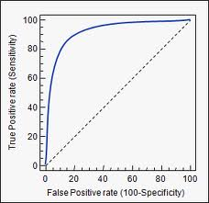
Receiver Operating Characteristic (ROC) Curve: Shows the Relationship between Sensitivity and the False Positive Rate as a Function of the Threshold Value Used by the Classifier. The Dashed Line represents the Naïve Classifier which does not use a Threshold Value.

Slide 10
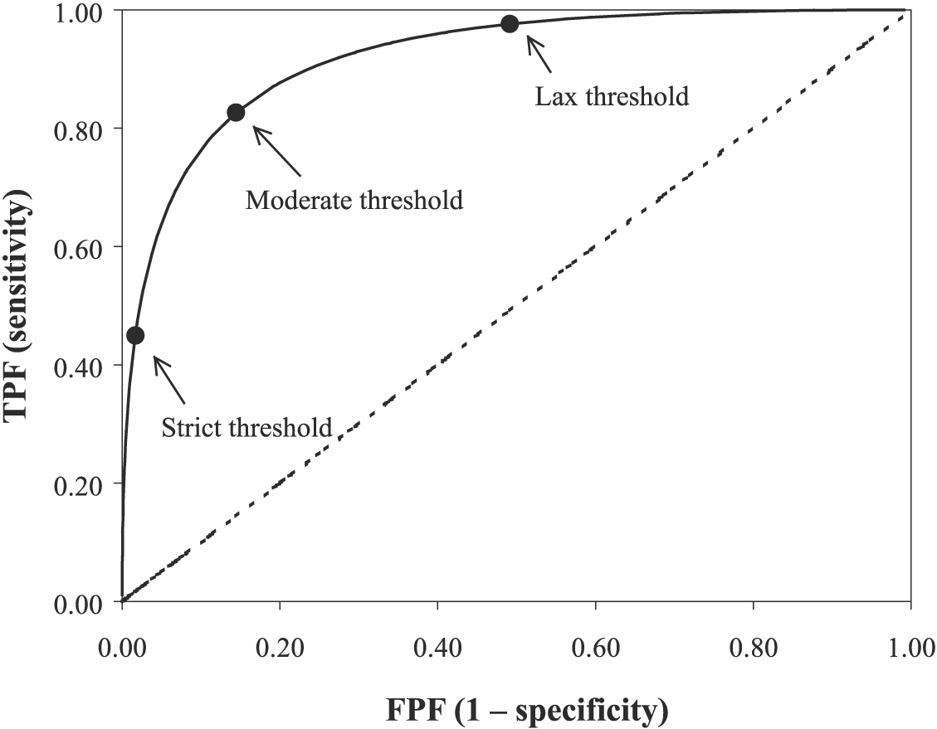
Tracing Out the ROC Curve for One Classifier as a Function of Threshold (Cutoff Probability) Note: A Perfect Classifier Would Produce the Point (0,1.0) in the ROC Diagram (upper left-hand corner). Strict Threshold means a high cutoff probability for classifying a case as a “success” (y = 1). Lax Threshold means a low cutoff probability for classifying a case as a “success” (y=1). If a case has a probability greater than the threshold, we classify the case as a success (y=1). Otherwise, we classify the case as a failure (y=0). FPF = False Positive Fraction = FPR = False Positive Rate. TPF = True Positive Fraction = TPR = True Positive Rate.

Slide 11
The Threshold Determines the Trade-off Between Committing a Type I Error (False Negatives) and a Type II Error (False Positives). If the Probability of a case exceeds the threshold, we classify the case as a 1, otherwise as a 0.
As the Threshold approaches one, we find that the sensitivity of the classifier will be zero while the specificity will be one. (See the (0,0) point on the ROC curve.)
As the Threshold approaches zero, we find that the sensitivity of the classifier will be one while the specificity will be zero. (See the (1,1) point on the ROC curve.)
The ROC curve is then traced out by decreasing the threshold from 1.0 to 0 as you move from the (0,0) point in the lower left-hand corner of the ROC diagram to the (1,1) point in the upper right-hand corner of the diagram.
Therefore, as the threshold becomes more strict (higher), we expect the Type I Error (false 0’s (negatives)) to occur more frequently while the Type II Error (false 1’s (positives)) would occur less frequently. Of course, with a lax (low) threshold you would expect the Type II Error to be more prevalent and the Type I Error to be less prevalent.

Slide 12
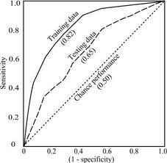
Training versus Test Data Set ROC Curves for One Classifier Here we are comparing the areas under the ROC Curves. Should be making Classifier Comparisons Across Test Data Set ROC Curves to Avoid Over-Training

Slide 13
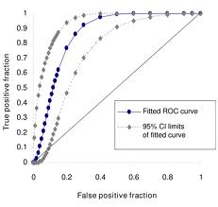
Confidence Intervals can be put around a given ROC Curve as in the below figure. However, when making ROC comparisons across Competing Classifiers, this is usually not done.

Slide 14
A Comparison of Four Different Classifiers with the Naïve Classifier (the dashed line). The ROC Curves should be based on the Test Data Sets. The Best Classifier has the Largest Area Under the ROC Curve.

Slide 15
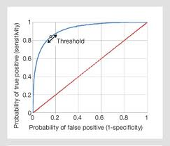
Euclidian Distance Comparison of ROC Curves
Another way of comparing ROC curves is to compare the minimum distance between the perfect predictor point (0,1) with a point on the ROC curve of the classifier.

Slide 16
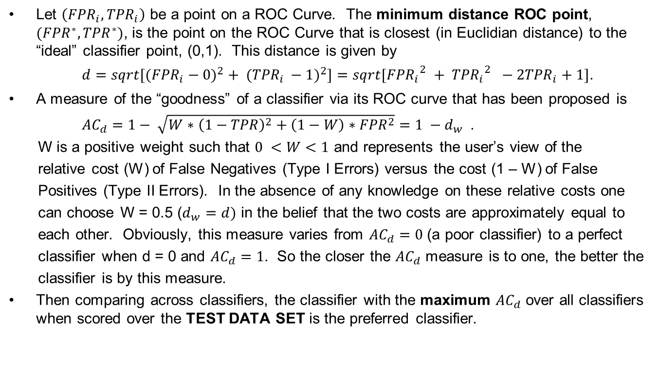
A Euclidian Distance Measure
Let $\left({FPR}_{i}, {TPR}_{i}\right)$ be a point on a ROC Curve. The minimum distance ROC point, $({FPR}^{∗}, {TPR}^{∗})$, is the point on the ROC Curve that is closest (in Euclidian distance) to the “ideal” classifier point, (0,1). This distance is given by
${d=sqrt[({FPR}_{i}−0)}^{2}+ {({TPR}_{i }−1)}^{2}]$ $=sqrt[{{FPR}_{i}}_{}^{2}+ {{TPR}_{i}}_{}^{2} −2{TPR}_{i}+1]$.
A measure of the “goodness” of a classifier via its ROC curve that has been proposed is
${AC}_{d}=1− \sqrt{W∗{\left(1−TPR\right)}^{2}+\left(1−W\right)∗{FPR}^{2}}=1 −d_{w}$.
W is a positive weight such that $0 <W<1$ and represents the user’s view of the
relative cost (W) of False Negatives (Type I Errors) versus the cost (1 – W) of False
Positives (Type II Errors). In the absence of any knowledge on these relative costs one
can choose W = 0.5 ($d_{w}=d)$ in the belief that the two costs are approximately equal to
each other. Obviously, this measure varies from ${AC}_{d}=0$ (a poor classifier) to a perfect
classifier when d = 0 and ${AC}_{d}=1$. So the closer the ${AC}_{d}$ measure is to one, the better the
classifier is by this measure.
Then comparing across classifiers, the classifier with the maximum ${AC}_{d}$ over all classifiers when scored over the TEST DATA SET is the preferred classifier.

Slide 17
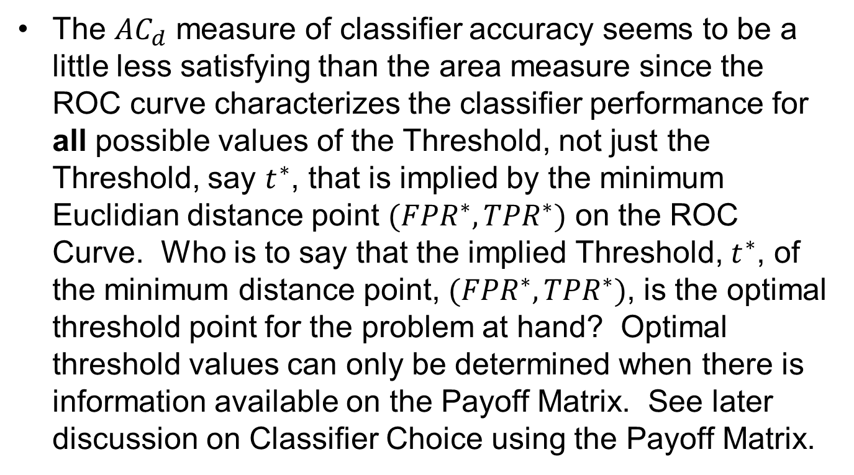
Caveat of the ${AC}_{d}$ Measure
The ${AC}_{d}$ measure of classifier accuracy seems to be a little less satisfying than the area measure since the ROC curve characterizes the classifier performance for all possible values of the Threshold, not just the Threshold, say $t^{∗}$, that is implied by the minimum Euclidian distance point $({FPR}^{∗},{TPR}^{∗})$ on the ROC Curve. Who is to say that the implied Threshold, $t^{∗}$, of the minimum distance point, $({FPR}^{∗}, {TPR}^{∗})$, is the optimal threshold point for the problem at hand? Optimal threshold values can only be determined when there is information available on the Payoff Matrix. See later discussion on Classifier Choice using the Payoff Matrix.

Slide 18
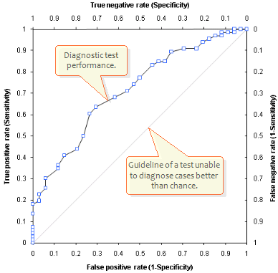
What a Test Data Set ROC Curve Might Look Like for One Classifier using a Finite Number of Thresholds (To get the area under the empirical ROC Curve, one has to sum up approximating rectangles)

Slide 19
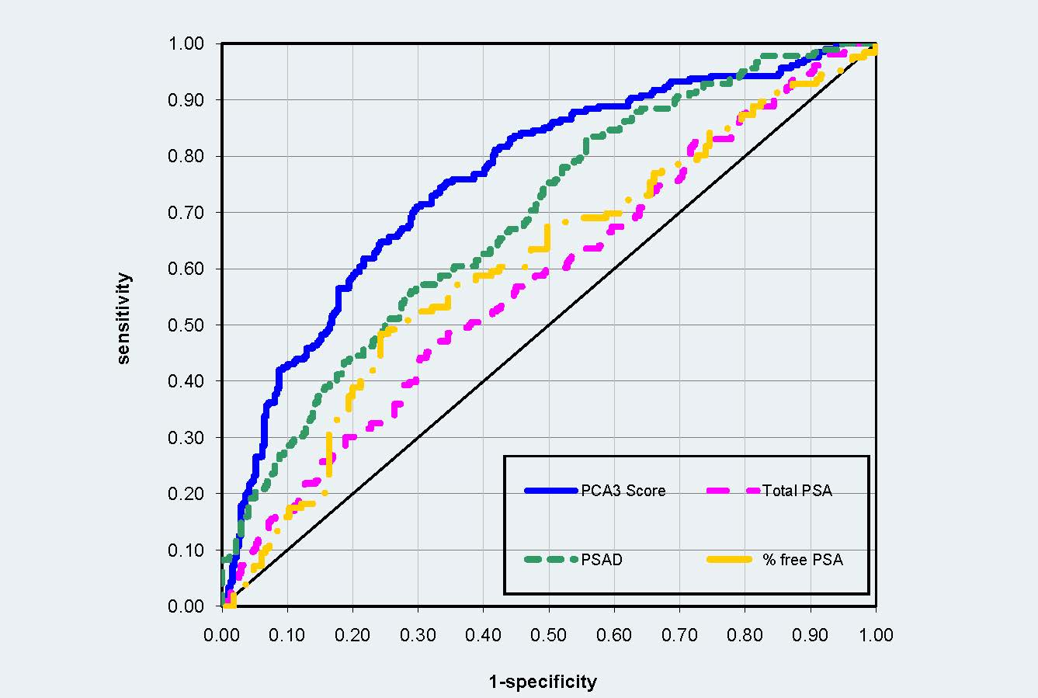
An Example of Empirical ROCs for Four Classifiers

Slide 20
Summary: ROC Curves
The areas under Test Data Set ROC Curves can be used to compare the performances of competing classifiers when considering the entire hold-out data set. The Classifier with the largest area under its Test ROC curve is the preferred classifier.
The ROC curve’s primary usefulness comes in the case where nothing is known about the Payoff Matrix associated with the Classification Problem at hand.
We now turn to studying cases where we know something about the Payoff Matrix.

