Slide 1
HW3 - Problem 2 REST API – Java Spring Boot

Slide 2
Topics
Describe the purpose of the Spring Boot
Client-server architecture
The MVC architecture design pattern
API, WEB API, RESTful APIs
Create a RESTful API with Spring Boot
Web Container

Slide 3
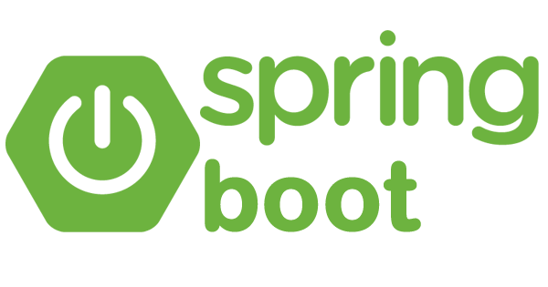
Spring Boot is a popular Java-based framework used for building stand-alone, production-grade Spring-based applications quickly and with minimal configuration.
Widely used to consume or build RESTful services. Spring Boot provides powerful support through its Spring MVC module.
Spring MVC: Spring Boot builds upon the Spring MVC framework, which provides robust support for building RESTful web services.

Slide 4
Client - Server Architecture
In software development, the client-server architecture is a model where computational tasks are divided between the client machines and the server machines.
This architecture is prevalent in networked applications and systems where multiple clients interact with a central server to access resources, data, or services.

Slide 5
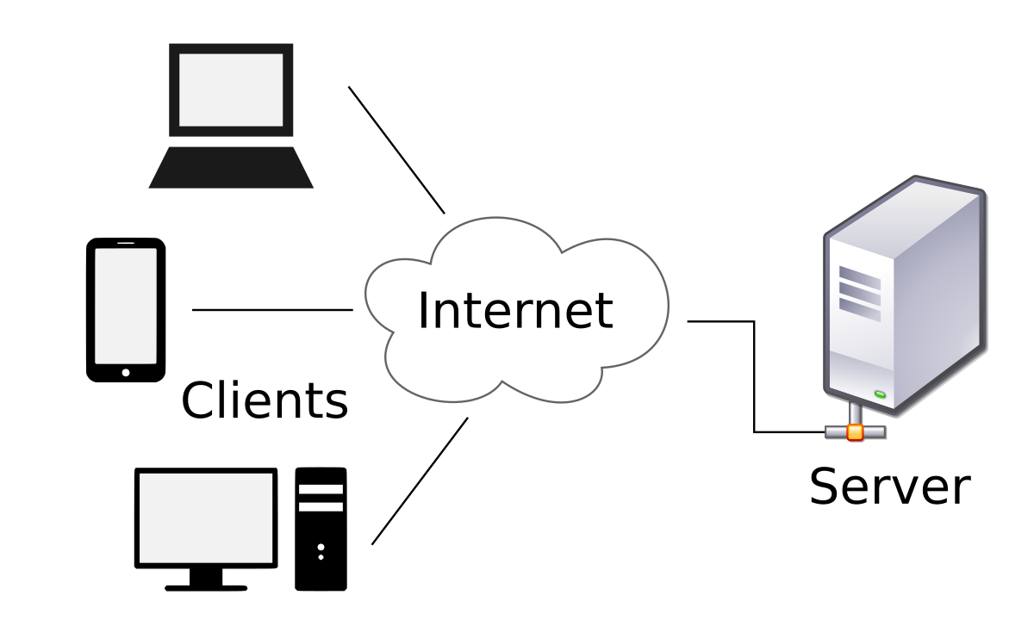
Clients and Server Architecture
Server is a generic term referring to either software or hardware that processes request from clients. A server offers shared resources that can be requested for use by a client.
A client is software that sends a request to a server to access a shared resource and processes the response returned from the server.
Client | Server
Web Browser | Web Server
Smart TV | Netflix’s computers
Phone | Messaging Server
Email App | Email Server
DbVisualizer | PostgreSQL

Slide 6
Client / Server
“I would like a cake”
Request
Response
API
Backend
Client (Frontend)
Server (Backend)
commonly HTML/CSS/JavaScript
Commonly Java

Slide 7
Client / Server
Server (on the internet)
Client
(on user’s computer)
http://excelsior.com/venue/6
Request
Database
CLI
Logic
Algorithms
DAOs
Service
API
Response
Menu
{ "id”: 6, "name":"Blue Normad Outpost", "city": "Yepford", "state": “Iowa", "description: "Blast off..." }
Backend
Examples: https://www.educative.io/blog/great-web-apis-for-web-development

Slide 8
Spring Boot - Spring MVC
Spring Boot is exceptionally well-suited for developing REST API servers due to several key features and advantages.
Spring MVC: Spring Boot builds upon the Spring MVC framework, which offers robust support for building RESTful web services.
Spring MVC provides annotations like @RestController, @RequestMapping, and @RequestBody, making it easy to define REST endpoints and handle HTTP requests and responses.

Slide 9
The MVC Pattern
MVC stands for Model-View-Controller, which is an architecture design pattern commonly used in software development to separate an application into three interconnected components.
By separating the concerns of data manipulation, user interface, and user input handling, MVC promotes modularization, reusability, and maintainability of code. This separation of concerns also facilitates parallel development by allowing developers to work on different components simultaneously.

Slide 10
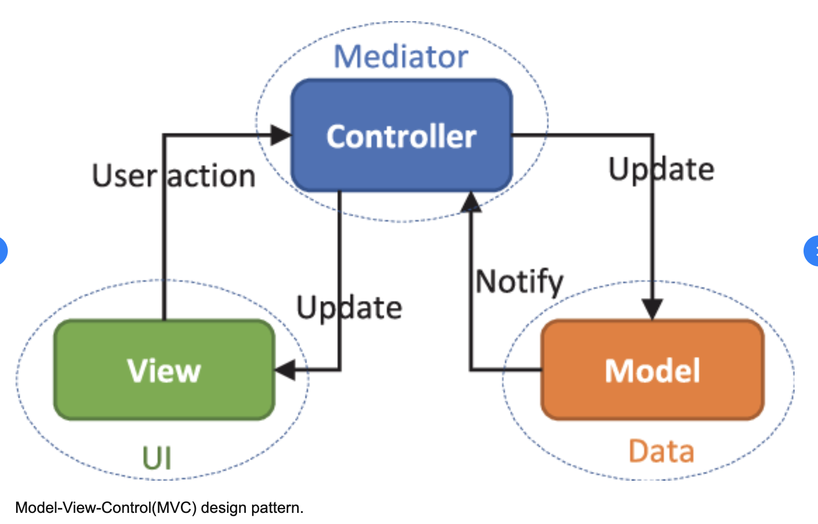
MVC Example

Slide 11
Model View Controller Definition
Model
application state and business logic
only part of the application that talks to the database
Models could be classes
View
presents data to user
accepts input from user
Views might be a desktop display, a mobile display, a file output based on a model
Controller
Takes input from the view and passes it to the appropriate model objects
Grabs all necessary building blocks and organizes them for the output
Takes results from the model and passes it to the appropriate view

Slide 12
API
Application Programming Interface
An API is a way for software components to talk to each other. The methods and properties in our classes that are exposed as public are the API of the object.
APIs allow communication between any software components, not just the ones in the same application. For example, browsers have an API that allows their functionality to be communicated with from JavaScript programs running inside them. When we use File.createNewFile() in Java it is calling the Operating System’s API to create the file.
APIs commonly allow 2 applications to communicate.

Slide 13
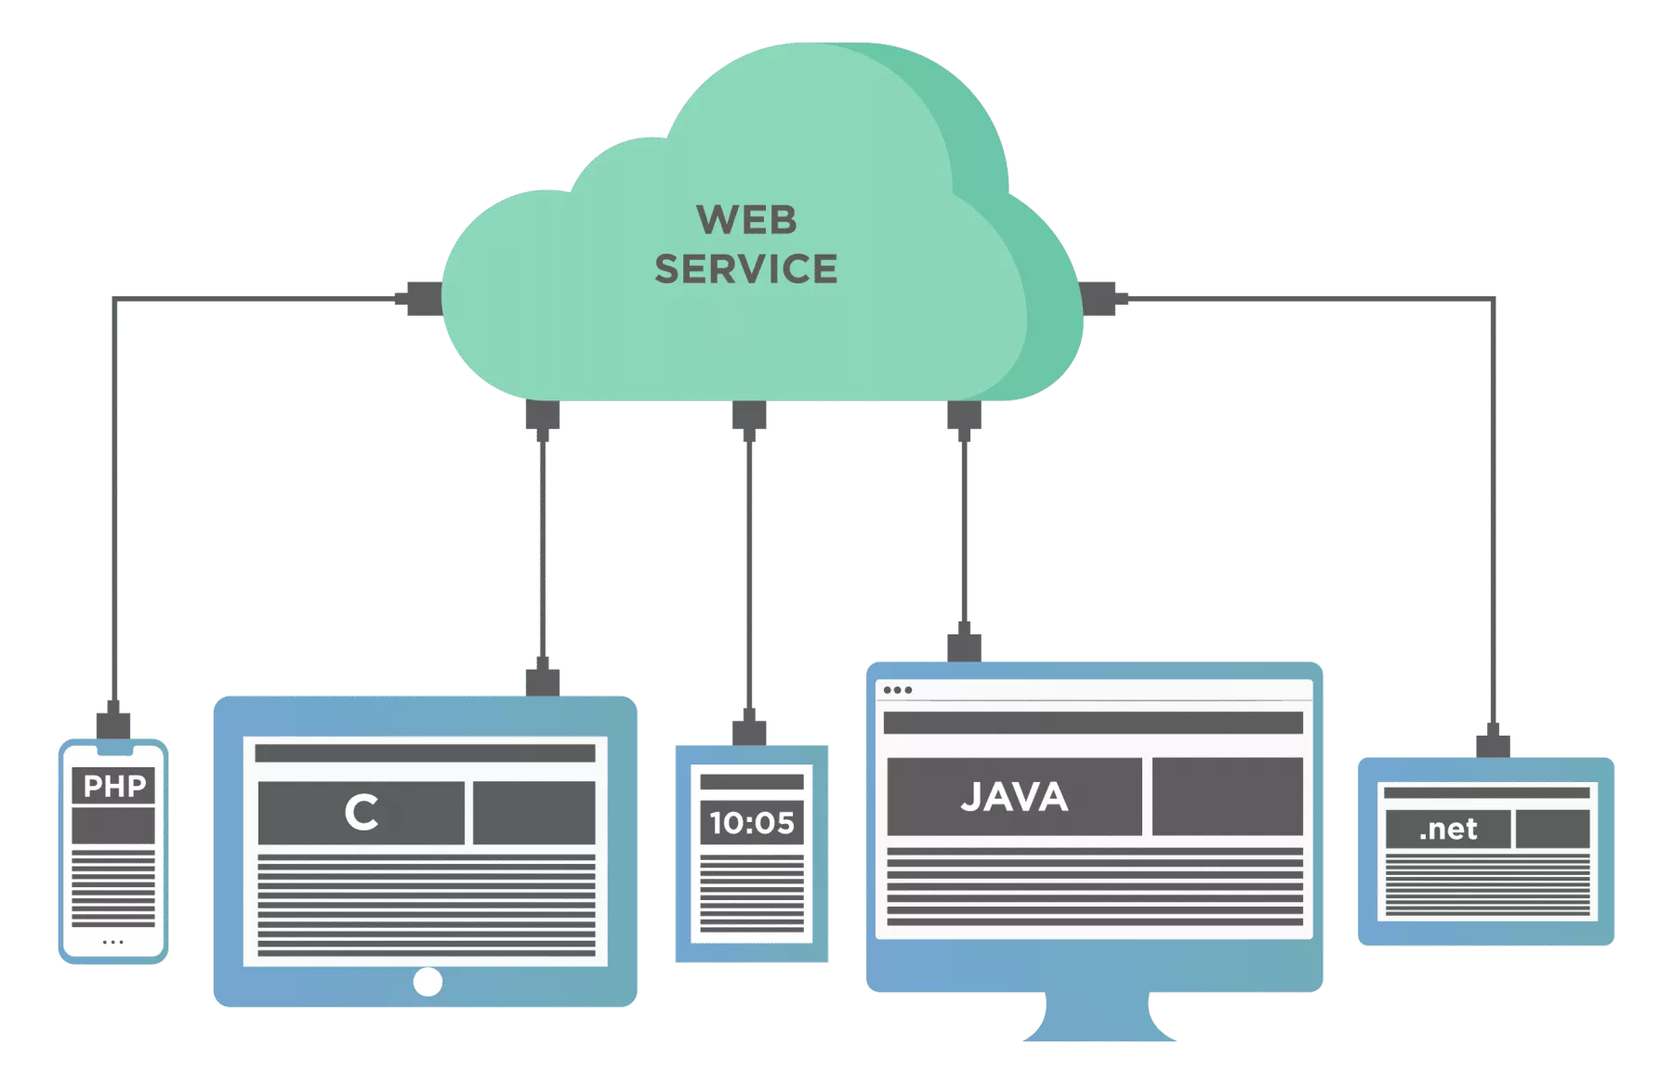
Web Service (Web API)
A Web Service or Web API is an API that allows for applications to communicate with each other across the internet. All Web Services are APIs, however, not all APIs are Web Services.

Slide 14
API’s as a source of data - HTML
After a controller receives a GET request in a traditional MVC Application, the user is presented with a view… the “website”:
Client
Server
Model
Get Request
Se r v i ce
Controller
DAO
database
View (UI/HTML) Response
View

Slide 15
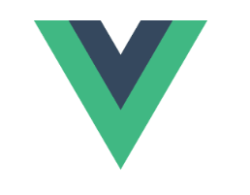
API’s as a source of data - JSON
Data API controllers only return data ( JSON ) as the View instead of returning an HTML document.
Server
Client
Request
This data can now be sent and used by JS applications.
Building these “front end” apps is the focus of Module 3!
Model
Controller
{... Only Data … }
database
DAO / Service called from Controller
Response
… or just for a user to analyze the raw data.
(analysts and data scientists?)

Slide 16
API’s as a source of data
https://www.educative.io/blog/great-web-apis-for-web-development
#12: REST Countries API
The REST Countries API provides free access to data about all countries in the world. It includes geographical information such as country names, capitals, official languages, etc. Developers can use this API to quickly create applications that display information about countries or filter results by a specific keyword or category.
A few of their endpoints are:
Name: https://restcountries.com/v3.1/name/{name} searches by country name (native or partial names supported)
Language: https://restcountries.com/v3.1/lang/{lang} searches by language name
Currency: https://restcountries.com/v3.1/currency/{currency} searches by currency name

Slide 17
API as a source of data
Consider what happens after a controller receives a GET request:

Slide 18
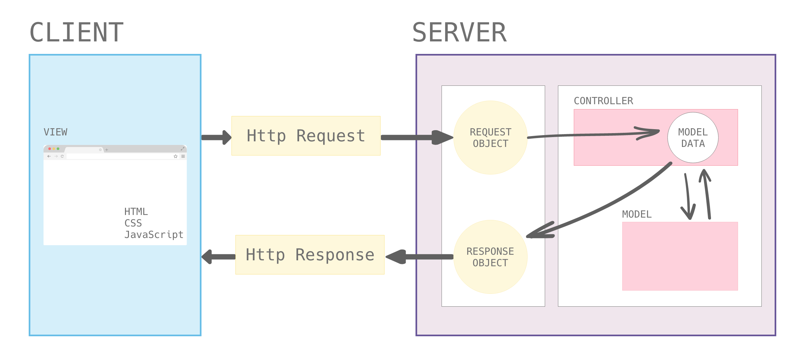
Request and Response life cycle

Slide 19
REpresentational State Transfer (REST)

Slide 20
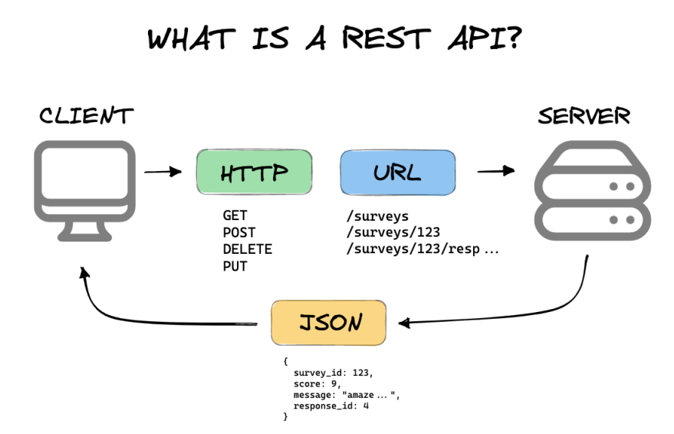

Slide 21
REST API
REST API stands for Representational State Transfer Application Programming Interface.
It is an architectural style used for building web services that provide interoperability between different systems on the internet.
RESTful APIs use HTTP protocol to access and manipulate data resources on a server.

Slide 22
Representational state transfer (Principle)
The term representational state transfer was introduced and defined in 2000 by Roy Fielding in his doctoral dissertation.
It means that a server will respond with the representation of a resource (today, it will most often be an HTML, XML or JSON document) and that resource will contain hypermedia links that can be followed to make the state of the system change.
Any such request will in turn receive the representation of a resource, and so on.
(https://en.wikipedia.org/wiki/Representational_state_transfer)

Slide 23
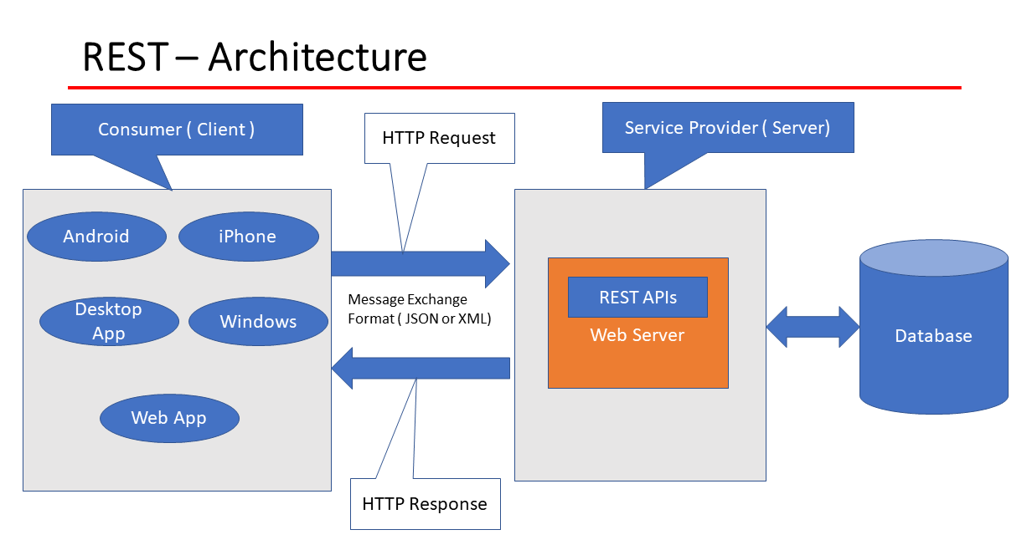

Slide 24
RESTful API
In a RESTful API, each resource is identified by a unique URL or endpoint, and can be accessed using standard HTTP methods such as GET, POST, PUT, DELETE, etc.
The data is usually sent and received in JSON or XML format, making it easy for different systems to communicate with each other.

Slide 25
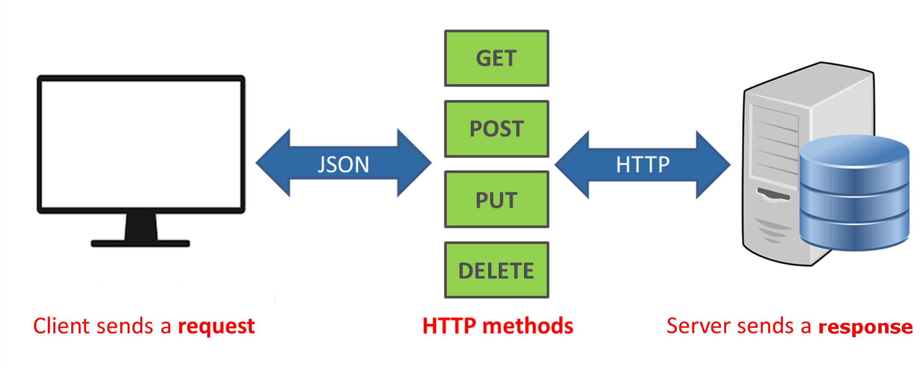
REST API Examples

Slide 26
JSON
{
"reviews": [
{
"hotelID": 1,
"title": "What a great hotel!",
"review": "I thought this was a really great hotel and would stay again!",
"author": "John Smith",
"stars": 4
},
{
"hotelID": 1,
"title": "Peaceful night sleep",
"review": "I had a really good night sleep and would stay again",
"author": "Kerry Gold",
"stars": 3
}
]
}
JSON (JavaScript Object Notation) is a messaging format that is commonly used by RESTful Web Services.
JSON uses key/value pairs to represent objects.
Objects are identified by { }, Arrays by [ ]
Objects have properties and values separated by a colon. The property names are Strings in double quotes. The value can be a number, String (with double quotes), Array, or Object.
Each property/value pair, object, or array is separated by a comma.

Slide 27
Calling a Web Service Using Java - Client
Spring Boot provides the RestTemplate, which is a Java based client for calling RESTful Web Services.
Endpoint - a URL that points to a Web Service.
To access a web service with RestTemplate, we must provide it the API endpoint: http://localhost:3000/hotels
String response = restTemplate.getForObject(endpointUrl, String.class);
getForObject() - method that retrieves a JSON response and converts it to an object.
String response - Variable to hold the response.
endpointUrl - the URL of the endpoint to make the request.
String.class - The Data Type of the Object to return. This should match the variable that will hold it.

Slide 28
Parameters in Endpoints
A Path Parameter (Variable) is one that is passed as part of the resource path in the URL.
http://localhost:3000/hotels/4
http://localhost:3000/hotels/4/reviews
A Query String Parameter is one that is passed as a key/value pair as part of the Query portion (called the Query String) of the URL.
http://localhost:3000/hotels?stars=3

Slide 29
Postman
Postman is a software tool that helps developers test Web APIs.
Postman is an effective testing tool because it allows you to quickly create API requests, input request data, and read response data.

Slide 30
HTTP Methods – GET
Usage
HTTP GET is generally used to retrieve web pages to display
It also is included for
images
documents
stylesheets, script files
Search Pages
HTTP GET requests are easily bookmarked because the parameters are in the url.
HTTP GET should never modify any data on the server. Get does not change the state on the server and has the same result each time it is repeated.
Parameters for a GET request travel as either Path Parameters or in the Query String.
http://localhost:3000/hotels/2/reviews?stars=4

Slide 31
HTTP Methods - POST
Usage
HTTP POST is used when
Data must be secure (credit card number, password, etc.)
Data is too large for the URL
When the request is asking to add something on the server
HTTP POST requests cannot be bookmarked or sent with the browser directly.
.
HTTP POST indicates that the request will add new data to the the server. Post modifies the server and leaves the server in a different state each time the same request is repeated.
POST transfers data in the message body instead of the URL. While HTTPS encrypts the message body, it cannot encrypt the URL.

Slide 32
HTTP Methods - PUT
Usage
HTTP PUT is used to update existing data
HTTP PUT requests cannot be bookmarked or sent with the browser directly.
HTTP PUT requests are meant to overwrite the entire record with the new values.
.
HTTP PUT indicates that the request will update existing data on the the server. Put changes the state on the server but the state remains the same if the same request is repeated multiple times.
PUT transfers data in the message body instead of the URL. While HTTPS encrypts the message body, it cannot encrypt the URL.

Slide 33
HTTP Methods - DELETE
Usage
HTTP DELETE is used to remove existing data from the server
HTTP DELETE requests cannot be bookmarked or sent with the browser directly.
Usually only requires the entities id, so parameters are sent in the query string.
.
HTTP DELETE indicates that the request will remove existing data from the the server.
Delete changes the state of the server but the state remains the same if the request is repeated multiple times.

Slide 34
Object Serializing and Deserializing
Transforming a Java Object to a string representation of the object, JSON, is called Serialization.
Java Object → JSON is Serialization
Transforming a string representation of an object, JSON, into an Java Object is called Deserialization.
JSON → Java Object is Deserialization

Slide 35
REST Controllers - server
Spring Boot makes it easy to build controllers using annotations. The @RestController annotation marks a class as a controller for an API.
@RestController
public class ProductReviewsController {
… }

Slide 36
Handler Methods - Server
Annotated with @RequestMapping
Handle a request from web
path= argument
Maps to the request path
method= RequestMethod.XXX
Specifies what type of request will cause the method to execute

Slide 37
Consuming a GET - example
This is the GET endpoint with a path variable that we defined today (server):
@RequestMapping(path = "/hotels/{id}", method = RequestMethod.GET)
public Hotel get( @PathVariable int id ) {
return hotelDAO.get(id);
}
… and this is how a different Java application can consume it (client):
hotel = restTemplate.getForObject(BASE_URL + "hotels/" + id, Hotel.class);

Slide 38
Consuming a POST - example
Server side logic example
@RequestMapping( path = "/hotels/{id}/reservations", method = RequestMethod.POST)
public Reservation addReservation(@RequestBody Reservation reservation, @PathVariable("id") int hotelID) {
return reservationDAO.create(reservation, hotelID);
}
… Client side logic example:
HttpHeaders headers = new HttpHeaders();
headers.setContentType(MediaType.APPLICATION_JSON);
HttpEntity<Reservation> entity = new HttpEntity<>(reservation, headers);
reservation = restTemplate.postForObject(BASE_URL + "hotels/" + reservation.getHotelID() + "/reservations",
entity, Reservation.class);

Slide 39
Container in REST API
In the context of a REST API in Java, a "container" typically refers to an object or entity that is used to hold or encapsulate data and functionality. In the example provided earlier, the Container class represents a model that holds information about a specific container, including its id, name, and type.
In the context of a RESTful API, a container could be any entity that is being managed or manipulated through the API endpoints. It might represent a resource, such as a user, a product, or any other type of data that the API is designed to handle.

Slide 40
Container in REST API
When building a RESTful API in Java, containers are often used as data transfer objects (DTOs) to represent the data being transferred to and from the API endpoints. They help to structure the data and provide a convenient way to serialize and deserialize data when communicating between the client and the server.

Slide 41
REST APIs with Spring Boot

Slide 42
