Slide 1
A critical review of the Slanted Edge method for MTF measurement of color cameras and suggested enhancements
Prasanna Rangarajan
Indranil Sinharoy
Dr. Marc P. Christensen
Dr. Predrag Milojkovic
Department of Electrical Engineering
Southern Methodist University
Dallas, Texas 75275-0338, USA
US Army Research Laboratory,
RDRL-SEE-E, 2800 Powder Mill Road,
Adelphi, Maryland 20783-1197, USA

Slide 2
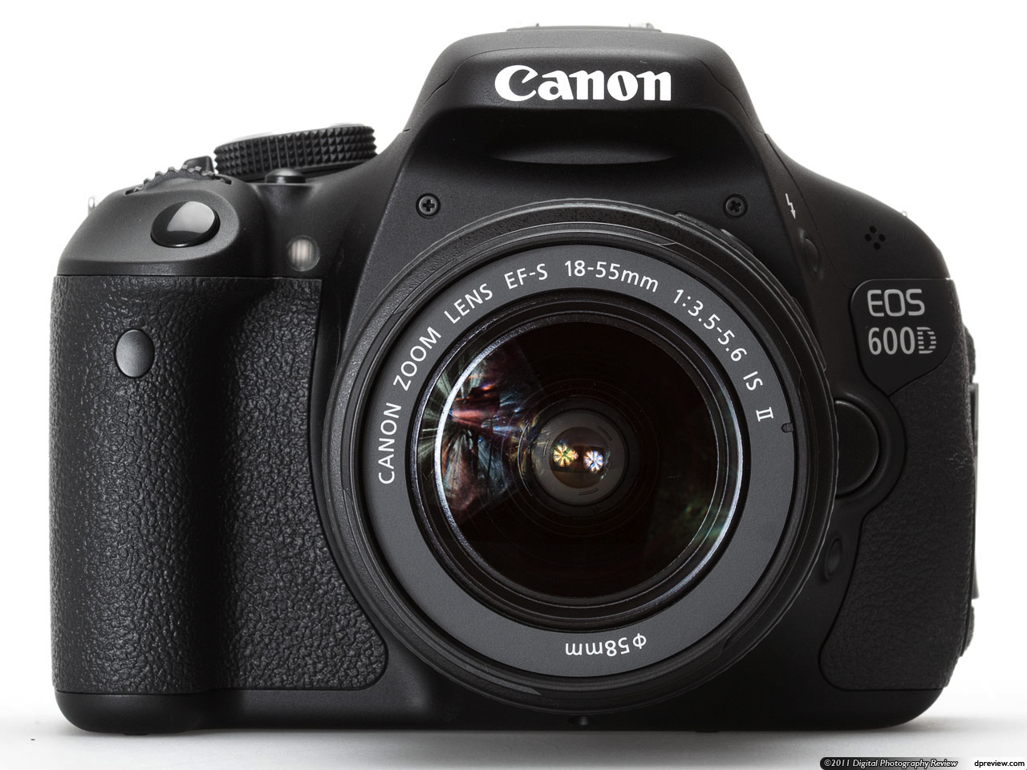
What is an objective measure of image quality & image sharpness ?
The “Spatial Frequency Response”
It describes the response of the imaging system to sinusoidal patterns
It depends on the optics, pixel geometry, fill-factor and the severity of optical low-pass filtering (among others)
It is an important performance metric that quantifies resolution & the severity of aliasing ( if any )
How does one currently estimate the SFR ?
Use the slanted edge method recommended by ISO12233 standard
Problem Demosaicing affects the assessment of image sharpness & image quality.

Slide 3
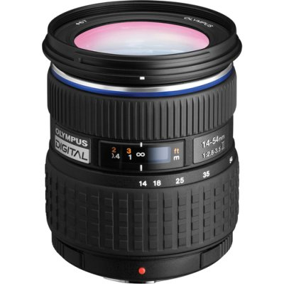
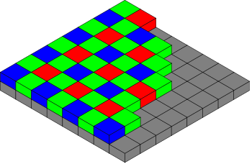
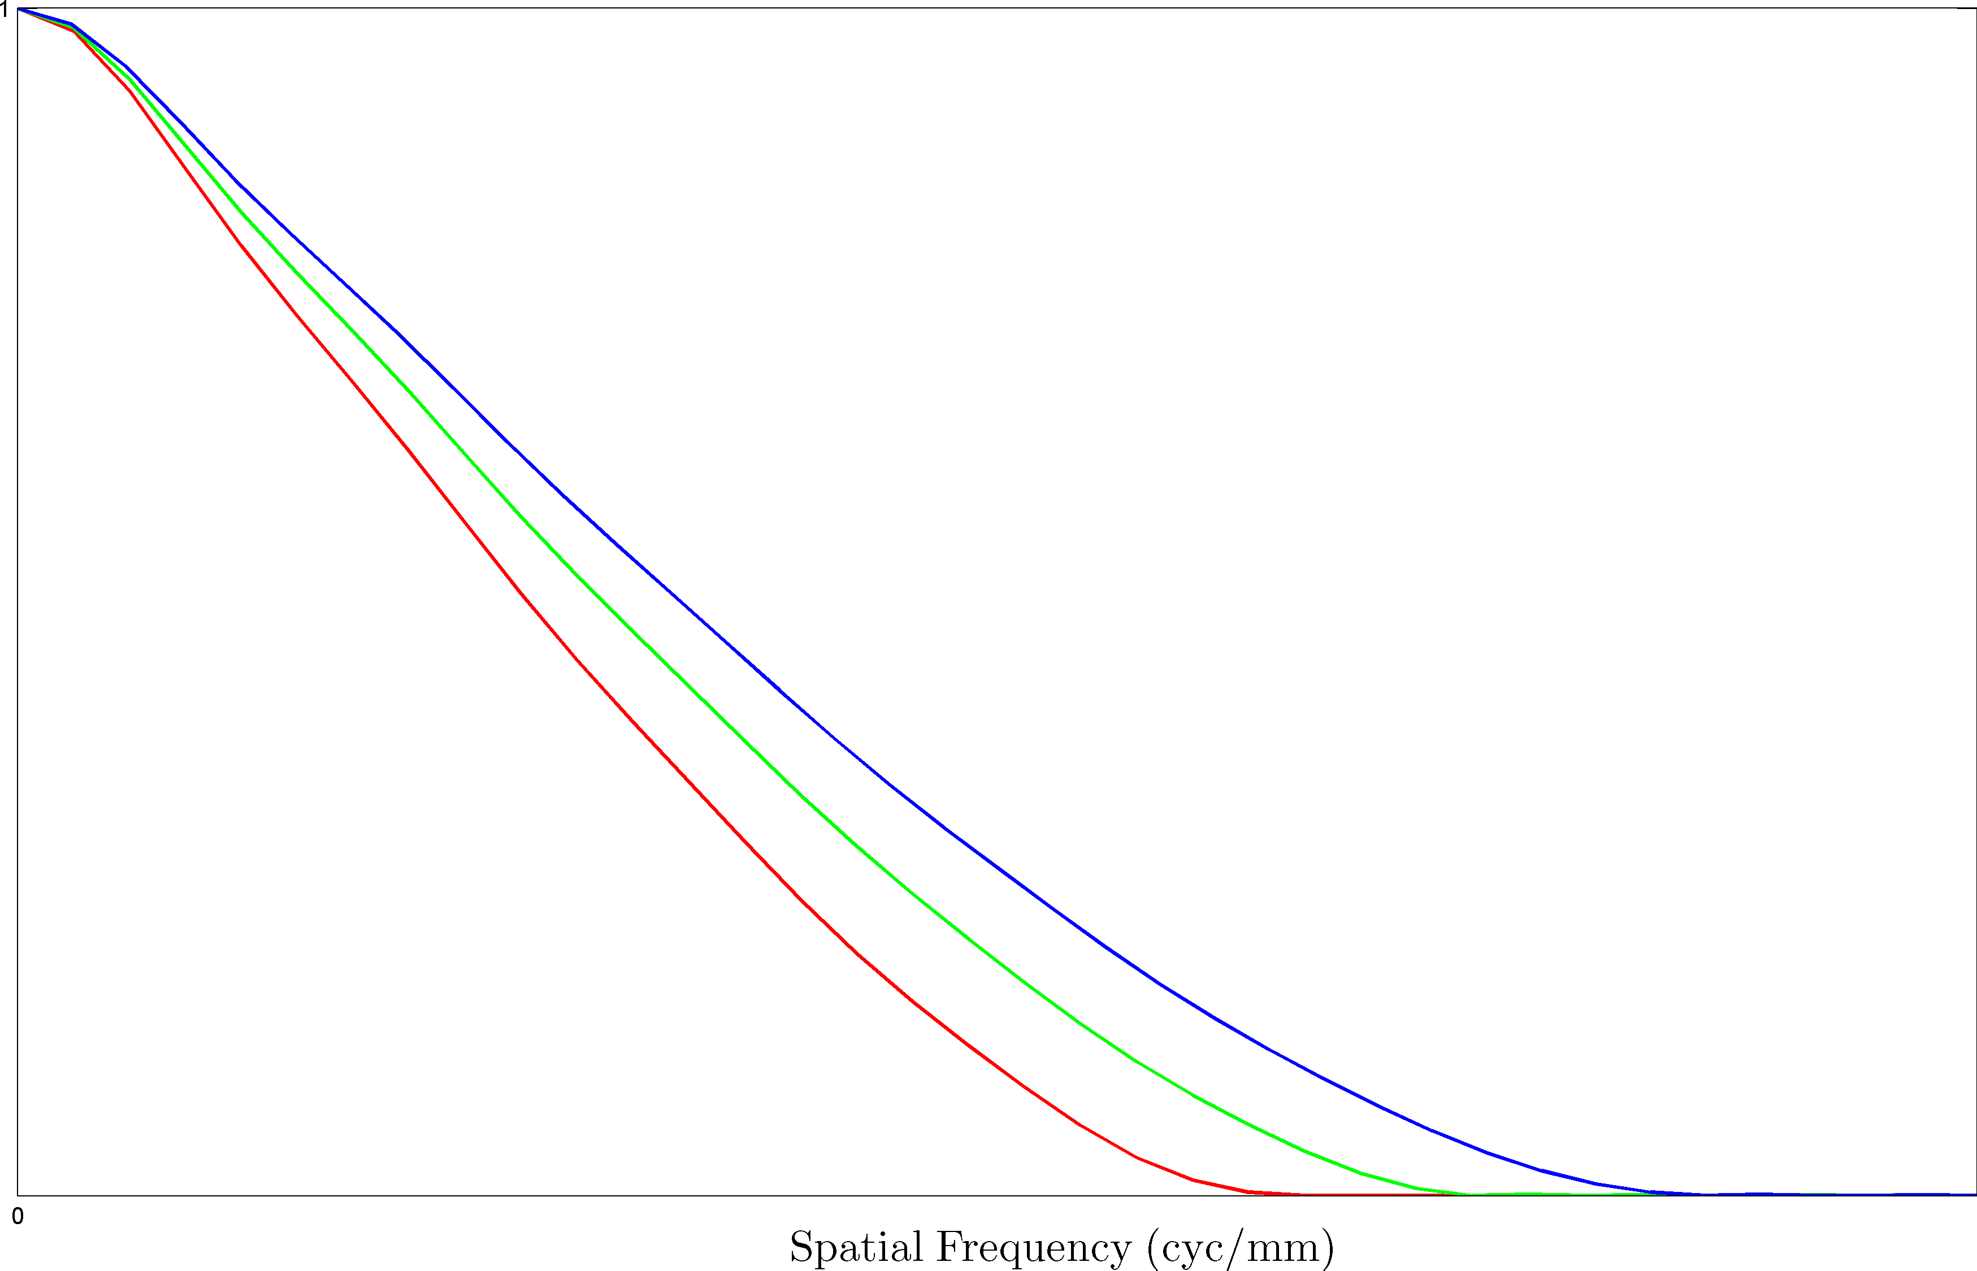
SFR Estimation – Slanted Edge Method
Slanted Edge Target
Optics
Optically Blurred Slanted Edge
Color Filtering
+
Sampling
CFA image of Slanted Edge
SFR estimates
Demosaiced image of Slanted
Edge
Slanted Edge SFR Estimation
Notes:
http://i-cdn.apartmenttherapy.com/uimages/unplggd/021411_cameramovie.jpg
http://www.canon.com/technology/canon_tech/explanation/images/cp_tech_ph021.jpg

Slide 4
Example of SFR estimation using ISO12233
zoomed-in view of region-of-interest (ROI)
Color Filter Array image
VNG
PPG
AHD
DCB
Modified AHD
AFD 5 Pass
VCD
VCD + AHD
LMMSE
Linear Interpolation
ROI 60 rows x 180 columns
Images demosaiced using
Notes:
LIN,VNG,PPG
AHD,DCB,MOD_AHD
AFD_5PASS,VCD,VCD+AHD
LMMSE

Slide 5
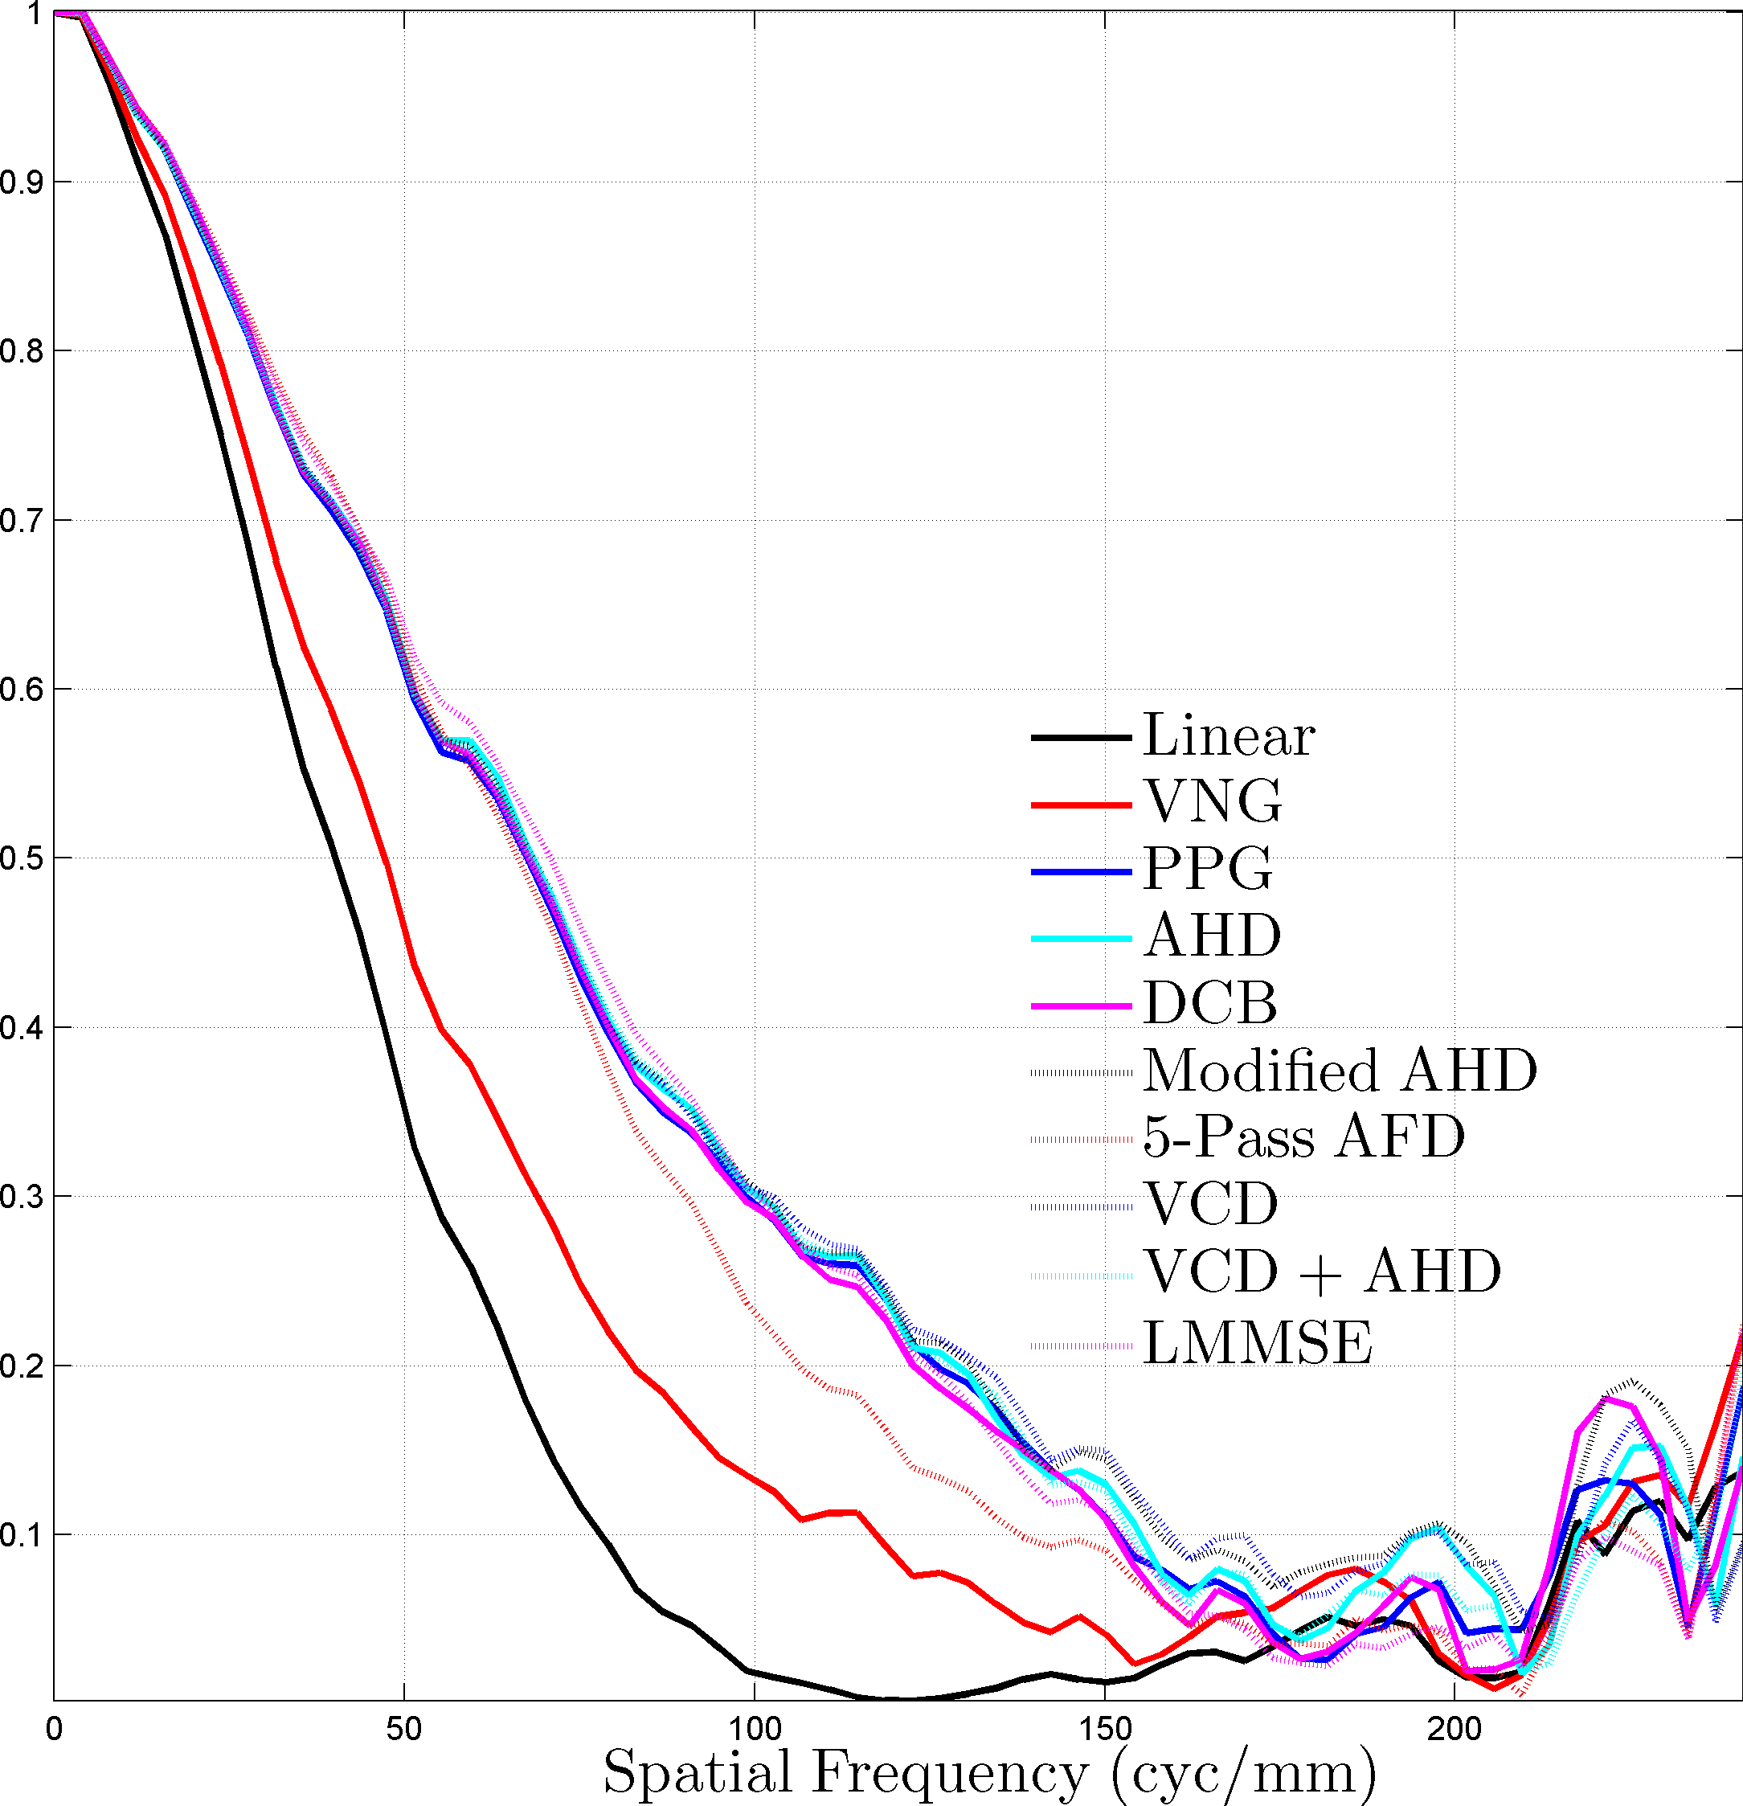
Example of SFR estimation using ISO12233
Red channel SFR
Demosaicing affects the SFR
Canon EOS 600D
18-55 mm, F3.5-5.6 IS kit lens
Pixel pitch $=4.17μm$
Nyquist frequency of sensor $=119.9\frac{lp}{mm}$
Red channel Nyquist $=59.95\frac{lp}{mm}$
Parameters
18mm
F/# = 5.6
ISO 100
SFR was estimated using tool recommended by International Imaging Industry Association
availabe for download @ http://losburns.com/imaging/software/SFRedge/index.htm
Notes:
Message @ the bottom
Insert msg “estimated using sfrmat”

Slide 6
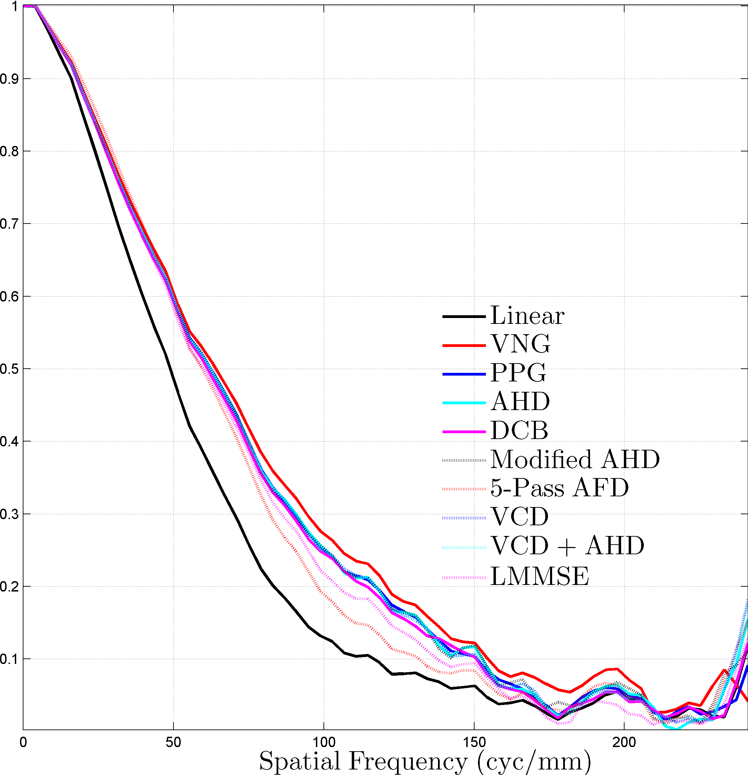
Example of SFR estimation using ISO12233
Green channel SFR
Demosaicing affects the SFR
Canon EOS 600D
18-55 mm, F3.5-5.6 IS kit lens
Pixel pitch $=4.17μm$
Nyquist frequency of sensor $=119.9\frac{lp}{mm}$
Green channel Nyquist $=84.79\frac{lp}{mm}$
Parameters
18mm
F/# = 5.6
ISO 100
SFR was estimated using tool recommended by International Imaging Industry Association
availabe for download @ http://losburns.com/imaging/software/SFRedge/index.htm
Notes:
LMMSE

Slide 7
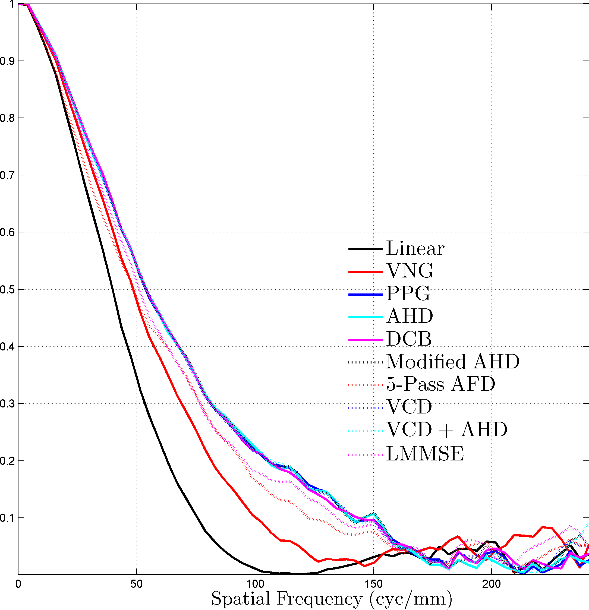
Example of SFR estimation using ISO12233
Blue channel SFR
Demosaicing affects the SFR
Canon EOS 600D
18-55 mm, F3.5-5.6 IS kit lens
Pixel pitch $=4.17μm$
Nyquist frequency of sensor $=119.9\frac{lp}{mm}$
Blue channel Nyquist $=59.95\frac{lp}{mm}$
Parameters
18mm
F/# = 5.6
ISO 100
SFR was estimated using tool recommended by International Imaging Industry Association
availabe for download @ http://losburns.com/imaging/software/SFRedge/index.htm
Notes:
LMMSE

Slide 8
Demosaicing affects the SFR & assessment of image quality
Problem
Proposed Solution
Estimate SFR directly from the color filter array samples

Slide 9
SFR Estimation – Proposed Workflow
Slanted Edge Target
Optics
Optically Blurred Slanted Edge
Color Filtering
+
Sampling
CFA image of Slanted Edge
SFR estimates
Proposed Extension to CFA images
Notes:
http://i-cdn.apartmenttherapy.com/uimages/unplggd/021411_cameramovie.jpg
http://www.canon.com/technology/canon_tech/explanation/images/cp_tech_ph021.jpg

Slide 10
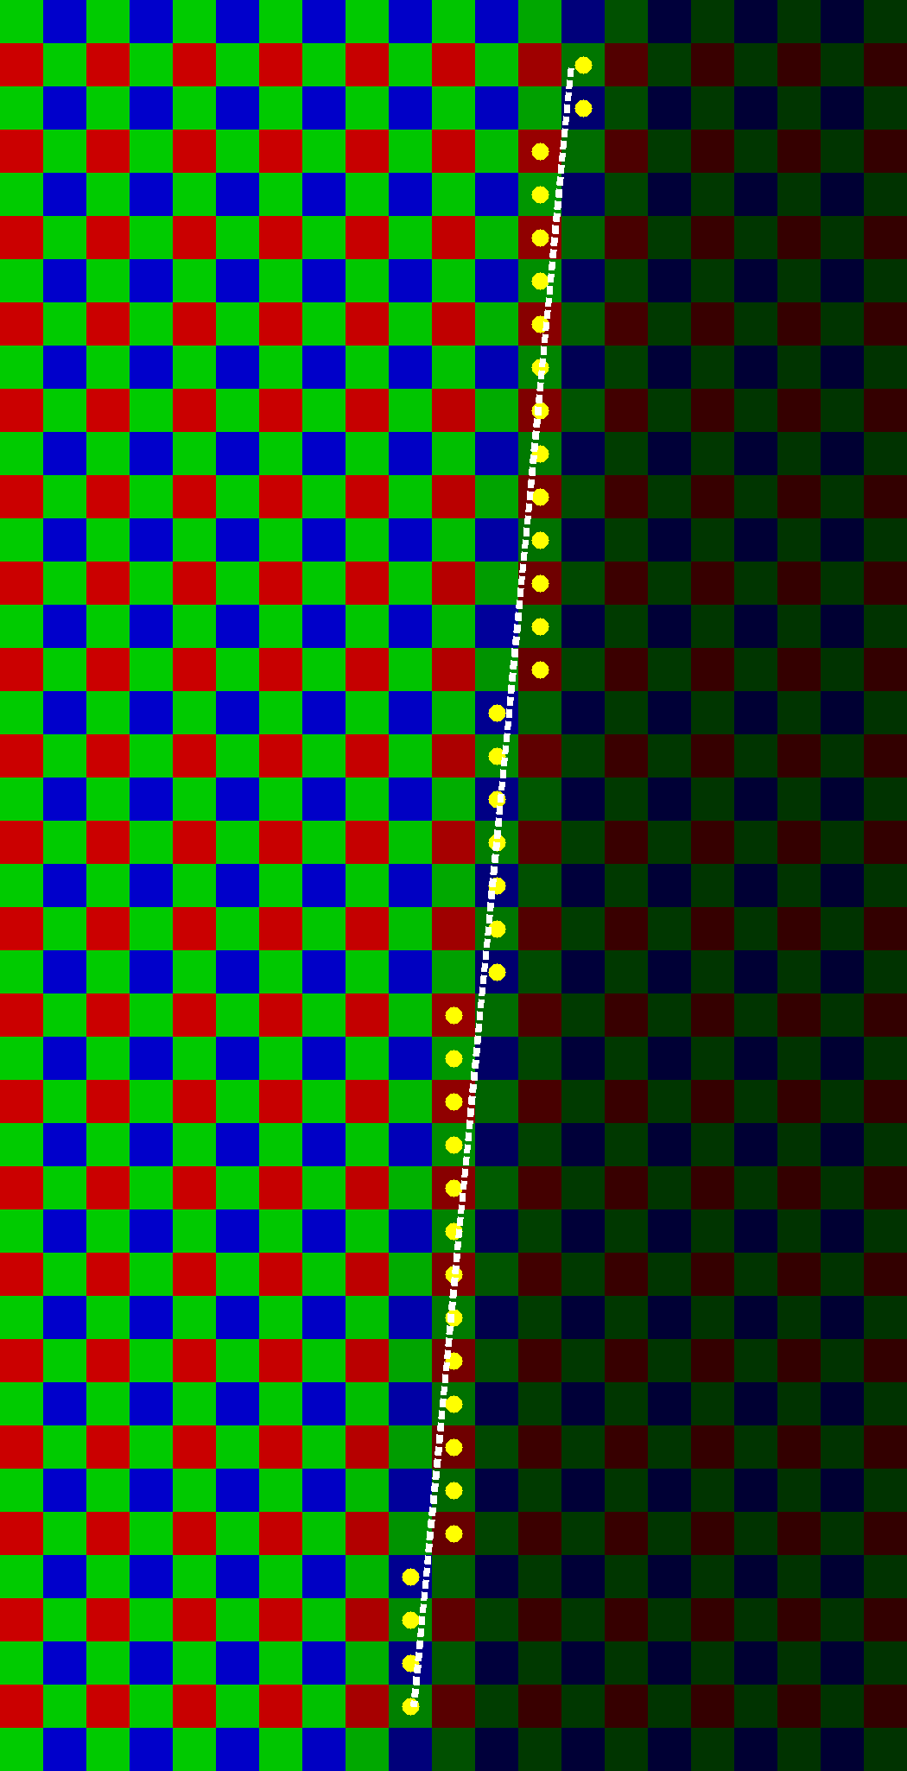
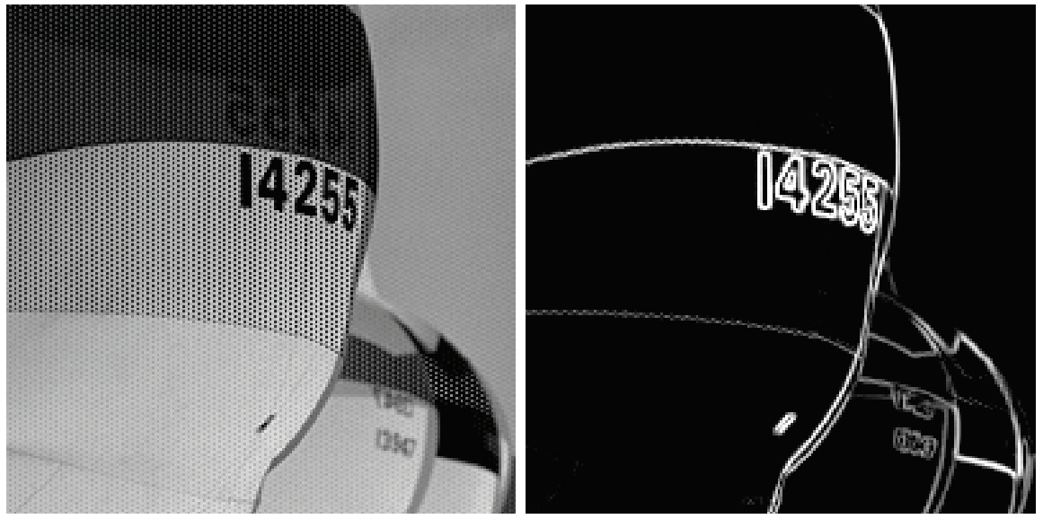
SFR Estimation – Proposed Method
CFA image of Slanted Edge
Slanted edge detection
CFA edgedetection
LS line fitting
Reference
Edge Oriented Directional Color Filter Interpolation
Ibrahim Pekkucuksen, Yucel Altunbasak Proceedings of ICASSP 2011
CFA image
Edge image

Slide 11
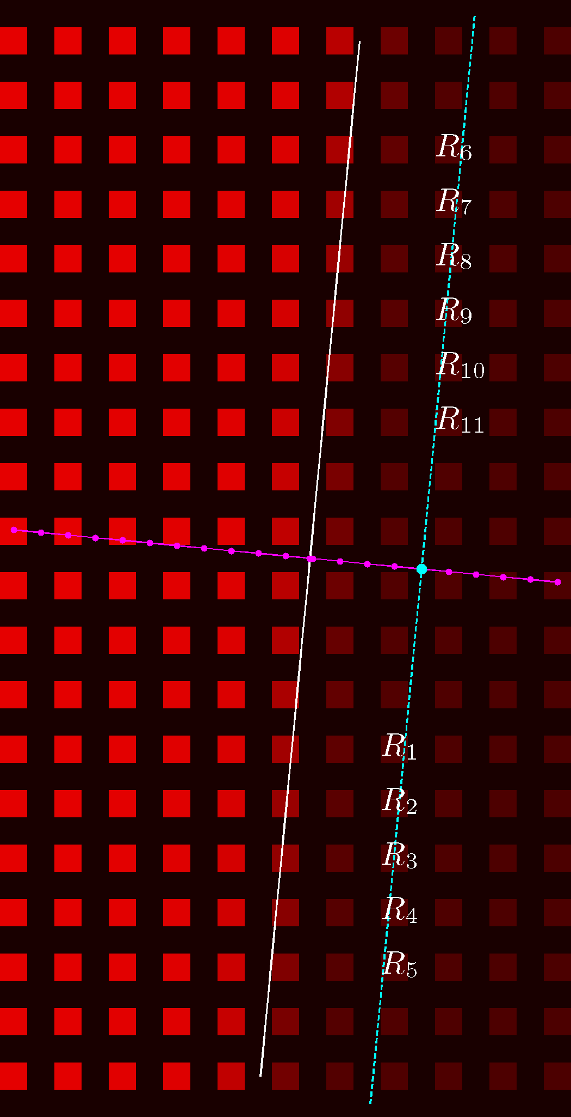
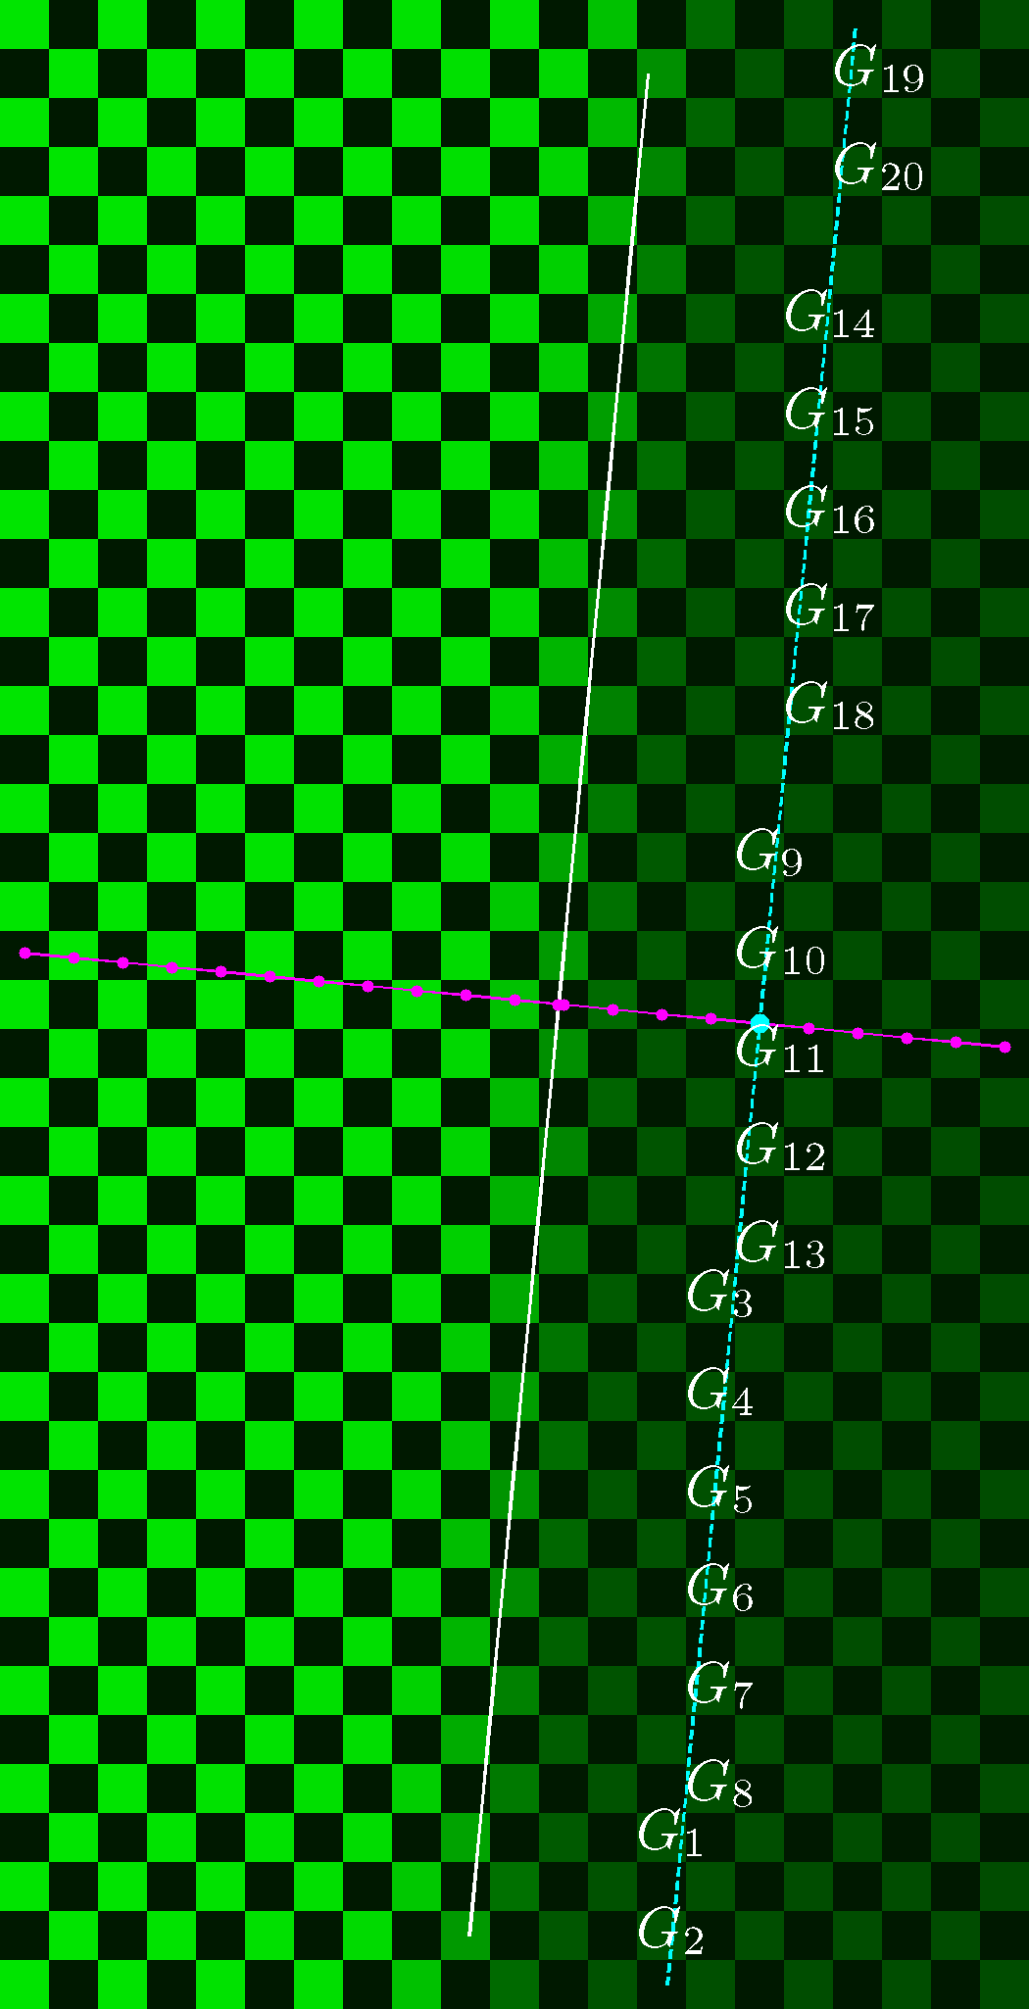
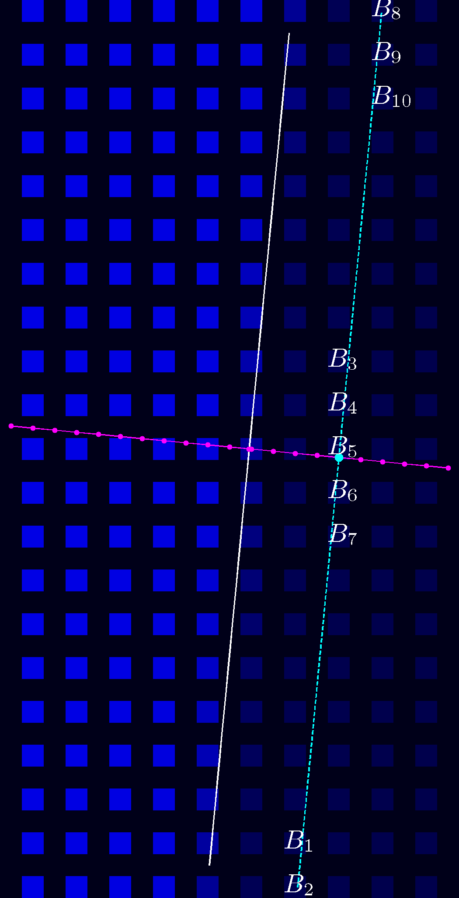
SFR Estimation – Proposed Method
CFA image of Slanted Edge
Slanted edge detection
CFA edgedetection
LS line fitting
Identify super-sampled edge spread function for each color channel
Notes:
http://i-cdn.apartmenttherapy.com/uimages/unplggd/021411_cameramovie.jpg
http://www.canon.com/technology/canon_tech/explanation/images/cp_tech_ph021.jpg

Slide 12
SFR Estimation – Proposed Method
CFA image of Slanted Edge
Slanted edge detection
CFA edgedetection
LS line fitting
Identify super-sampled edge spread function for each color channel
$$ℱ\{…\}$$
Fourier Transform
Derivative
filtering
$$\frac{∂}{∂n}\left(…\right)$$
Identify SFR
Identify super-sampled line spread function
Notes:
http://i-cdn.apartmenttherapy.com/uimages/unplggd/021411_cameramovie.jpg
http://www.canon.com/technology/canon_tech/explanation/images/cp_tech_ph021.jpg

Slide 13
Denoise the super-sampled Edge Spread Function by parametric fitting
What do the lines in the inset represent ?
The solid white line represents the location of the step edge
Ideally, the intensities of all pixels lying on this line are identical up-
to sampling & quantization
The magenta dots represent points on the super-sampled ESF grid
Recommended method for identifying the super-sampled edge-spread function
Suppose we wish to identify the $n^{th}$ sample of the $esf$, represented by the cyan dot in the inset
Imagine drawing a line with the same slope as the step edge, such that it passes through the $n^{th}$ sample. Ideally, the intensities of all pixels lying on the cyan line are identical up-to sampling & quantization. This suggests that the $n^{th}$ sample of the $esf$can be inferred from the red pixels in the CFA image that intersect the cyan line. The corresponding pixels are labeled $R_{1},R_{2},…,R_{10},R_{11}$in the inset.
$e_{red}\left[n\right]$= $μ\left(R_{1},R_{2},…,R_{10},R_{11}\right)$
where the function $μ(…)$ represents the statistical mean
Red component of CFA image of slanted edge
Notes:
LMMSE

Slide 14
Proposed Method for identifying the super-sampled Edge Spread Function
What do the lines in the inset represent ?
The solid white line represents the location of the step edge
Ideally, the intensities of all pixels lying on this line are identical up-
to sampling & quantization
The magenta dots represent points on the super-sampled ESF grid
Recommended method for identifying the super-sampled edge-spread function
Suppose we wish to identify the $n^{th}$ sample of the $esf$, represented by the cyan dot in the inset
Imagine drawing a line with the same slope as the step edge, such that it passes through the $n^{th}$ sample. Ideally, the intensities of all pixels lying on the cyan line are identical up-to sampling & quantization. This suggests that the $n^{th}$ sample of the $esf$can be inferred from the green pixels in the CFA image that intersect the cyan line. The corresponding pixels are labeled $G_{1},G_{2},…,G_{19},G_{20}$in the inset.
${ e}_{green}\left[n\right]$= $μ\left(G_{1},G_{2},…,G_{19},G_{20}\right)$
where the function $μ(…)$ represents the statistical mean
Green component of CFA image of slanted edge
Notes:
LMMSE

Slide 15
Proposed Method for identifying the super-sampled Edge Spread Function
What do the lines in the inset represent ?
The solid white line represents the location of the step edge
Ideally, the intensities of all pixels lying on this line are identical up-
to sampling & quantization
The magenta dots represent points on the super-sampled ESF grid
Recommended method for identifying the super-sampled edge-spread function
Suppose we wish to identify the $n^{th}$ sample of the $esf$, represented by the cyan dot in the inset
Imagine drawing a line with the same slope as the step edge, such that it passes through the $n^{th}$ sample. Ideally, the intensities of all pixels lying on the cyan line are identical up-to sampling & quantization. This suggests that the $n^{th}$ sample of the $esf$can be inferred from the blue pixels in the CFA image that intersect the cyan line. The corresponding pixels are labeled $B_{1},B_{2},…,B_{9},B_{10}$in the inset.
$e_{blue}\left[n\right]$= $μ\left(B_{1},B_{2},…,B_{9},B_{10}\right)$
where the function $μ(…)$ represents the statistical mean
Blue component of CFA image of slanted edge
Notes:
LMMSE

Slide 16
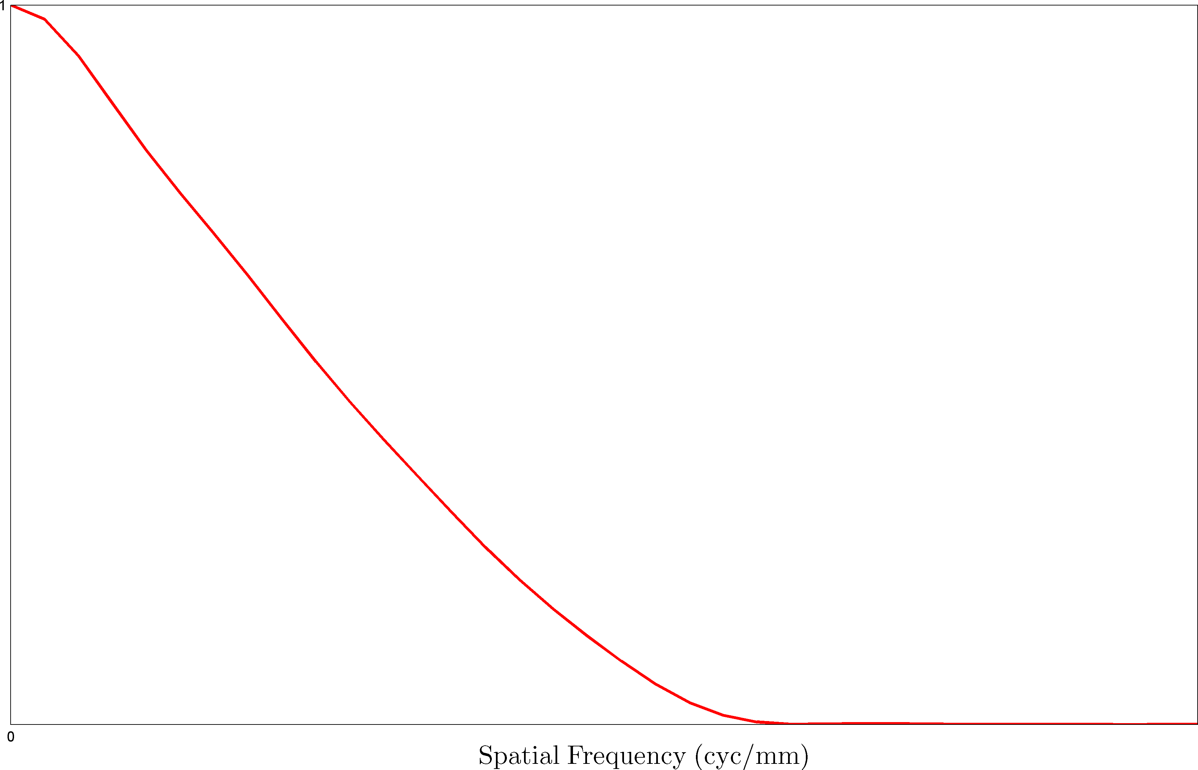
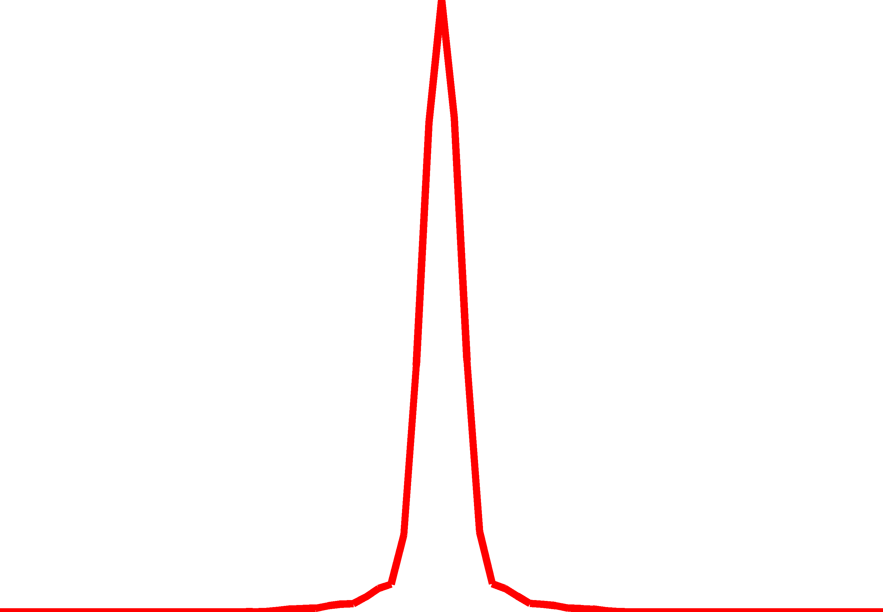
Proposed Method for identifying the Spatial Frequency Response
Spatial Frequency Response
Red component of CFA image of slanted edge
$$e_{blue}\left[n\right]$$
$$\frac{∂}{∂n}\left(…\right)$$
$$ℱ\{…\}$$
Super-sampled
Edge Spread Function
Super-sampled
Line Spread Function
Notes:
LMMSE

Slide 17
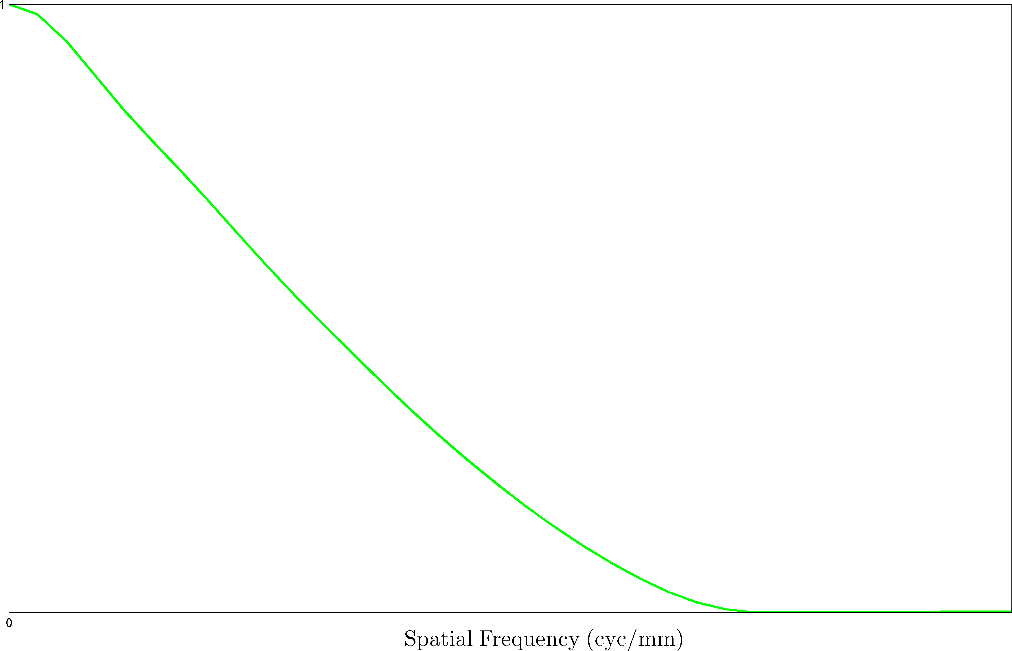
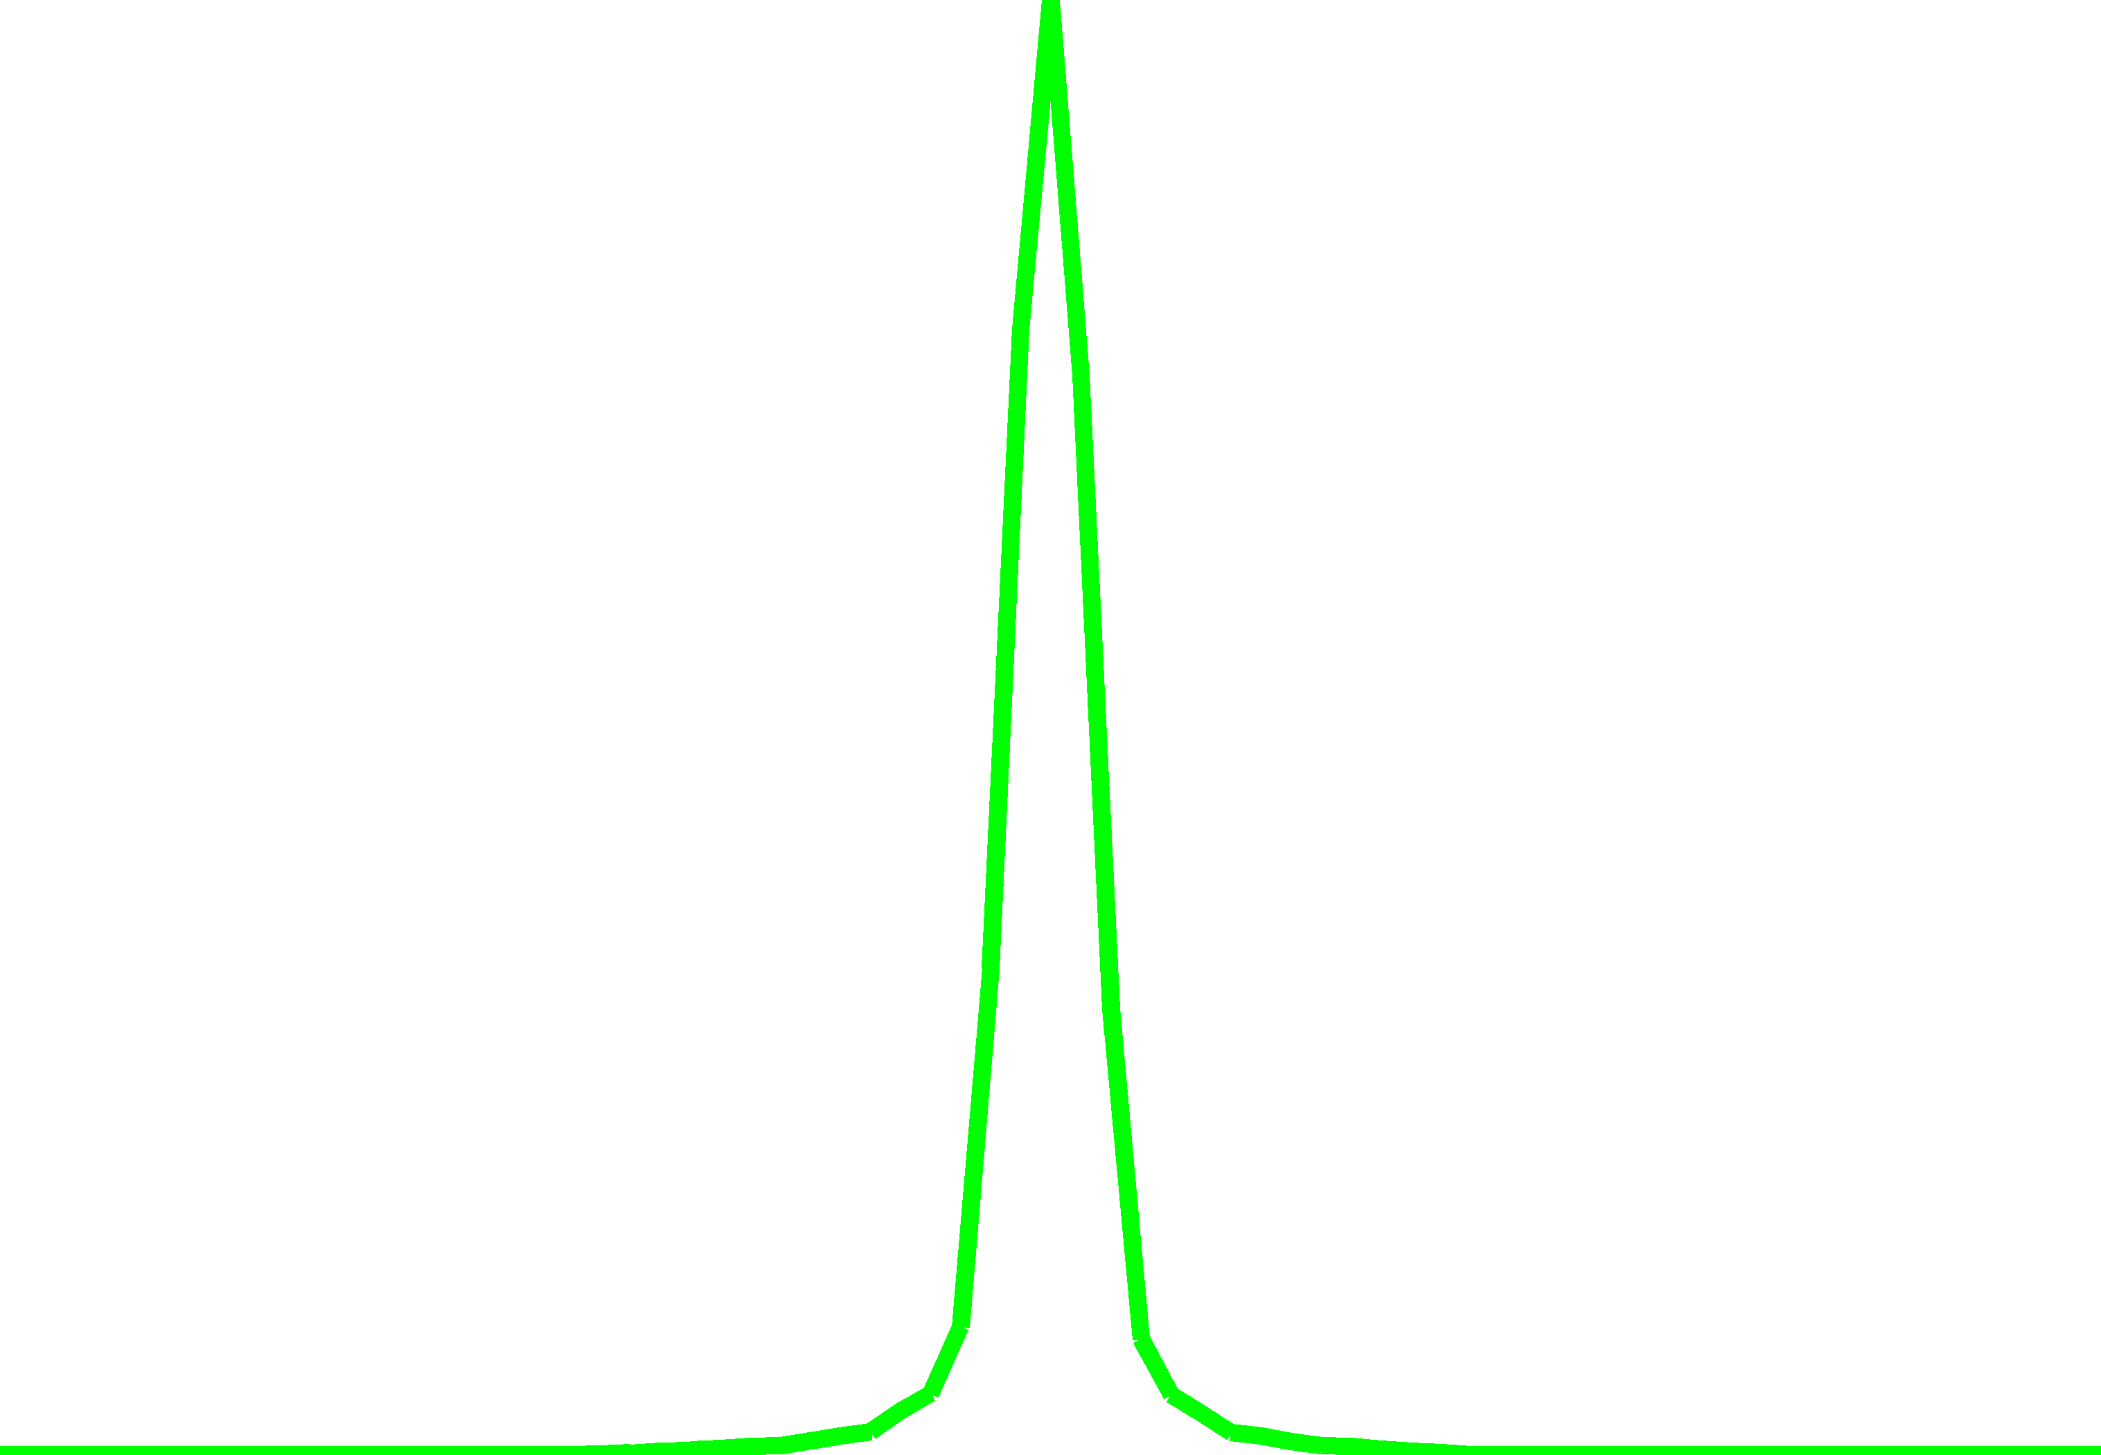
Proposed Method for identifying the Spatial Frequency Response
Spatial Frequency Response
Green component of CFA image of slanted edge
$$e_{blue}\left[n\right]$$
$$\frac{∂}{∂n}\left(…\right)$$
$$ℱ\{…\}$$
Super-sampled
Edge Spread Function
Super-sampled
Line Spread Function
Notes:
LMMSE

Slide 18
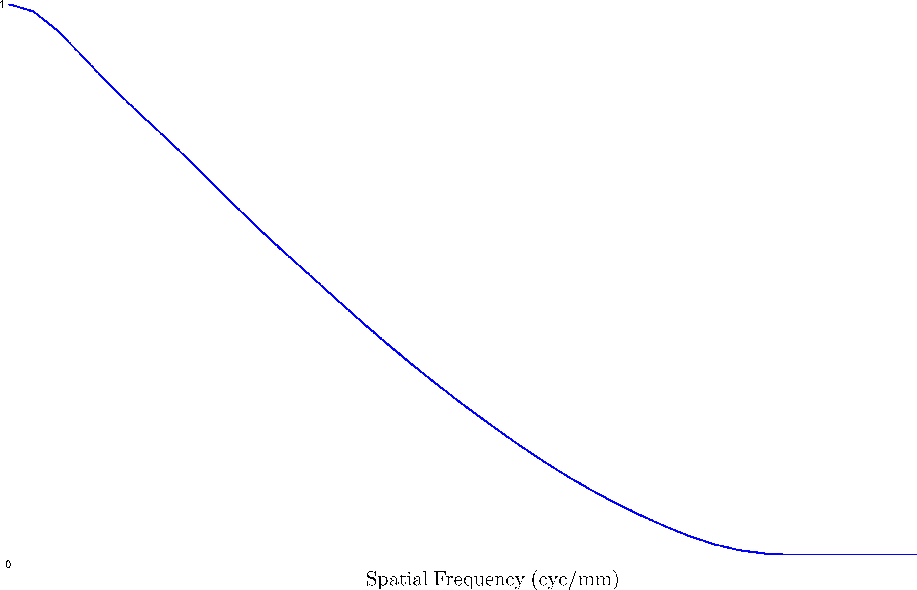
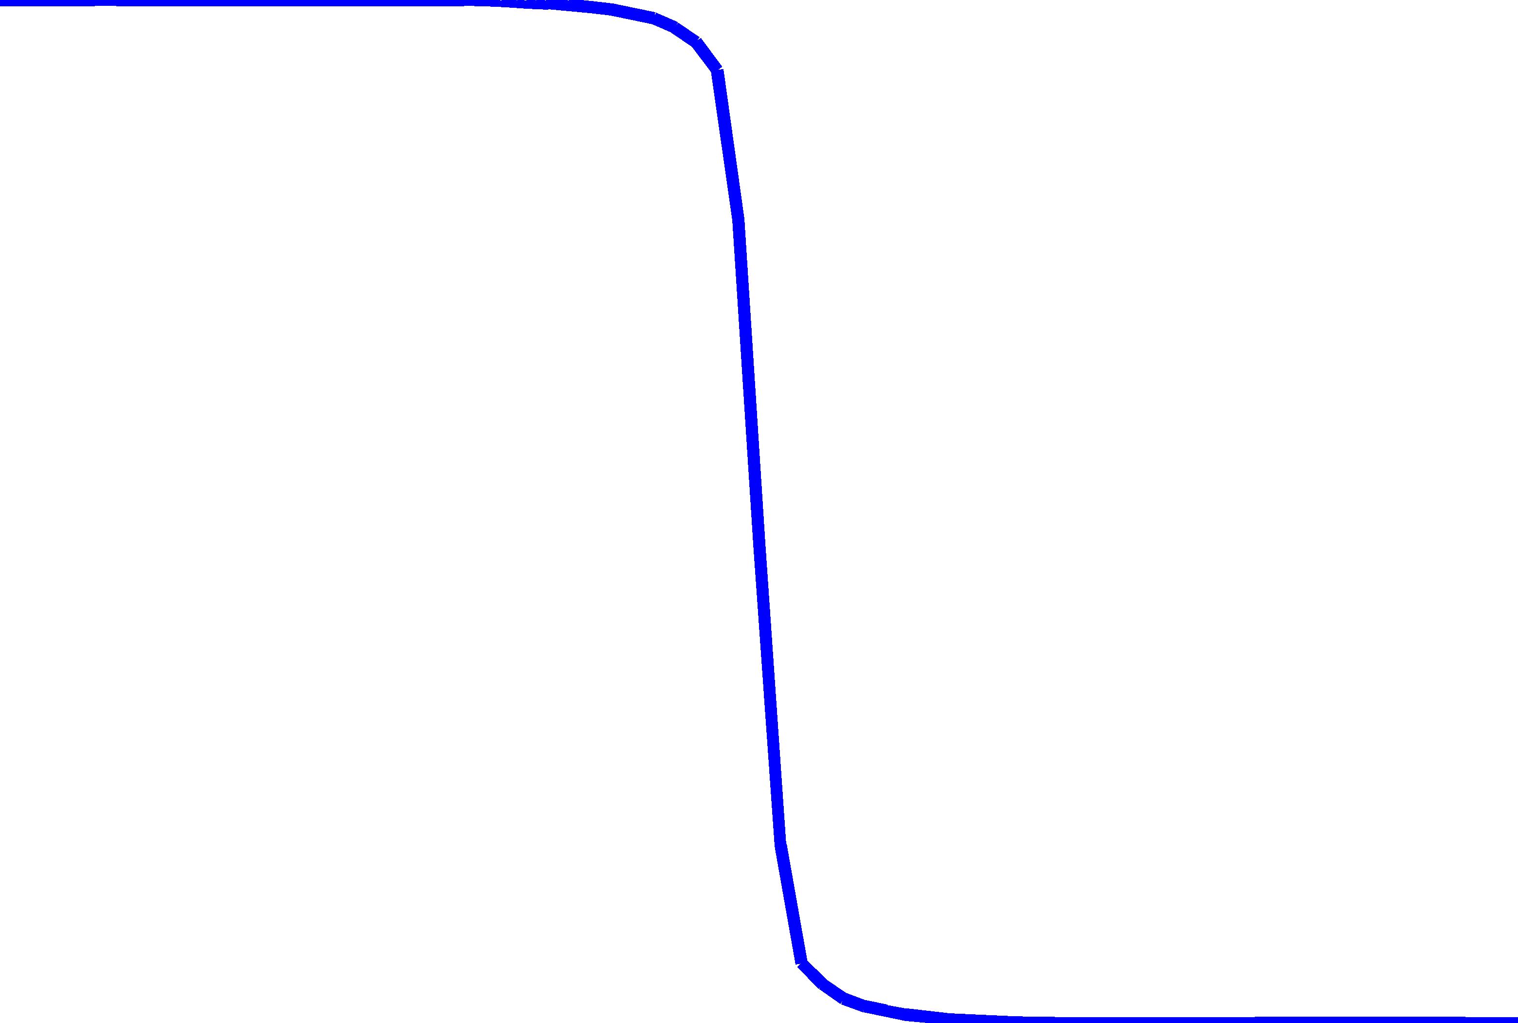
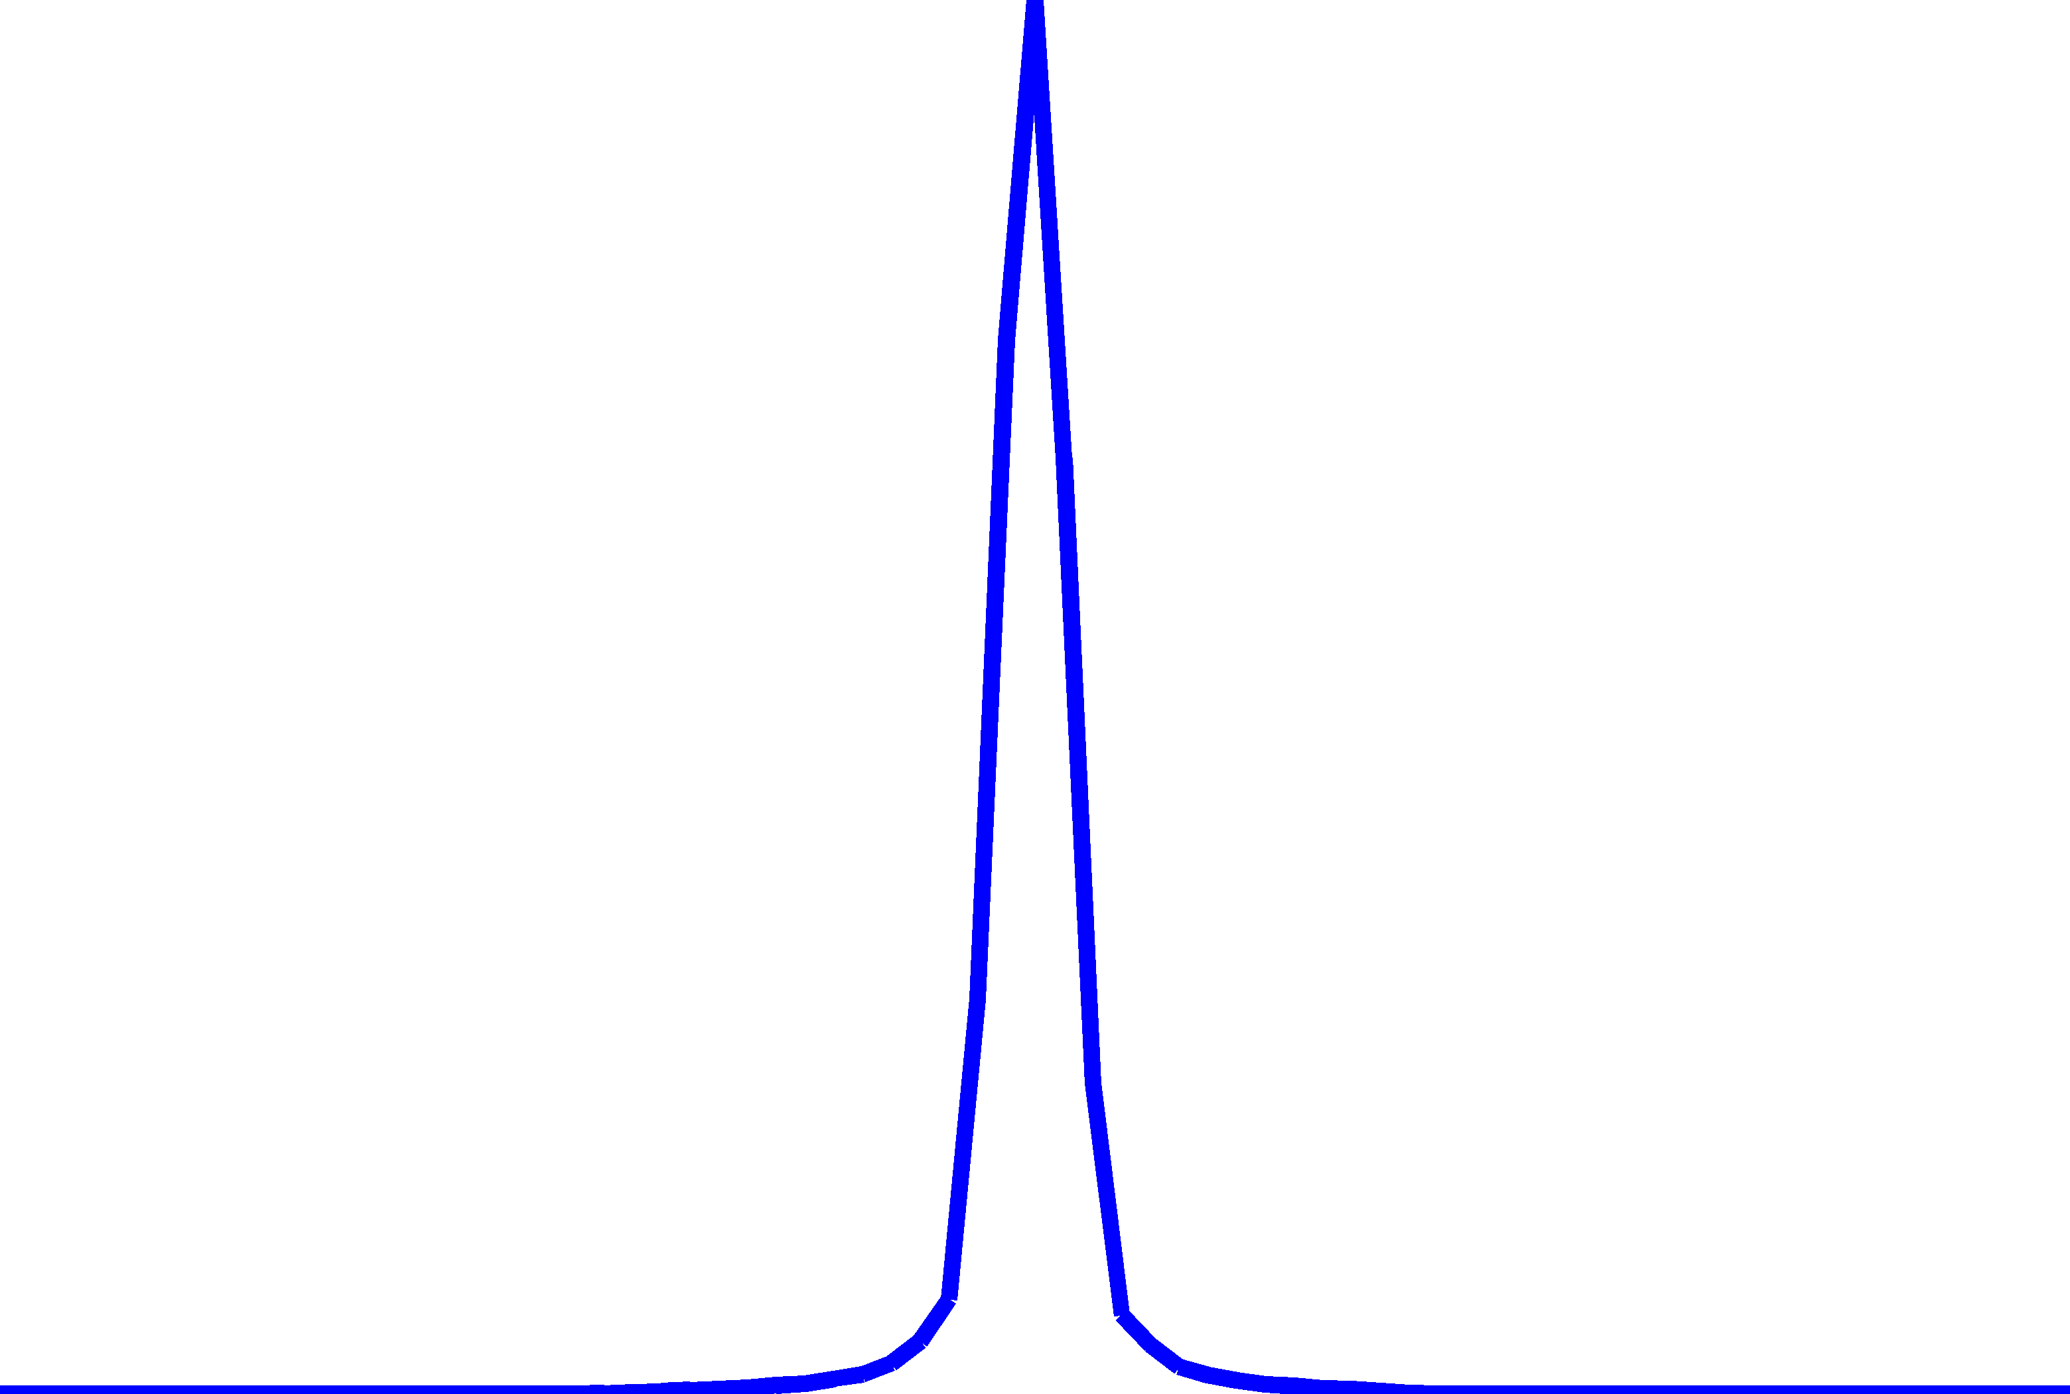
Proposed Method for identifying the Spatial Frequency Response
Spatial Frequency Response
Blue component of CFA image of slanted edge
$$e_{blue}\left[n\right]$$
$$\frac{∂}{∂n}\left(…\right)$$
$$ℱ\{…\}$$
Super-sampled
Edge Spread Function
Super-sampled
Line Spread Function
Notes:
LMMSE

Slide 19
Proof-of-concept
Simulation

Slide 20
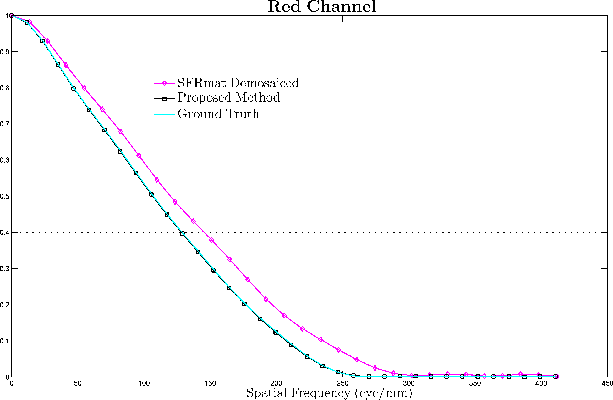
Validation of proposed method using simulated imagery
NOTE: The red component of the CFA image is aliased, due to sub-sampling by the Bayer CFA pattern.
Sensor
Optics
Pixel pitch $=1.2μm$
Nyquist frequency of sensor $=\frac{1}{2×0.0012}=416.67\frac{lp}{mm}$
Red channel Nyquist frequency $=\frac{1}{4×0.0012}=208.33\frac{lp}{mm}$
Circular aperture
F/# = 6, Diffraction limited
Red channel cutoff $=260.41\frac{lp}{mm}$
Notes:
LMMSE

Slide 21
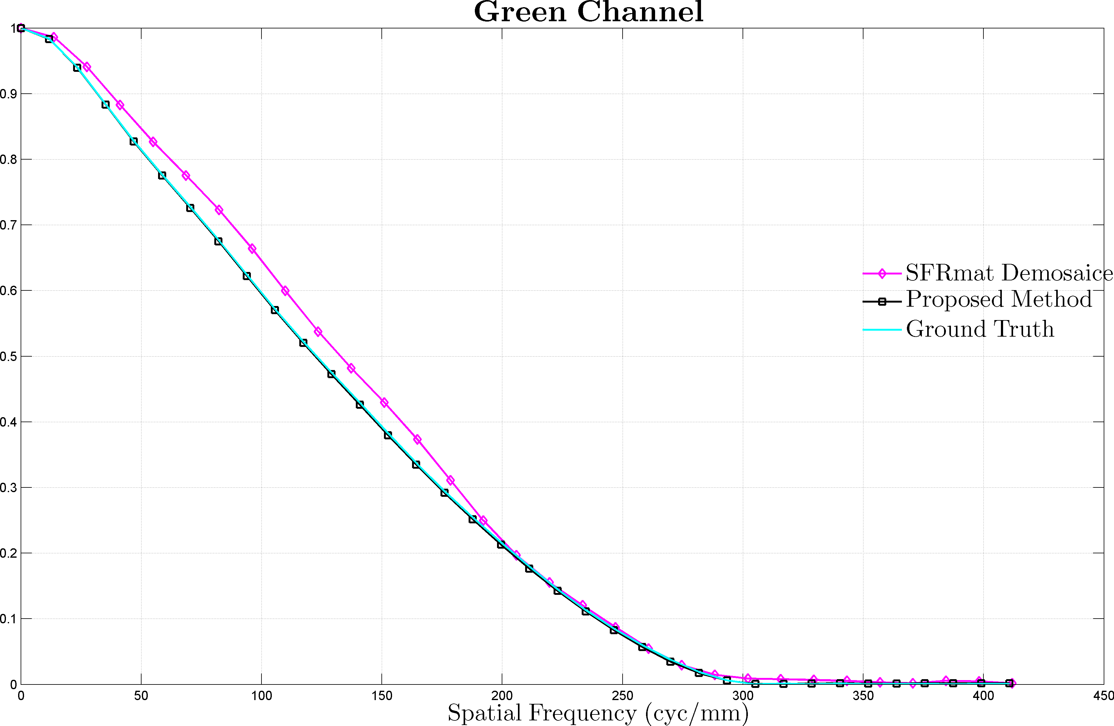
Validation of proposed method using simulated imagery
NOTE: The green component of the CFA image is aliased, due to sub-sampling by the Bayer CFA pattern.
Sensor
Optics
Pixel pitch $=1.2μm$
Nyquist frequency of sensor $=\frac{1}{2×0.0012}=416.67\frac{lp}{mm}$
Green channel Nyquist frequency $=\frac{1}{2\sqrt{2}×0.0012}=294.63\frac{lp}{mm}$
Circular aperture
F/# = 6, Diffraction limited
Green channel cutoff $=303.03\frac{lp}{mm}$
Notes:
LMMSE

Slide 22
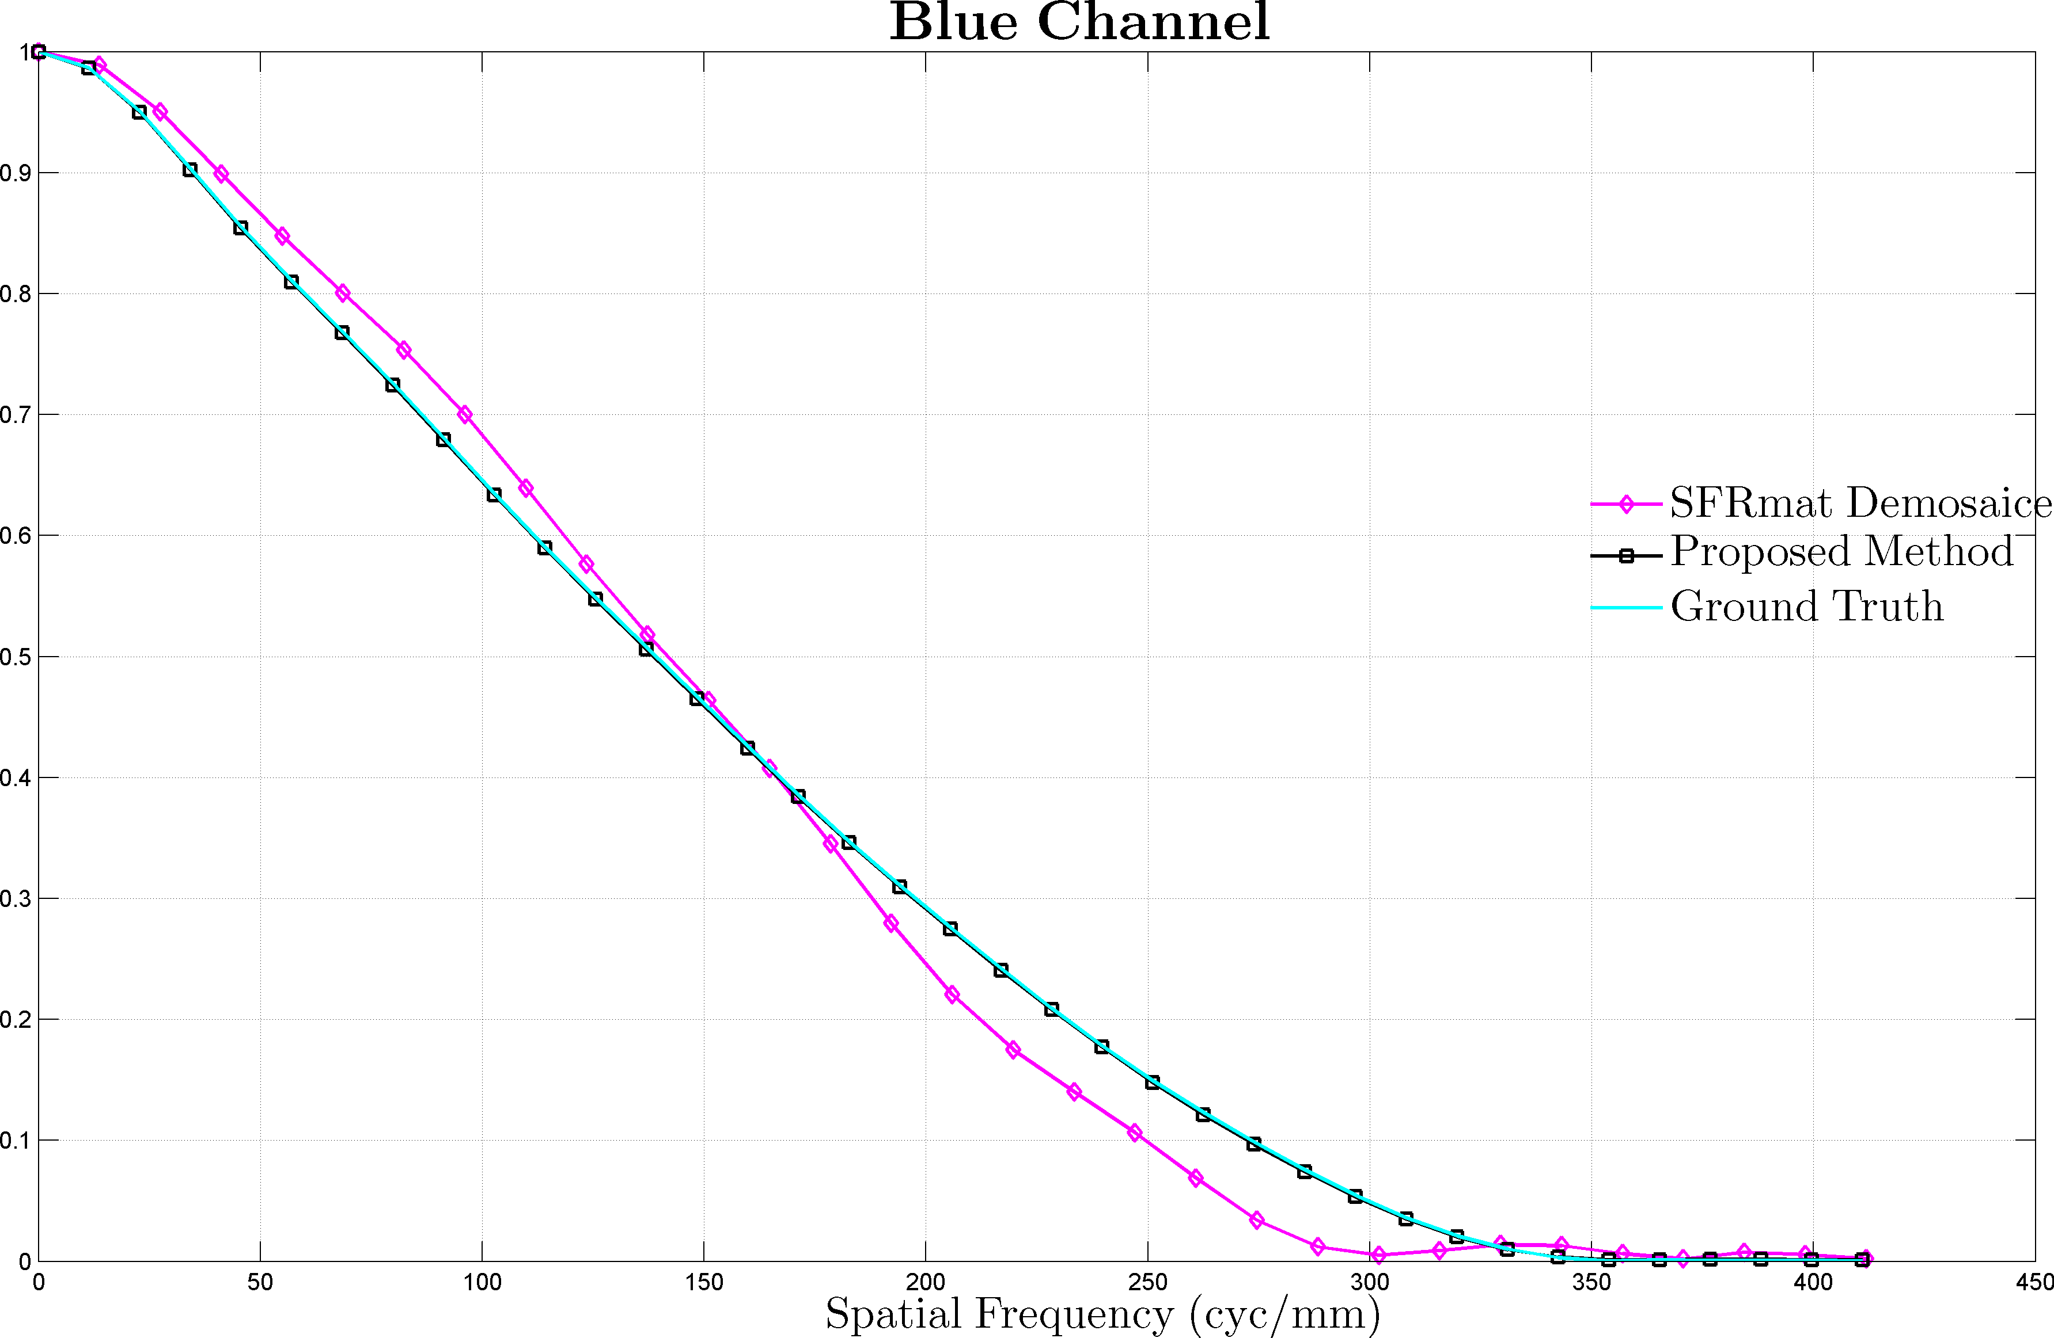
Validation of proposed method using simulated imagery
NOTE: The blue component of the CFA image is aliased, due to sub-sampling by the Bayer CFA pattern.
Sensor
Optics
Pixel pitch $=1.2μm$
Nyquist frequency of sensor $=\frac{1}{2×0.0012}=416.67\frac{lp}{mm}$
Blue channel Nyquist frequency $=\frac{1}{4×0.0012}=208.33\frac{lp}{mm}$
Circular aperture
F/# = 6, Diffraction limited
Blue channel cutoff $=347.22\frac{lp}{mm}$
Notes:
LMMSE

Slide 23
Experimental Validation
Caveat
The estimates of the ESF & LSF identified using the proposed method are likely to be corrupted by noise
Causes
Noise arising during image capture
Inadequate sampling of the Red/Blue color channels in the CFA image
Inaccuracies in slant angle estimation
Proposed Solution ( 2-step process )
Smooth tails of ESF by fitting sigmoid functions
This step avoids amplifying noise when computing the derivative of the super-sampled ESF
Attempt to fit gauss-hermite polynomials to LSF
Notes:
The tails of the ESF have the most noise as we are averaging the least number of samples

Slide 24
SFR Estimation – Proposed Method
CFA image of Slanted Edge
Slanted edge detection
CFA edgedetection
LS line fitting
Identify super-sampled edge spread function for each color channel
$$ℱ\{…\}$$
Fourier Transform
Parametric fitting of $ℓ.s.f$
Derivative
filtering
Denoise $e.s.f$ tails by curve fitting
$$\frac{∂}{∂n}\left(…\right)$$
Identify SFR
Express $ℓ.s.f$as sum of gauss-hermite functions
Identify super-sampled line spread function
Fit sigmoid functions to tails of the $e.s.f$

Slide 25
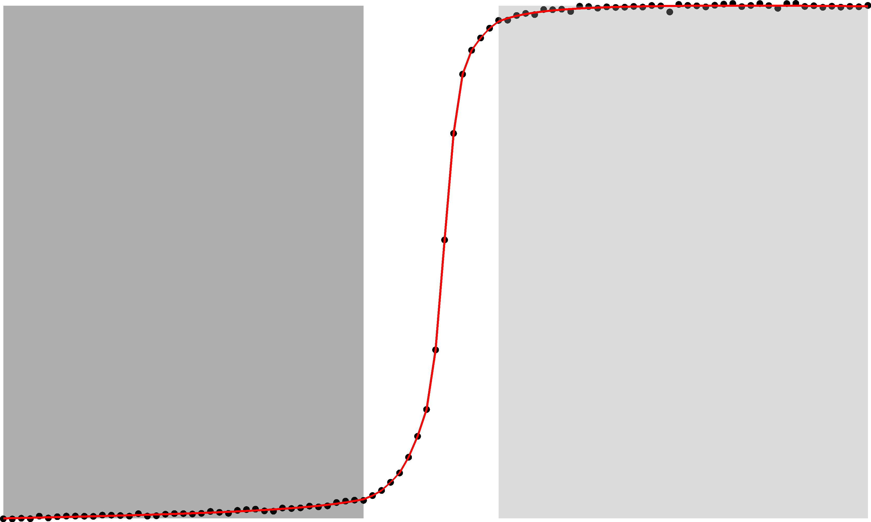
Denoising the Edge Spread Function
Fit sigmoid to this portion of ESF
$$\frac{1}{2}\left(a_{1}+b_{1}\right)+\left(\frac{b_{1}−a_{1}}{π}\right)\tan^{−1}\left(\frac{x−μ_{1}}{s_{1}}\right)+m_{1}\left(x−μ_{1}\right)$$
$a_{1}$ minimum value
$b_{1}$ maximum value
$μ_{1}$ location parameter
$s_{1}$ scale parameter
$m_{1}$ slope of linear component
Fit sigmoid to this portion of ESF
$$\frac{1}{2}\left(a_{2}+b_{2}\right)+\left(\frac{b_{2}−a_{2}}{π}\right)\tan^{−1}\left(\frac{x−μ_{2}}{s_{2}}\right)+m_{2}\left(x−μ_{2}\right)$$
$a_{2}$ minimum value
$b_{2}$ maximum value
$μ_{2}$ location parameter
$s_{2}$ scale parameter
$m_{2}$ slope of linear component
The black points represent samples from the noisy ESF
The solid red line represents the denoised ESF
2 independent sigmoid functions allow us to accommodate asymmetries in the tails of the ESF
The optimal values of the fitting parameters are identified using non-linear LS minimziation
Notes:
Assumption : The tails of the LSF resemble the tails of a Cauchy distribution !!!
This implies the tails of the ESF resemble the CDF of the Cauchy distribution, given by
Reference: http://en.wikipedia.org/wiki/Cauchy_distribution
Q: Why can’t I possibly fit a single sigmoid to the central portion of the raw super-sampled ESF ?
A: Uniform sampling of a single sigmoid is not likely to produce
Q: Why not fit cubic
http://www.asf.alaska.edu/sites/www.asf.alaska.edu.pi_symp/files/documents/presentations/Mukaida_A._optcalval.pdf

Slide 26
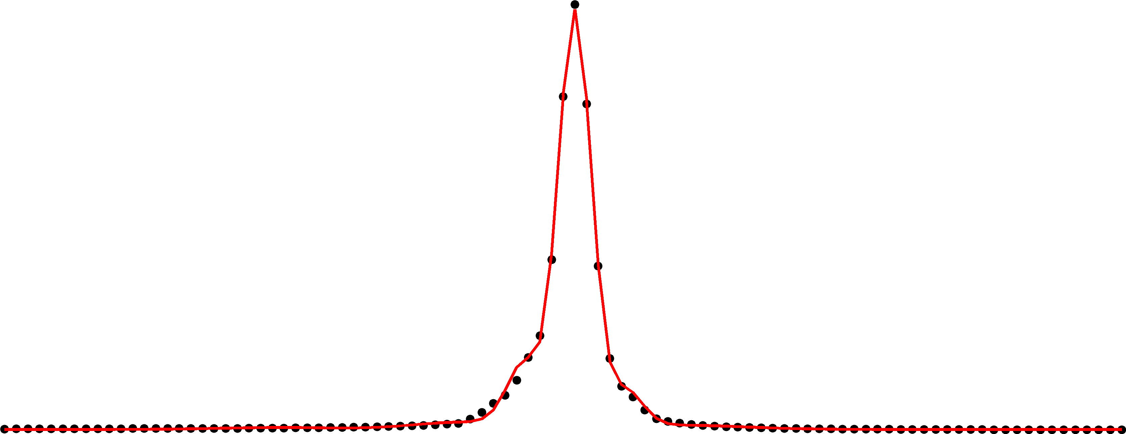
Parametric fitting of the Line spread function
Why choose Gauss-Hermite $(𝒢ℋ)$ functions ?
optical LSF’s have compact spatial support
$𝒢ℋ$ functions constitute an orthonormal basis set for signals with compact spatial support
$𝒢ℋ$ basis functions are eigenfunctions of the fourier transform
$⇒$ SFR can be identified from the fitted
$ℓsf$in analytical form
The set of $𝒢ℋ$ basis functions includes the gaussian function (a popular choice for fitting $ℓsf$’s)
Parametric form of the $ℓsf$
$$ℓsf\left(x\right)=\sum_{i=1}^{L}{c_{i}\left(\sum_{n=0}^{4}{\frac{1}{\sqrt{2^{n}n!\sqrt{π}}}φ_{n}\left(\frac{x−μ_{i}}{s_{i}}\right)}e^{−{\left(\frac{x−μ_{i}}{\sqrt{2} s_{i}}\right)}^{2}}\right) }$$
$μ_{i}$ location parameter
$s_{i}$ scale parameter
$c_{i}$ weight of the
$L$ number of lobes in $ℓsf$
$φ_{0}\left(y\right)=1$ $φ_{3}\left(y\right)=8y^{3}−12y$
$φ_{1}\left(y\right)=2y$ $φ_{4}\left(y\right)=16y^{4}−48y^{2}+12$
$$φ_{2}\left(y\right)=4y^{2}−2$$
The black points represent samples from the noisy ESF
The solid red line represents the fitted LSF
The optimal values of the fitting parameters are identified using non-linear LS minimziation
Notes:
LMMSE

Slide 27
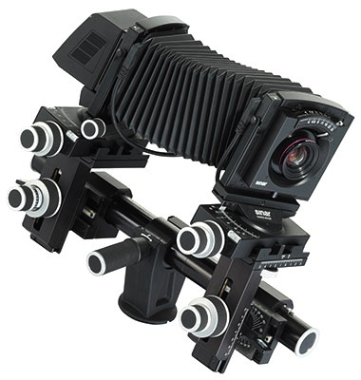
Experimental Setup
Target
Imaging System
360 x 4 pixels
360 x 6 pixels
360 ppi straight edge target printed on $4"×6"$ Premium Glossy Photo Paper using Epson R3000 printer
Printed at 1440 x 1440 dpi
Contrast ratio 4:1
Sinar P3 with 86H back: 48.8-MP
180mm, F/5.6 HR Rodenstock lens
Aperture Setting = F/11
ISO 50
Advantage of using this camera:
captures full-color information (R,G,B) at every pixel in 4-shot mode.

Slide 28
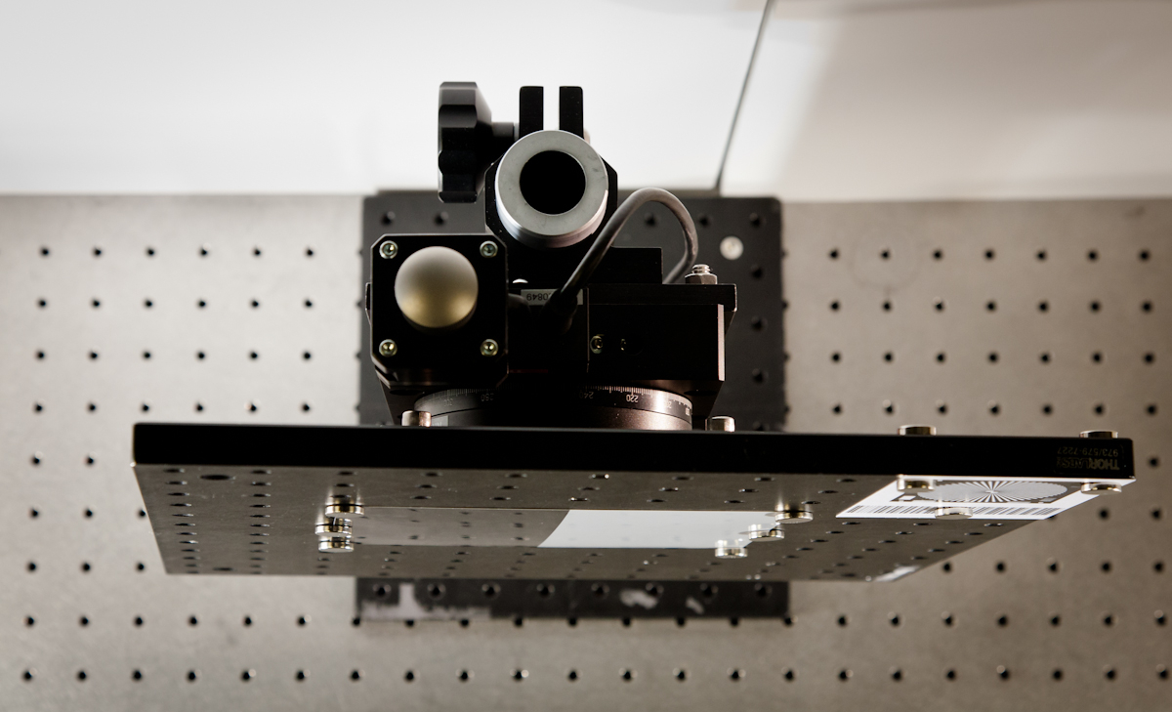
Experimental Setup
Top view of Target
Front view of Target
Rotation stage
6°
4700K Solux Lamps
Camera to Target distance = 280 inches
Camera optical axis is $⊥$ to target surface and passes through the center of the slanted edge
The target was rotated by 6° following alignment with the camera
Algorithm -1 SFRmat v3
Algorithm -2 Proposed
Input 3-channel RGB image captured by the camera ( no need for demosaicing !!! )
Input synthetically generated Color Filter Array image, obtained by subsampling the 3-channel RGB image captured by the camera
CFA pattern used in experiment : G R
B G
In theory, the SFR estimates produced by the 2 methods must be in agreement
Notes:
Camera mounted on Fatif 2.5M Studio Stand.
Target mounted on the optical table.
The target was uniformly lit using 4700K Solux lamps with diffuser from either side.

Slide 29
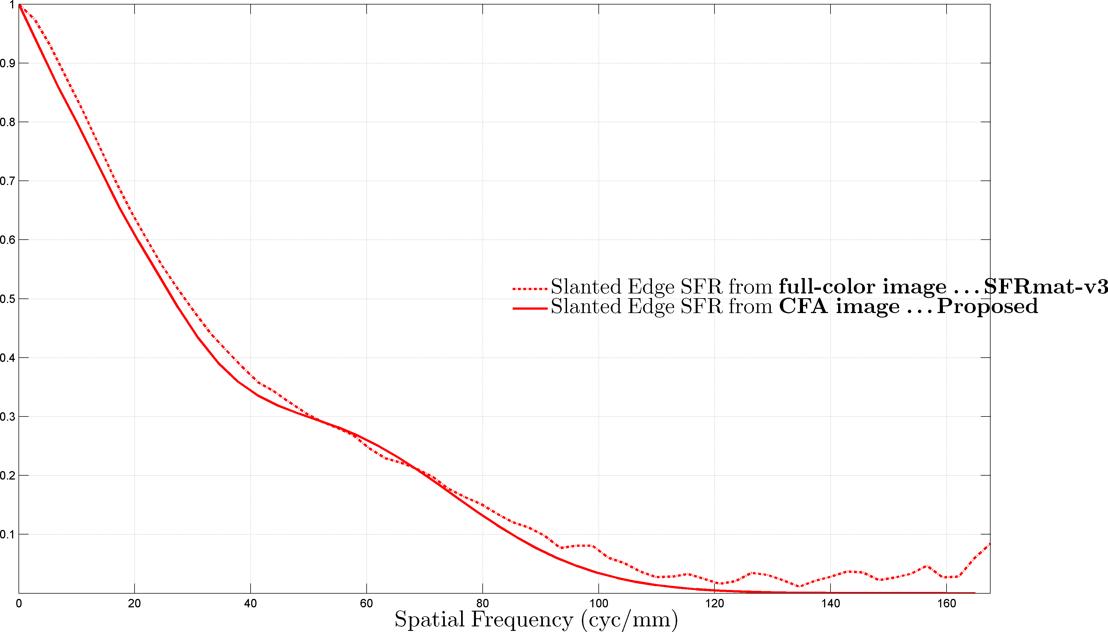
Experimental Validation of proposed method
Why is there a disagreement between the plots?
SFRmat does not denoise the ESF/LSF. This contributes to the noise in the estimated SFR
In SFRmat, the noisy LSF is subject to windowing prior to computing the SFR by applying a DFT.
Sensor
Optics
Pixel pitch $=6.0μm$
Nyquist frequency of sensor $=\frac{1}{2×0.006}=83.33\frac{lp}{mm}$
Red channel Nyquist frequency $=\frac{1}{4×0.006}=41.67\frac{lp}{mm}$
F/# = 11
Notes:
LMMSE

Slide 30
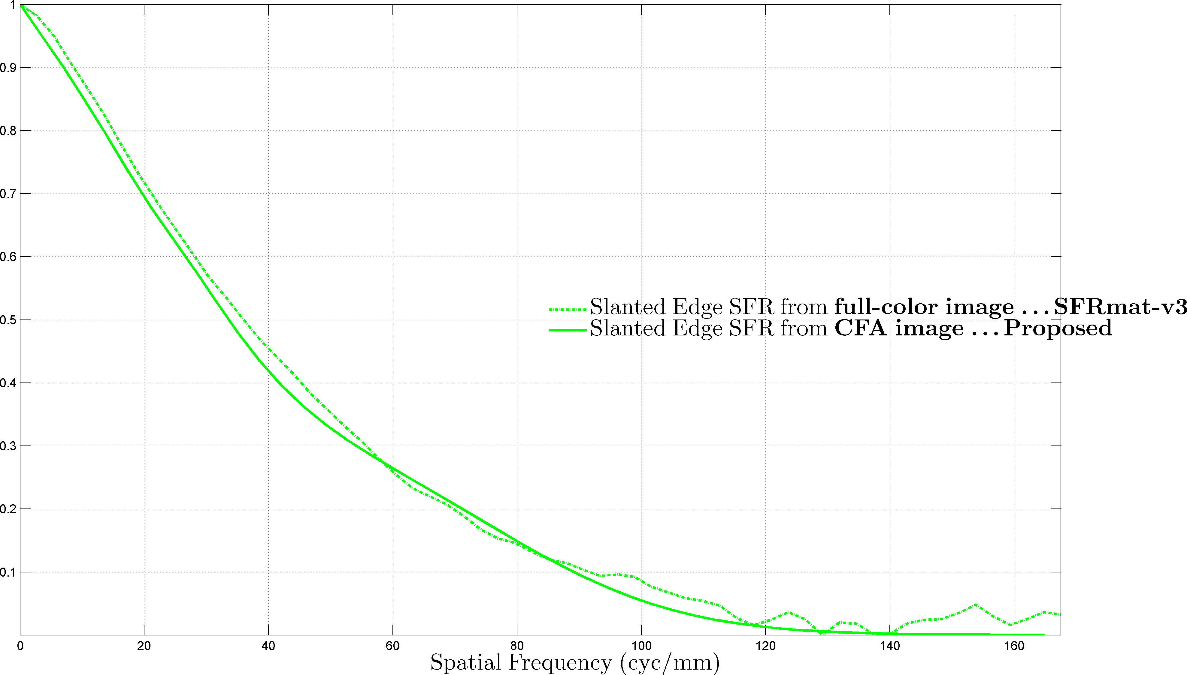
Experimental Validation of proposed method
Why is there a disagreement between the plots?
SFRmat does not denoise the ESF/LSF. This contributes to the noise in the estimated SFR
In SFRmat, the noisy LSF is subject to windowing prior to computing the SFR by applying a DFT.
Sensor
Optics
Pixel pitch $=6.0μm$
Nyquist frequency of sensor $=\frac{1}{2×0.006}=83.33\frac{lp}{mm}$
Green channel Nyquist frequency $=\frac{1}{2\sqrt{2}×0.006}=58.93\frac{lp}{mm}$
F/# = 11
Notes:
LMMSE

Slide 31
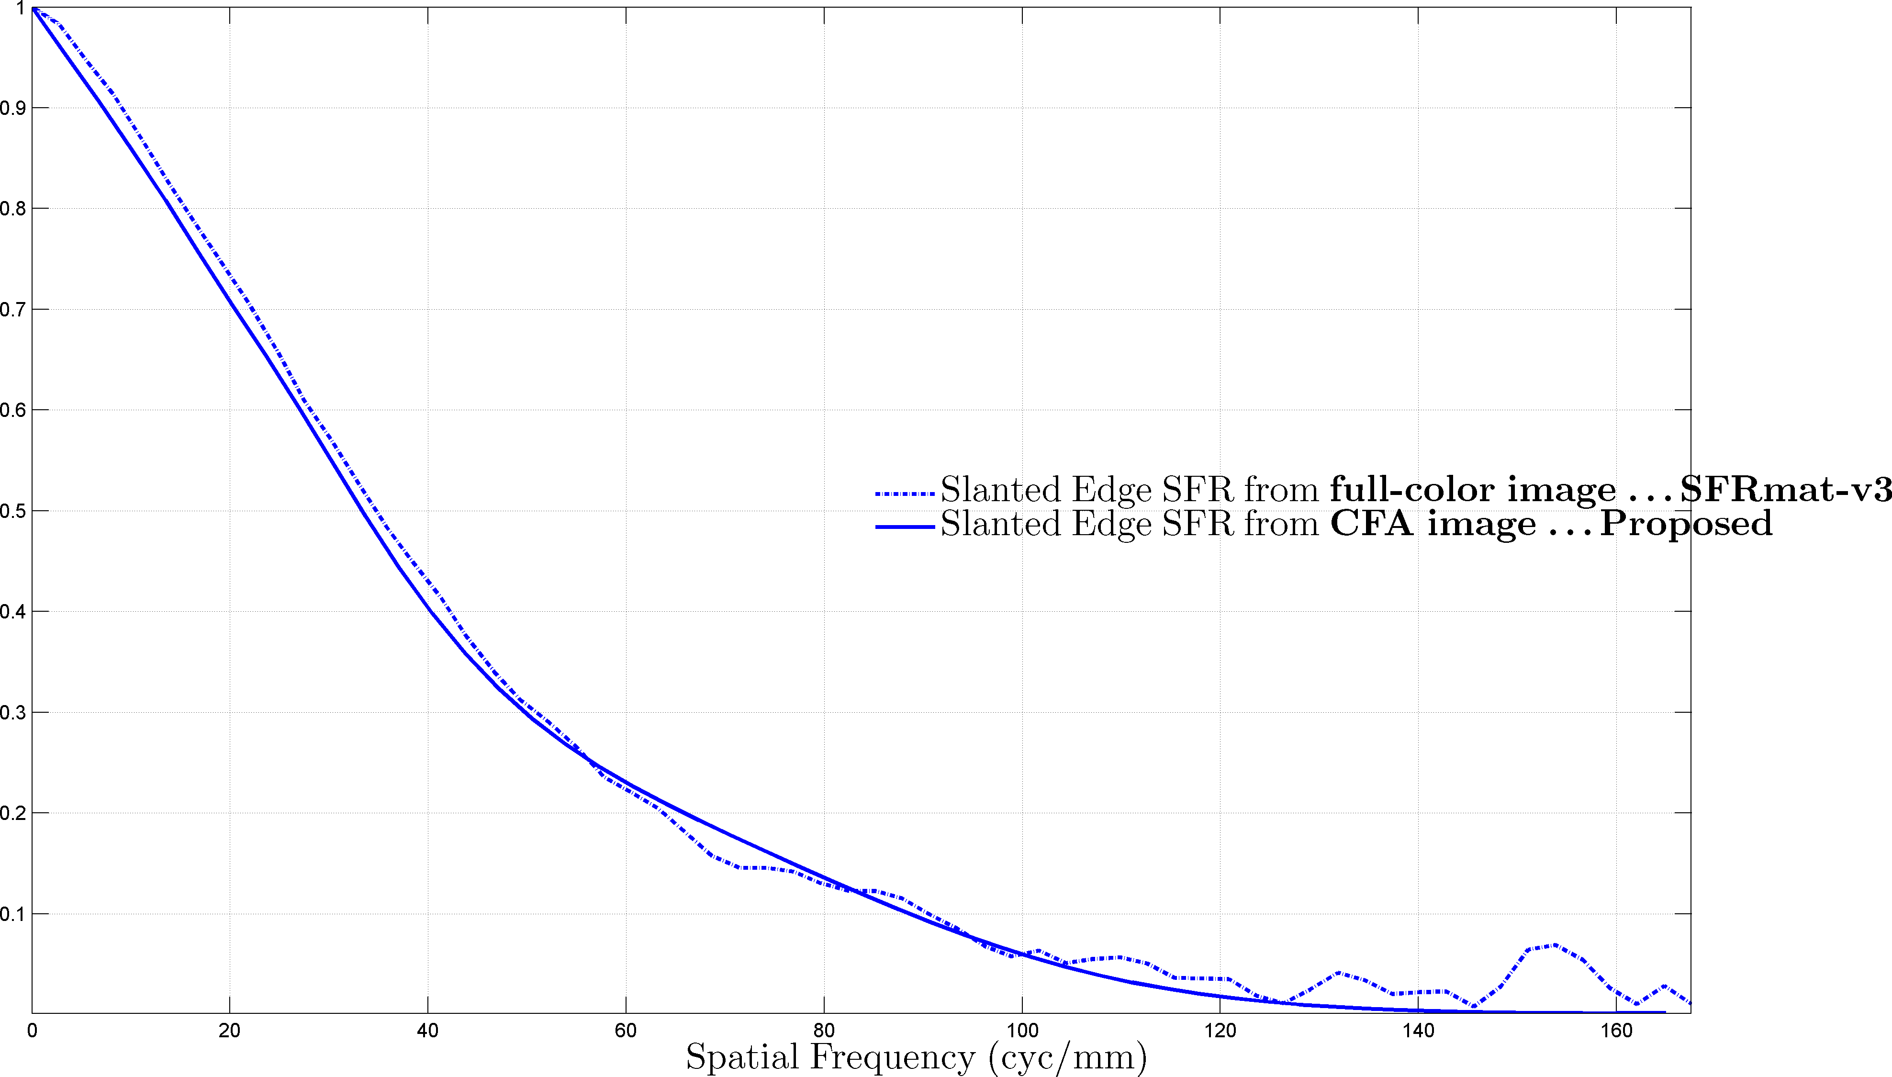
Experimental Validation of proposed method
Why is there a disagreement between the plots?
SFRmat does not denoise the ESF/LSF. This contributes to the noise in the estimated SFR
In SFRmat, the noisy LSF is subject to windowing prior to computing the SFR by applying a DFT.
Sensor
Optics
Pixel pitch $=6.0μm$
Nyquist frequency of sensor $=\frac{1}{2×0.006}=83.33\frac{lp}{mm}$
Blue channel Nyquist frequency $=\frac{1}{4×0.006}=41.67\frac{lp}{mm}$
F/# = 11
Notes:
LMMSE

